Slide 1
Early Trade with Asia
Trade with Asia grew throughout the 1200s into the 1300s
With the breakup of the Mongol Empire and Black death, overland trade routes waned
However, it was INCREDIBLY lucrative to trade with the East

Slide 2
FOR GOLD, GOD, and GLORY!
GOLD! (WEALTH! )
New spices in Europe (introduced during the Crusades) = demand for the spices.
Europeans wanted to cut out the middle man !
Europeans try to find new trade routes because they want new sources of wealth.
Muslims sold
Spices to Italians
for lots of $
Italians
sell it
to Europe
for
MORE $$$
Europe buys
it for a
higher price

Slide 3
GOD (Spread of Christianity)
The Crusades pushed Christians to feel it was their duty to spread their religion and convert people to Christianity ( and not to be Muslim)
Bartolomeu Dias – “ To serve God and His Majesty, to give light to those who were in darkness, and to grow rich as all men desire to do.”:

Slide 4
GLORY !
BEING “The FIRST!”
First to: Find an spice?
Find a area?
Create a trading port?
Control a COUNTRY!?

Slide 5
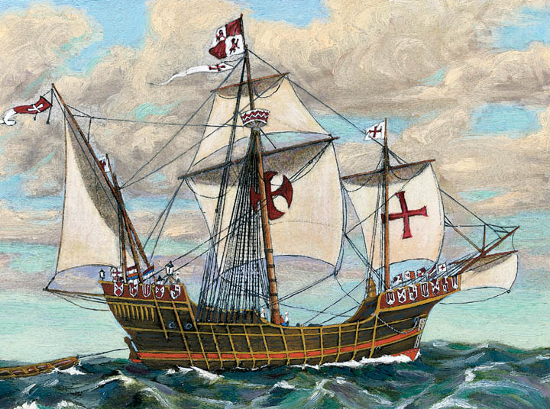
TECHNOLOGY HELPS !
The introduction of the Caravel made travel easier !
65 feet long = more space for food/ppl.
Able to explore
close to shore.
Larger sails for
easier movement
and power!

Slide 6
Strong Nations
Christians on the Iberian Peninsula were successful in pushing Muslims out of their territory by the 1400s
This stability brought wealth and an increasing desire to expand it
Prince Henry (the explorer) began mapping Africa in the 1450s
By 1460, Bartholomeu Dias Rounded the Cape of Good Hope

Slide 7
HUGE PROFITS!!!!
By 1497, Vasco de Gama sailed to India and profited 3000%%%!!!!!
ZOMG

Slide 8
Columbian Exchange Quiz Time

Slide 9
Profit wasn't cheap...
It rotted all my gums, which gave out a black and putrid blood. My thighs and lower legs were black and gangrenous, and I was forced to use my knife each day to cut into the flesh in order to release this black and foul blood. I also used my knife on my gums, which were livid and growing over my teeth. Many of our people died of it every day and for the most part they died with no aid given them, expiring behind some case or chest

Slide 10
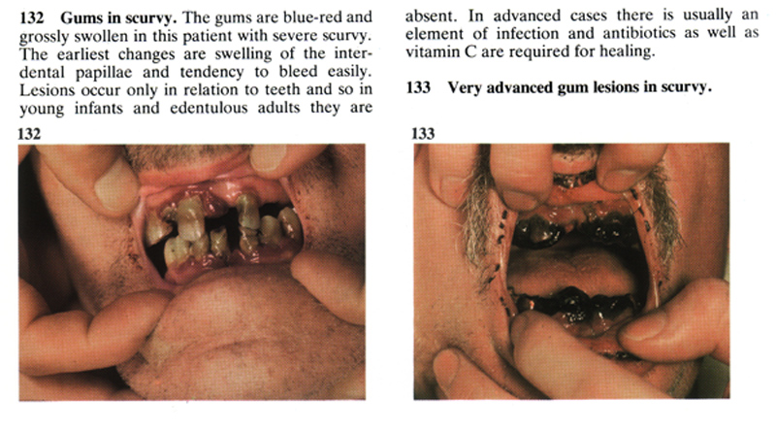

Slide 11
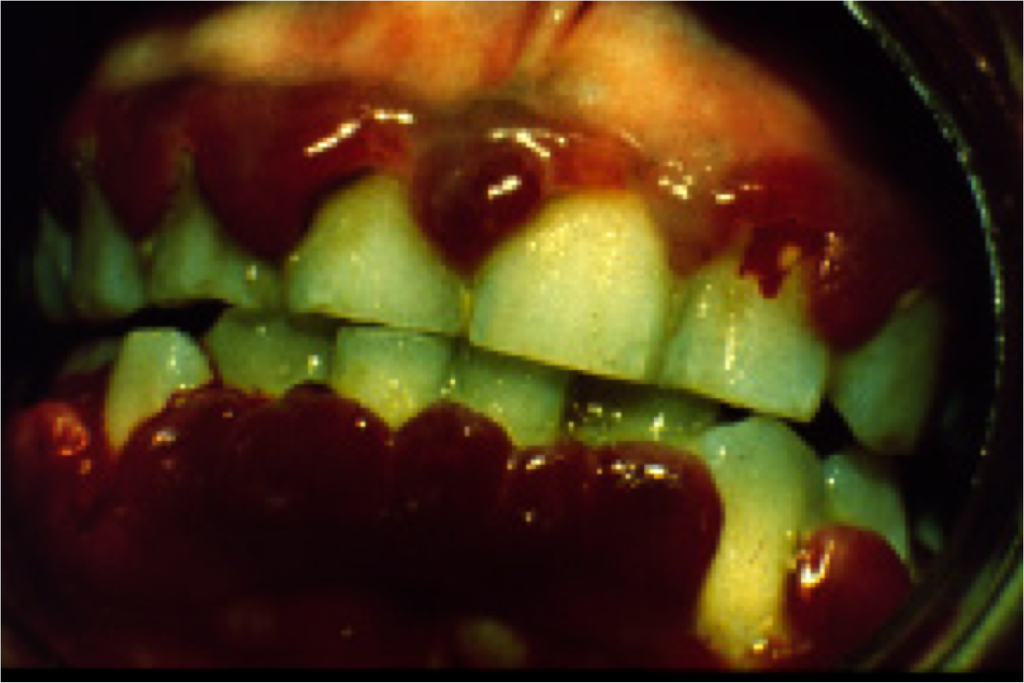

Slide 12
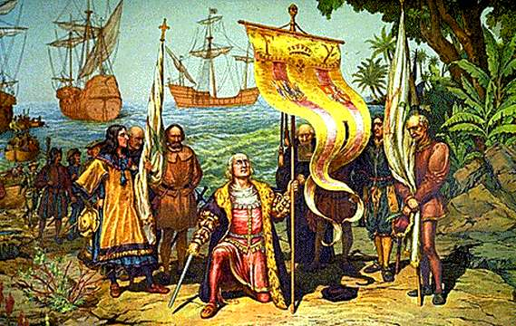
Christopher Columbus Admiral of the Ocean Sea

Slide 13
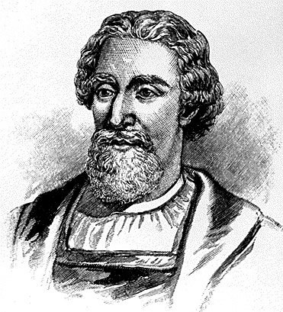
Christopher Columbus Biographical Data
Born: 1451 in Genoa, Italy
Sent by Queen Isabella and King Ferdinand of Spain
Died: May 20, 1506 in Valladolid, Spain

Slide 14
Christopher Columbus Reason for Exploring
Thought that Japan and the Indies were much closer than they are.
“Enterprise of the Indies.”
Explore a new route to the East Indies (Spice Islands).
Would become Governor of any lands discovered.
Keep 10% of wealth discovered.

Slide 15
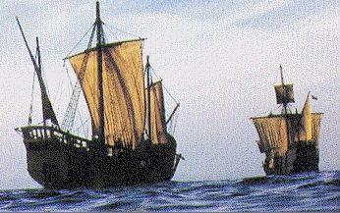
Christopher Columbus His Voyage
Three ships:
the Niña, the Pinta, and the Santa Maria
A crew of about 90 men and boys
The Santa Maria, at 100 feet in length, was the largest of the three ships;
the Niña and the Pinta were 70-foot caravels.
Set sail on Aug 3, 1492 from port of Palos, Spain.

Slide 16
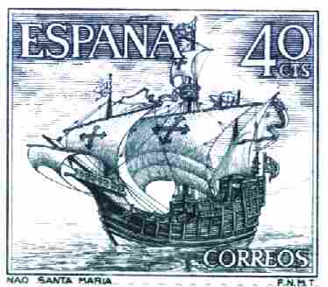
Christopher Columbus His 1st Voyage
Voyage into uncharted waters.
Made good time, but it was much further than he thought.
Had to ration food & drink.
October 10th crew became mutinous..wanted to turn back
Oct 12th..sighted land “Tierra, tierra.”
Landed in the Bahamas.

Slide 17
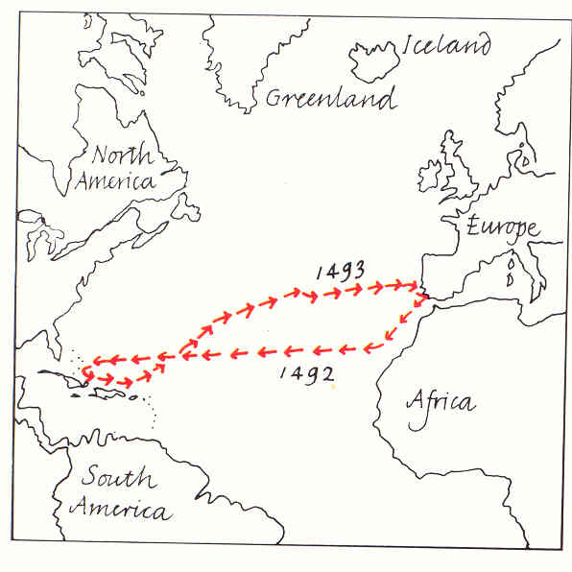
Christopher Columbus
1st Voyage

Slide 18
Christopher Columbus Discoveries/Outcomes
Explored Cuba and Hispaniola (Haiti and Dominican Republic)
Met Native Americans (Taino) and traded gold with them.
Returned to Palos on March 15th.
Made three more voyages to explore the Caribbean region. 1493-1496, 1498-1500, 1502-1504

Slide 19
Christopher Columbus Opinion
Did not “discover” America since many native peoples were already there.
Maybe they came from Asia
Maybe Vikings and other sailors came before him.
Started commerce between Europe and Americas
Was an excellent sailor and explorer.

Slide 20
Exploration Explodes
Within years of Columbus “discovering” America, Ferdinand Magellan's crew completed the first “circumnavigation” of the globe. Although Magellan was actually killed in the Philippines, he still receives credit because it was his crew.

Slide 21
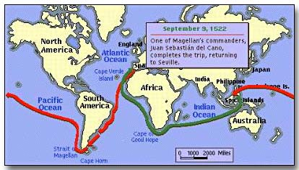

Slide 22
Overseas Empires
The European powers quickly started gobbling up the “available” lands that were being discovered
The Portuguese set themselves up along the African coast, in India, and in Brazil

Slide 23
The Spanish Empire
The Spanish conquerors (conquistadors) came to the Americas for two reasons
To Spread Christianity, and to get RICH!!!
They set up a system of trade known as the “triangle trade.”

Slide 24
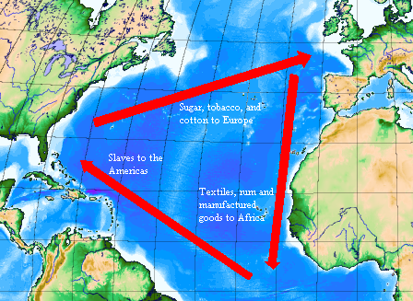

Slide 25
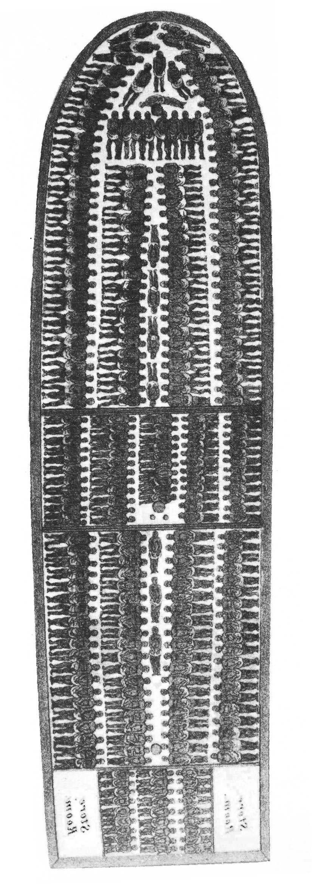
Middle Passage
The 3000 mile stretch between Africa and America
Most Africans were captured by other Africans
The economic
Tightly packed = more money
10 – 24 million with a 5% mortality

Slide 26
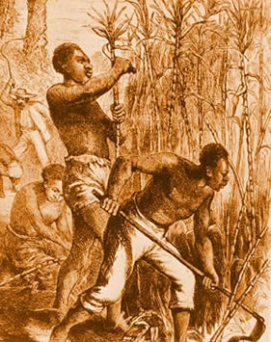
An Enslaved Person's Life
After arriving in America, Africans would be auctioned off to work, generally as laborers
Africans were viewed as a unit of labor, as something fit for hard work to be exploited

