Slide 1
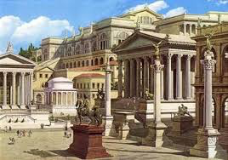
The History of Ancient Rome

Slide 2
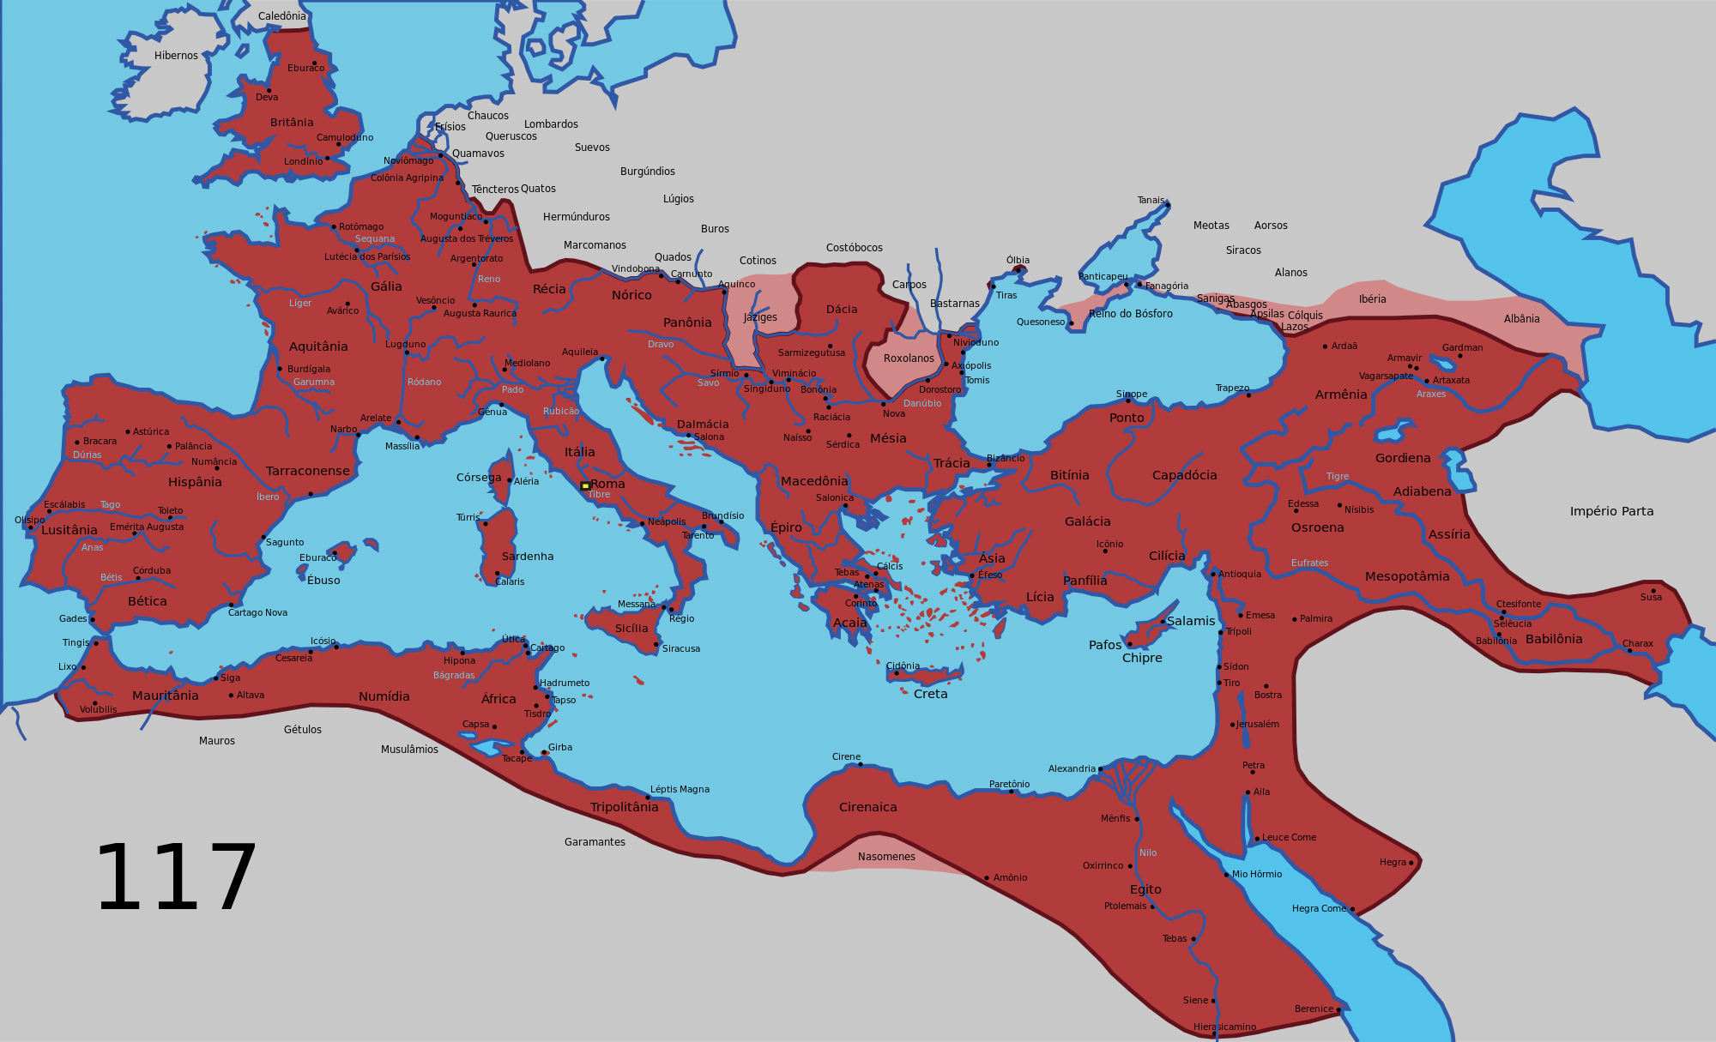
The Roman Empire 117 AD

Slide 3
In the Beginning

Slide 4
As an Emerging Powerhouse

Slide 5
After Julius Caesar

Slide 6
The Roman Empire 117 AD

Slide 7
Roman Provinces

Slide 8
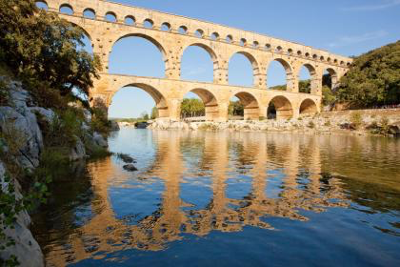
Aqueducts

Slide 9
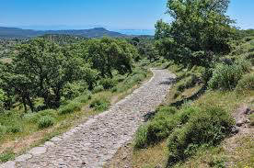
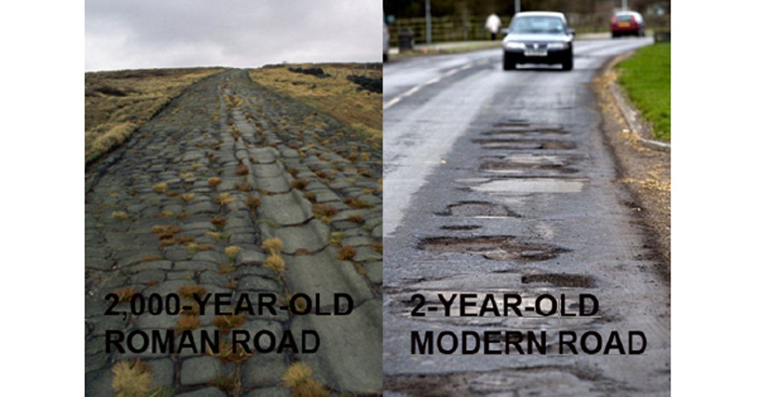
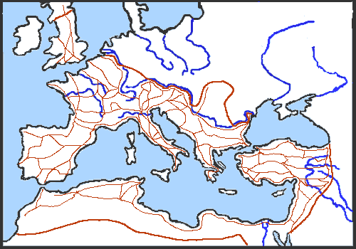
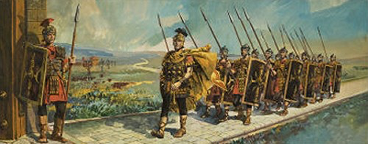
Roads

Slide 10
The Impact of the Roads

Slide 11
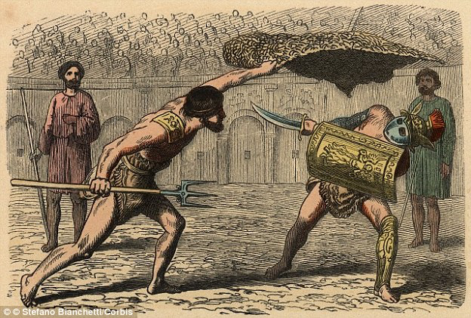
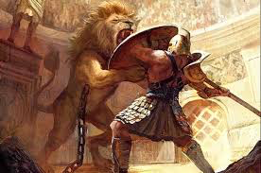
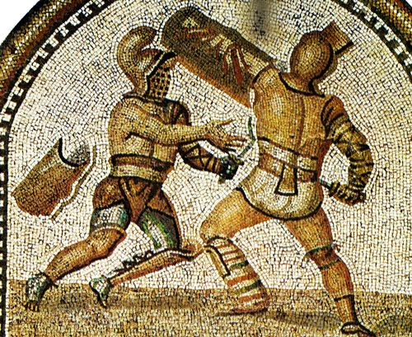
Gladiators

Slide 12
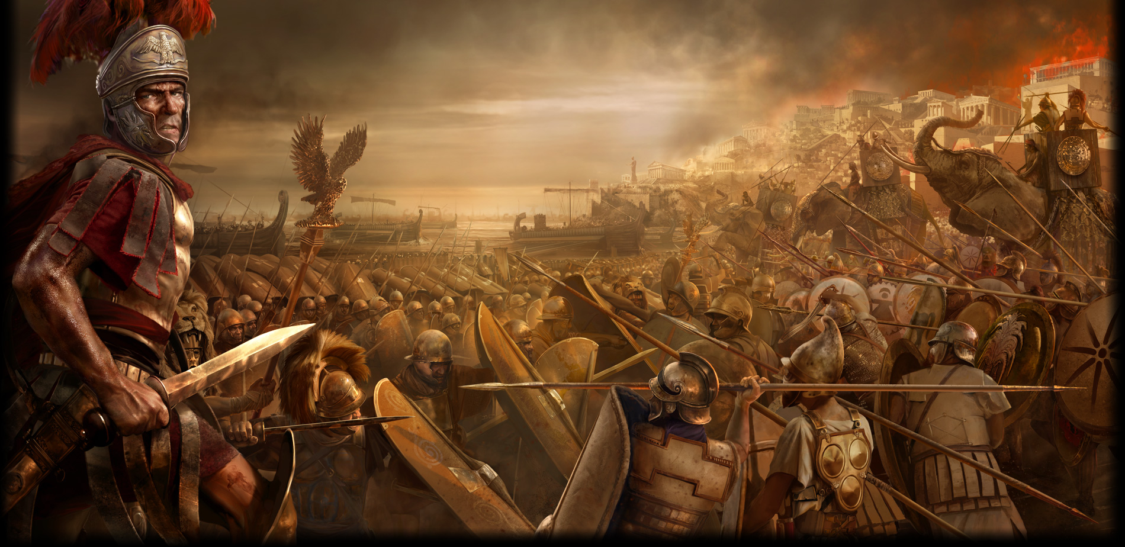
Warfare

Slide 13
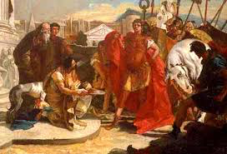
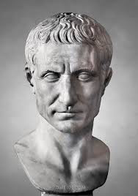
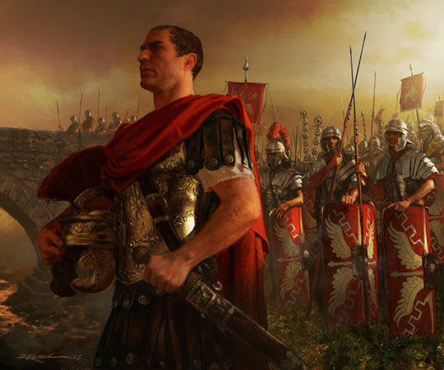
Caesar

Slide 14
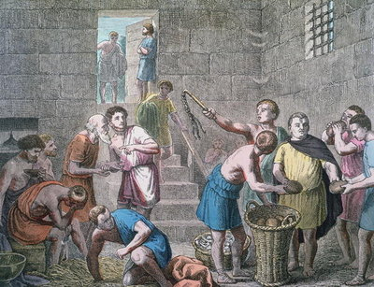
Slaves

Slide 15
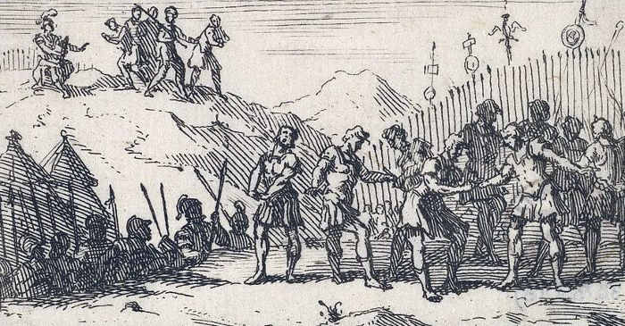
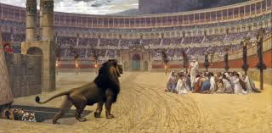
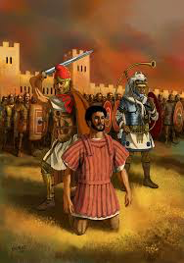
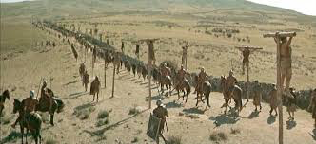
Cruelty

Slide 16
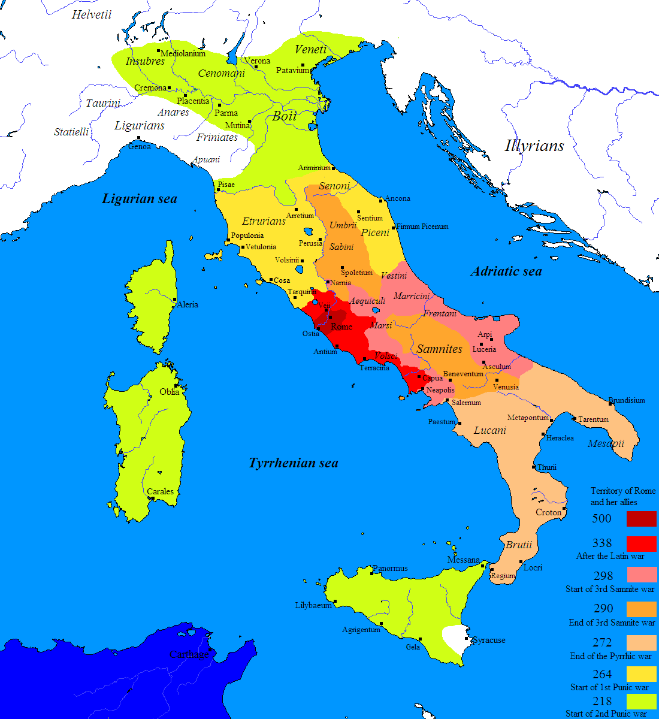
The Beginning

Slide 17
The Height

Slide 18
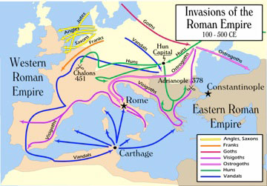
The End

Slide 19
…

Slide 20
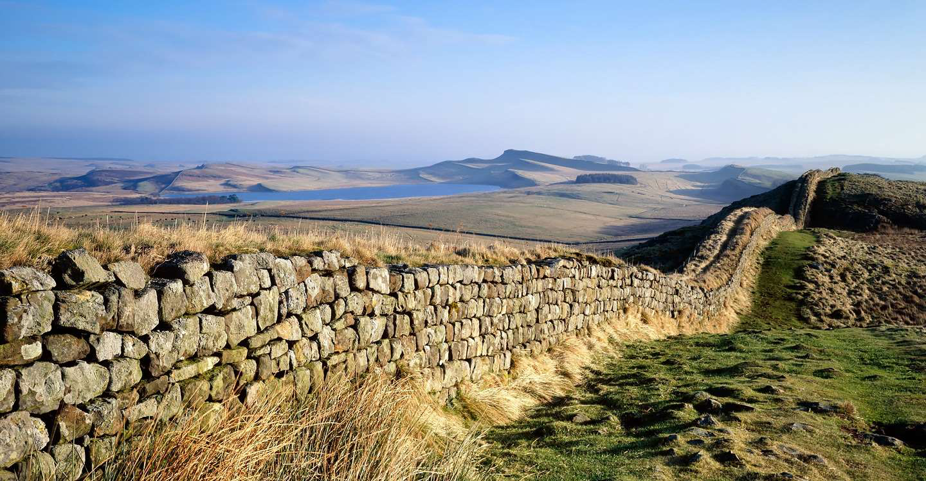

Slide 21
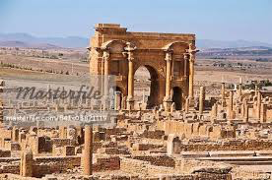

Slide 22
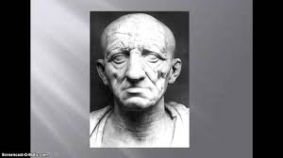
Who were the Romans?

Slide 23
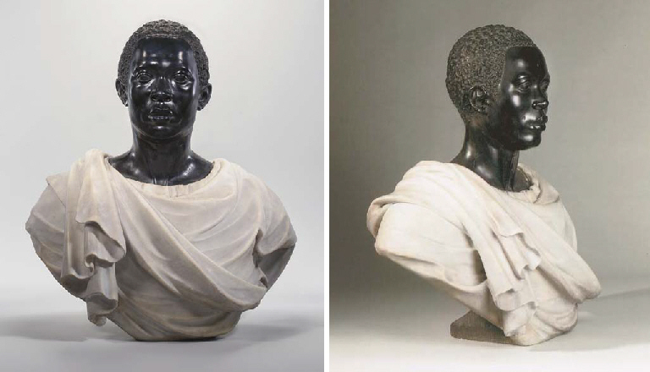
Romans

Slide 24
What did it mean to be “Roman”
Willing to Sacrifice
Honorable
Conservative
Practical
Disciplined
Orderly
Unemotional
Willing to Borrow/Learn
Tolerant
Cruel
Callous
Unemotional
Hypocritical
Pragmatic
Intellectually un-curious
Willing to Steal

Slide 25
The Foundations of Rome
The Legends and the Truth
Aeneas → Great Great Great Great Great Great Great Great Great Great Great Great Great Great Grandsons
Fall of Troy → Carthage

Slide 26
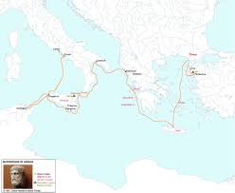
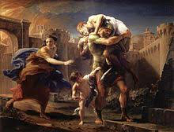
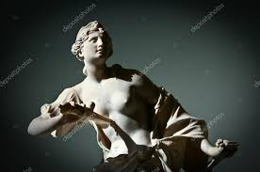
Aeneas

Slide 27
The Foundations of Rome
The Legends and the Truth
Aeneas → Great Great Great Great Great Great Great Great Great Great Great Great Great Great Grandsons
Fall of Troy → Carthage
Rutuli betrayed by Latinus – Aeneas controls Latins and Trojans
Etruscans defeated by the Latins - Tiber

Slide 28
The Early People of Italy
Etruscans – may have Migrated from Asia Minor (Troy?)
Artisans, Craftsman, Traders
Trade Routes went directly through Rome
Latins – Balkan – Pastoral Herdsmen
Shepards and Farmers with almost no arts and crafts
Excelled at warfare and engineering
Stole ideas from others –Greek Gods

Slide 29
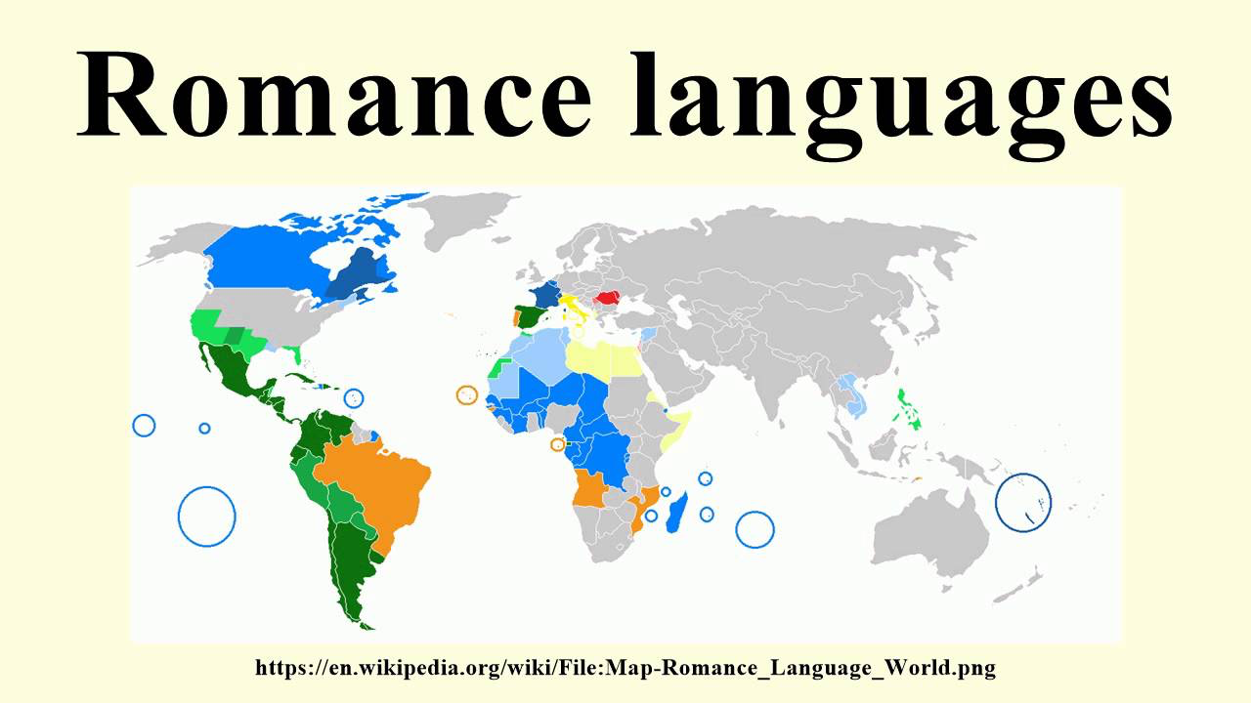
Latin
Basis for ½ of the European Languages

Slide 30
Story of the Wolf
Alba Longa founded – Kingship passed from Aeneas’ son through Numitor (who was chased from Alba Longa)
Daugher, Rhea, forced to be a Vestal Virgin
Imprisoned for “allowing herself to be raped”
Twin boys abandoned near river… found by shewolf
Did not happen…
Livy – true reason for the Story of the Wolf

Slide 31
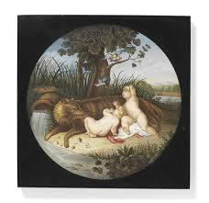
She Wolf

Slide 32
Young Romulus and Remus
Romulus and Remus – fought criminals who were robbing their town
Remus captured, taken to Numitor, the leader of the criminals, who “recognized” the boys
Restored to throne

Slide 33
Rome Founded
Established a city where they had been abandoned
Romulus Palatine (12) vs Remus Aventine (6, but first)
Remus lept the walls – Remus jumped his wall – “So perish whoever shall overleap my battlements”
April 21, 753 BC
Settlements from 800s BC
Latins vs. Etruscans – fits

Slide 34
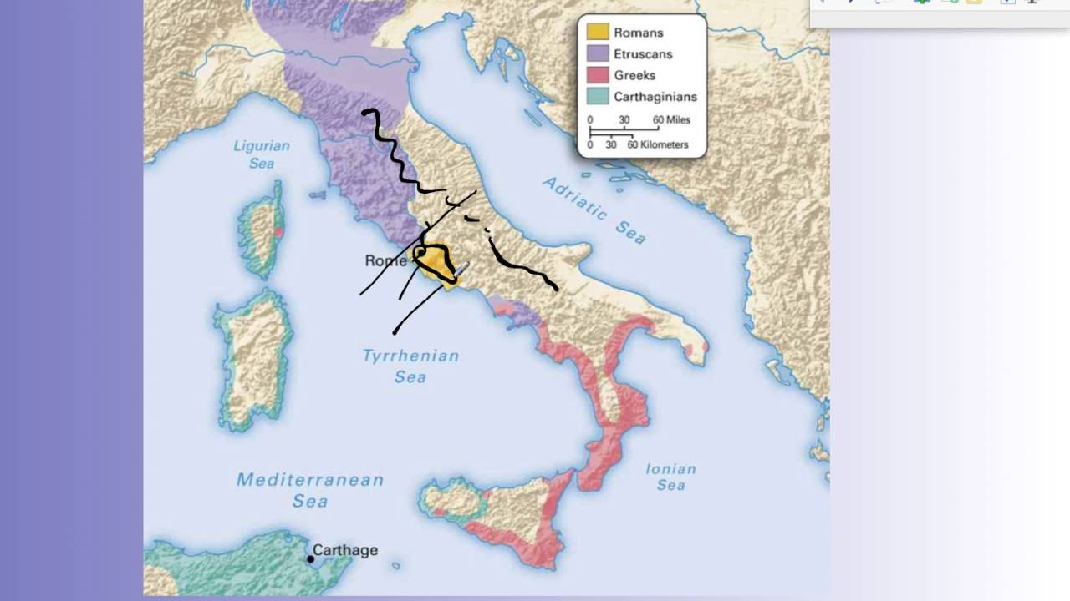
Why Rome?
Easy River Crossing
Natural Defenses
Trade Route

Slide 35
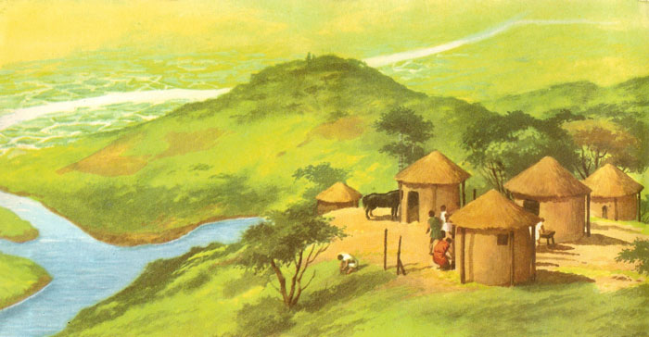
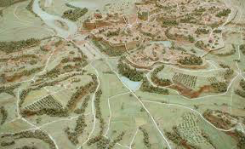
Romulus’ Rule
Need for settlers

Slide 36
Romulus’ Rule
Need for settlers
Open to everyone – fugitives, escaped slaves, debtors, criminals
Army – Able Bodies, Others
Foot Soldiers and Cavalry
Self Equipped Soldiers
How does the type of people filling Rome’s Armies benefit Rome even more?

Slide 37
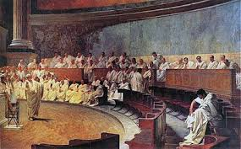
The Senate
Originally 100 – enough, or limited
Ancestors of those who became known as “Patricians”

Slide 38
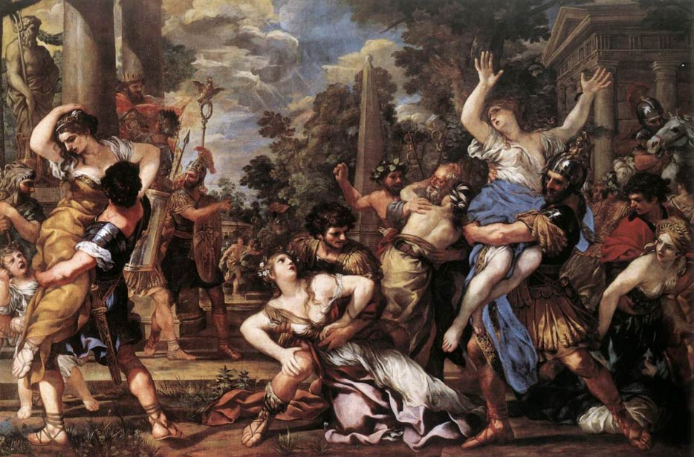
Early Stories
Army and Government→ Needs Women
Rape of the Sabine Woman

Slide 39
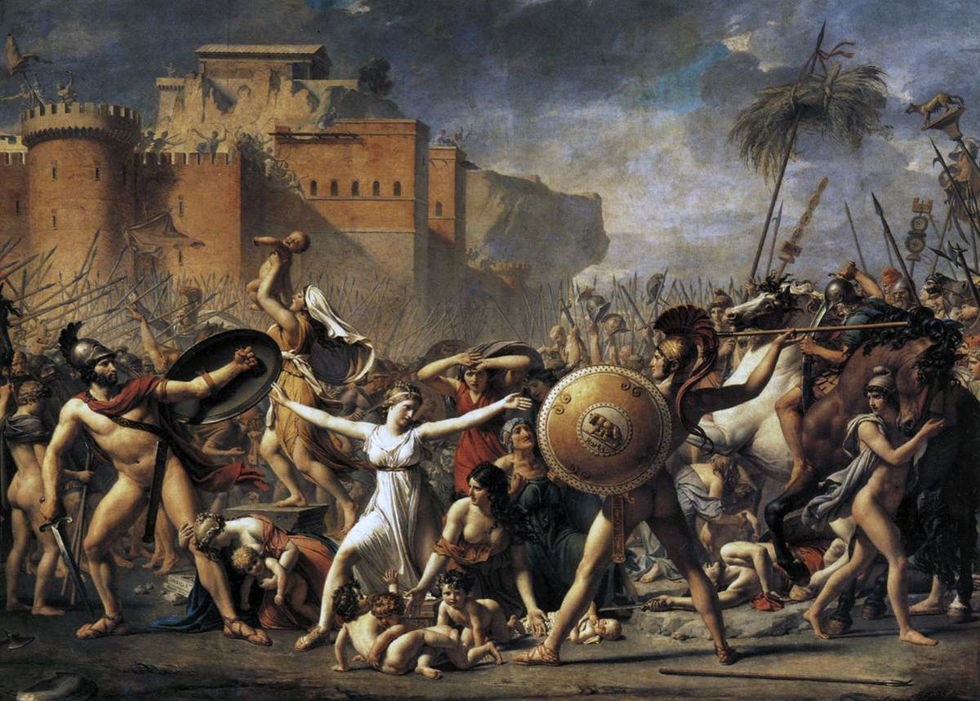
Early Stories
Trade post → Needs Women
Rape of the Sabine Woman
Romulus promised to treat them well → obligated by guilt
Abducted Sabine women begged their attacking parents to stop fighting

Slide 40
Commitia Curiata
Each cast 1 vote
Elected Magistrates
Passed Routine Law
**Precedent of Citizen Involvement, even in Monarch**

Slide 41
End of Romulus
Romulus disappeared into the thunderstorm while reviewing his troops
Happened while surrounded by Senators who never found his body….
Romulus is an easy go to answer → Founder, namesake, organizer, etc.
GW?

Slide 42
Not yet the lovable underdog
The early Romans were mean, ruthless, and just… bad
But they were also bad ass
Might doesn’t make right, but it allowed the Romans to get a solid foothold

