Slide 1
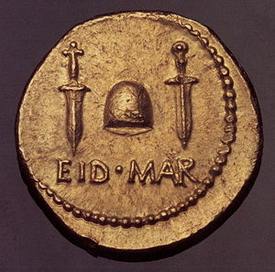
The Ides of March, 44 BCE
The assassins emerged from the Senate building declaring Rome free from Caesar
They were greeted by empty streets

Slide 2
Choose one of the following power options for Rome... what should this “leader” do to assume command of Rome and set up a more stable system. Remember, we have just had our beloved leader assassinated and we need a more

Slide 3
Who should take over????
19 Year Old
Sickly
Little Military Experience
Distant relative of Caesar
Caesar's second in command
Loved by his troops
Esteemed military commander
For years has led Rome as de facto leaders
Has now asserted its authority over the Romans by assassinating Caesar

Slide 4
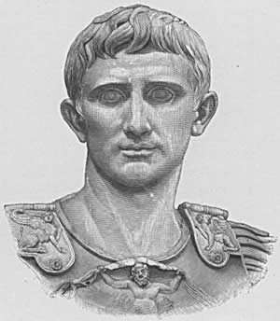
Who should take over???
Octavius
Adopted by Caesar posthumously
Declared Caesar's sole heir
Marc Antony

Slide 5
Learning from the Past
Octavian looked to his predecessors from the previous 100 years for examples on what to do and what not to do.
What, if you were Octavian, would you do to make sure to have the support of a) the people, b) the Army, c) the government(?) …?

Slide 6
Octavius... that sly devil...
Octavian took the necessary actions to secure the favor of the people of Rome
He gave each Roman citizen the money promised to them by Julius Caesar
He also had Julius Caesar declared a god... why on earth would he do this...?

Slide 7
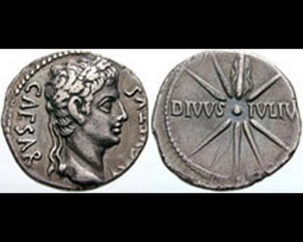
Caesar, the God

Slide 8
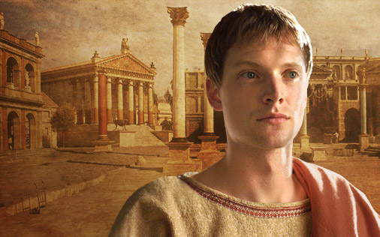
The 2nd Triumvirate
Octavian and Antony formed the 2nd Triumvirate and split up the Roman world
The three initiated a series of proscriptions: Just like Sulla, they killed their many political opponents, and killed anyone worth enough money to help fund their war effort
Octavian was positioned in Rome, Antony in the East (in Egypt), and Lepidus... though we won't focus on him....

Slide 9
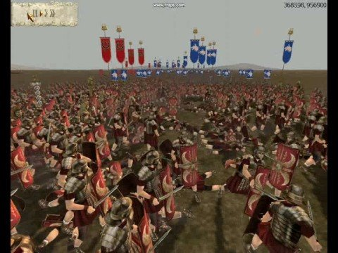
Revenge
Marc Antony and Gaius Julius Caesar Octavianus allied with one another to crush those responsible for the assassination of Caesar
At the Battle of Philippi ( 42BCE), they defeaedt Cassius and Brutus, finally eliminating any Republican Hope

Slide 10
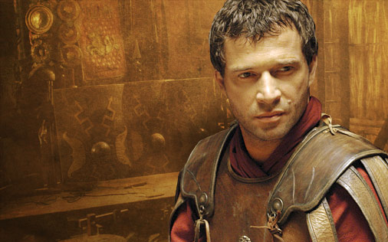
All things fall apart
After the 2nd Triumvirate eliminated Caesars assassins, they had no common enemy, and immediately their relationship declined
** See Events on timeline (42-31 BCE)

Slide 11
Another Civil War Becomes Inevitable
Octavian, using his political savvy and position in Rome, is able to convince the SPQR that Antony is the enemy
He declares war on Cleopatra, Antony's new wife, knowing that Antony will have to side with her, and thus against Rome
Although he has VERY little military genius,Octavian's best friend, Marcus Agrippa, is an amazing military commander, and helps Octavian out at the Battle of Actium in 31 BCE

Slide 12
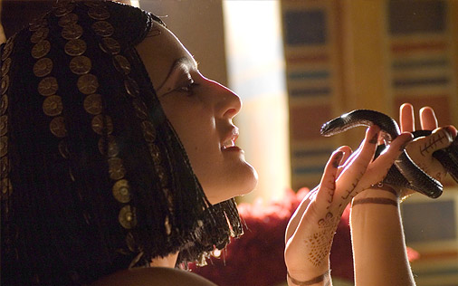
Aftermath of the Battle of Actium
After pursuing Antony and Cleopatra to Egypt where the two eventually killed themselves, Octavian was left in sole control of the Roman World

Slide 13
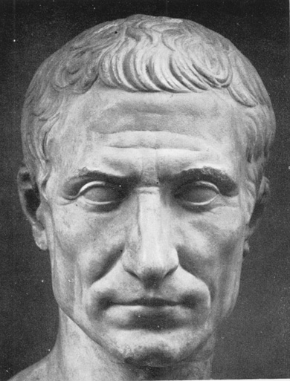
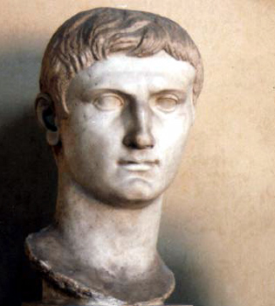

Slide 14
Comparing Octavian to Caesar
Similarities
Both loved by the people
Control MASSIVE army
Eliminated military threats
Differences
Caesar practiced clementia
Augustus truly eliminated ALL threat
Caesar = lots of remaining Republican Sentiment
31 BC – different memories for active political families

Slide 15
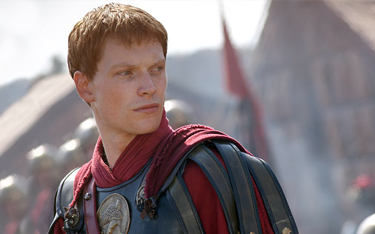
The Benefit of starting early
Octavian eliminated ALL threats by 30 BCE... at the age of 33
He could not give up power... Rome would descend into chaos
He could not name himself king... no one would accept that.

Slide 16
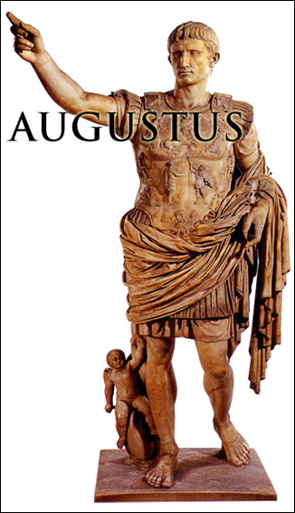
The First Settlement 27 BCE
Octavian “gave up” all of his power in a public show
This pleased the Senators, who BEGGED Octavian to retain control in certain provinces... the border provinces
He received the title: Augustus

Slide 17
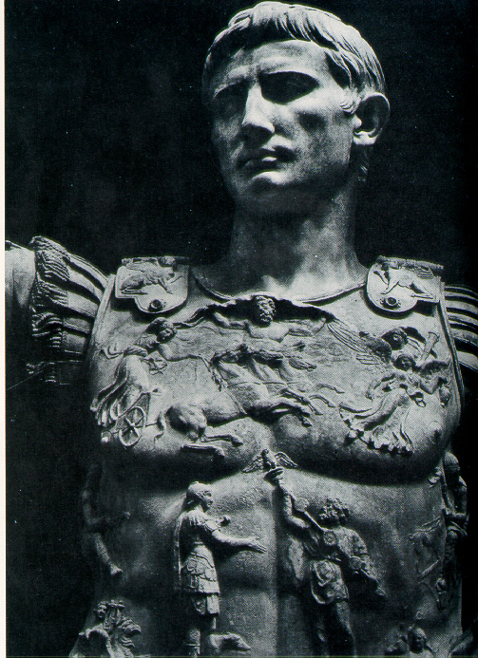
Auctoritas Augusti
Except for times of Crisis, Augustus rarely held political offices
He let the traditional workings of the Republic continue, with his authority being the guiding force

Slide 18
Augustus claimed that he found the city of Rome one of brick, and left it one of marble.

Slide 19
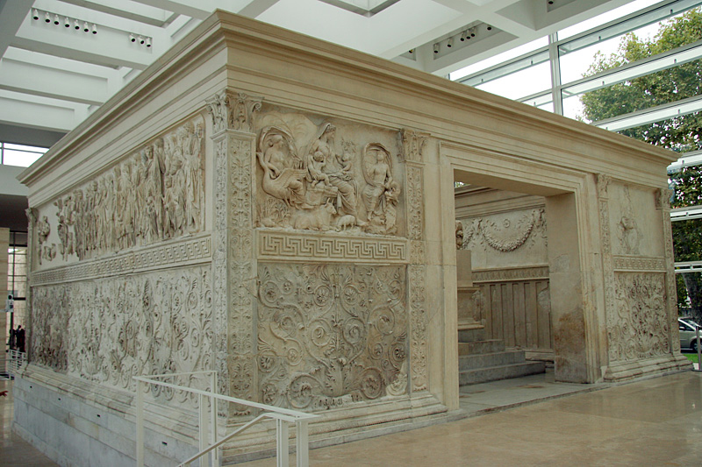
The Pax Romana
During the period of his reign, Rome experienced an unprecedented flourishing of arts, architecture, and trade

Slide 21
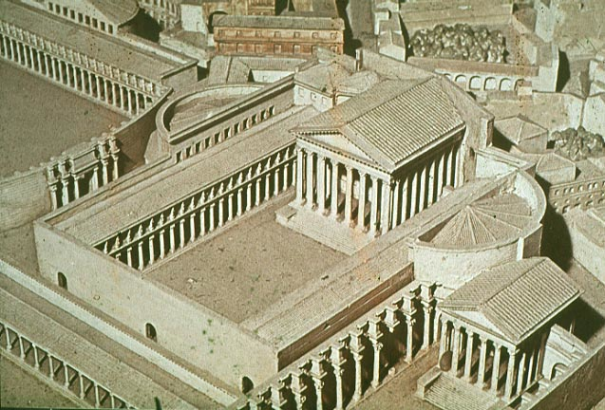
Augustan Forum

Slide 22
The Pantheon

Slide 23
Concerns Augusti
Throughout his reign, Augustus had two main concerns:
Establishing a system that would be stable through the transition of authority... a system where a successor could be designated
Establishing a system where everyone was taken care of... he established a veil of competition under a system where he was absolute ruler.

Slide 24
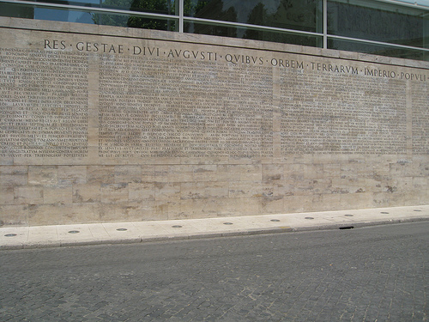
What Augustus Accomplished
In his Res Gestae, Augustus displayed proudly, though humbly his most important accomplishments.

