Slide 1
Capital Punishment

Slide 2
History
The death penalty has a long history; it began in colonial America.
It is restricted to the most serious crimes, murder and treason.

Slide 3
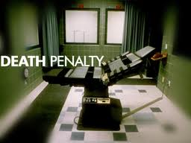
Furman v. Georgia (1972)
The Supreme Court held that the death penalty, as applied, was unconstitutional under the cruel and unusual punishment clause of the 8th amendment.
However, the Court left the door open for states to rewrite their statutes.

Slide 4
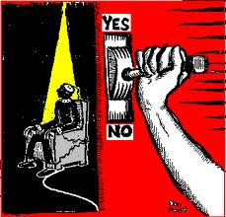
Gregg v. Georgia (1978)
The Court upheld the death penalty “as an expression of society’s outrage.”
Statutes must allow consideration of aggravating and mitigating circumstances.

Slide 5
Circumstances
Aggravating circumstances make the crime worse.
Mitigating circumstances do not excuse the crime, but tend to make it less severe.

Slide 6
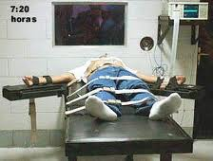
Death by Numbers
37 states have the death penalty.
36 states and the federal government use lethal injection.
10 states use electrocution

Slide 7
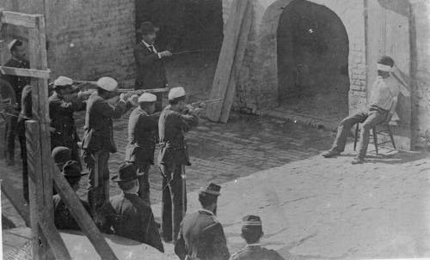
Death by Numbers
4 states use lethal gas
3 states use firing squads (Idaho, Oklahoma and Utah).
3 states use hanging (Delaware, New Hampshire, and Washington)

