Slide 1
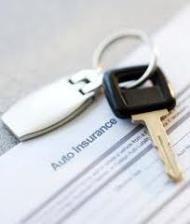
Car Insurance

Slide 2
Insurance Rates
Why are insurance rates so high for teenagers?
Annual accident rates for mean are 18/100 and for women 15/100
Annual accident rates for boys are 23/100 and for girls 17/100

Slide 3
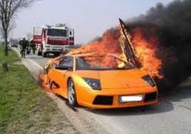
Insurance Rates
Motor vehicle crashes are the leading cause of death for teenagers.
16 year olds have higher crash rates than drivers of any other age.
The economic impact of car accidents involving 15-20 year old drivers is over $40 billion.

Slide 4
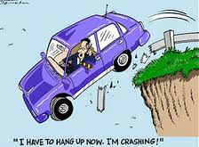
Teenage Drivers
56% of young drivers use cell phones while driving
69% say they need to keep up with traffic.
64% say the speed through yellow lights

Slide 5
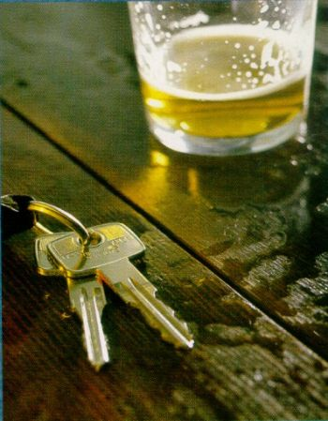
Teenage Drivers
47% say passengers distract them while driving.
7.31% of teen drivers killed in 2006 had been drinking.

