Slide 1
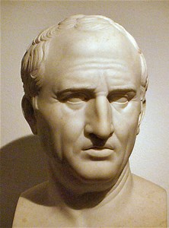
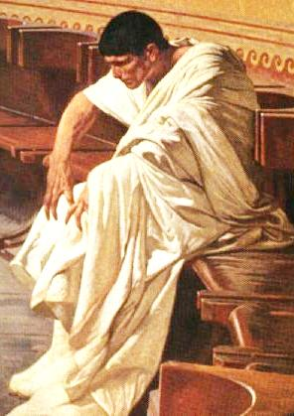
In Defense of the Republic
Cicero vs.
Catiline

Slide 2
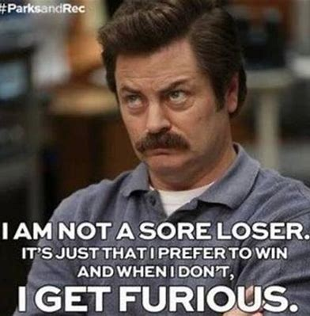
Catiline
Incredibly Patrician Background
Worked his way up to the Praetorship
Lost multiple elections for Consulship
Should have backed down

Slide 3
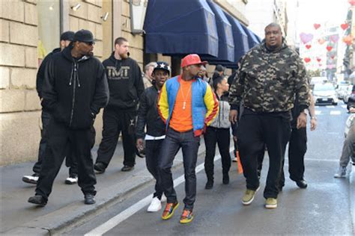
“Attempted Murder of Cicero” – First Conspiracy
Cicero found out about a plot that Catiline was trying to carry out to assassinate him
Luckily, he was able to protect himself from any harm…

Slide 4
2nd Conspiracy
Catiline wanted to hit the reset button
He promised the rich and poor alike that he would wipe out their loans; he promised land to veterans
He raised a following of about 10,000 men

Slide 5
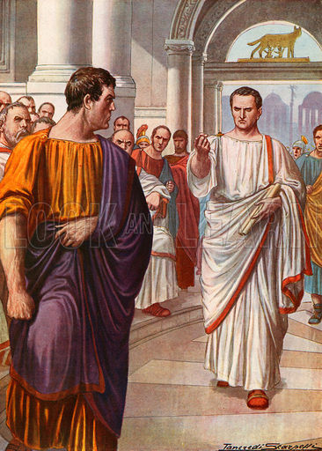
Catiline Called Out
Cicero, one of the most renowned speakers of antiquity, gave a series of speeches calling out Catiline for his plans
The first was delivered, with Catiline in the room, to the rest of the Senate

Slide 6
Romans and Gauls… friends?
Catiline tried to lure some Gauls to help him fight
They made him write down all his promises to them in a letter signed by the main conspirators

Slide 7
Silly Goose
The Gauls promptly turned this letter into the Roman Authority

Slide 8
Catiline Meets his End
Many of Catiline’s troops abandoned him
The 3000 or so that remained fought well but were defeated
When the battle was ended it became evident what boldness and resolution had pervaded Catiline's army. For almost every man covered with his body, when life was gone, the position which he had taken when alive at the beginning of the conflict. A few, indeed, in the centre, whom the praetorian cohort had scattered, lay a little apart from the rest, but the wounds even of these were in front. But Catiline was found far in advance of his men amid a heap of slain foemen, still breathing slightly, and showing in his face the indomitable spirit which had animated him when alive

