Slide 1
Introduction to Law
The Creation of Laws

Slide 2
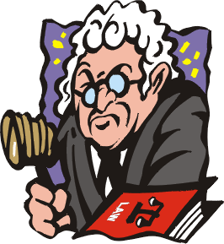
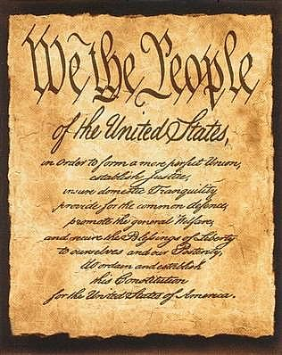
Laws are primarily created through two different methods:
Case Law
Statutory law

Slide 3
Statutory Law
Written laws that are created and passed by a legislature on the state or federal level.

Slide 4
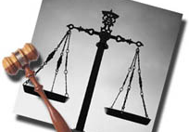
Case Law
Law that is based on judicial decision and precedent.

Slide 5
The Fourth Amendment
Actual Text
Basic Idea
The right of the people to be secure in their persons, houses, papers, and effects, against unreasonable searches and seizures, shall not be violated, and no Warrants shall issue, but upon probable cause, supported by Oath or affirmation, and particularly describing the place to be searched, and the persons or things to be seized.
It is unreasonable for the government to search a place or seize a person or things without a warrant.

Slide 6
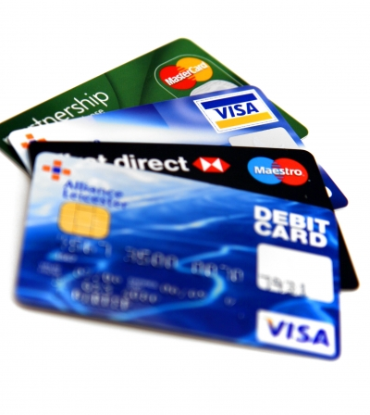
Watson’s Car
Watson was suspected of having stolen credit cards. The police searched him and found no cards. They then asked him if they could search his car. He said “Go ahead,” and the officer’s found two stolen credit cards under the floor mat. He was convicted and sent to jail.

Slide 7
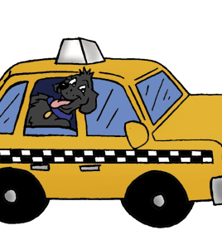
Cocoa Lane
An armed robber entered the offices of a taxi company, stole $363, and ran. Two taxi drivers who heard shouts of “holdup,” followed the robber to 2111 Cocoa Lane. Police proceeded to the house and were let in by a woman. Officers spread out through the house and found Hayden upstairs pretending to sleep. He was arrested and convicted.

Slide 8
Horton’s Rings
Horton was suspected of robbing a coin collector. Police got a warrant to search his house for three rings that were stolen. Police did not find the rings during the search, but they did find guns that matched the description of those used in the robbery lying on a bed in one of the rooms. He was arrested and convicted.

Slide 9
Does our original interpretation still work?
Original interpretation:
It is unreasonable for the government to search a place or seize a person or things without a warrant.
So what would it look like now:
It is unreasonable for the government to search a place or seize a person or things without a warrant unless the suspect’s CONSENT to a search, there are EXIGENT CIRCUMSTANCES, the suspect is in an AUTOMOBILE, or police find the items in PLAIN VIEW while legally searching for other evidence.

Slide 10
No Vehicles in the Park
The town of Beautifica has a lovely park in its center. The city council wishes to preserve the feeling of nature, undisturbed by city noise, traffic, pollution and crowding. It is a place where people can go to find grass, trees, flowers and quiet. In addition, there are playgrounds and picnic areas. In order to make sure the park stays as it is, the city council passed a law, called an ordinance. At all entrances to the park, the following sign is posted: "NO VEHICLES IN THE PARK."

Slide 11
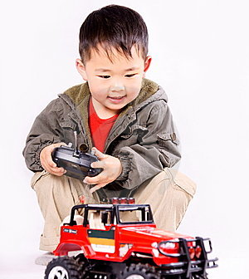
State v. Charles
Andy Charles, a 4-year old boy, is playing in the park with his remote control speed race car. The car goes 40 kilometers per hour and makes a loud buzzing sound. A dutiful police officer arrests him.

