Slide 1
Divorce

Slide 2
Separation
A separation is when a married couple agrees to live apart. Sometimes this is a “cooling off” period. Sometimes couples separate for religious reasons.
A Separation agreement sets out the couple’s understanding on alimony, child custody, support, and division of property.

Slide 3
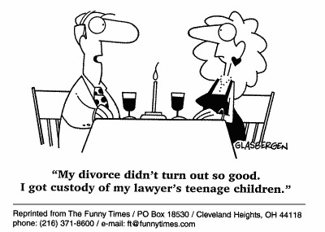
Divorce
A divorce is a court order legally ending a valid marriage.
About half of all marriages end in divorce.

Slide 4
Divorce
Divorce is expensive-=costs include legal fees, alimony, and child support payments. Property will be divided and the couple will need two homes instead of one.
Pro se (do it yourself) kits are available. When should a couple consider this option?

Slide 5
Reasons for Divorce
In the past, most states only allowed divorces for serious reasons including
Adultery
Desertion
Mental cruelty
Physical cruelty
Insanity

Slide 6
No Fault Divorce
Most states now permit no fault divorce. The couple needs to cite irreconcilable differences.

Slide 7
Child Custody
The parent with custody can decide on most important aspects of the child’s life, including where the child will live and go to school.
The non-custodial parent is usually given visitation rights.
Joint custody is becoming more common, but many courts still do not favor it. Why?

Slide 8
Child Custody
Laws require courts to treat men and women equally in custody matters. Custody is determined using the “best interests of the child” standard.

Slide 9
Best Interests of the Child Standard
The youth’s actions in the home, school, and community
The emotional and economic stability of the parents
Each parent’s religion

Slide 10
Best Interests of the Child Standard
Which parent has the stronger bonds with the child
Who has been the primary care provider
Courts listen to the child, if he or she is mature enough

