Slide 1
Fighting Words and Offensive Speech

Slide 2
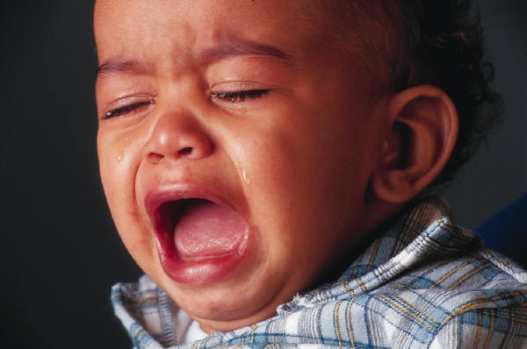
The First Amendment
The First Amendment does not protect fighting words.

Slide 3
Fighting Words
spoken face to face
abusive or threatening
likely to cause an imminent breach of the peace
do not contribute to the marketplace of ideas

Slide 4
Offensive Speech
Words that are offensive and make people angry are not fighting words unless they meet the above criteria.

Slide 5
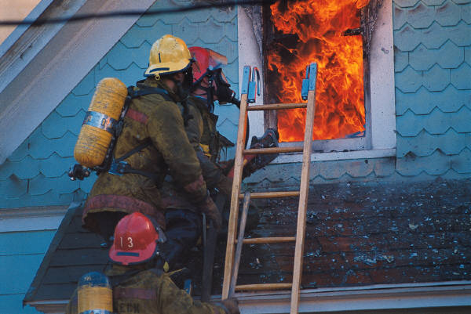
The Incitement Test
The incitement test is used—the government may only punish speech when immediate lawless action is a likely consequence.

