Slide 1
Freedom of Speech

Slide 2
Speech is usually protected
Freedom of speech is usually protected from government interference.
Like all rights, free speech is subject to a balancing test.

Slide 3
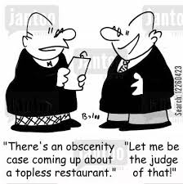
Obscenity
Obscene (sexually explicit) speech is not protected.

Slide 4
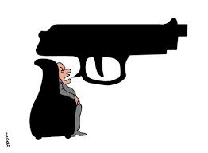
True Threats
Speech that is a legitimate threat (not just blowing off steam) is not protected.

Slide 5
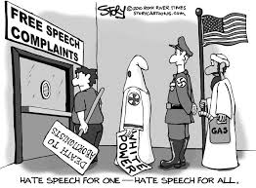
Fighting Words
Face-to-face words which could lead to an imminent breach of the peace are not protected

Slide 6
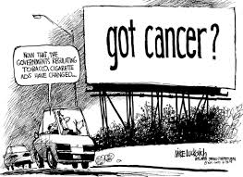
Commercial Speech
Speech meant to sell a product or service must not contain false information.

Slide 7
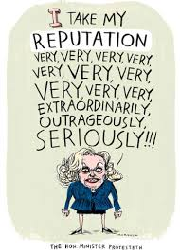
Defamation
Untrue statements which harm a person’s reputation are not protected.

Slide 8
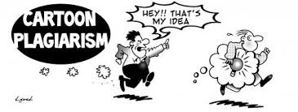
Intellectual Property
Copyrights and patents protect authorship and inventions.
That is why people need permission before using someone else’s creations.

