Slide 1
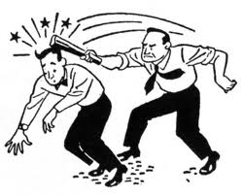
Intentional Torts

Slide 2
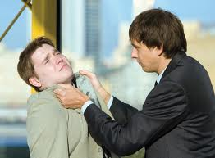
Kinds of Intentional Torts
There are two kinds of intentional torts
Injury to the person
Injury to property

Slide 3
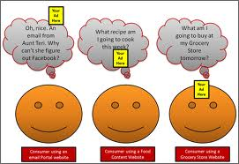
Intent
Intent means the desire to act—it does not mean the desire to harm.
If your friend pulls a chair out from under you as a joke, and you break your arm, this is an intentional tort, even though your friend did not mean to injure you.

Slide 4
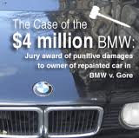
Types of Damages
Compensatory damages cover hospital bills, pain and suffering, and lost wages.
Nominal damages are symbolic awards of money.
Punitive damages punish the defendant for malicious, willful, or outrageous acts.

Slide 5
Torts That Injure Persons
Battery—intentionally causing offensive contact.
Assault—putting someone in fear of immediate harmful or offensive conduct.
Infliction of Mental Distress—using words or actions that might cause fright, extreme anxiety, or mental distress.

Slide 6
Torts that Injure Persons
False Imprisonment—intentionally and wrongfully confining another person against his or her will.
Defamation—a false statement, communicated to a third party, causing harm to the plaintiff. Truth is a defense.

Slide 7
Torts That Injure Property
Real Property
Trespass is going onto another’s property without permission
Nuisance is the unreasonable interference with the use and enjoyment of property. This is not a one time event.

Slide 8
Torts that Injure Property
Personal property
Conversion is unlawfully exercising control over someone else’s property

Slide 9
Torts that Injure Property
Intellectual Property
Patents protect inventions that are truly new.
Copyrights protect ownership of creative expression (not ideas or facts)
Using someone’s intellectual property without permission is called infringement.

Slide 10
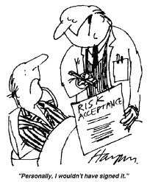
Defenses to Intentional Torts
Consent
Privilege—public policy is served by the behavior (protection of a third party)

Slide 11
Defenses to Intentional Torts
Legal Authority—the police have authority to detain someone.
Defense of Property—people may use reasonable force to defend property.

