Slide 1
The Industrial Revolution
From 1750 – 1850 a series of inventions changed the way the world operated
Steam Engine
Advancing Railroads
Spinning mule

Slide 2
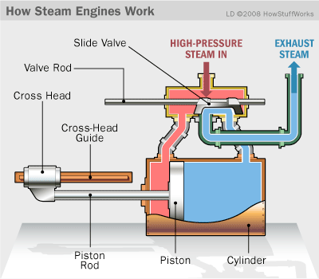
Improved Steam Engine

Slide 3
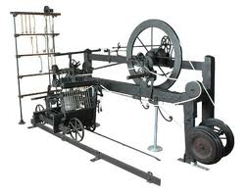
Spinning Mule

Slide 4
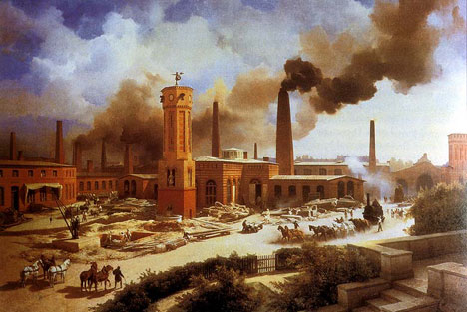
The Revolution
For thousands of years, society had been defined by agriculture
By the 1850s, 100 years after the beginning of the Industrial Rev, all this had changed

Slide 5
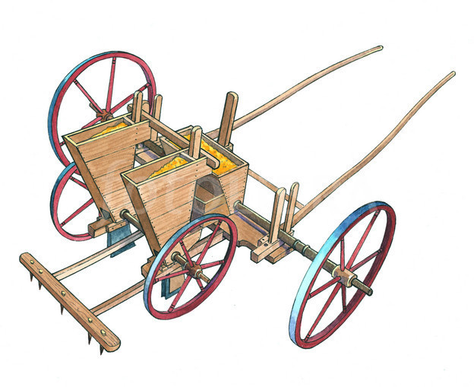
Agricultural Revolution
Improved farming techniques and machinery allowed more crops to be produced
Better fertilizer increased soil yield

Slide 6
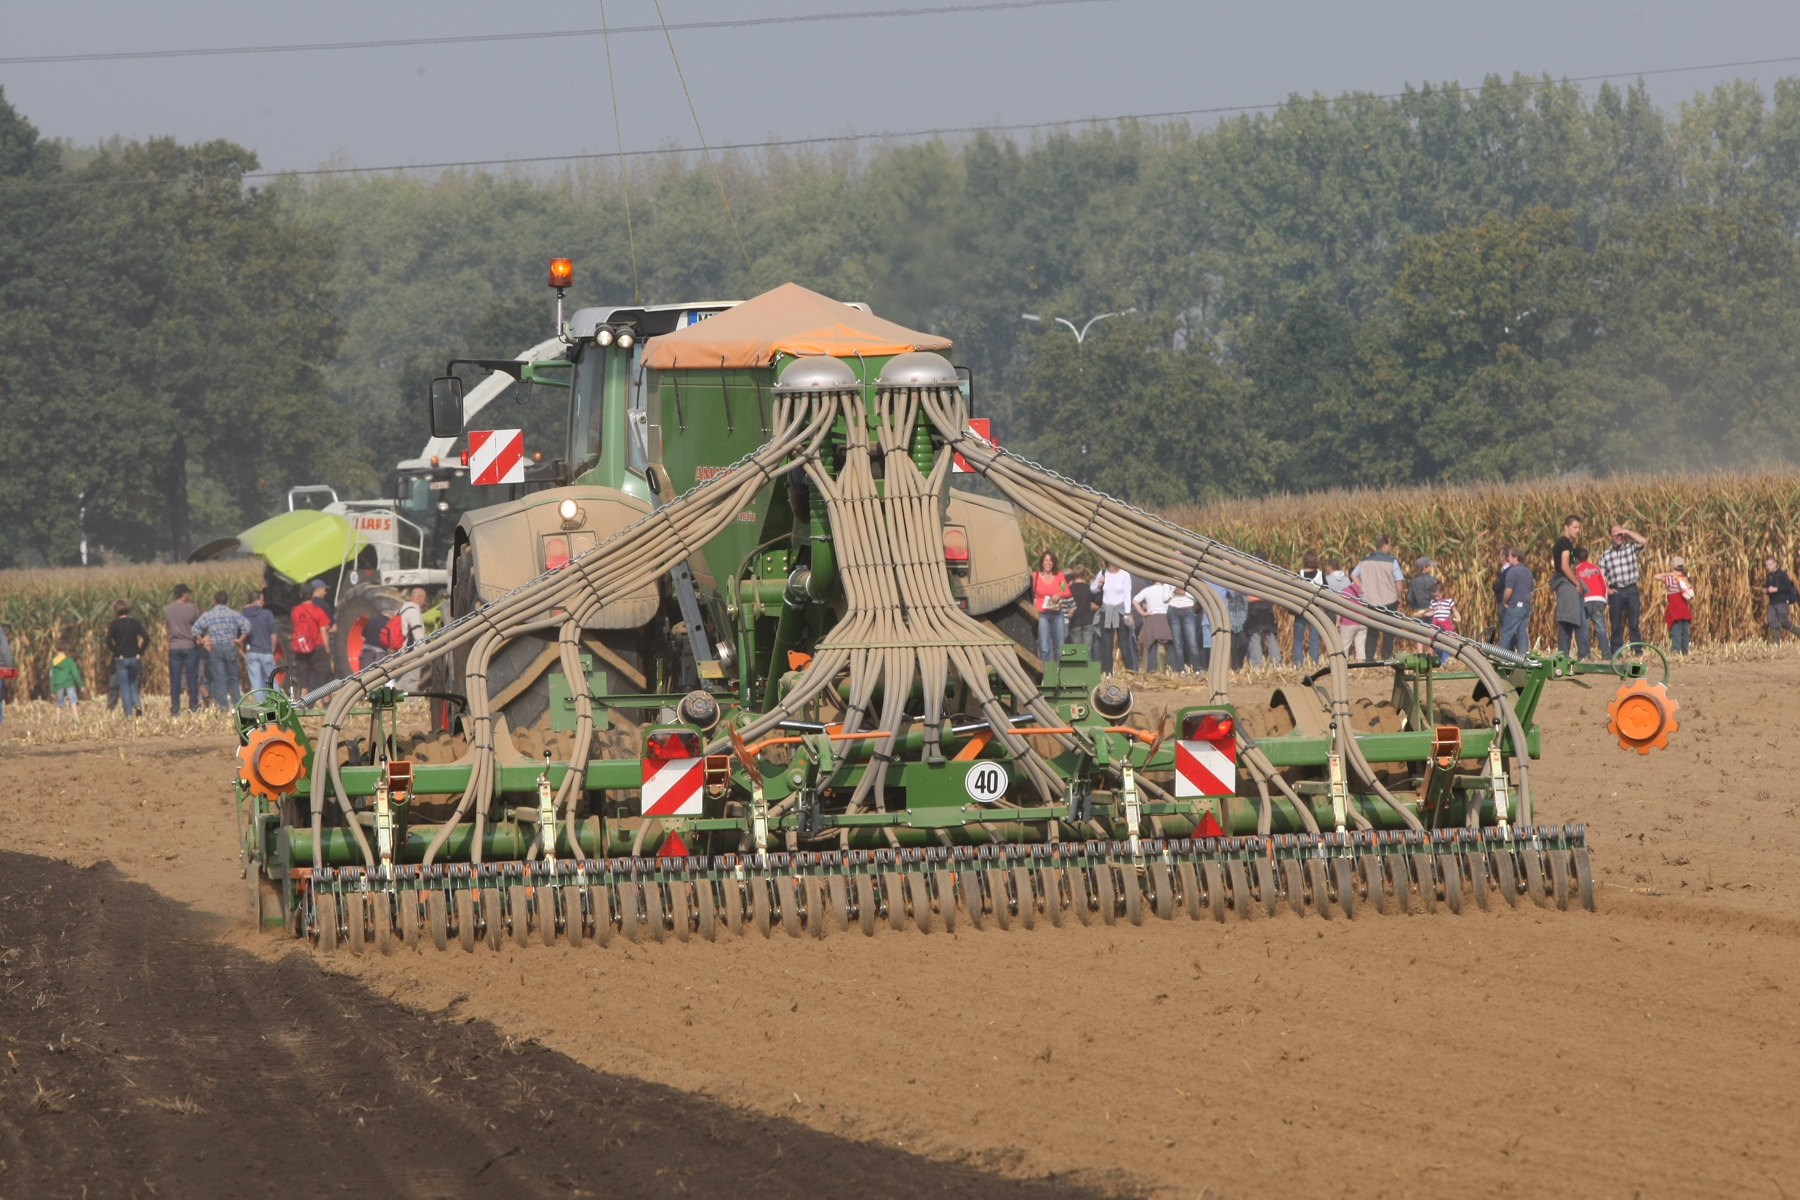

Slide 7
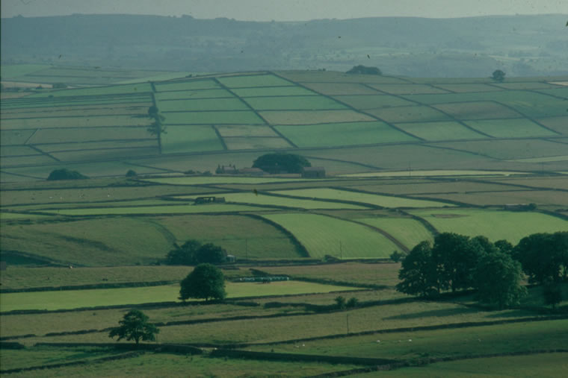
Enclosures
Wealthy landowners took over millions of acres of land from peasants, turning them into massive farms
Where to?

Slide 8
Population Explosion
Britain
1700 – 5 million
1800 – 9 million
France
-1715 – 18 million
1789 – 26 million
Europe as a whole
70 million more people

Slide 9
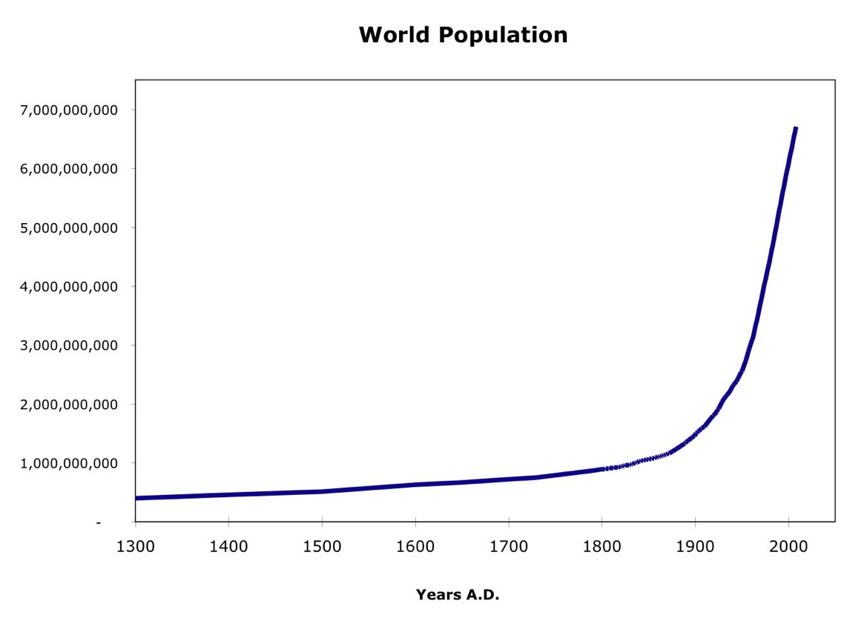

Slide 10
Why so many people
Declining death rates, rather than rising birth rates account for this growth
Better food, sanitation, hygiene, and medical care

Slide 11
The Energy Revolution
Your Majesty; have at my disposal what the whole world demands: something which will uplift civilization more than ever by relieving man of all undignified drudgery. I have steam power
- Matthew Boulton – ~1769

Slide 12
Why Britain?
Britain had the many necessary qualities for this Revolution to take place
High, displaced population
Substantial capital in the business class from overseas empires
Stable govt.
Strong Navy
Religion

Slide 13
Textile Industry
Putting out system
Peasant families turning cotton to thread
Flying shuttle
Weavers outpaced spinners
Spinning Jenny -1764

Slide 14
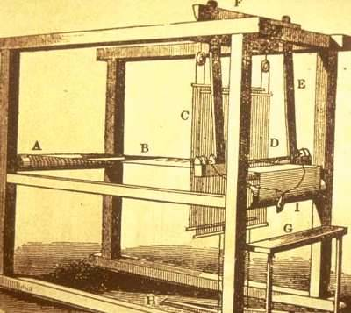
Flying Shuttle

Slide 15
Spinning Mule

Slide 16
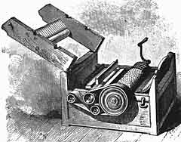
The Cotton Gin - 1793

Slide 17
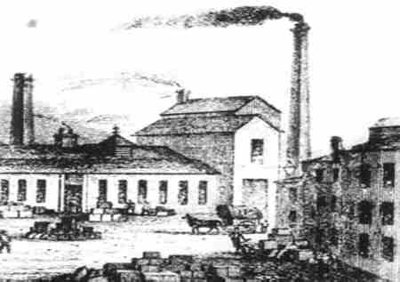
Factories
People flocked to cities and the growing factories: places where workers and machines are brought together the create large quantities of goods

Slide 18
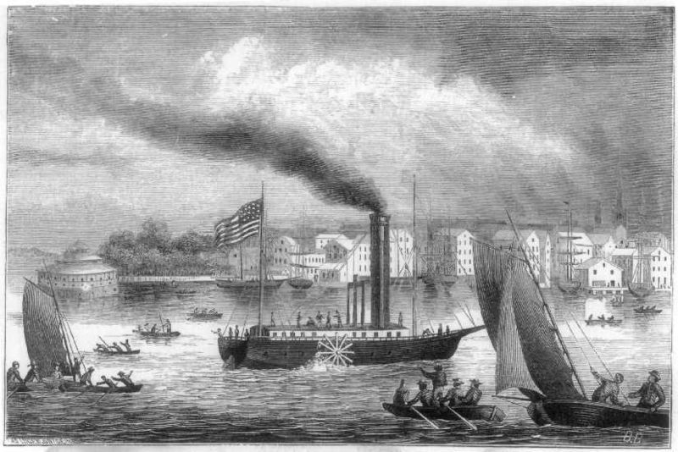
Transportation
Turnpikes – Private roads
Steam locomotive
1807 – Robert Fulton and the Clermont
Hudson River

Slide 19
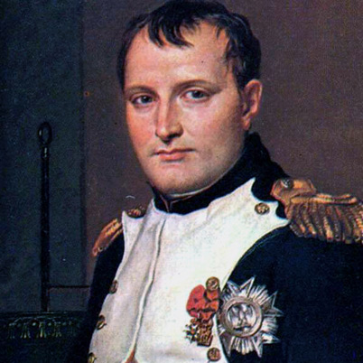
The Restructuring of Europe Napoleon to WWI
Napoleon capitalized on victories against England during the French Revolution and the anarchy of the new government. He was proclaimed “consul for life in 1802, and became Emperor 2 years later

Slide 20
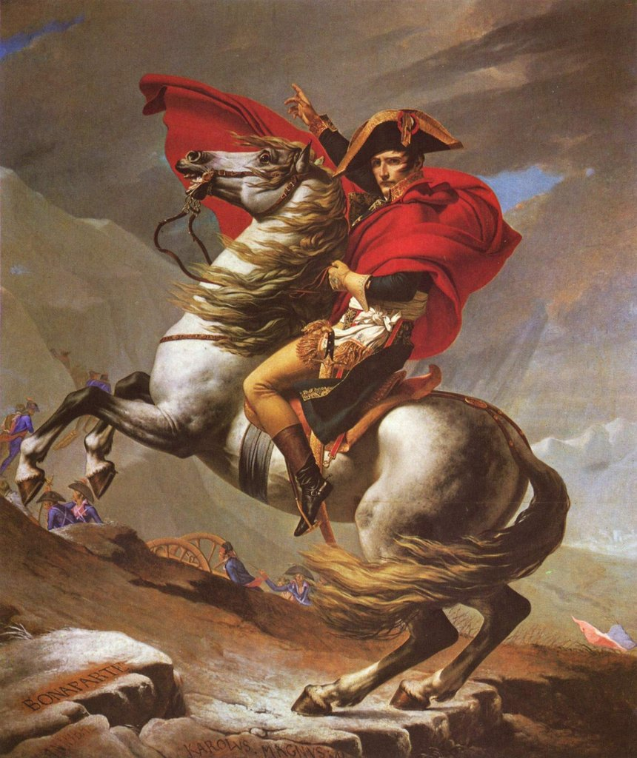
Napoleon!
In France, Napoleon created a strong central government with consolidated power

Slide 21
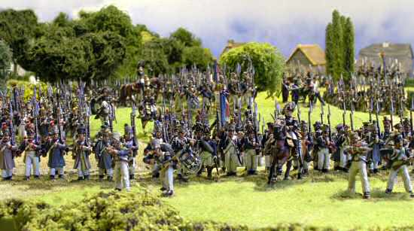
Napoleon's Victories
Napoleon led an unstoppable army.
“Napoleon's presence on the battlefield was worth 40,000 troops”

Slide 22
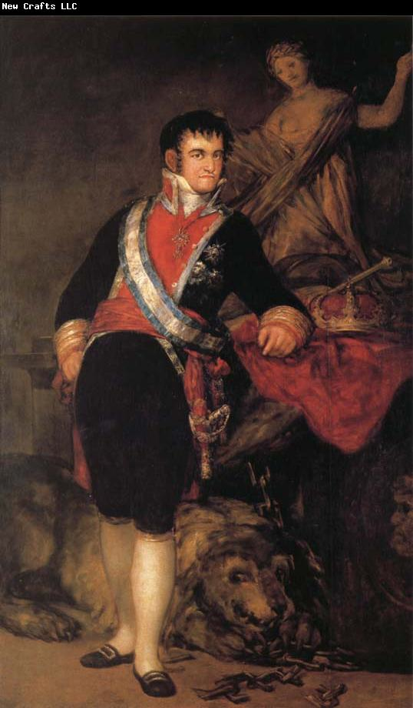
Further Conquests
Napoleon used diplomacy and alliances to strengthen his hold on the continent

Slide 23
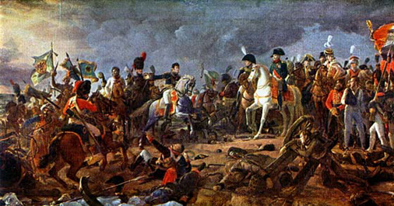
The Battle of Austerlitz – 1805
AKA the battle of the 3 Emperors. One of Napoleon's most incredible victories
Holy Roman and Russia vs. France
HRE ceased to exist

Slide 24
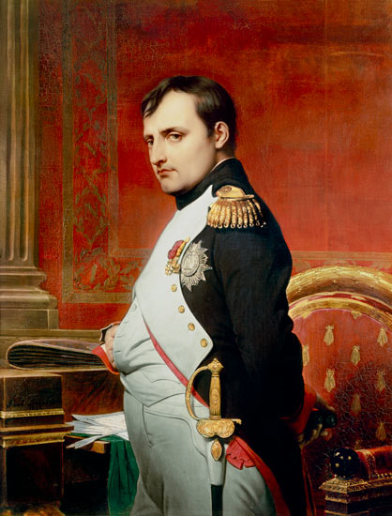
Napoleon Wins over the Frenchies
After the battle, Napoleon adopted the children of all of the men lost in battle.
Child support, education, marriage, and even naming rights

Slide 25
The Continental System
Napoleon could not invade England, so he instead closed all European ports to British Goods
*This caused the Americans to fight a war against England...

Slide 26
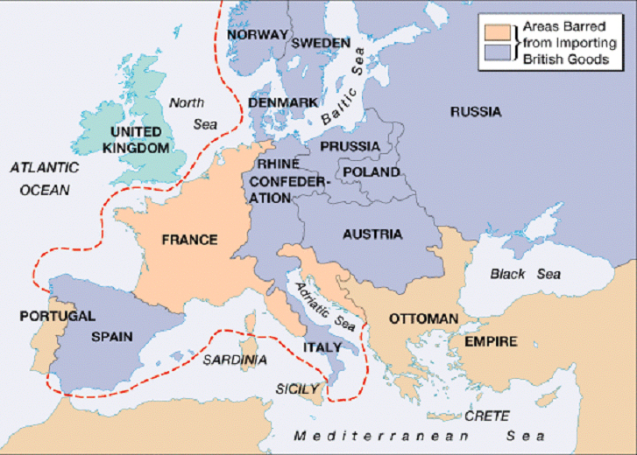

Slide 27
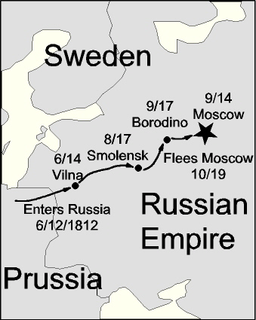
The beginning of the end
In June 1812, Napoleon invaded Russia
Hoped to spread liberal reforms throughout these lands

Slide 28
Nationalism kicks in
People liked the ideas brought by French troops, but did not like foreign nationals invading their territory

Slide 29
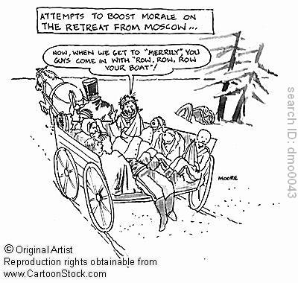

Slide 30
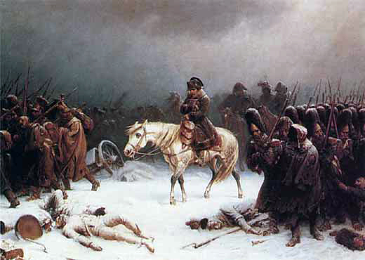

Slide 31
Napoleon Retreats
Napoleon and his army were forced to retreat
Lost about 500,000 men
Briefly exiled to Elba 1814

Slide 32
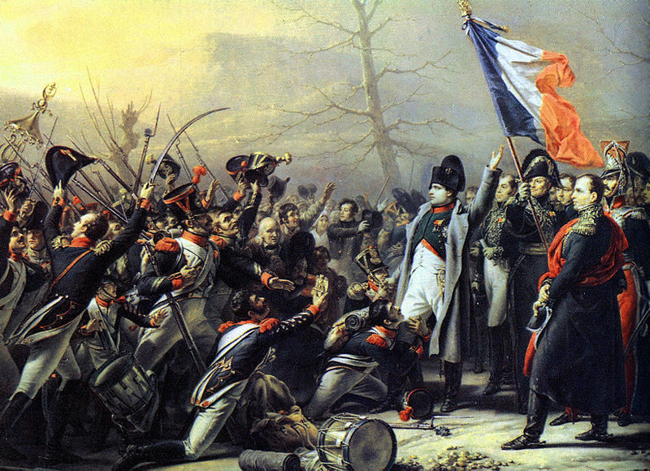
His Return – 1815

Slide 33
Waterloo Part 1
Napoleon returned to Paris in 1815
Within 4 days, Prussia, Russia, Great Britain, and Austria formed an alliance

Slide 34
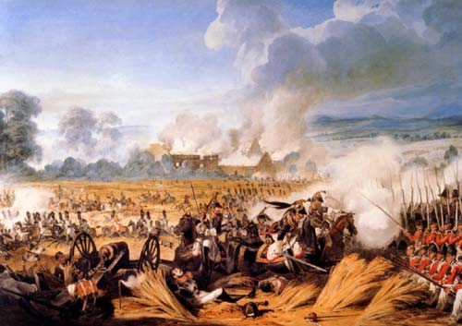
Waterloo Part 2
The large contingent of allied nations decisively defeated Napoleon in June 1815
He was placed under arrest until his death in 1821

Slide 35
Nationalism All Around
Stronger Armies
Growing Trade = $$$
Expanding Empires

Slide 36
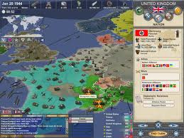
Napoleon's Aggression Leads to nationalism
Although the Germans appreciated some Napoleonic reforms, they eventually resented having the French dictate their affairs

Slide 37
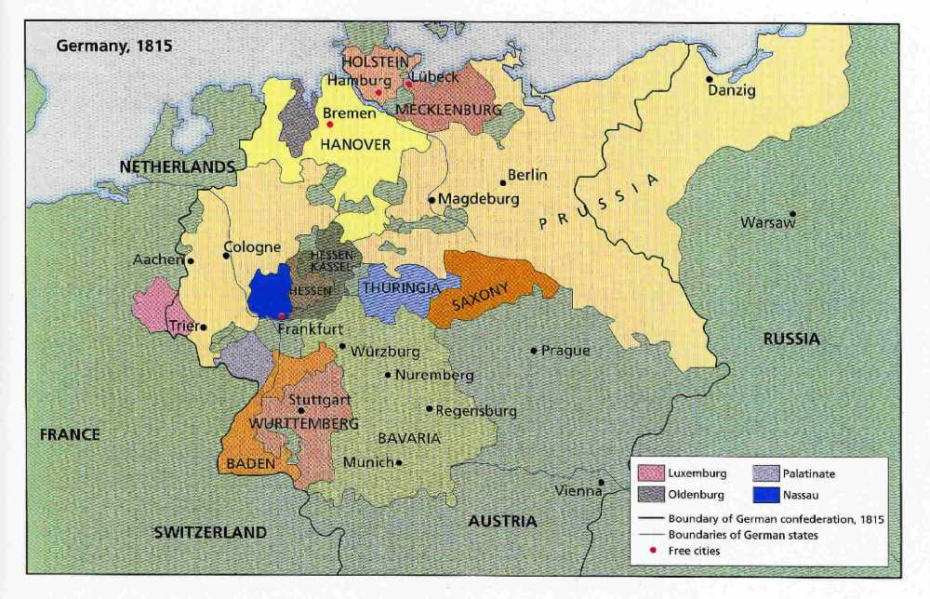
Uniting Germany
Germany was divided into different regions, each with its own government
Created a German “Confederation”
Zollverein
Removed tariffs between German States

Slide 38
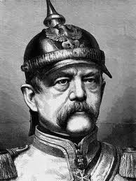
Otto von Bismarck
Bismarck started as German PM in 1862, and within a decade advanced to the position of Monarch, and united Germany
Blood and Iron

Slide 39
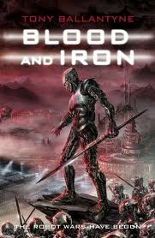
Blood and Iron
Bismark argued that the strength of a nation was determined not by its liberalism, but through blood and iron... might determined a society's worth

Slide 40
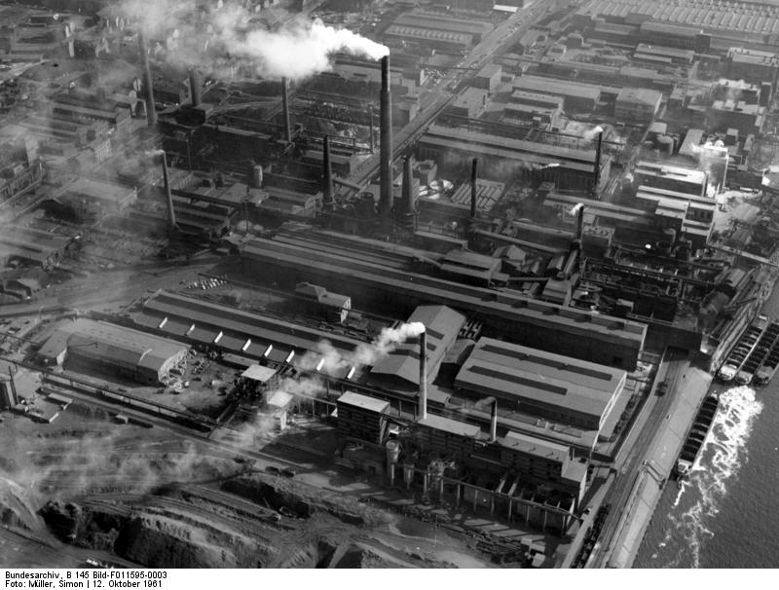
The right situation
Germany had multiple factors lending to its rapid progress
Huge stores of iron and coal
Large, educated middle class
Massive population increase

Slide 41
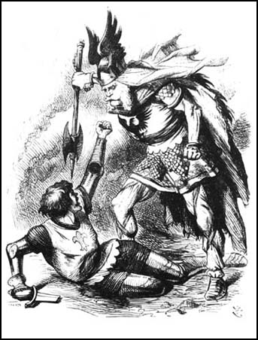
War with France
By 1870, the Germans were strong enough to wage war against France
Propaganda
By 1871, the Prussians had made their way to Paris

Slide 42
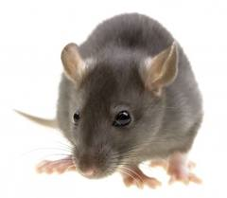
Foreign Policy
“Water rats do not fight with land rats”
Avoided conflict with Britain until competition for overseas colonies

Slide 43
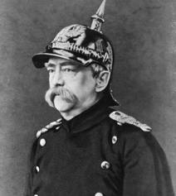
Domestic Policy
Had a distrust of the Catholics (1/3 of German Population)
State > Church
Growing socialist movement
Bismark had to give workers benefits
Pioneer of social reform

Slide 44
Kaiser William II
“There is only one master in the Reich”... sorry G-Pa
“My grandfather considered the office of king was a task that God had assigned to him... That which he thought I also think... Those who wish to aid me in that task, I welcome with all my heart; those who oppose me in this work I shall crush

Slide 45
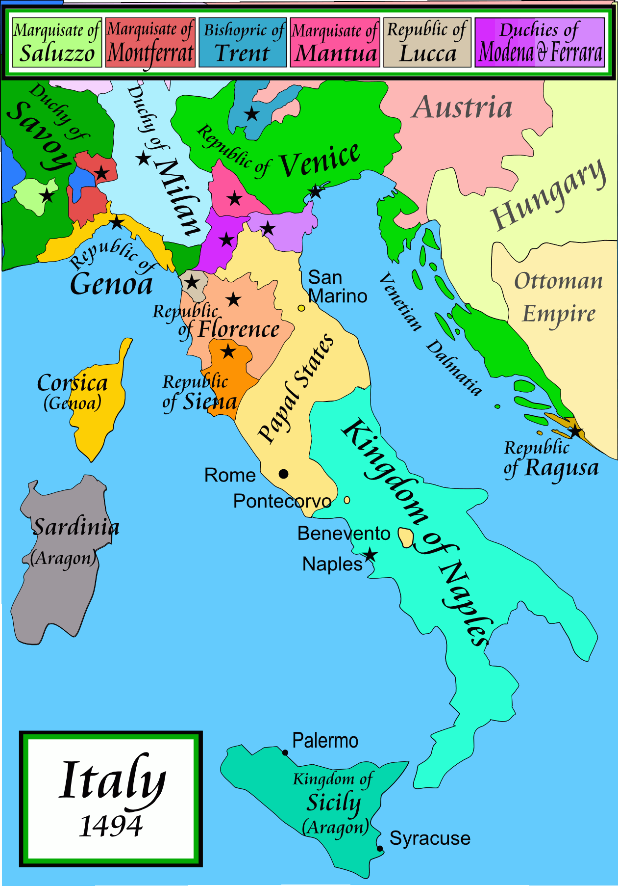
Italy as well
For centuries, Italy had been divided into a series of competing city states ruled by princes who frequently fought one another

Slide 46
Rule by Foreigners
Some states in Italy were dominated by foreign rulers... Hapsburgs, Bourbons, Austrians
These rulers worked hard to quell nationalist uprisings (1820-1848)

Slide 47
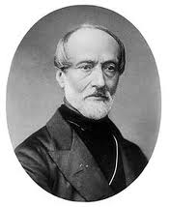
Guiseppe Mazzini
“Ideas grow quickly when watered by the blood of martyrs”
Nationalistic Leader who tried to start a rebellion in Rome in 1830s

Slide 48
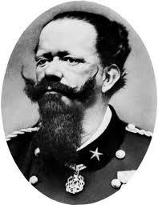
Unity Achieved
After numerous struggles and diplomatic moves, the regions of Italy were finally united in 1861, and Victor Emmanuel II was declared the King of Italy

Slide 49
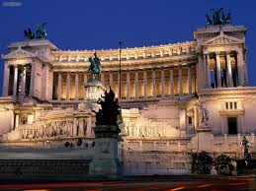

Slide 50
Difficulties with unification
The Italians had not been united since the Roman Empire, so there were rifts, especially between North and South

Slide 51
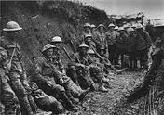
The War to End All Wars....

Slide 52
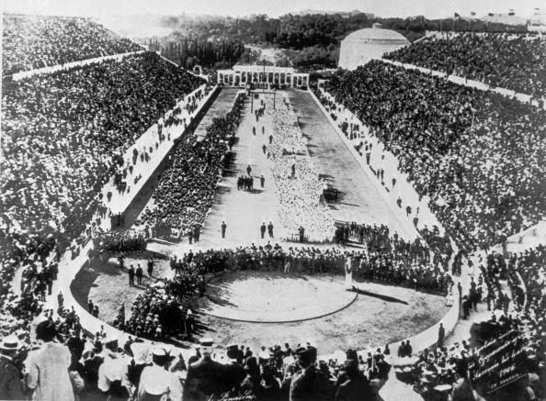
Europe in 1914
Except for wars of Unification, Europe had largely been at peace for almost a century
Olympic Games – 1896
Universal Conference on Peace – 1899

Slide 53
Differing Views
“The future belongs to peace”
French Economist Frederic Passy
“I shall not live to see the Great war, but you will see it, and it will start in the East”
Otto von Bismark

Slide 54
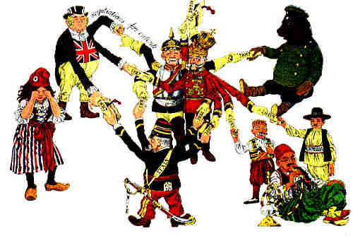
Reasons for the Great War 1- Alliance Systems
The European Powers distrusted one another
Allied with one another
Promote peace through massive threats

Slide 55
Reasons for the Great War 1- Alliance Systems
The Triple Alliance
Bismarck knew France would want revenge for Franco-Prussian War
Germany, Italy, Austria-Hungary
Don't ask about Italy...

Slide 56
Reasons for the Great War 1- Alliance Systems
The Triple Entente
Entente – a non-binding agreement to follow common policies
France-Russia (1893) -alliance
France-Britain (1904) - entente

Slide 57
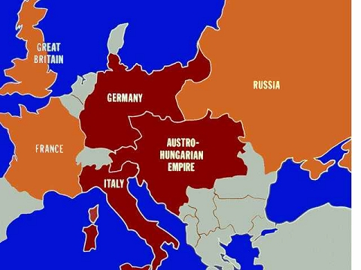
Reasons for the Great War 1- Alliance Systems

Slide 58
Rivalries and Nationalism
Austria-Hungary and the Ottomon Empire, two old empires, struggled to survive in the age of nationalism

Slide 59
Rivalries and Nationalism
England feared Germany... it had industrialize very quickly
Germany feared Russia. If it was able to industrialize, Russia had a massive pool of workers

Slide 60
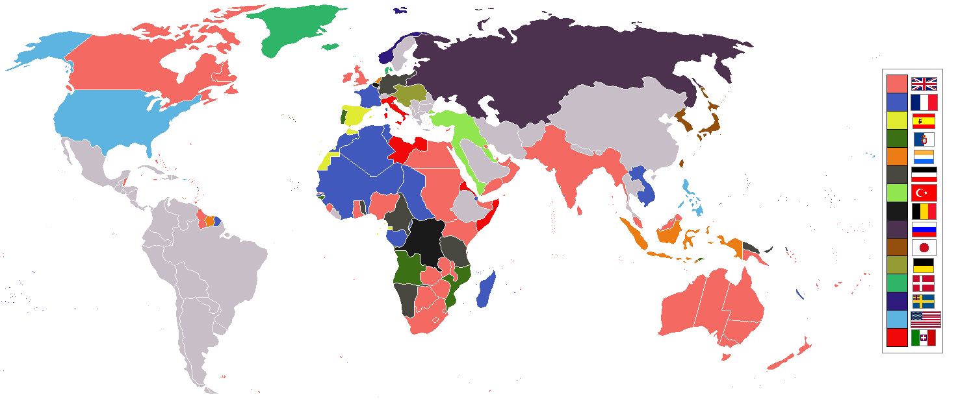
Empires

Slide 61
Competition overseas
France and Germany competed with one another for control of Morocco – 1905 and 1911, the two Moroccon Crises

Slide 62
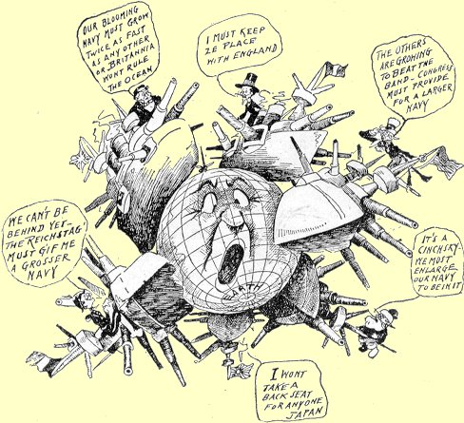
Arms Race

Slide 63
Building Militaries
Britain had a massive navy
Germany increased the size of it's navy... so
Britain's response?

Slide 64
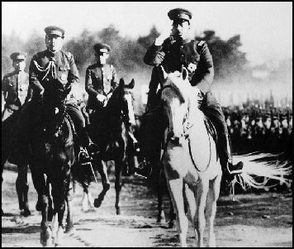
Militarism

Slide 65
Militarism
Militarism, the glorification of the military, excited young men about the prospects of war and courageous cavalry charges

Slide 66
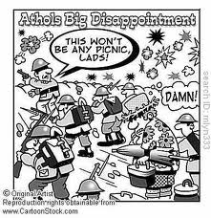
Militarism

Slide 67
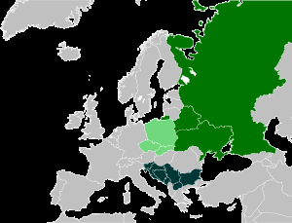
Nationalism Continues
Alsace and Lorraine
France bitter it lost this region in the Franco-Prussian War (1871)
Pan-Slavism
Russia's idea that all Slavic people should be United
Sebia

Slide 68
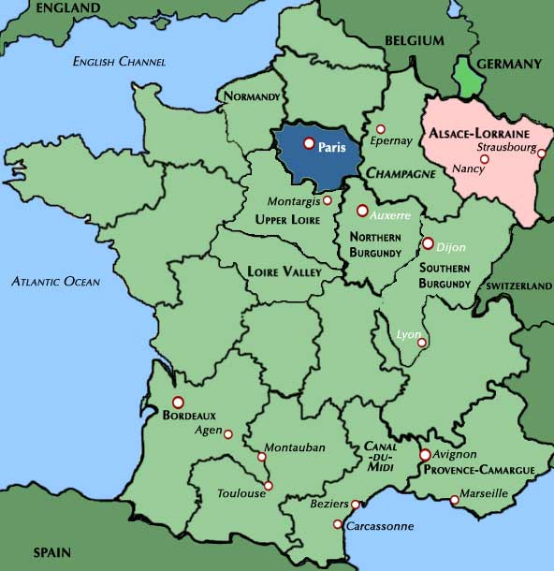
Alsace Lorraine

Slide 69
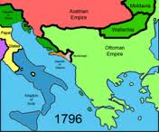
The Powder Keg of Europe
The Balkan States, in east Europe, attacked both Austria-Hungary and the Ottoman Empire, seizing Slavic land from the two empires

Slide 70
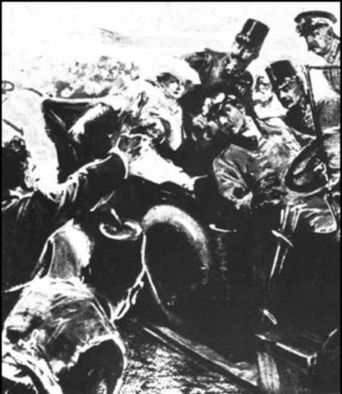
Archduke Francis Ferdinand The Austria-Hungary Heir
The Archduke of Austria-Hungary was on a visit to Sarajevo, Bosnia
A Serbian nationalist group, the Black Hand, assassinated the Archduke and his wife – June 28, 1914
1389- Serbia conquered (Ottoman)
1912 – Serbia gained freedom

Slide 71
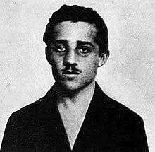
Gavrilo Princip

Slide 72
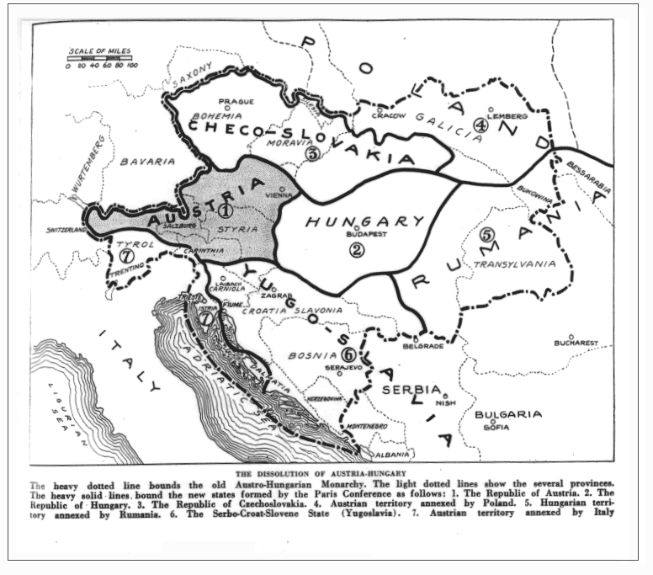
The Blank Check
Germany promised “unconditional support” to Austria to punish Serbia
The Ultimatum
A final set of demands

