Slide 1
Marriage and Common Law Marriage

Slide 2
Common Law Marriage
Agree to be married
Hold themselves out to the public as married
Live together as husband and wife
To end a common law marriage, the couple must divorce

Slide 3
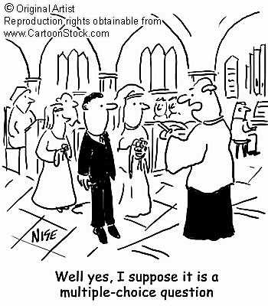
Marriage and the Law
Marriage has implications: personal, social, economic, legal and religious.
90% of all Americans marry.

Slide 4
Requirements for Marriage
A blood test for STDs (not required in Colorado).
A marriage license ($20 fee in Colorado).
A waiting period (none in Colorado).
A civil or religious ceremony.

Slide 5
Marriage is a Contract
Age: Both parties must be 18. Sixteen and seventeen year-olds may marry with parent permission.
You may not marry a close family member (parent, aunt, uncle, sibling). In Colorado, you may marry your first cousin.
Marriage is between two people. Marrying more than one person is bigamy.

Slide 6
Marriage is a Contract
Marriage is between a man and a woman. Same-sex marriages are traditionally not valid, although Massachusetts has same-sex marriage.
Marriage requires consent. No one can be forced to marry against his or her will.

Slide 7
Common Law Marriage
Common law marriage is a legally recognized marriage without a ceremony or license.
Requirements:
Live together as if married
Agree to be married
Hold yourselves out to the public as married

Slide 8
Annulment
An Annulment is a court order declaring that the marriage never existed. Reasons include:
Age—the couple was too young.
Bigamy—one spouse was already married.
Fraud—one spouse lied about an important matter.
Lack of consent—one spouse was forced to marry, drunk, or insane.

