Slide 1
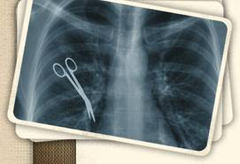
Negligence

Slide 2
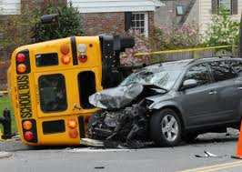
Negligence
Negligence results from conduct that creates an unreasonable risk of harm.

Slide 3
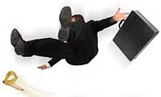
Elements of Negligence
A duty of care (there is usually not a duty to help—this is a moral obligation)
A breach of that duty
Causation
Actual damages

Slide 4
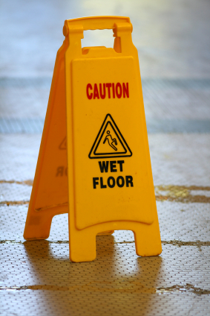
The Reasonable Person
The standard for negligence is based on an imaginary creature “the reasonable person of ordinary prudence or carefulness.”

Slide 5
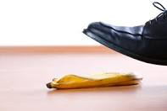
The Reasonable Person
The reasonable person considers
How likely a certain harm is to occur
How serious the harm would be
The burden involved in avoiding the harm

Slide 6
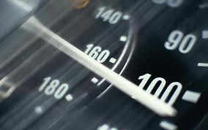
Violating the Law
Violating the law is automatically considered to be unreasonable.

Slide 7
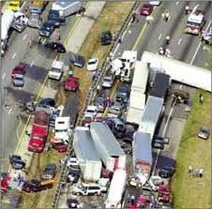
Two Kinds of Causation
Cause in fact—the harm would not have occurred without the harmful act.
Proximate cause—a close connection between the wrongful act and the harm that occurred. This issue is whether damage was foreseeable.

Slide 8
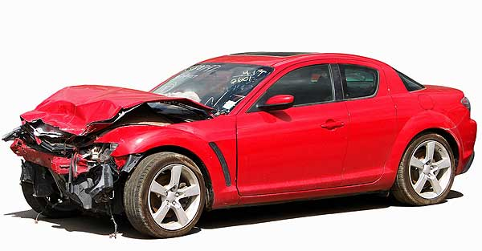
Damages
Damages in a negligence claim include hospital bills, lost wages, damage to property, reduced future earnings, and other economic harm.

Slide 9
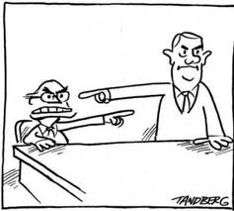
Defenses to Negligence
Contribution negligence—you cannot recover if your own negligence contributed to the damage.
An example is when a store employee warns a customer not to walk on an icy part of a sidewalk.

Slide 10
Defenses to Negligence
Comparative Negligence—some states reduce damages according to the degree each person is at fault.

Slide 11
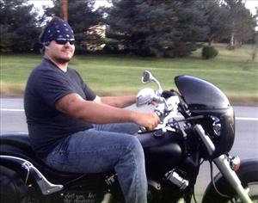
Defenses to Negligence
Assumption of the risk—a person voluntarily encounters a know danger and accepts the risk.
An example is attending a hockey game.

Slide 12
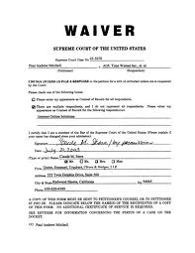
Defenses to Negligence
Waivers are signed documents releasing someone from liability.
They are valid if they are understandable.
They are not valid in the case of intentional torts.

