Slide 1
Parents and Children

Slide 2
Duties of Parents
Support—food, clothing, shelter, education, and medical care
Education—parents may be fined or arrested if their children do not attend school
Medical Care—Parental consent is required. Parents may be charged with neglect for failing to provide adequate medical care.

Slide 3
Duties of Parents
Care and Supervision—Parents may decide what is best. Young children may not be left alone.
Discipline—Parents may establish reasonable rules.

Slide 4
CHINS
Children who continually disobey their parents may be charged as status offenders (CHINS).

Slide 5
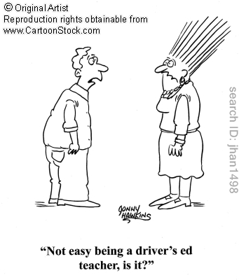
Parents’ Responsibility for A Child’s Actions
Parents may be held responsible if they aid or encourage improper conduct.
Parents may be charged with contributing to the delinquency of a minor.
The family car doctrine holds parents responsible for damage caused by any driver in the family.

