Slide 1
Post Bellum
Now that Rome has won, what is it to do…?

Slide 2
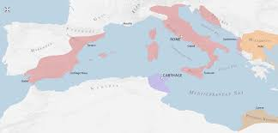
The End? Or the Beginning of the End
One would think that, after defeating the scariest enemy the Romans had ever faced, that Rome would relax
One would be wrong..
The victory over the Carthaginians ushered in a period of more expansion, wealth, and of course… internal turmoil

Slide 3
The Med
The Mediterannean was nicely divided, by the Adriatic, into two halves, a Roman West, and a Greek East
After the 2nd Punic War, the Romans owned the West…
Great Job Team

Slide 4
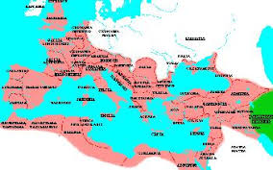
MORE MORE MORE
Naturally, they wanted the east as well.
SPOILER ALERT: The Romans were the first group to successfully conquer the entire Mediterranean Basin
Who was the next group to do so?

Slide 5
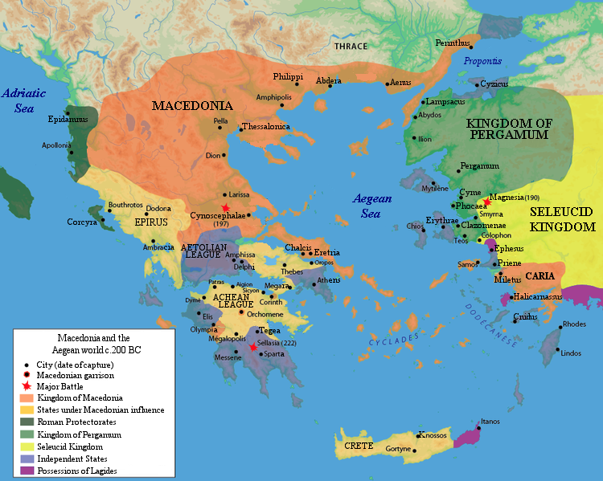
Potential Threats
The potential enemies came in the form of Kingdoms growing out of the former empire of Alexander the Great
Philip V – Macedonia
Antiochus – Syria (Seleucid)

Slide 6
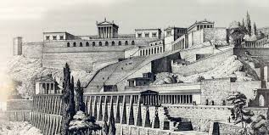
Egyptian Power Vacuum
Antiochus and Philip decided to split the former Egyptian Empire
A neighbor, Attalus in Pergamum, allied with Rome, got very nervous…

Slide 7
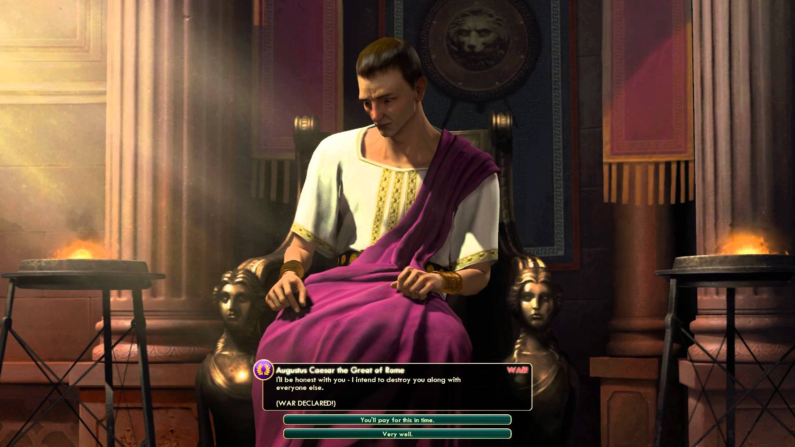
Pergamum asked Rome to step in 201 BC
Although initially unwilling to intervene, Rome was convinced by arguments about the high expense of future wars against a stronger Philip

Slide 8
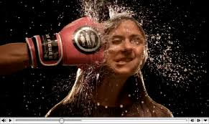
Hey Rome.. Shut Up
Philip thought that Rome dictating affairs in Greece was as ridiculous as him dictating affairs in Italy
To prove a point, he attacked Athens…
Smart…

Slide 9
JK… not smart
Rome issued an ultimatum, knowing Philip would reject it.
He saw their treaties as unfair, Rome didn’t care much…

Slide 10
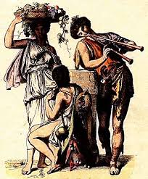
Two Year Stalemate
Titus Flamininus – Consul of 198, a lover of Greek culture, elected to the consulship
Gained Greek allies by arguing that he was a defender of Greece from a barbaric Macedonian warlord

Slide 11
To Fight, or not To Fight
That was Titus’ question
Didn’t want to lose command to new consul
Didn’t want to negotiate a weak treaty
Given a longer command… plenty of time to fight.

Slide 12
Battle of Cynoscephalae

Slide 13
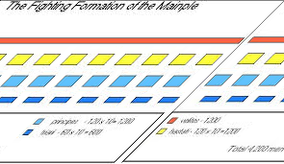
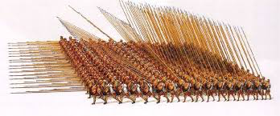
Rome is just better..
Maniple
Phalanx

Slide 14
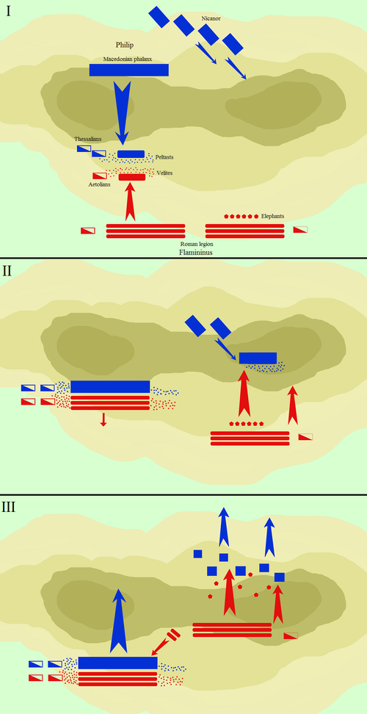
Battle of Cynoscephalae

Slide 15
Might and Savvy
After the destruction of Philip V, Flamininus announced that Rome had no desire to stay in Greece…
Greeks and Romans both thrilled by this
Expected continued loyalty

Slide 16
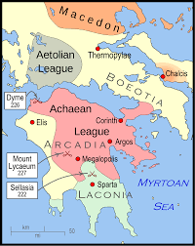
Aetolian League
Grumpy that they were not given command of Greece
Threatened to Ally with Sparta, against Rome
So Rome attacked Sparta

Slide 17
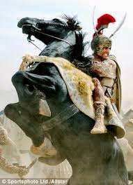
Liberator to Oppressor
Rather than being the people who had freed Greece from Macedonia, the Romans were conquerors

Slide 18
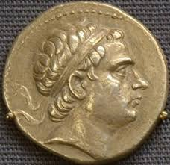
At the same time…
While the Romans were dealing with Sparta, Antiochus of Syria crept into the forefront
They had a dinner party during the negotiations. They were… awkward

Slide 19
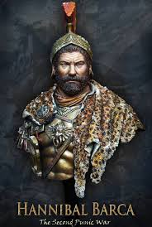
HANNIBAL IS BACK!!!

Slide 20
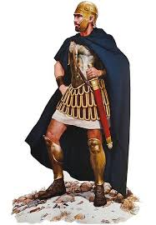
Hannibal had fled to Syria after the Second Punic war
Scipio Africanus was sent to negotiate with Syria…
Scipio to Hannibal… Who is the greatest General of all time?

Slide 21
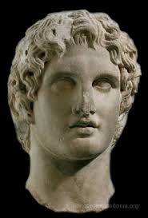
Alexander

Slide 22
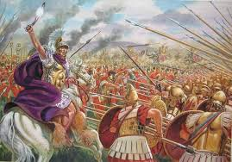
Pyrrhus

Slide 23
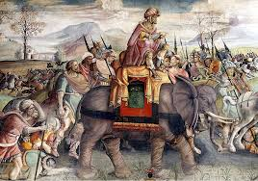
Hannibal

Slide 24
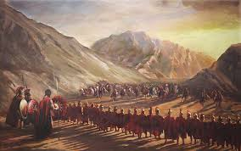
Showdown at Thermopylae
The 10,000 Syrians ended up choosing Thermopylae to fight the Romans.
It didn’t go well…
Rome led by “Cato the Elder”

Slide 25
Scipio Pursued
Antiochus and his army East
Despite a massive victory, Scipio was prosecuted for misusing funds
“Ungrateful Fatherland, you will not even have my bones” – Tomb In Campagna

Slide 26
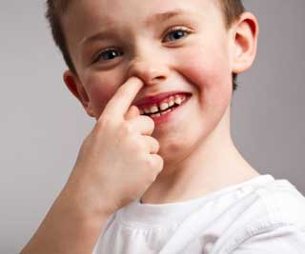
Third Macedonian War
Philip V Behaved himself, but when he died, his snot of a son Perseus took over
(After a little fratricide)
Began to Expand Macedonia again
Pergamum, again, asked for assistance

Slide 27
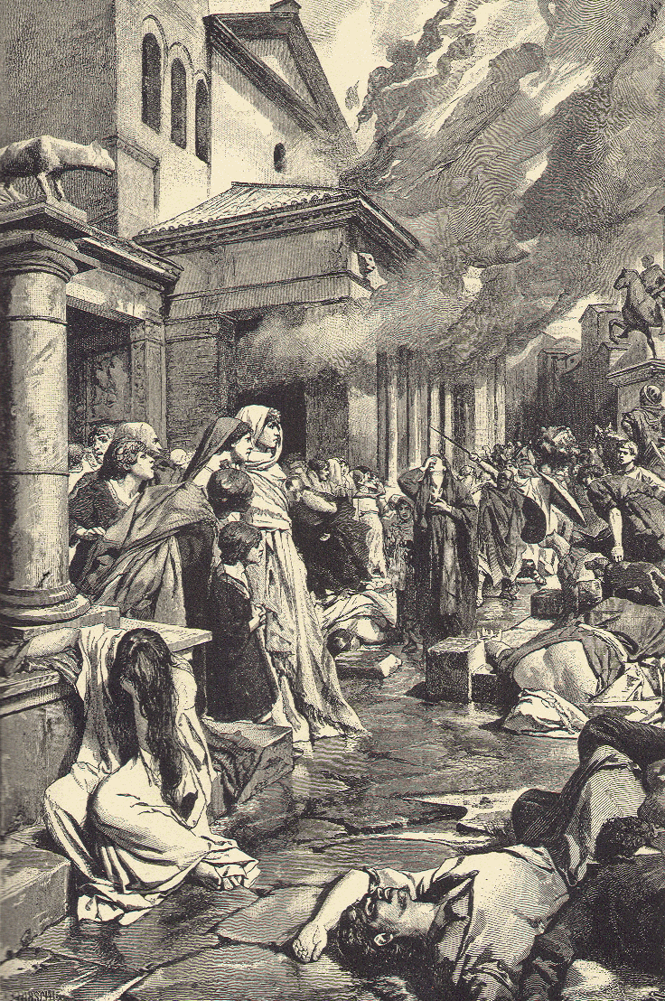
Third Time’s A Charm
Rome sent a small army, led by Marcus Licinius Crassus (not him, but almost him)
Small Roman army defeated by Macedon
Led to Greeks supporting Macedonia (DUM)
Large Roman army dispatched
Began destroying individual Greek towns

Slide 28
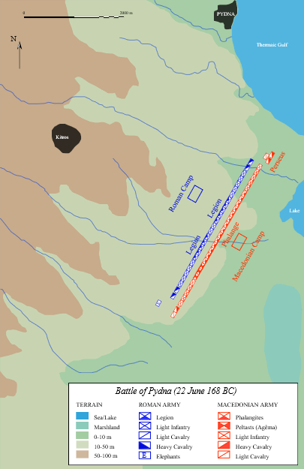
168 - Pydna
New Consul appointed
Paullus
Romans eventually forced battle outside the town of Pydna
Took play in a wide, flat valley.

Slide 29
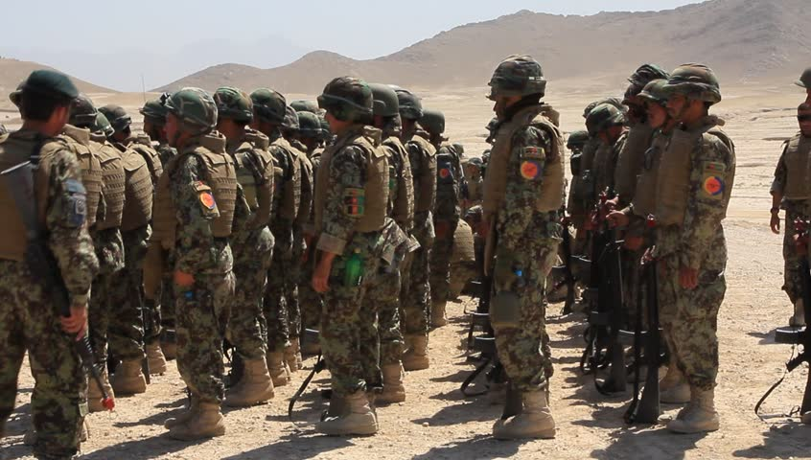
Paullus deployed troops in the morning, but delayed the battle until evening

Slide 30
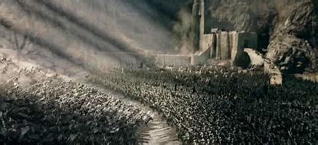
The Sun then set on the Macedonians
When the sun was in the Macedonians eyes, Paullus started the battle
Initially, Macedonians successful… Pushed the Romans up into the hills…

Slide 31
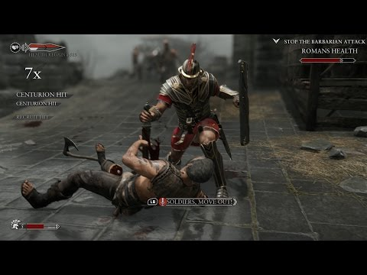
Roman Maniple Dominance
The Roman maniple wa far more effective in the hills, and destroyed the Macedonians
25,000 vs. 1000 KIA
Perseus dethroned, Macedonia ended

Slide 32
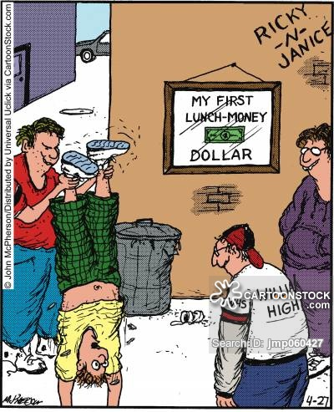
Paullus teaches a lesson
Paullus headed back to Italy through the Greek town of Epirus
He told the town to bribe him not to destroy their town…
They did

Slide 33
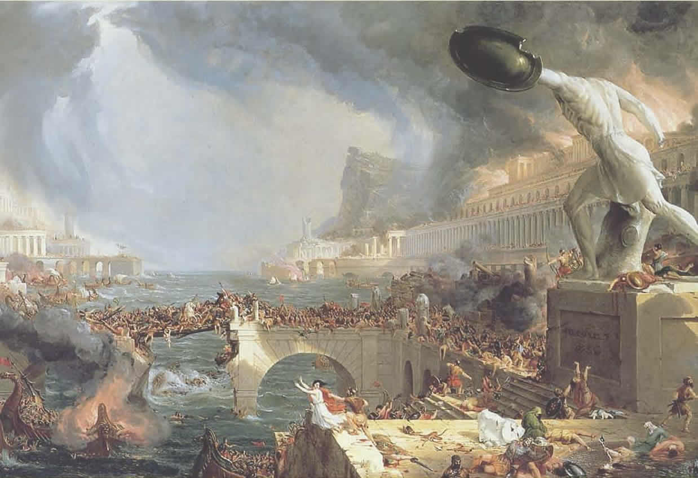
And then he destroyed the town

Slide 34
It is better to be feared, than loved

Slide 35
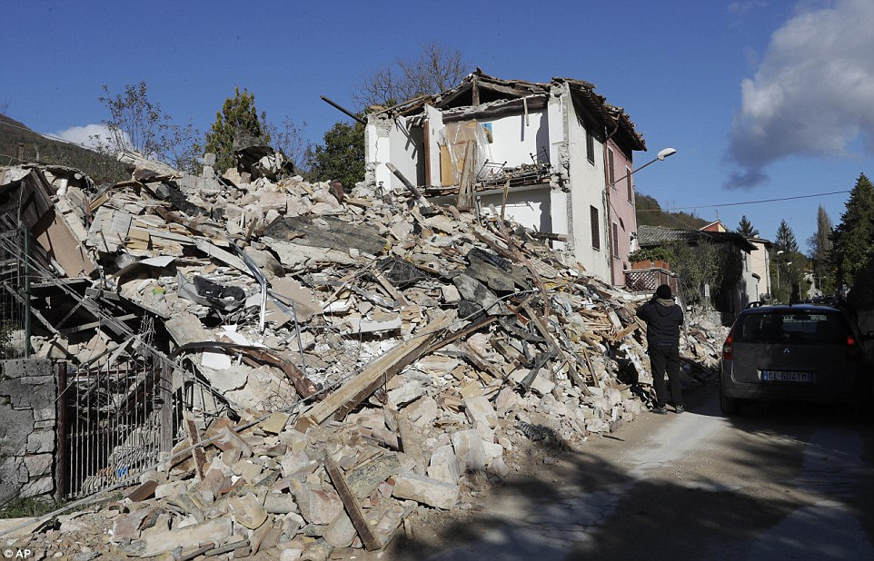
Post Pydna - 168
Most of Greece remained free, but decided to test Rome’s patience… dum
Macedonia tried to rise again
Metellus Macedonicus

Slide 36
Corinth… you idiots
Corinth, head of the Achaean League tried to defy Rome
Lucius Mummius Achaicus
146 BC – Corinth Destoryed

Slide 37
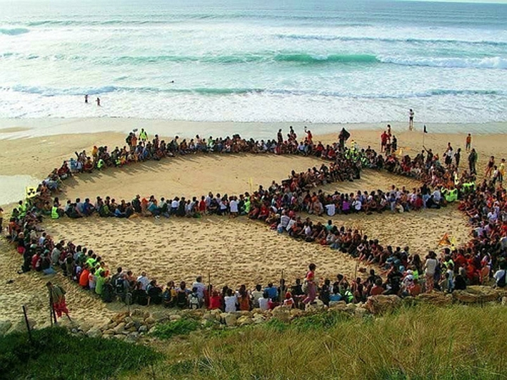
What about Carthage
Carthage, this entire time, was pretty much hanging out
They had returned to their roots as traders and were doing exactly that

Slide 38
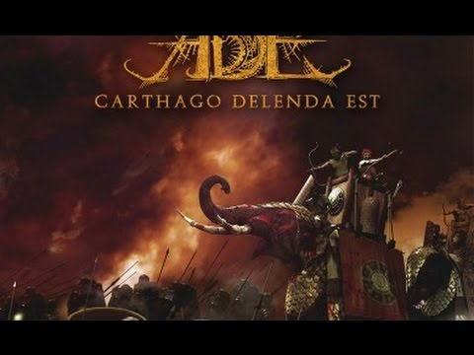
CARTHAGO DELENDA EST CTE

Slide 39
Huh?
Since the Second Punic War, Carthage had built up their economy, asked to give Rome all the money they owed them, and even tried to give the Romans free Grain

Slide 40
CARTHAGO DELENDA EST CTE

Slide 41
“sorry”
Under their peace treaty, Rome was obliged to protect Carthage, as Carthage was forbidden from having an army
Instead, the Romans encouraged the Numidians, from North Africa, to attack Carthaginian Towns

Slide 42
CARTHAGO DELENDA EST CTE

Slide 43
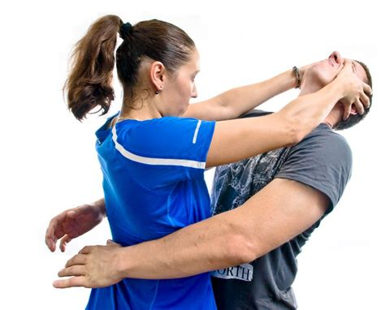
Cartharge Defended Herself

Slide 44
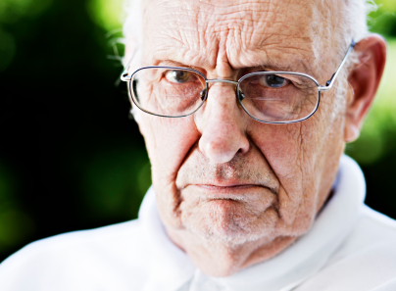
Rome Attacked

Slide 45
CARTHAGO DELENDA EST CTE

Slide 46
Roman Invasion
The Romans sent a large army to Carthage
Carthage immediately attempted to surrender
Move your city 10 miles inland…

Slide 47
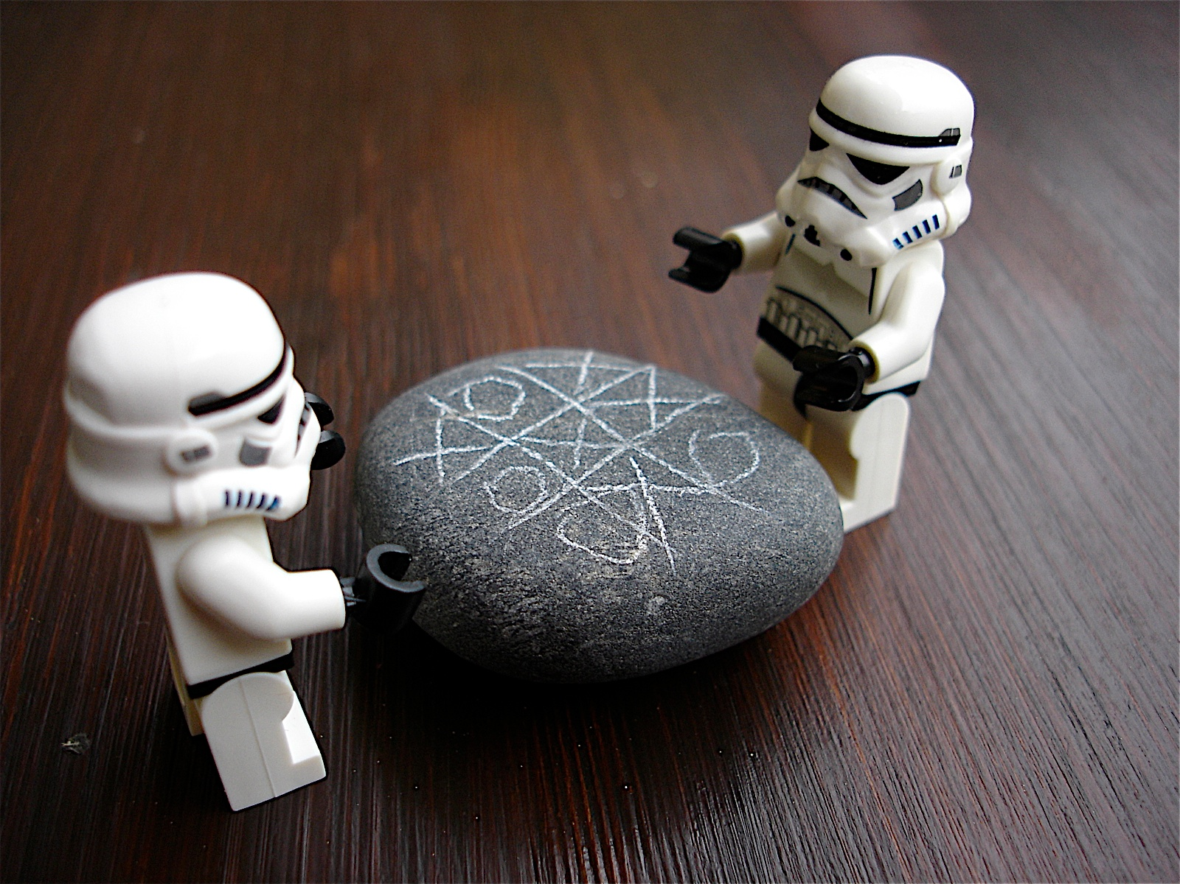
Carthage Besieged
For 2 years, the Romans besieged the Carthaginians
They finally figured out they would be unable to take the city until they got…

Slide 48
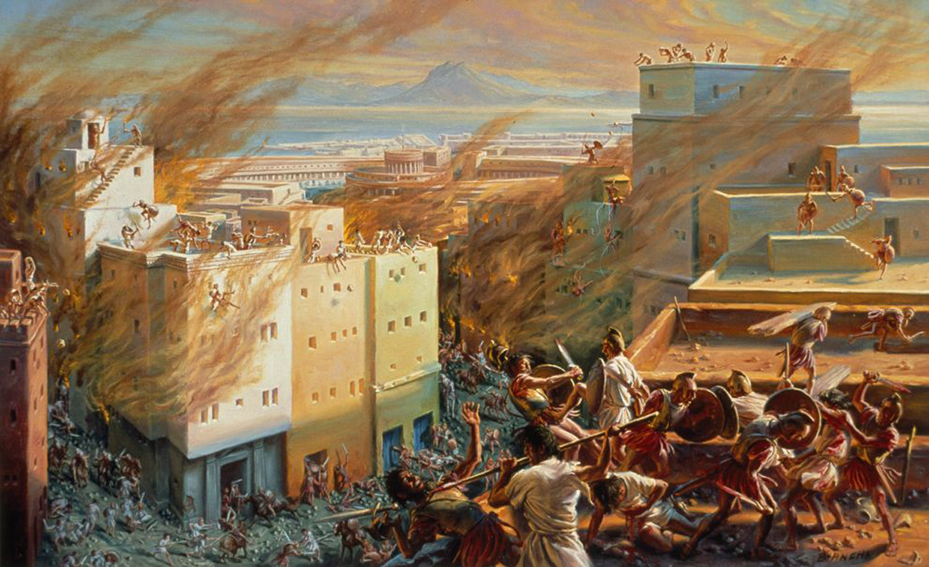
A SCIPIO!!!!!

Slide 49
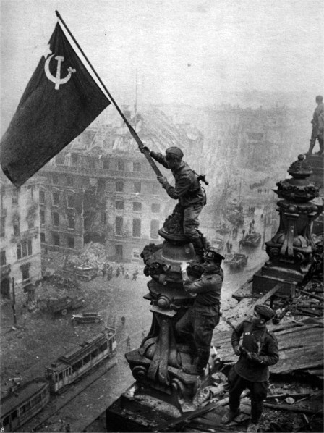
Scipio Aemilianus
Spring 146
Rome launched a full attack
6 days of street fighting
Carthage burnt to the ground
Rome ploughed salt into the earth

Slide 50
CARTHAGO DELENDA EST CTE

Slide 51
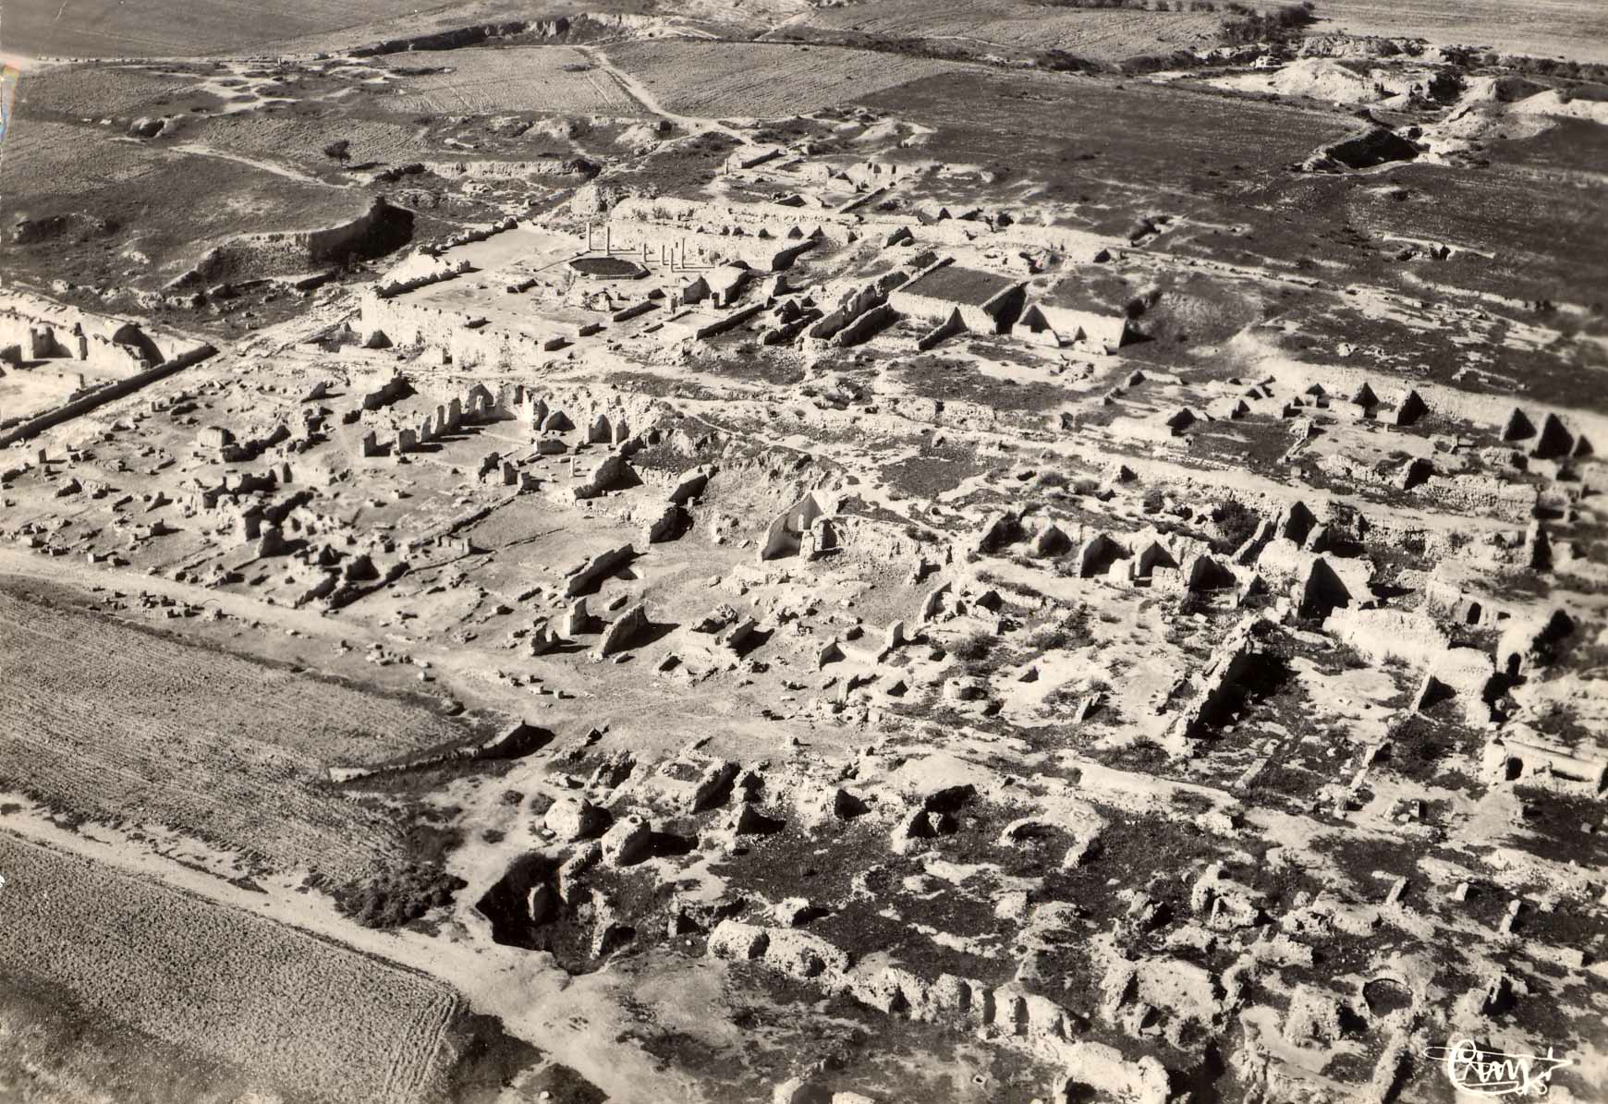
146 was a very good/bad year for Rome…

