Slide 1
The Right of Privacy

Slide 2
The Constitution
The Constitution creates penumbras (zones) of privacy.

Slide 3
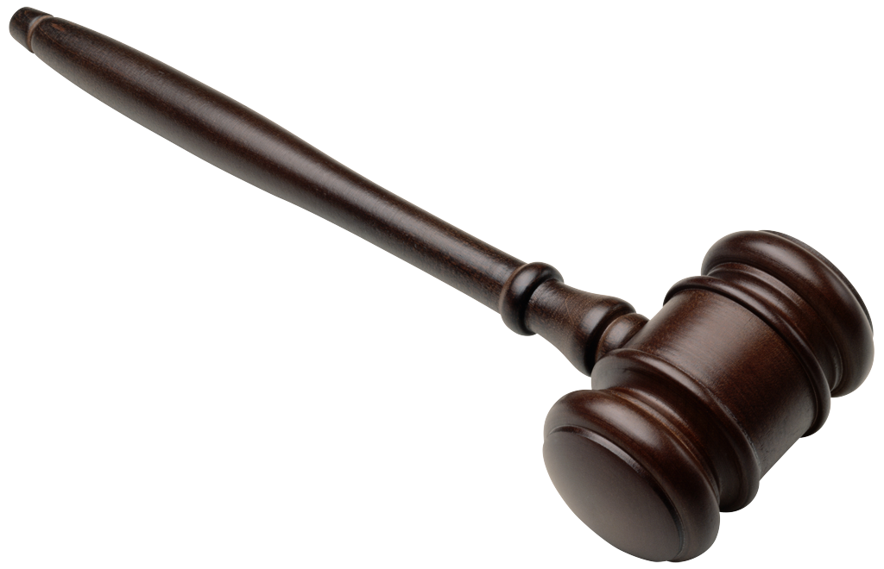
Privacy and Amendments
Although privacy is not mentioned in the Constitution, this right stems from the several constitutional amendments.

Slide 4
Privacy and Amendments
First (speech and association)
Fourth (freedom from unreasonable search and seizure)
Third (freedom from quartering of soldiers)
Ninth (unspecified rights)
The fundamental right of substantive due process

Slide 5
Conflicting Rights
The right of privacy sometimes conflicts with important government interests

Slide 6
Privacy and Conflicting Interests
Gathering information needed to solve crimes
Determining eligibility for government programs
Notifying the public of sex offenders
Preventing terrorism

Slide 7
Privacy at Home
In general, a warrant is required before authorities may search a home.
Homosexual behavior among consenting adults in their own home is a protected privacy right.

Slide 8
Privacy at School
Privacy at school exists, but the right is more limited.
Desks and lockers can be searched, because they belong to the school.
Schools may search other student property with a “reasonable suspicion of wrongdoing.”
Students who are 18 have the right to see their high school and college records.
Parents have a right to see students’ records.

Slide 9
Information Gathering
The right of privacy does not protect checks or deposit slips.
The Privacy Act of 1974 prevents the unauthorized release of medical, financial, criminal, and employment records.
In general, the privacy of work and school computers (including folders and emails) is not protected.

Slide 10
Abortion
In Roe v Wade (1973), the Court held that there is a fundamental, but not absolute, right to an abortion. No state interference is allowed during the first trimester. States may regulate safety during the second trimester. States may ban abortion during the third trimester.

Slide 11
Abortion
States may not require spousal consent.
States may require parental consent and impose a waiting period.
States are not required to pay for abortions for poor women.

