Slide 1
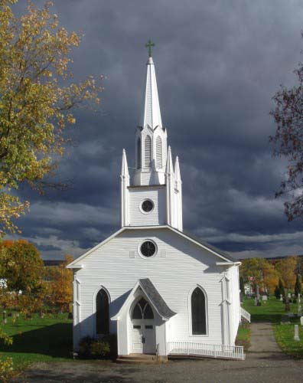
Freedom of Religion

Slide 2
First Amendment
The First Amendment contains two clauses dealing with religion: The Establishment Clause and the Free Exercise Clause.

Slide 3
The Establishment Clause
Forbids state and federal governments from setting up churches, or favoring one religion over another.
Creates a “wall of separation” (Thomas Jefferson) between church and state, but this is not complete.
The endorsement test is used to determine whether a law or government action endorsed religion in the eyes of the community.

Slide 4
The Establishment Clause
The Supreme Court uses a 3-pronged test to determine whether the clause has been violated:
Does the law have a secular purpose?
Does the law’s primary effect advance or inhibit religion?
Does the law foster excessive entanglement between government and religion?

Slide 5
School Prayer
In Engel v. Vitale (1962), the Court ruled that school-sponsored prayer violated the Establishment Clause.

Slide 6
The Free Exercise Clause
Protects an individual’s right to worship however they choose.
As a rule, religious beliefs are protected.
Actions based on those beliefs may be restricted if they conflict with an important government interest (polygamy, use of peyote by Native Americans).

Slide 7
The Balancing Test
Sometimes, the Establishment Clause conflicts with the Free Exercise Clause (student groups who want to pray at school). These cases are decided using a balancing test.

