Slide 1
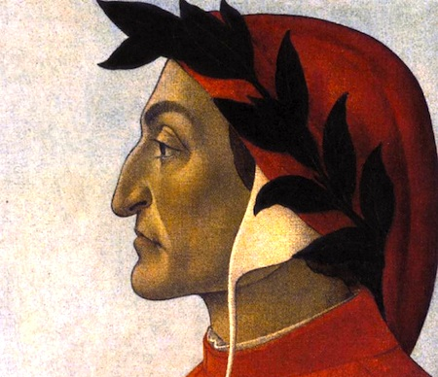
Dante Alighieri

Slide 2
Literature
In addition to artistic developments, literature also evolved during the Renaissance. Dante Alighieri wrote The Divine Comedy(1308-1321) , a poem that mirrored the Roman Aeneid. It was one of the first Renaissance books, and was written in the vulgar, Tuscan dialect.

Slide 3
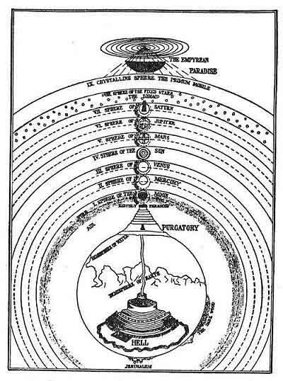

Slide 4
Dante's combination of Renaissance political thinking with religious undertones marked an important transition in literature.

Slide 5
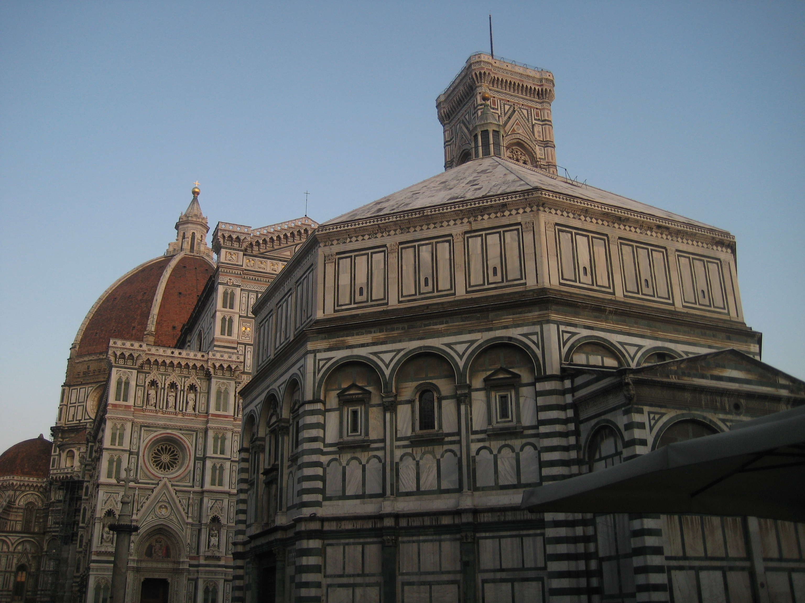
The Renaissance!

Slide 6
Rebirth!
The Renaissance was a period of cultural revival. During this time, literature, art, and philosophy rose once again to the prominent spot they had held in ancient cultures

Slide 7
Trade → Wealth → Spending!
The trade that developed during the High Middle Ages led to increased wealth. The Tuscan city Florence experienced rapid economic growth. This, coupled by its Republican roots led to Florence's central role in the Italian Renaissance.

Slide 8
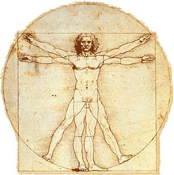
What is the Renaissance?

Slide 9
The Renaissance “isms” These are words that help describe the foci (focuses) and schools of thought in the Renaissance. Keep these in mind throughout the Unit

Slide 10
Humanism
Humanism put an emphasis on the abilities and beauty of humanity. Rather than being focused only on living a life that would get them to heaven, people during the Renaissance began to focus on what they could accomplish during their time on Earth

Slide 11
Individualism
A new definition of man emerged from humanist studies - man the measure of all things, master of his own destiny - worthy in & of himself-not just as part of the Great Chain of Being.

Slide 12
Secularism
Focus on this world - separate from spiritual world Involvement in civic affairs - civic humanism Individual credit for achievement - in arts etc. Curiosity about geographic limits Awareness of manners and morals Interest and involvement in intellectual, aesthetic and athletic endeavors

Slide 13
Rationalism
the beginnings of the scientific revolution. Observable data being gradually accumulated/recorded - waiting for new theories on the physical world. New emphasis on science would lead to advances in technology

Slide 14
Classicism
Interest in the Classical World Search for authentic sources Importance of Latin and Greek among the educated

Slide 15
Realism
A movement in art to achieve a realistic portrayal of of humans and the natural world. Experimentation with media and a quest to understand function thereby better representing form took place

Slide 16
Consumerism
Growing demand for consumable/possessable goods by many in expanding middle class, nobles, even high church officials.

Slide 17
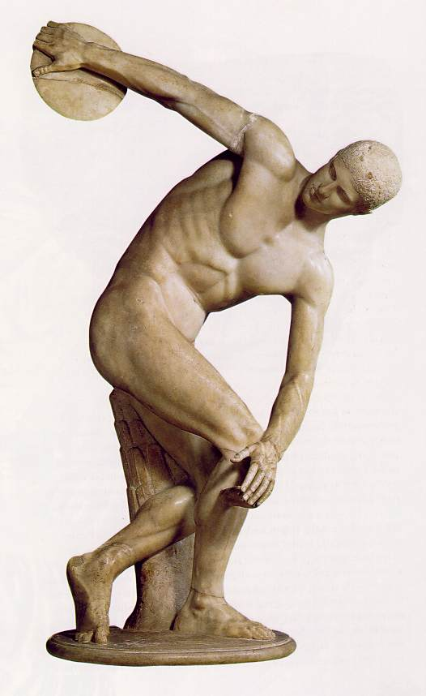
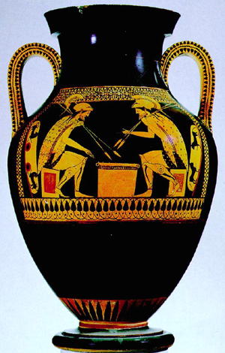
What can we learn from the ancients?
Art

Slide 18
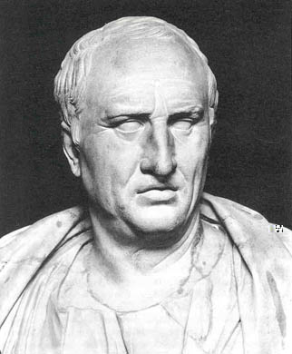
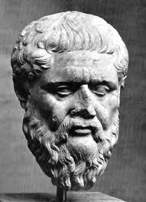
Politics and Philosophy

Slide 19
Revival of the Humanities
Grammar
Rhetoric
Poetry

Slide 20
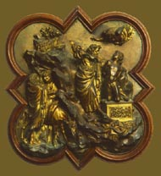
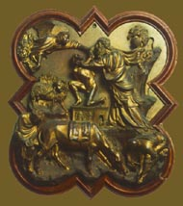
Competition to Kick Things Off
Ghiberti
Brunelleschi

Slide 23
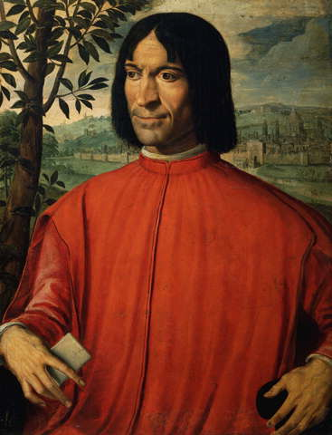
The Medici
Patrons of the Art
The Medici earned most of their money by being bankers. Through their massive wealth, they became the Renaissance’s most important “Patrons”

Slide 24
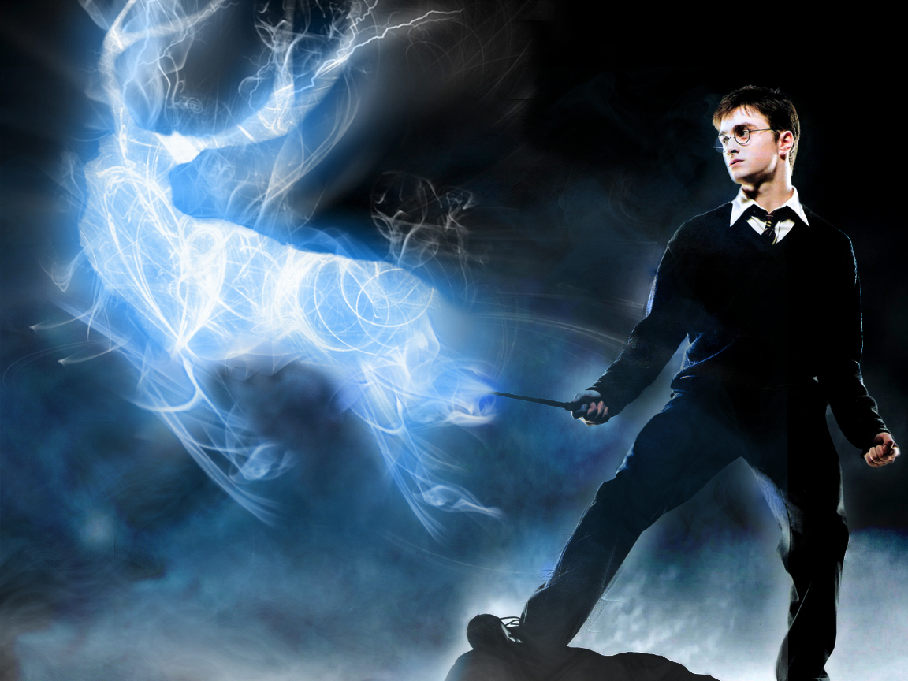
Patrons
A Patron is a supporter, generally financially, of a cause, organization, or activity

Slide 25
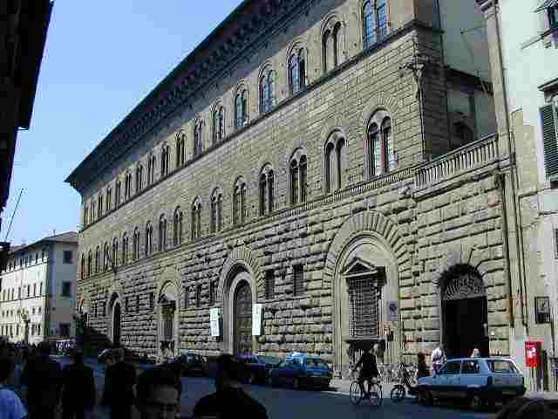
Palazzo Medici

Slide 26
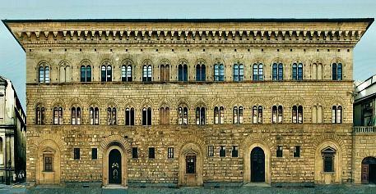

Slide 27
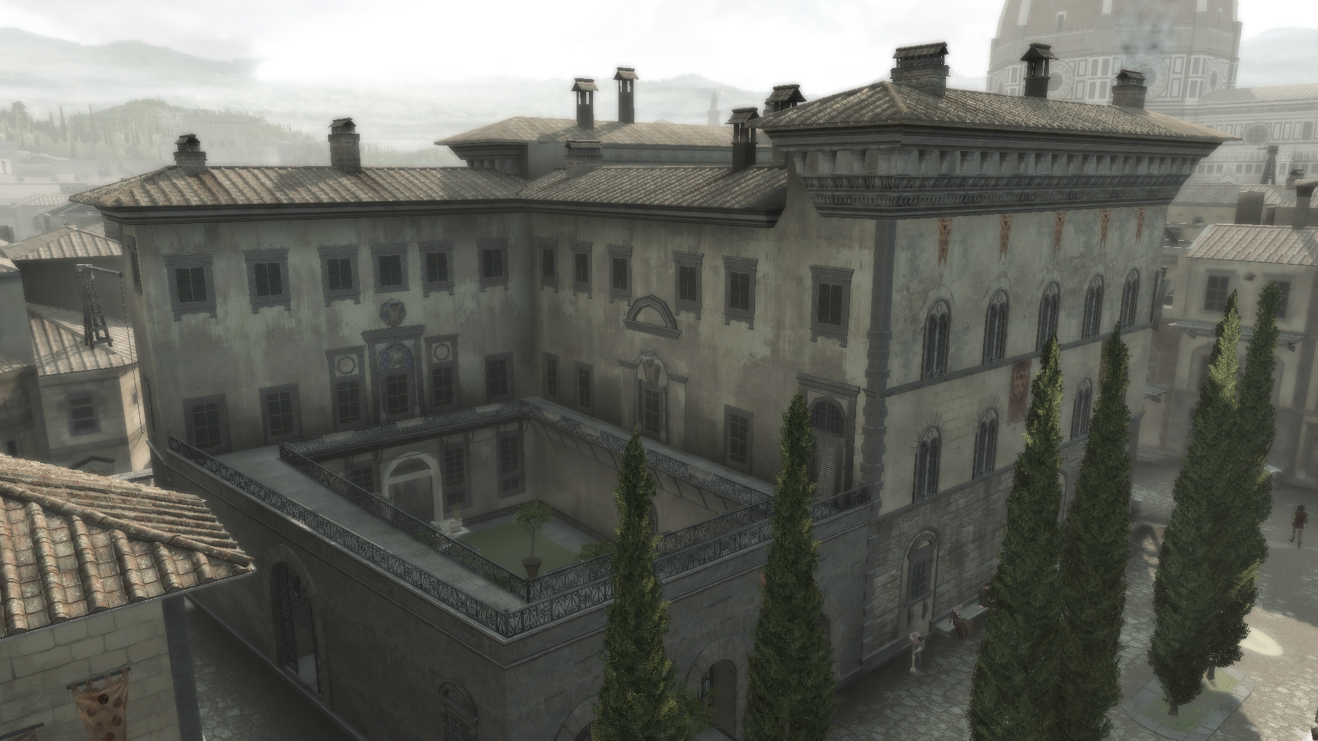

Slide 28
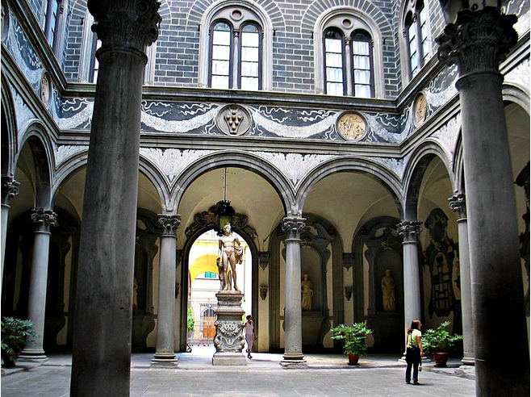

Slide 29
The Medici commissioned Donatello to create this statue of David. They placed it in the center of the courtyard at their Palazzo Medici where the figure was supposed to remind visitors of the Medici power. He was the first free standing nude bronze since antiquity

Slide 30
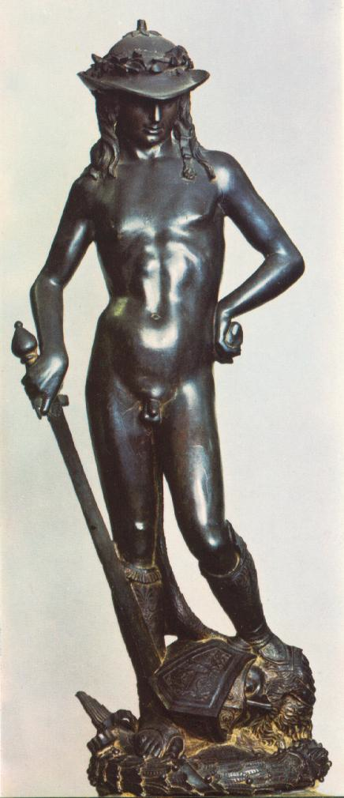
Donato di Niccolo di Betto Bardi
The Bronze David
Circa 1440

Slide 31
Governmental Influences
Florence, one of the many city states in Italy, was a Republic, but came under the rule of the wealthy Medici family (1434-1494)
Lorenzo de' Medici supported the arts, artists, philosophers, and public events

Slide 32
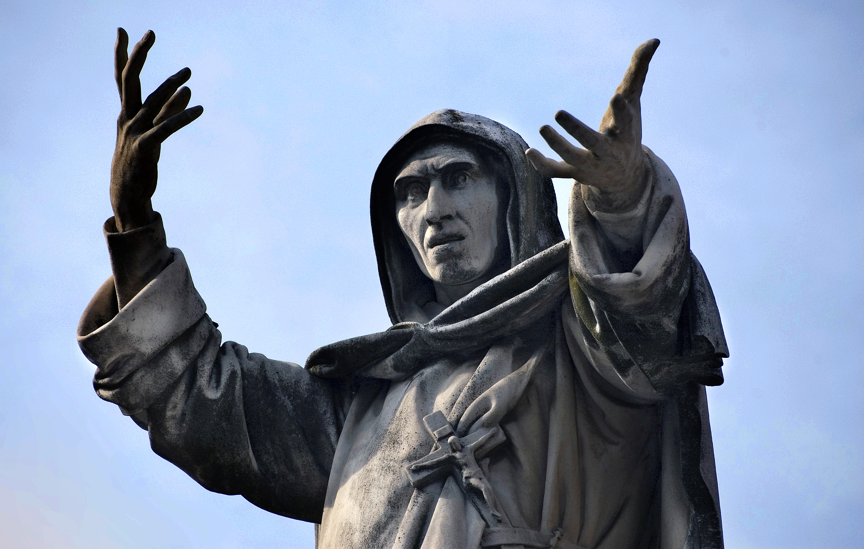
The Medici Exiled
The Medici were exiled from 1494-1512.
Girolamo Savornarola

Slide 33
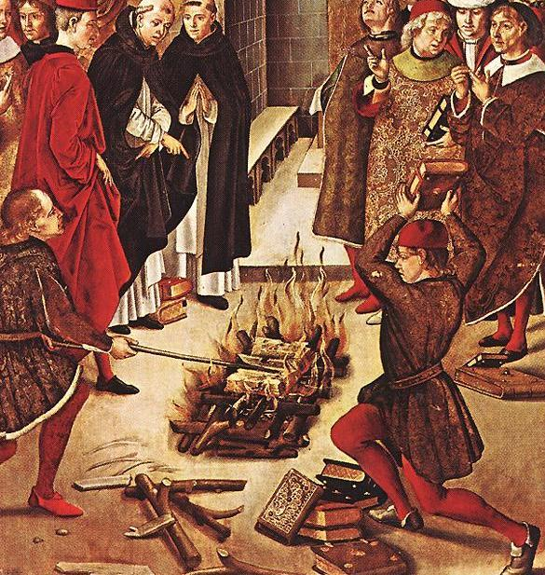
Bonfire of the Vanities vs. Bonfire of Savornarola

Slide 34
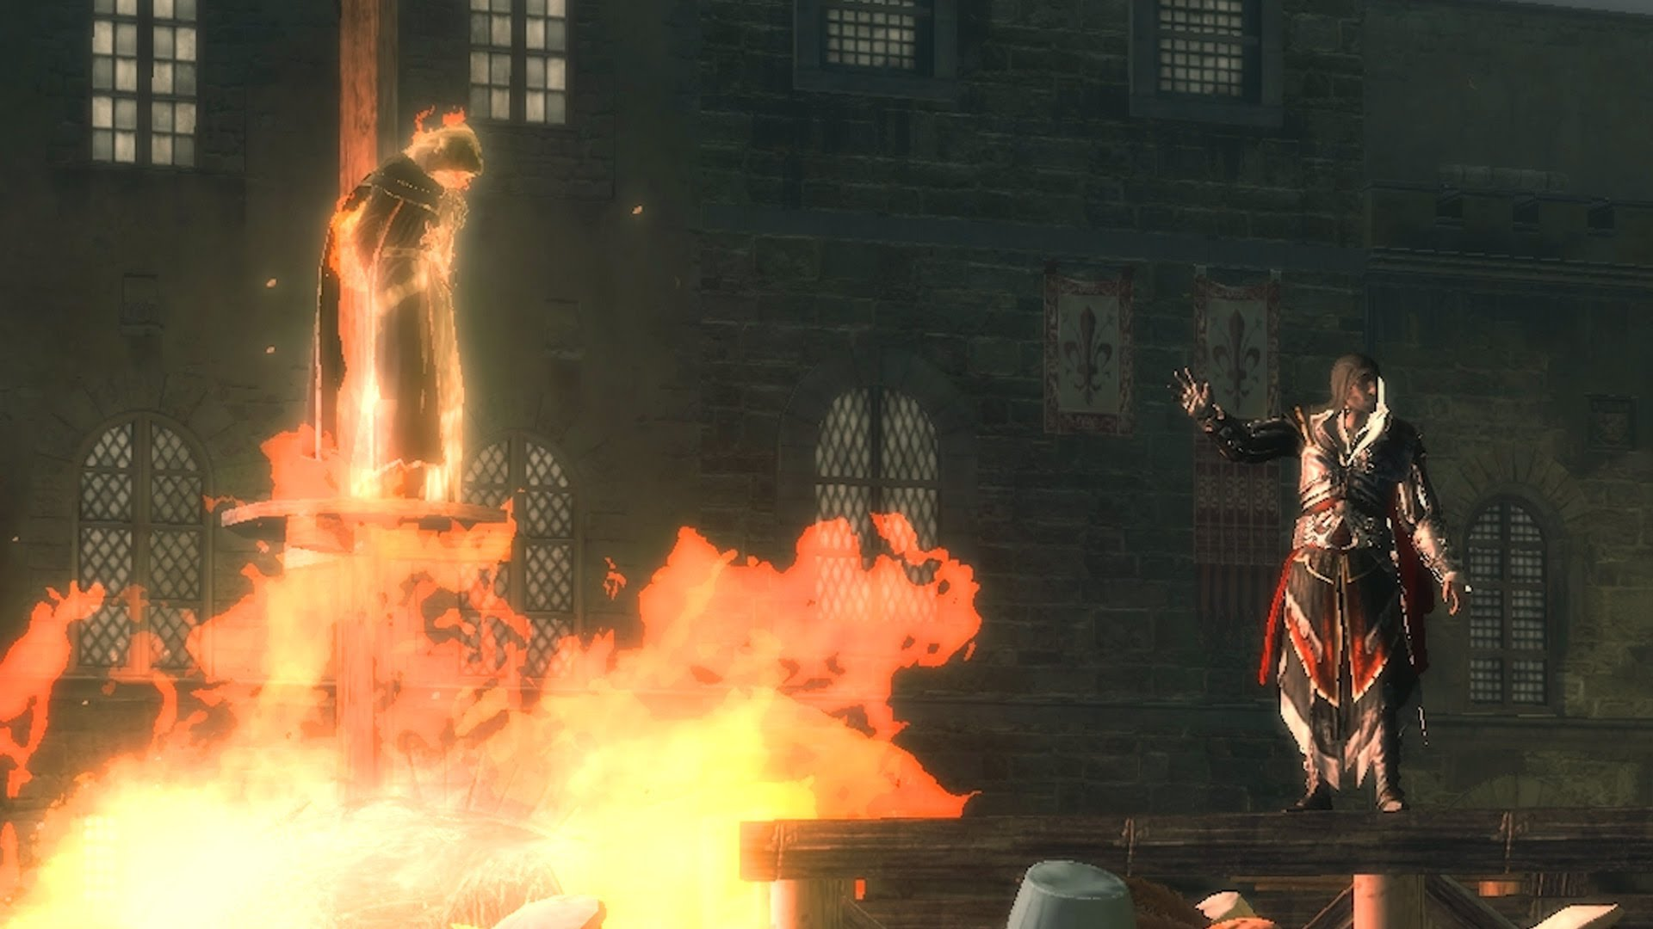

Slide 35
Medici Return
When the Medici returned, they asked a diplomat, Niccolo Machiavelli, to help them understand the politics of Renaissance Florence
.... oh. After they had tortured him of course

Slide 36
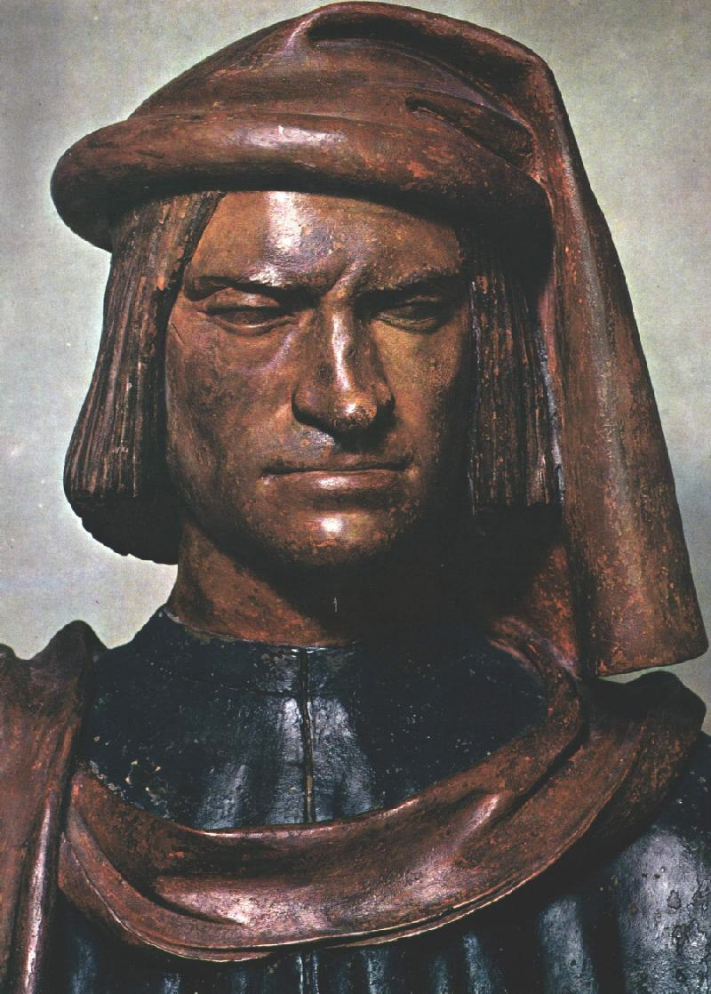

Slide 37
The Prince
Machiavelli stressed ruthlessness
The ends justify the means
Use whatever means is necessary
“How praiseworthy is it for a prince to keep his word and live with integrity rather than craftiness, everyone understands, yet... those princes have accomplished most who paid little heed to keeping their promises, but who knew how craftily to manipulate the minds of men.”

Slide 38
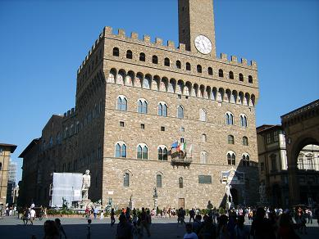
Palazzo Vecchio

Slide 39
Michelangelo's David, completed between 1501 and 1504, was commissioned by the Florentine Republic. It was supposed to represent the defense of the Republic FROM the Medici who had recently been kicked out of Florence

Slide 40
Did anyone get to see the David when it came to America? Unfortunately, after its trip here, it will never be the same....

Slide 41
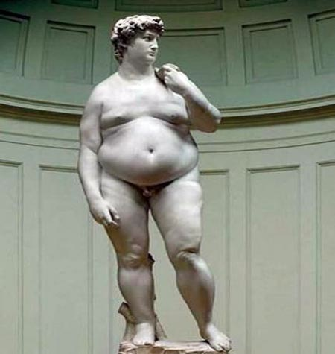

Slide 42
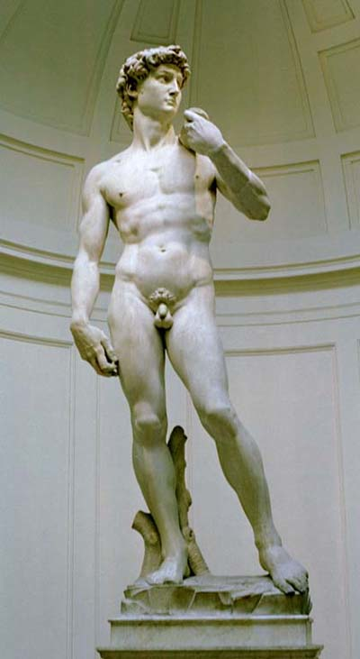
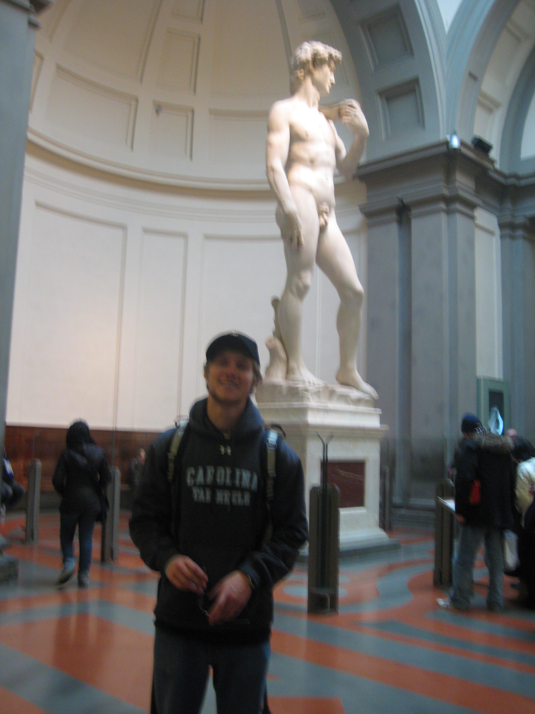
The David
1501-1504
Michelangelo di Lodovico Muonarroti Simoni

Slide 43
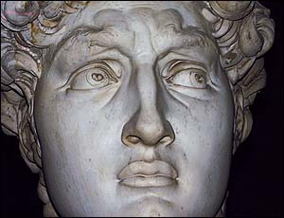

Slide 44
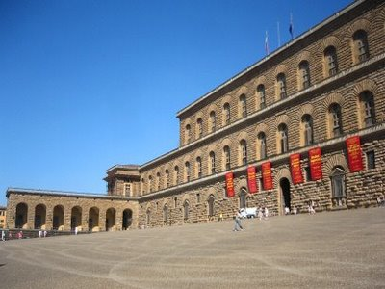
Palazzo Pitti

Slide 45
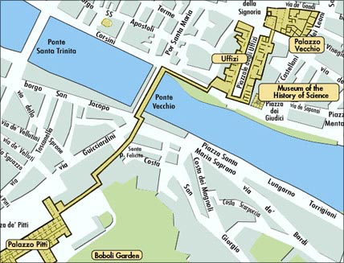

Slide 46
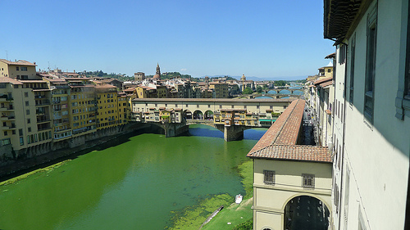

Slide 47
Political Writings

Slide 48
One of the driving forces behind the spread of literature was the printing press, invented by Johannes Gutenberg in 1456

Slide 49
Thomas More (English) – Utopia (1516)
Machiavelli (Italian) – The Prince (1532)
William Shakespeare (English) (1564-1616)

Slide 50
“It is safer to be feared than loved”

Slide 51
Under the commission of Pope Julius II, Michelangelo was commissioned to pain the ceiling of the Sistine Chapel. He decorated it with scenes from Genesis. Michelangelo painted using the fresco style: a slow, but permanent process

Slide 52
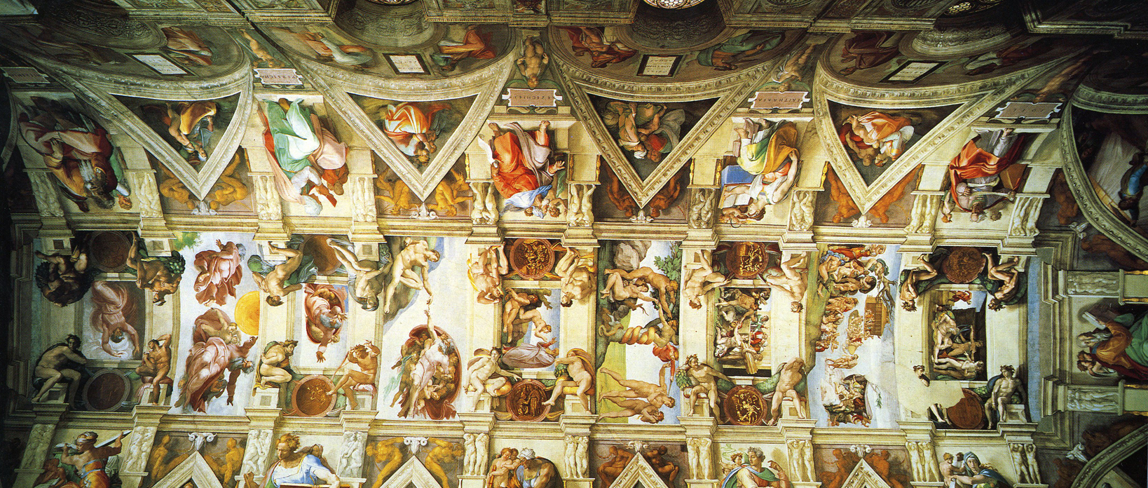
The Sistine Chapel
1508-1512

Slide 53
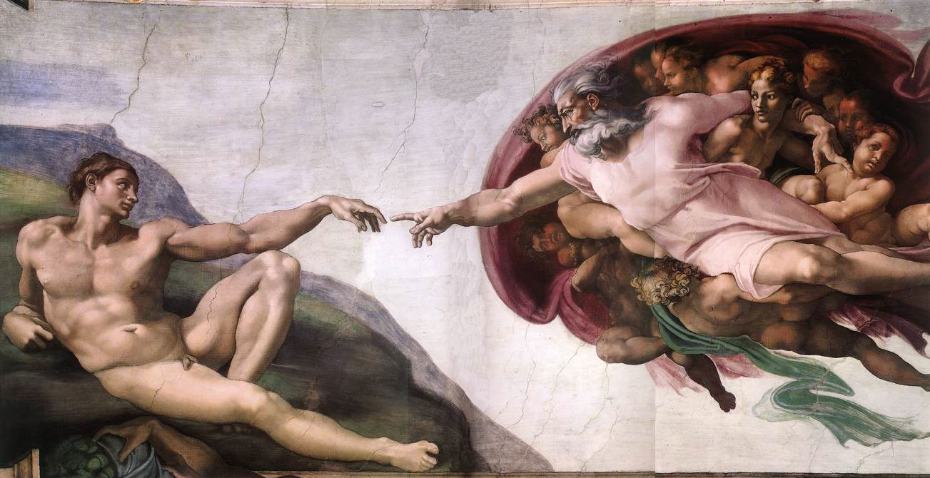
The Creation of Adam

Slide 54
Rafael painted the school of Athens for the Pope Julius II. It is also located in the Vatican The fresco took over a year for Rafael to complete, though when he did, the work embodied the Renaissance in so many ways.

Slide 55
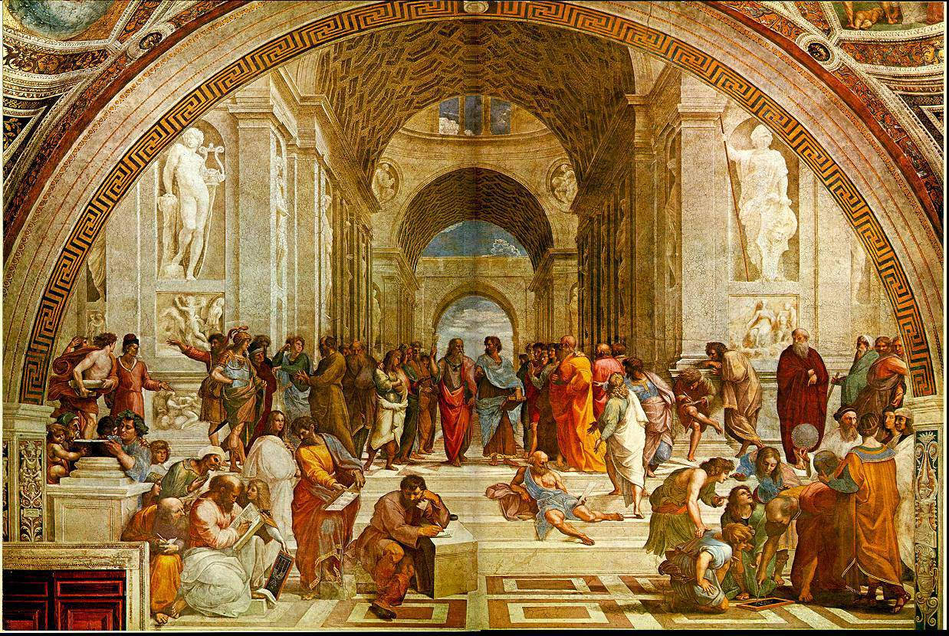
The School of Athens
Raffaello Sanzio da Urbino 1509-1510

Slide 56
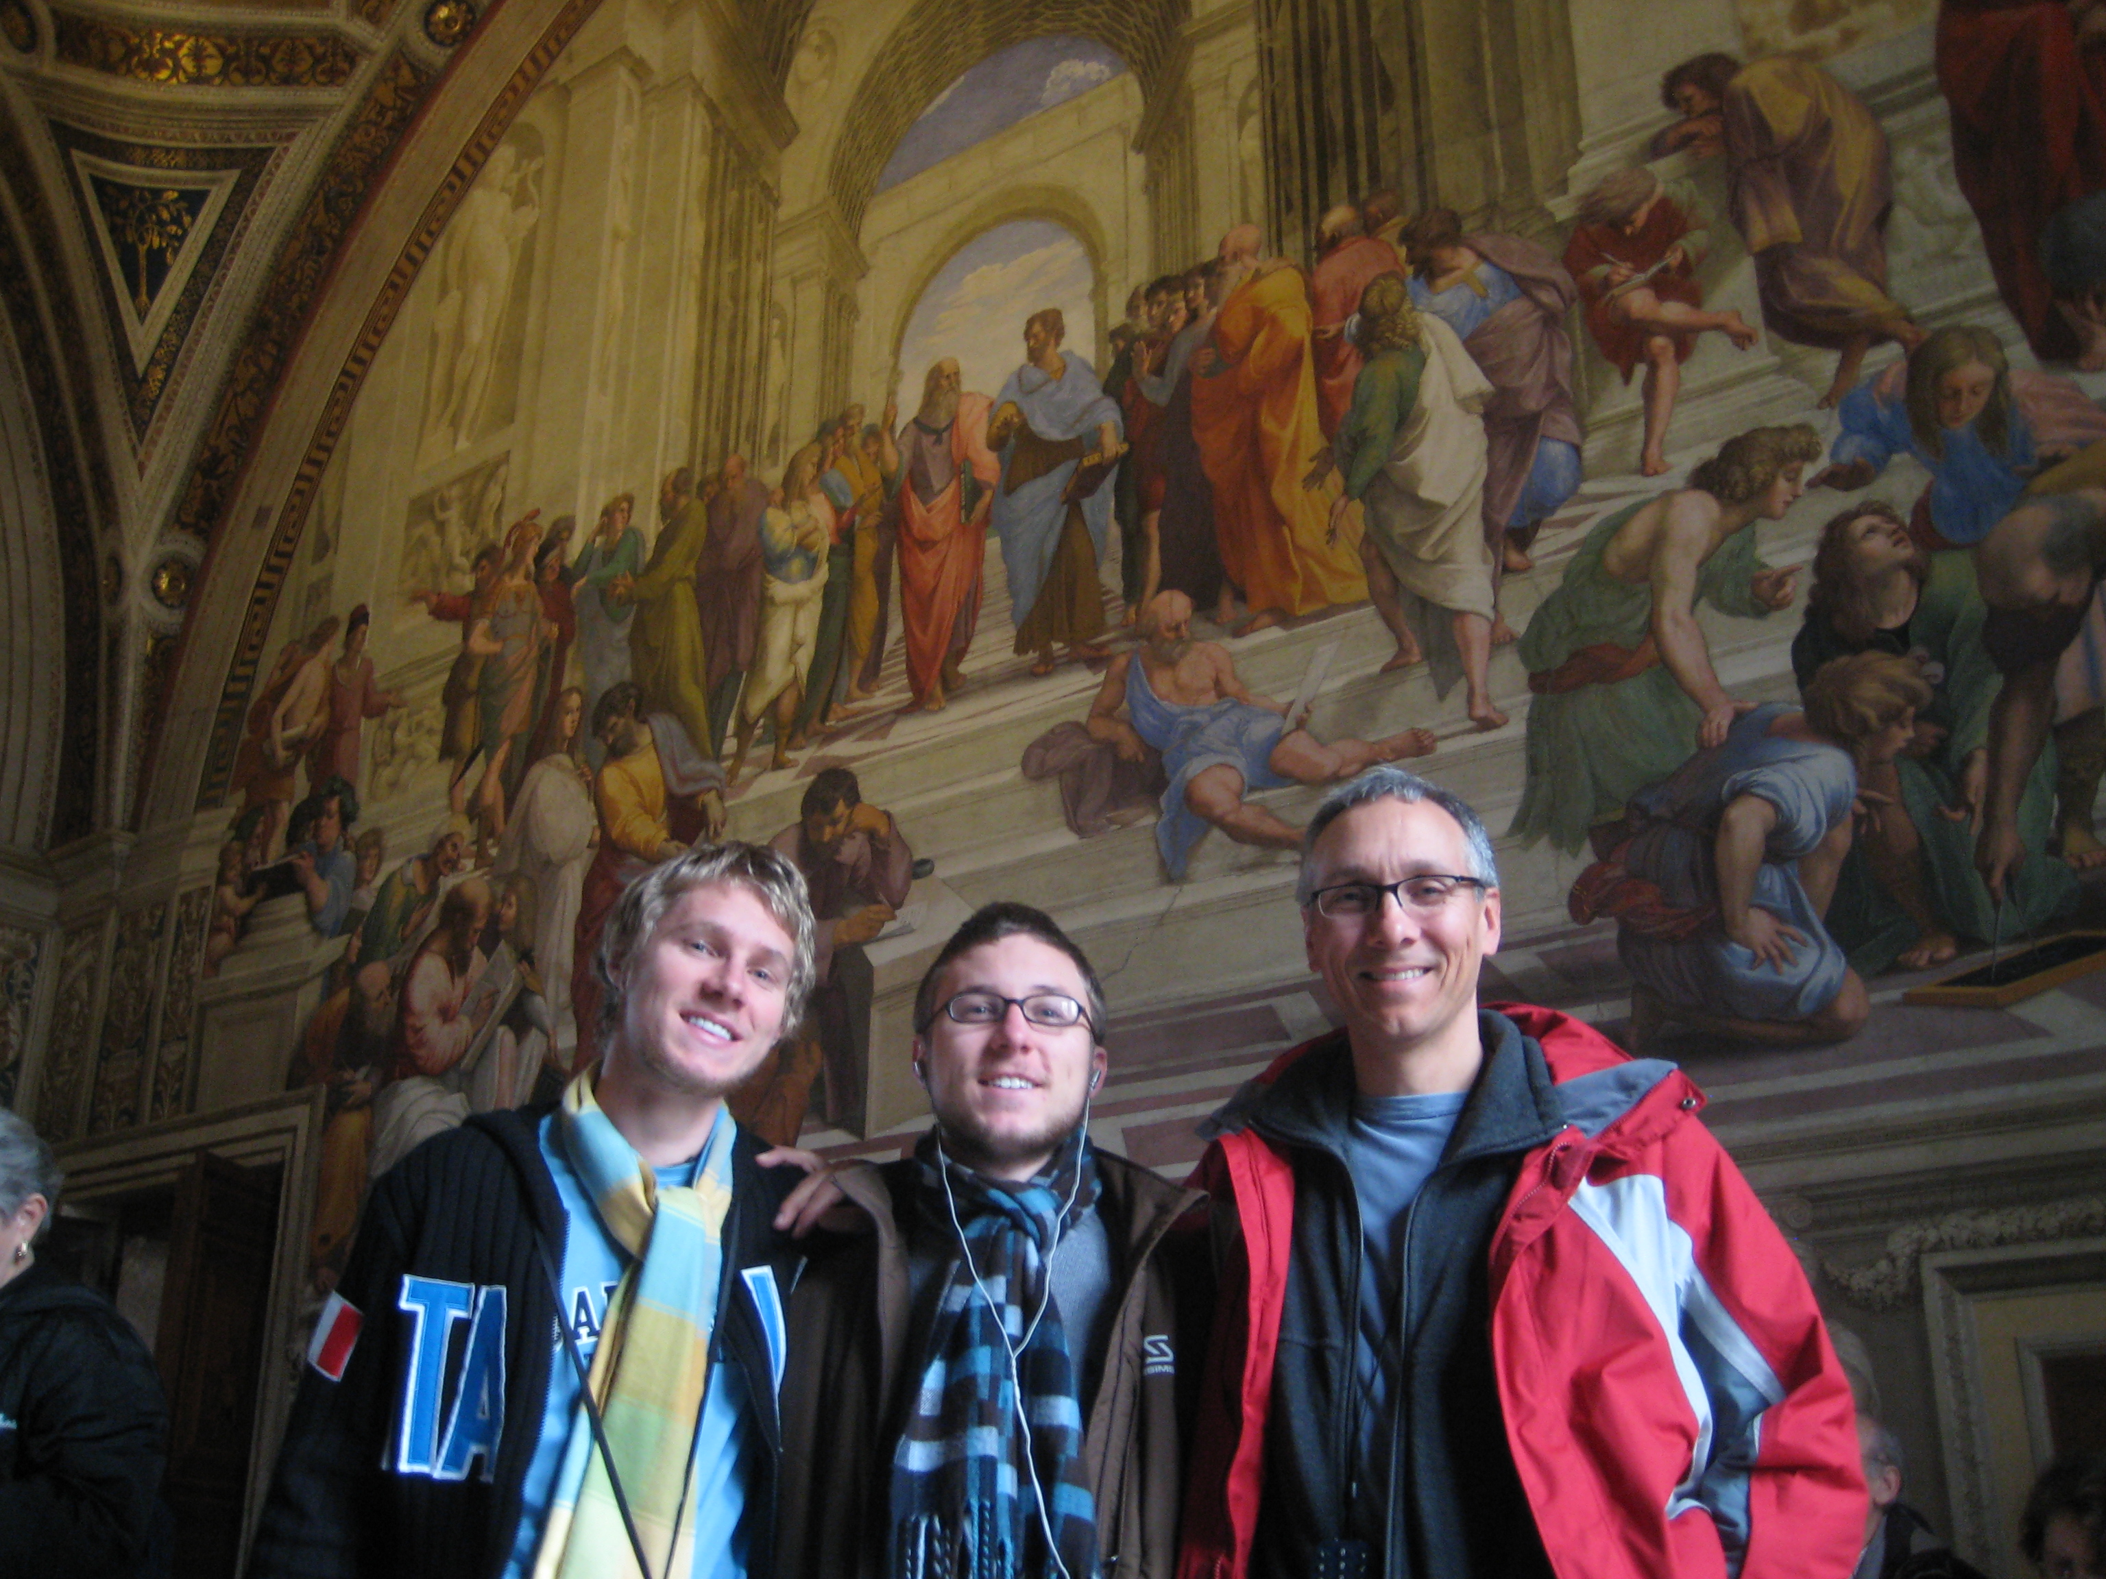

Slide 57
Sandro Botticelli was commissioned by the Medici to produce a number of the most beautiful paintings ever produced to decorate one of their mansions. The “Birth of Venus” shows the goddess of love emerging from the sea after a violent episode

Slide 58
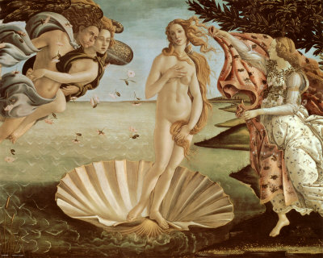
The Birth of Venus
Sandro Botticelli 1486

Slide 59
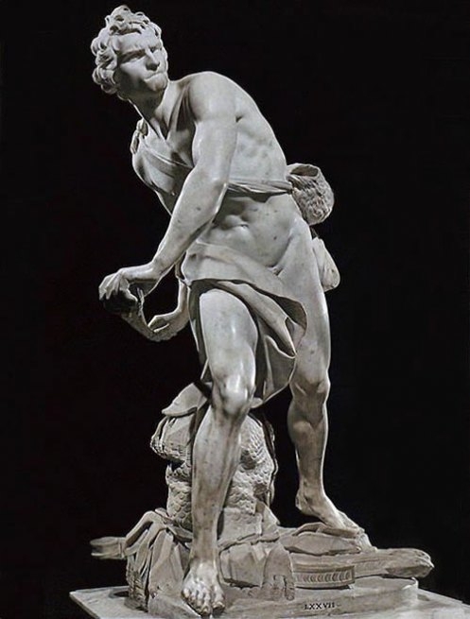
Lorenzo Bernini
1623-1624

Slide 60
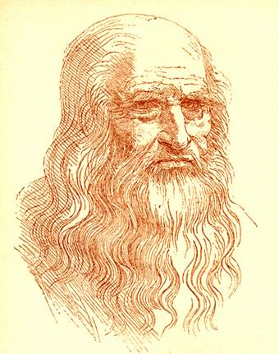
Leonardo da Vinci

Slide 61
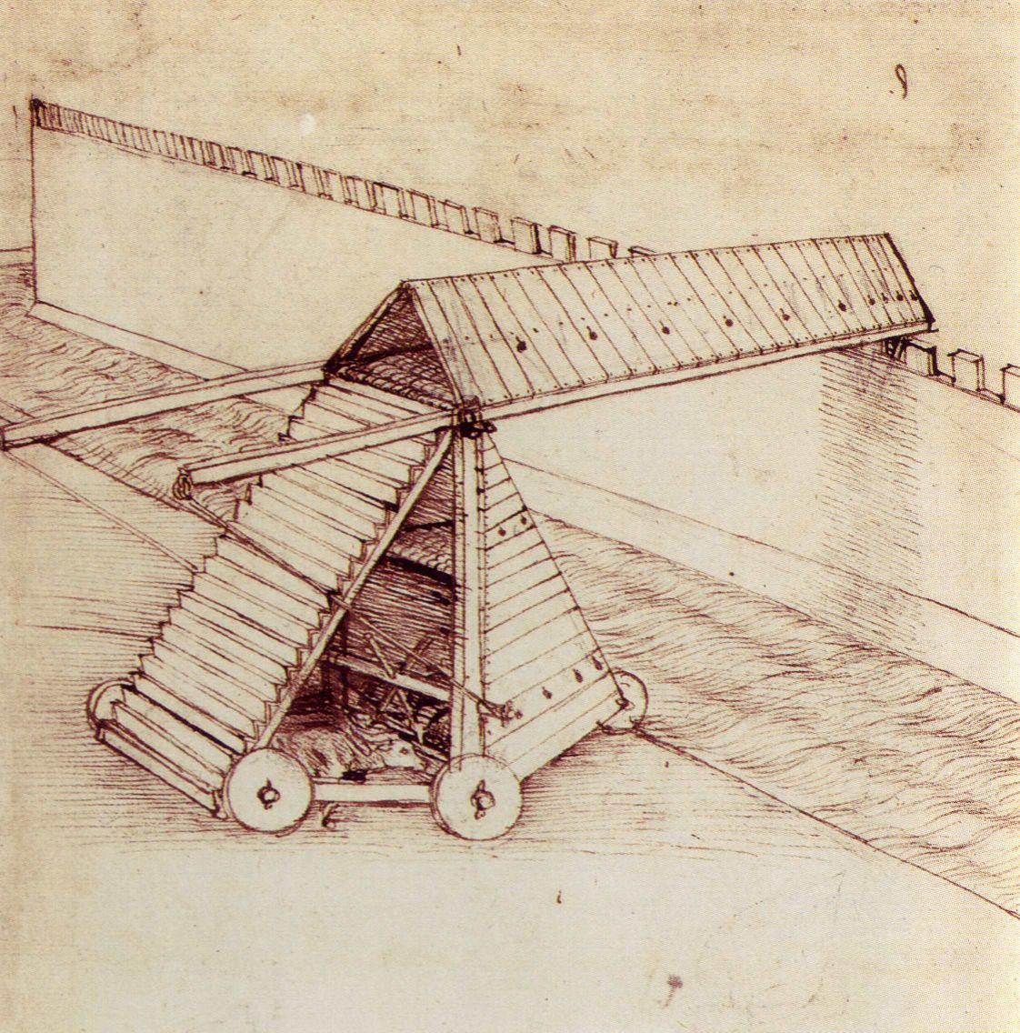
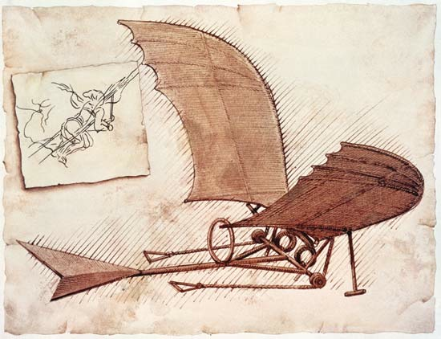
Da Vinci's Inventions

Slide 62
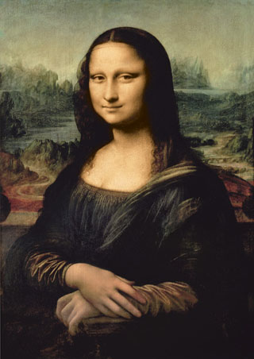
What are you so happy about?

Slide 63
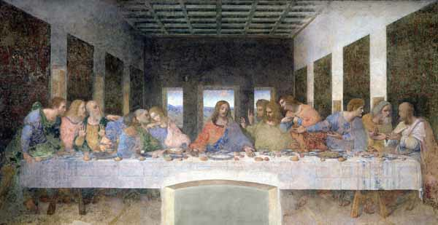
Did he say they're out of BBQ?!

Slide 64
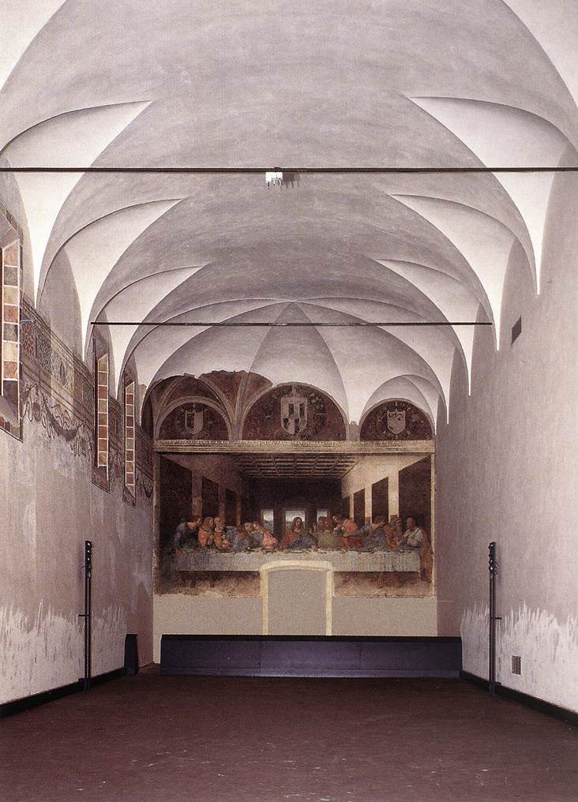

Slide 65
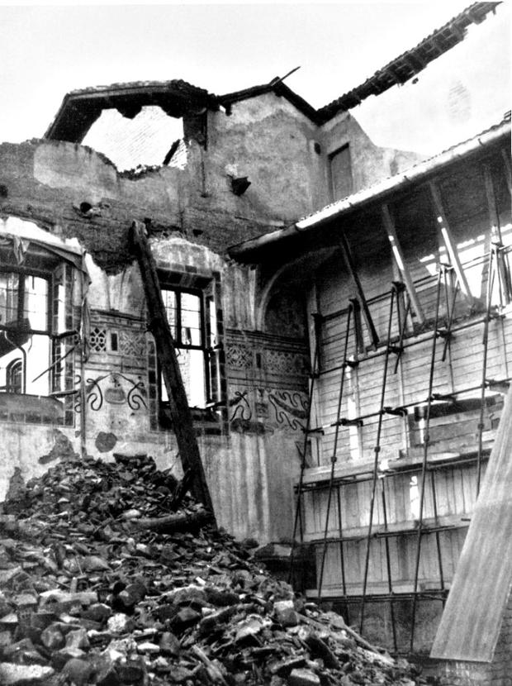

Slide 67
Influence in all realms
In addition to influencing art, the classical civilizations also affected Renaissance architecture, government, and education

Slide 68
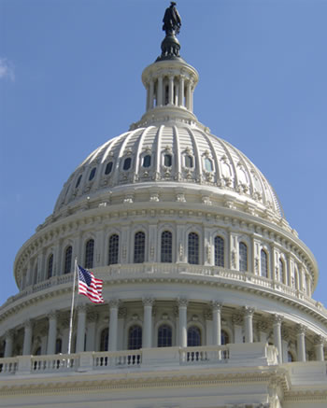
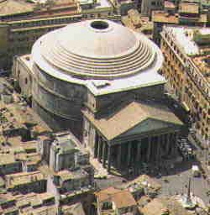
The Dome... then and now

Slide 69
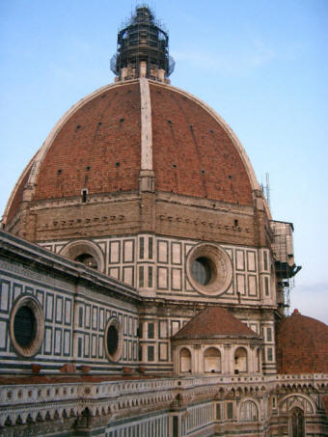
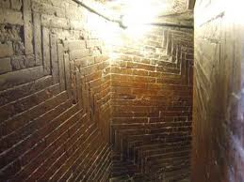
And Somewhere In Between
Filippo Brunelleschi

Slide 70
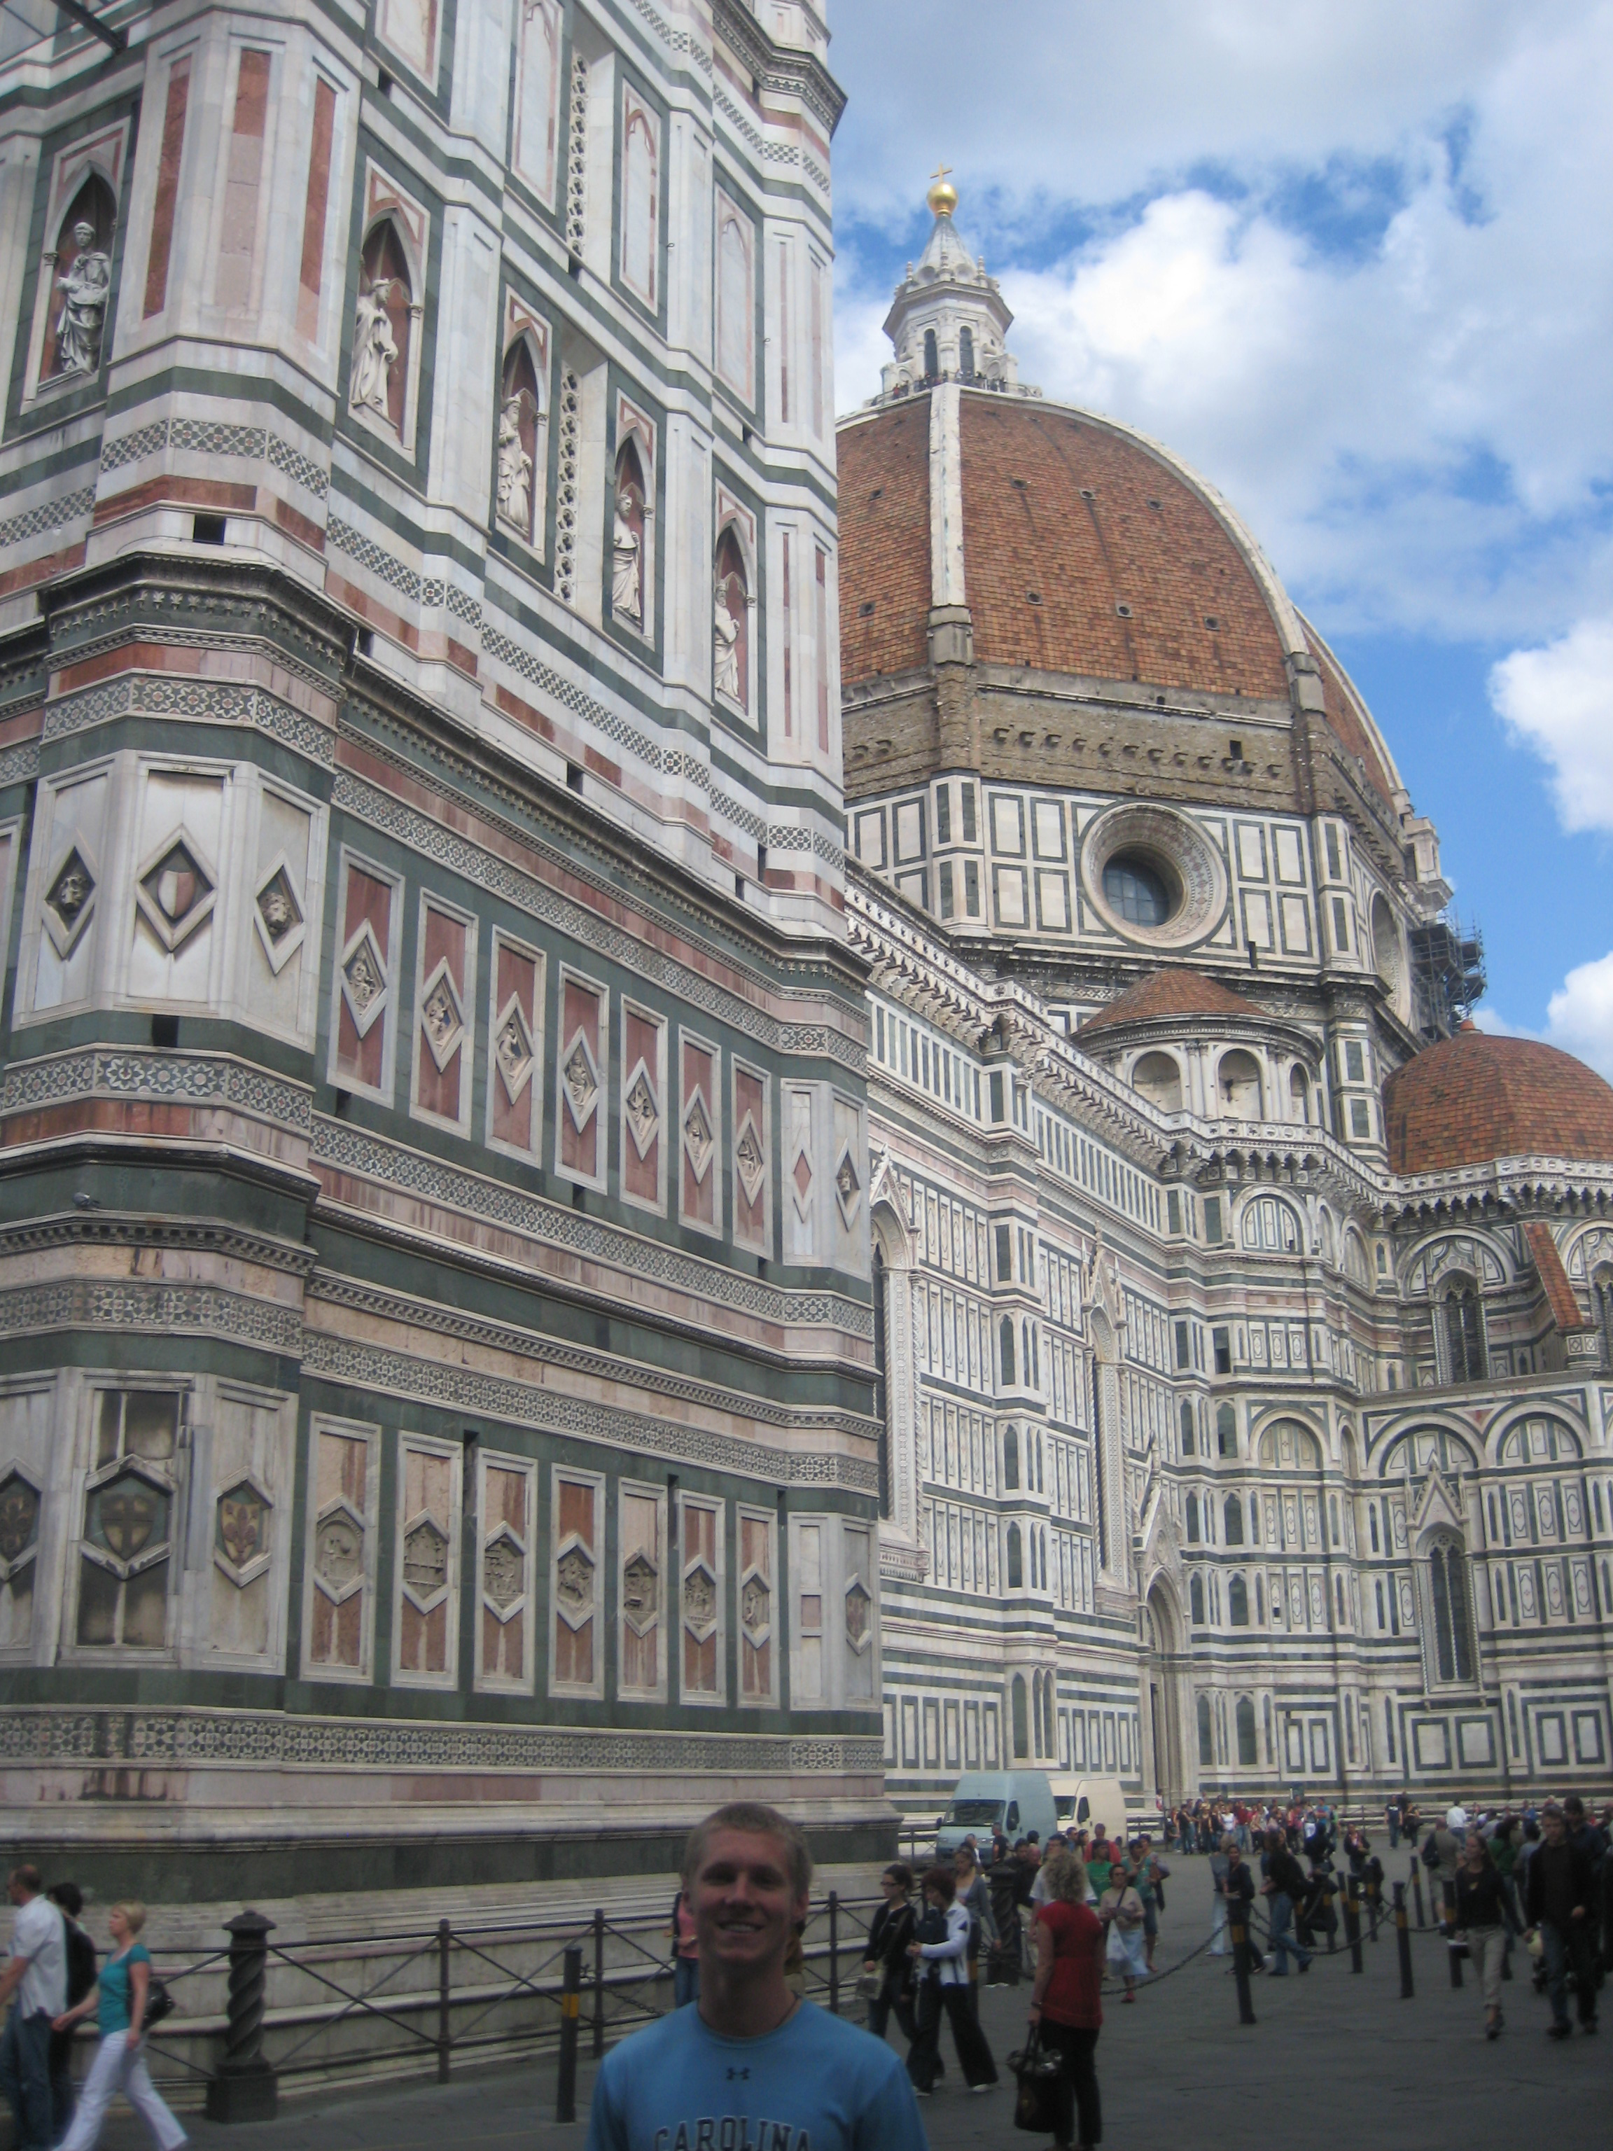

Slide 71
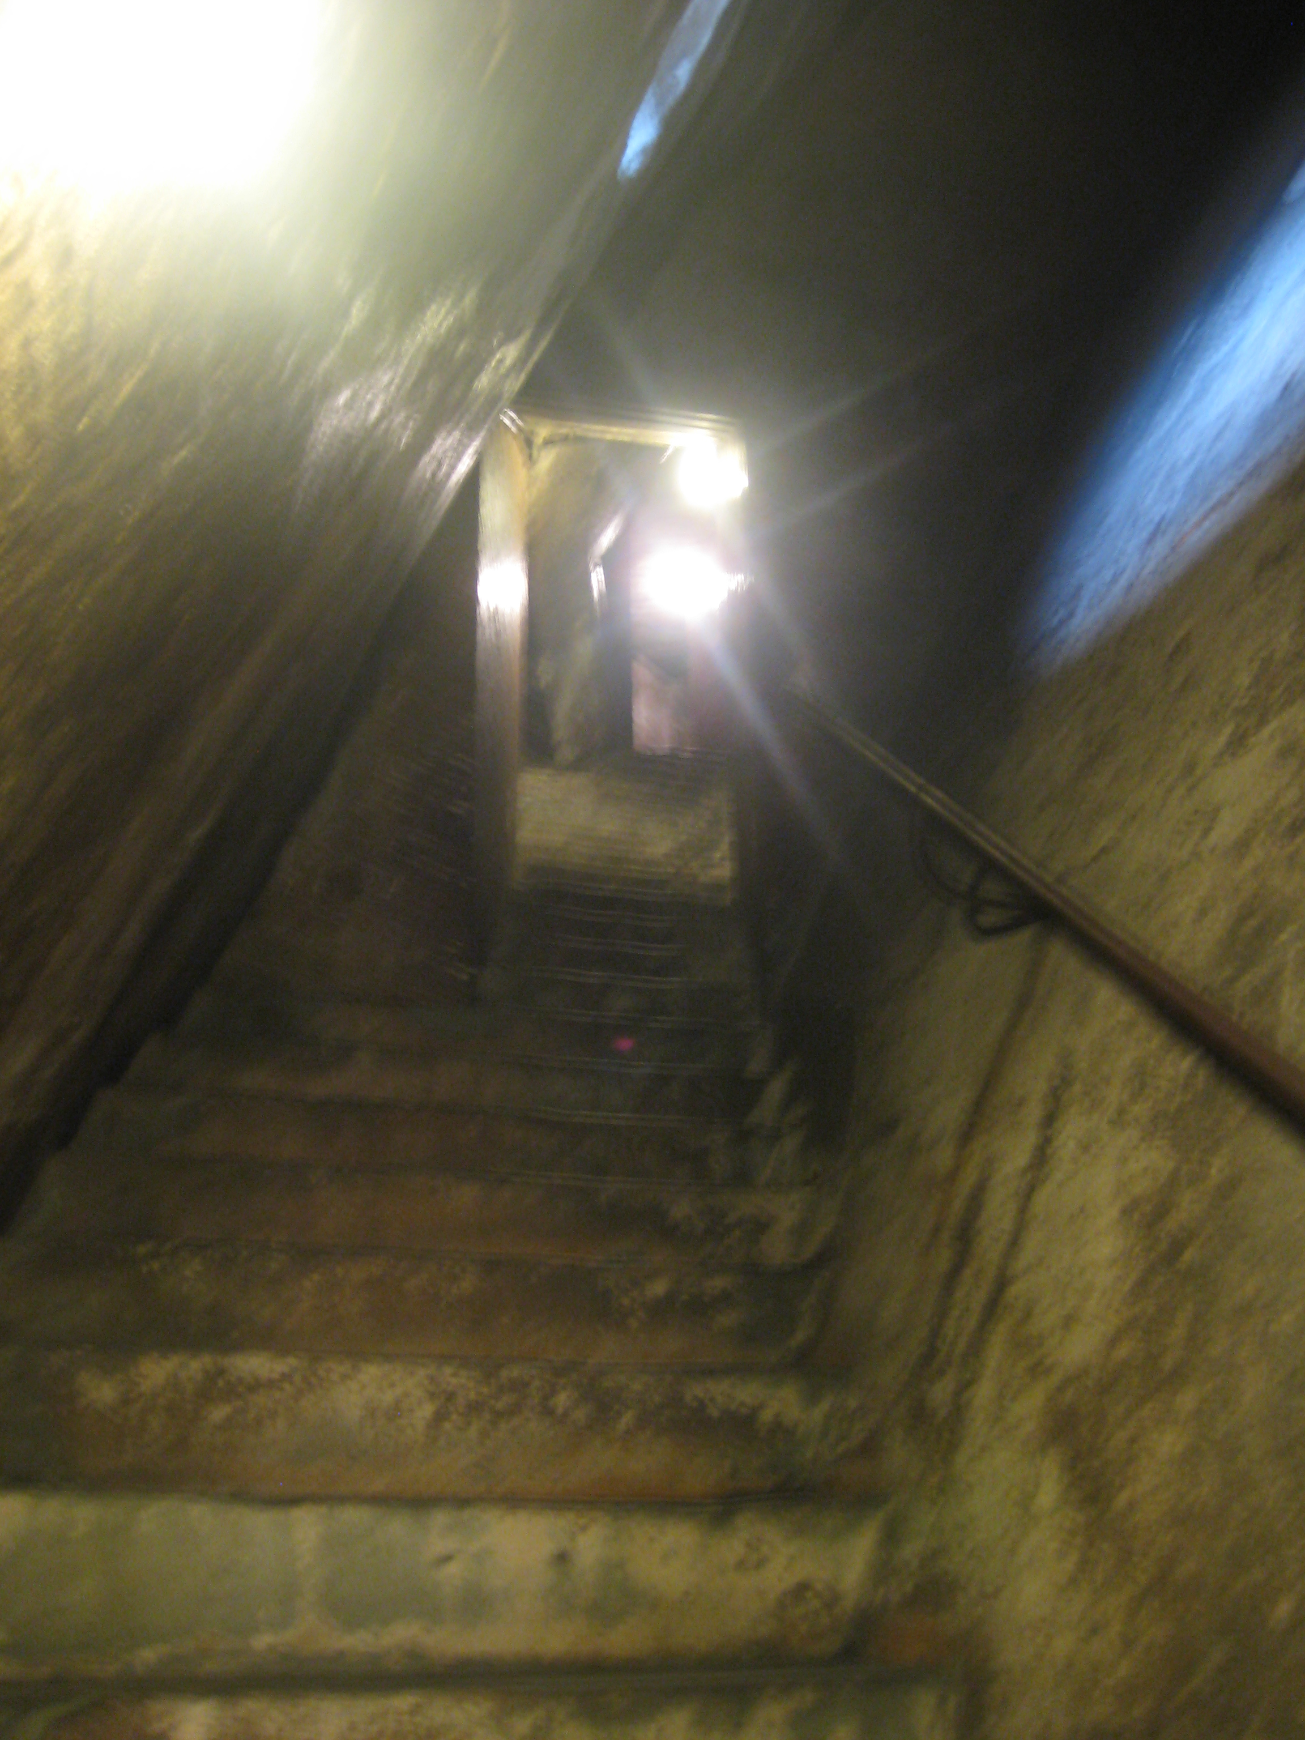

Slide 72
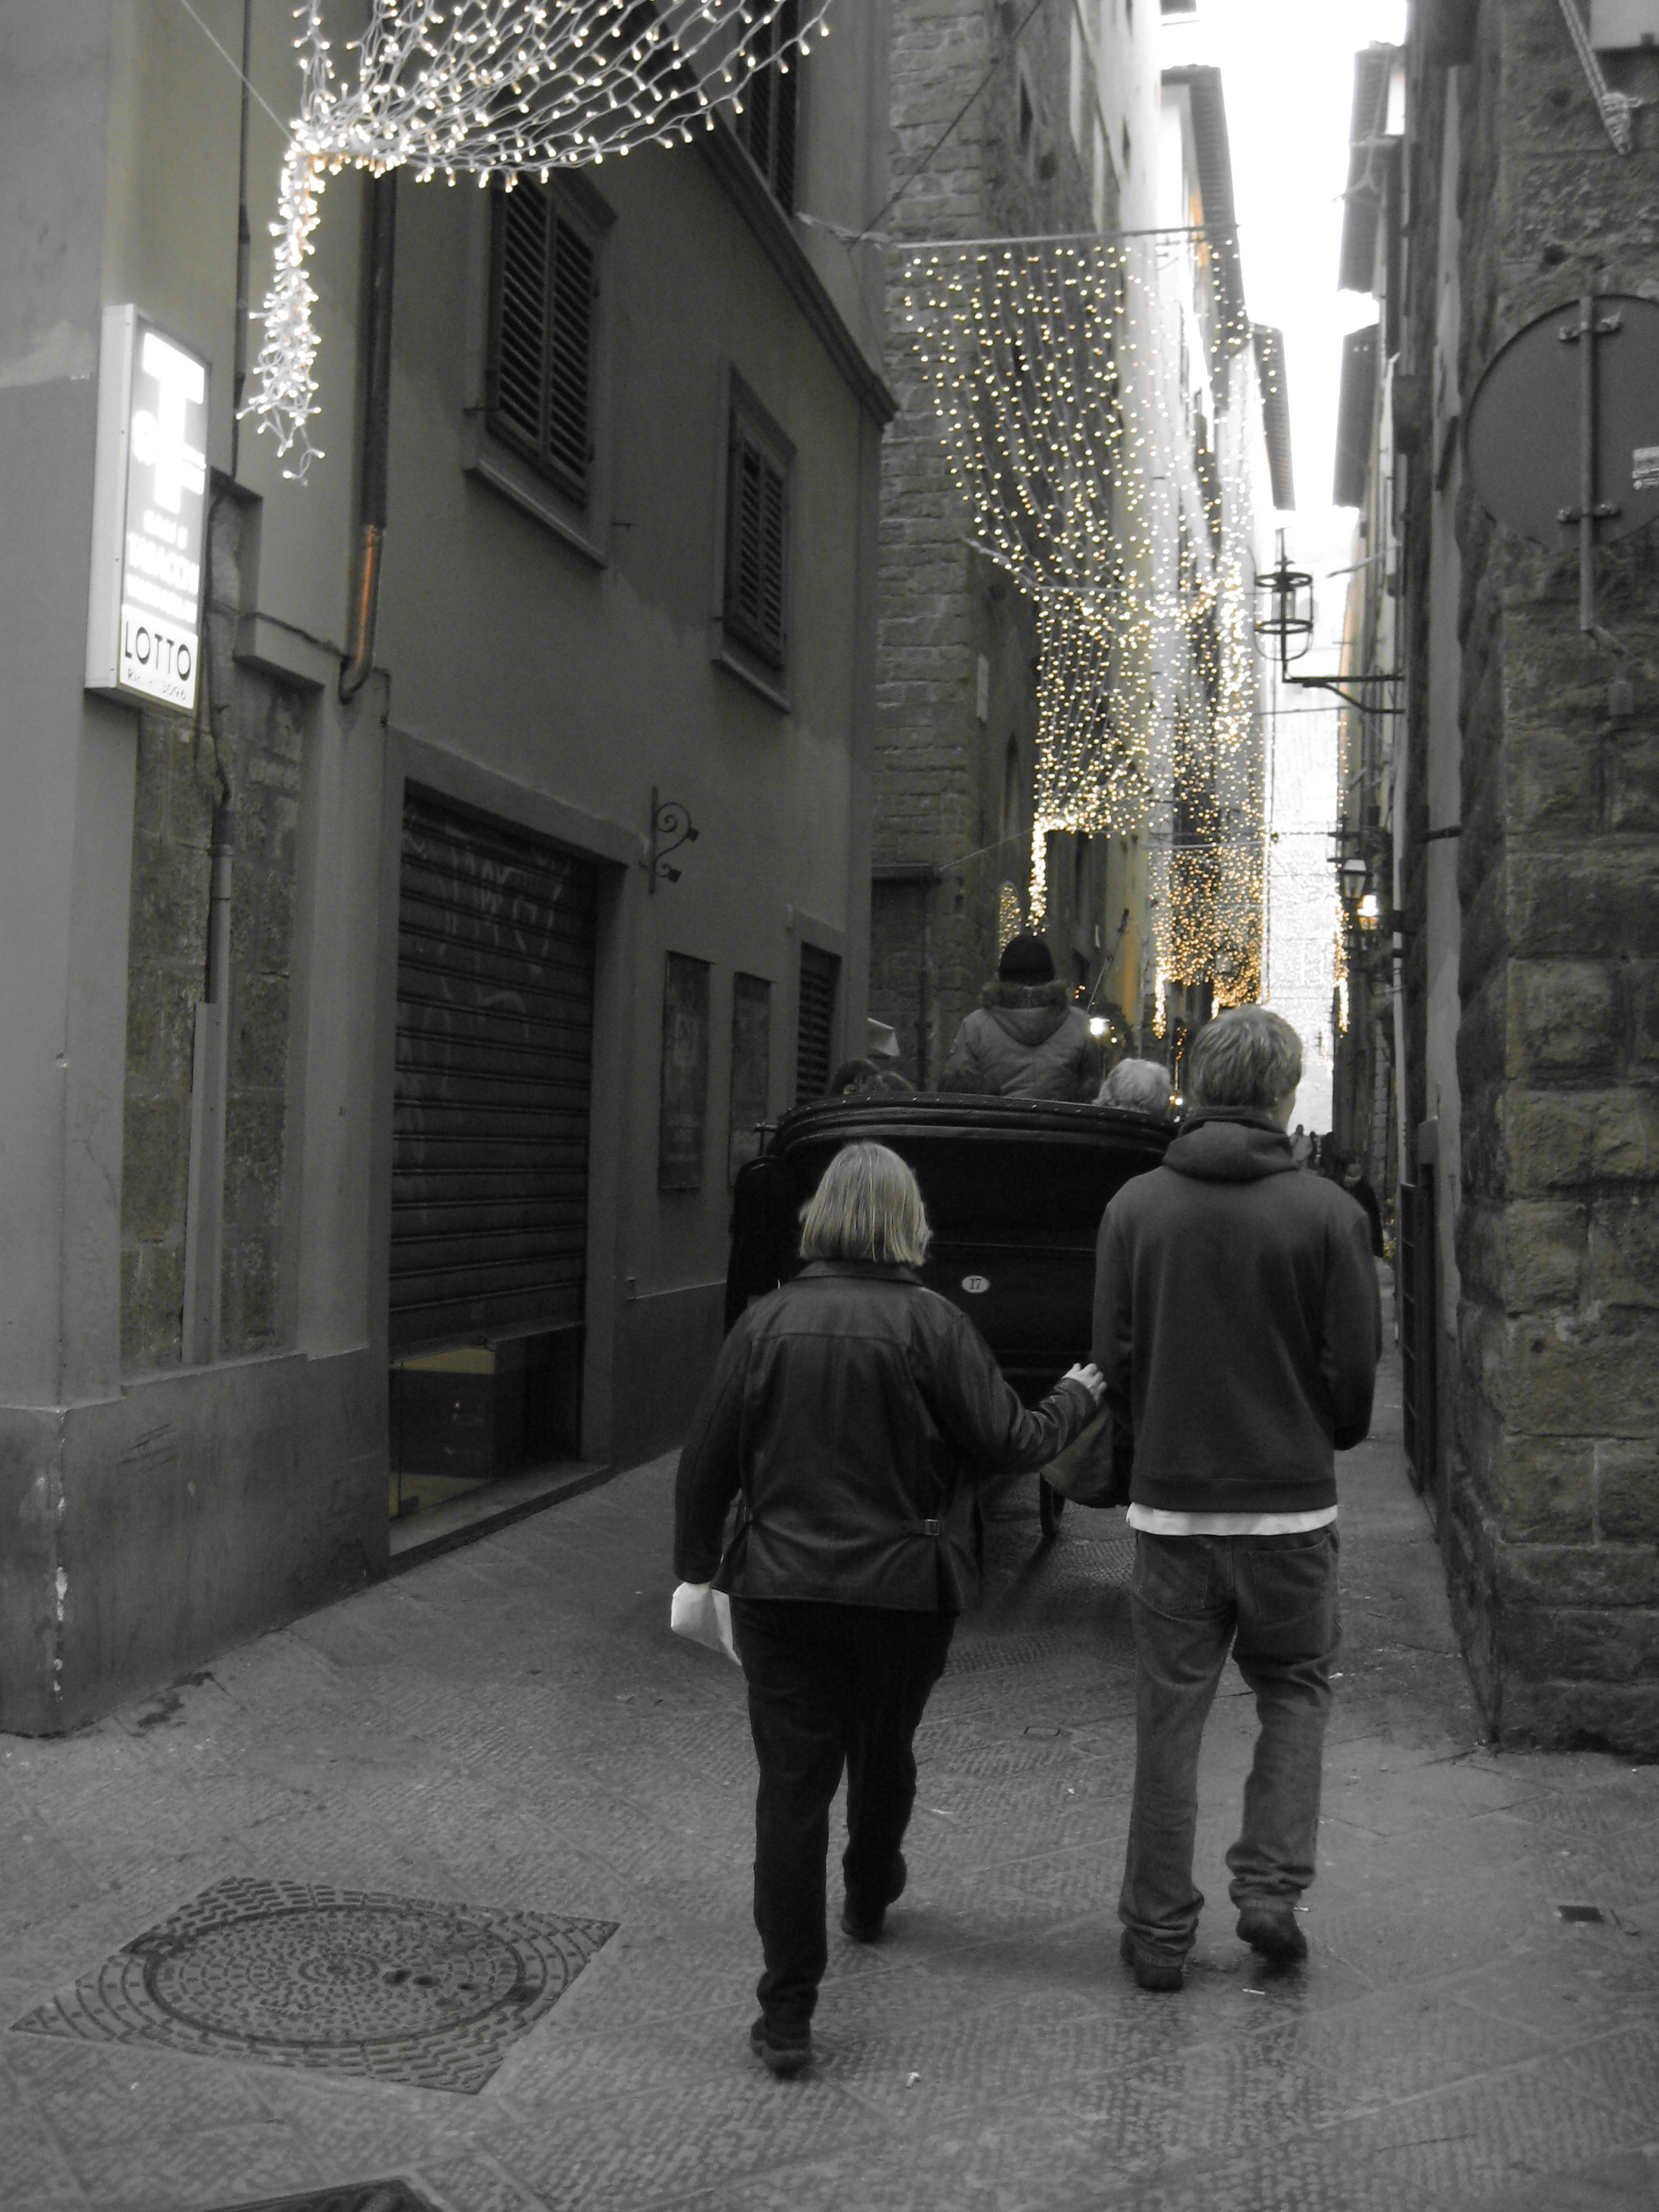

Slide 73
Architecture Re-Revolutionized
Many of the buildings in the United States share the Greco-Roman influence we see during the Renaissance
There is an emphasis on order and stability

Slide 74
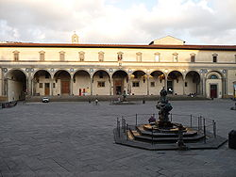
Brunelleschi's Ospedale degli Innocente

Slide 77
Under the commission of Pope Julius II, Michelangelo was commissioned to pain the ceiling of the Sistine Chapel. He decorated it with scenes from Genesis. Michelangelo painted using the fresco style: a slow, but permanent process

Slide 78
The Sistine Chapel
1508-1512

Slide 79
The Creation of Adam

Slide 80
Rafael painted the school of Athens for the Pope Julius II. It is also located in the Vatican The fresco took over a year for Rafael to complete, though when he did, the work embodied the Renaissance in so many ways.

Slide 81
The School of Athens
Raffaello Sanzio da Urbino 1509-1510

Slide 83
Sandro Botticelli was commissioned by the Medici to produce a number of the most beautiful paintings ever produced to decorate one of their mansions. The “Birth of Venus” shows the goddess of love emerging from the sea after a violent episode

Slide 84
The Birth of Venus
Sandro Botticelli 1486

Slide 85
The Scientific Revolution

Slide 86
1543 – Nicolaus Copernicus proposed a “heliocentric” model of the universe
1564-1642 – Galileo Galilei devised a telescope that allowed him to see mountains on the moon, sun spots, and moons revolving around Jupiter, just as we do around the sun

Slide 87
Turns out it's not a dude on his Chariot pulling the sun :-(

Slide 88
Understanding of the World

Slide 89
1610 CE
“and yet it moves...”
For his revelations on the movement of the planet's Galileo's work was censored by the Catholic Church. While he was not put to death, he had to spend the rest of his life under house arrest
His works are burned as heretical

Slide 90
Artistic ideas eventually spread. After coming to Italy to study the great artists from 1505-1507, Albrecht Durer returned north and introduced rationality and scientific study into northern art. This, combined with new technologies in oil painting, led to intricate, beautiful works

Slide 91
The Arnolfini Marriage
Jan van Eyck

Slide 92
I probably should have started with the man in the mirror

Slide 93
Literary and Scientific Developments in the Renaissance

Slide 94
Do Something Good Today

