Slide 1
The Principate
Rome After Gaius Julius Caesar

Slide 2
What to do after the Assassination
The Liberators did not restore the Republic, as they had hoped
Instead, they got rid of the one person who had brought order to the Roman World
Instead of strengthening the republic, they more quickly brought about its end

Slide 3
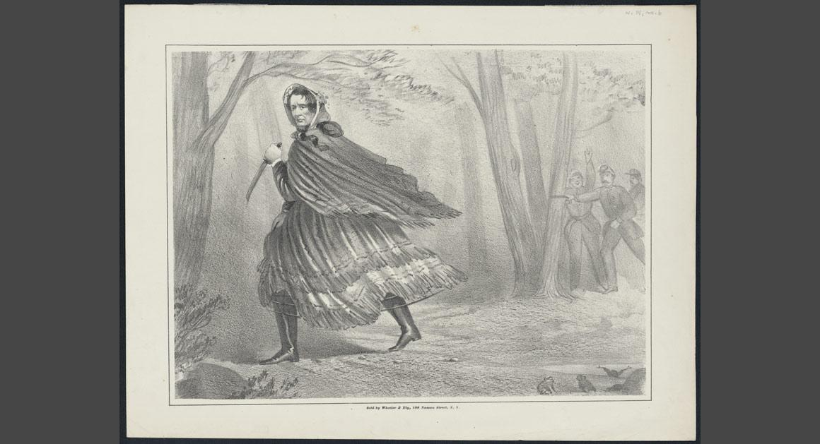
No Replacement Available… Kind of
Antony fled, disguised as a slave
Came back (as legal consul) as few days later when it was clear he was not a target of assassination
He should have been…

Slide 4
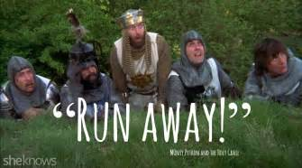
The “liberators,” were, just a few days later, chased out of Rome by the common people who had loved Julius Caesar

Slide 5
Caesar’s Will
Antony opened the will and was shocked to find out that he was mentioned nowhere in the will
Instead, Gaius Octavius was given the vast majority of Caesars wealth and was made Caesar’s son

Slide 6
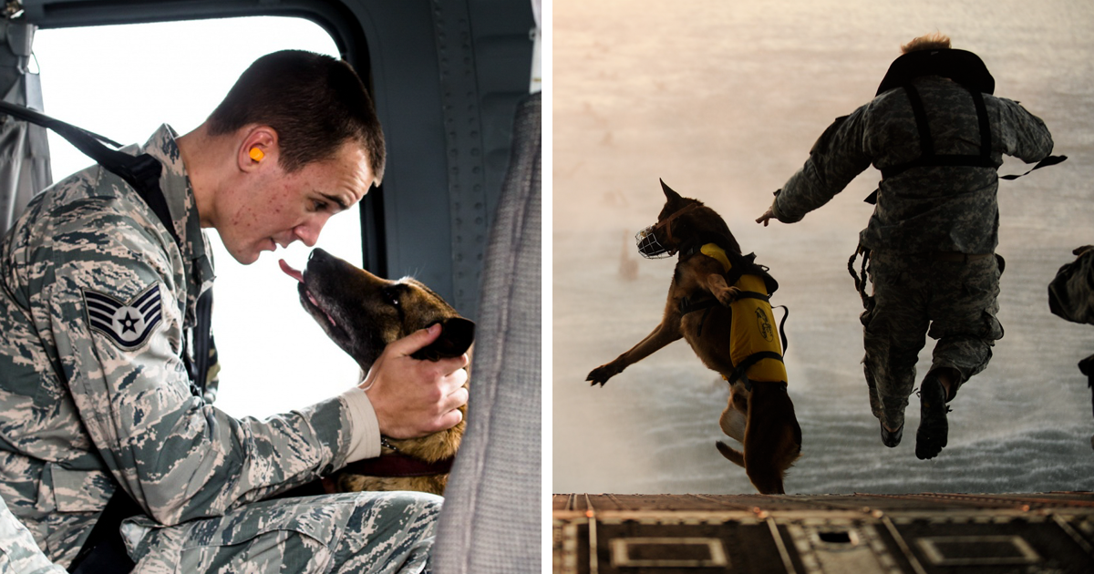
Where will the legions go
Armies had to make a decision –
Stay loyal to the man who had fought and bled with them over the years?
Or stay loyal to the request of the man they loved and respected so much

Slide 8
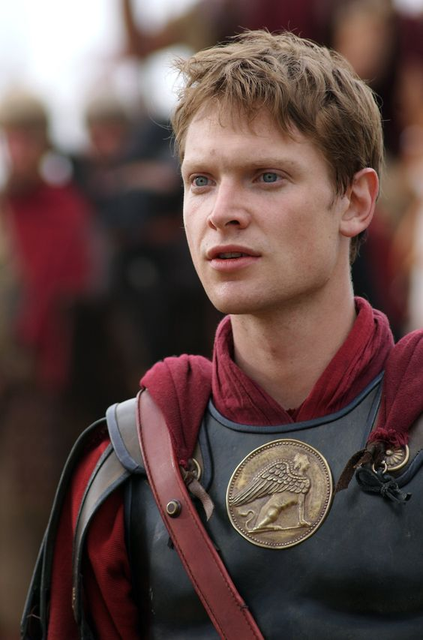
Gaius Octavius – 63 BC
Son of a novos homo who had married into the Julii family
Octavius(n) spent most of his youth with his grandmother, Caesar’s sister
Fragile, sick (coward?), helicopter baby
Insanely smart and….

Slide 9
Surrounded himself with good people
Marcus Agrippa
Caesar had to have noticed how capable his nephew’s friends were
Solidified friendship by asking Caesar for clementia for Agrippa’s brother

Slide 10
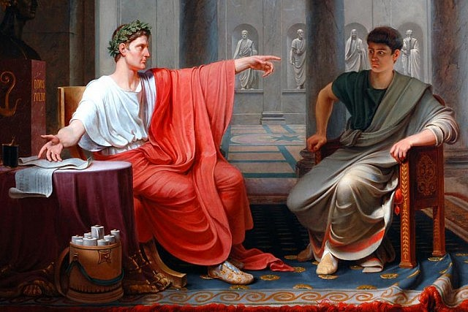
Joined Caesar in Spain
Stayed with Caesar in his tent, rode home with him, and learned a substantial amount about Caesar on the trip home
Back in Rome, He acted more or less as Caesar’s secretary.

Slide 11
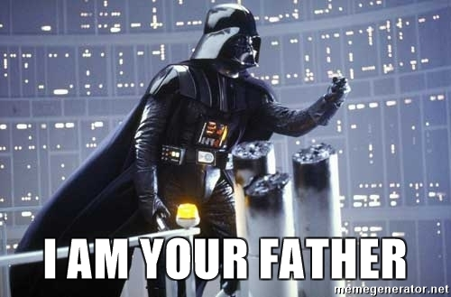
Caesar’s New Will
Posthumous Adoption and put in charge of family and fortune
Stupid Brutus

Slide 12
Positioned in the East on the Ides of March
Mother wanted him to lay low
Octavian urged by his friends to seize the legions positioned for the Parthian invasion and march on Rome..
He was too smart for either of those..

Slide 13
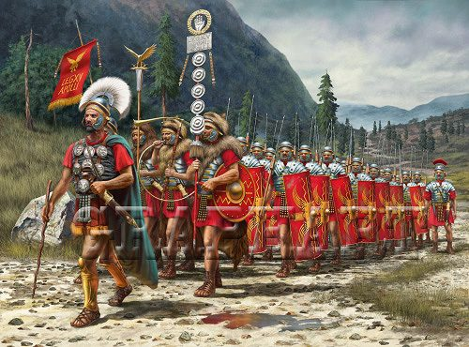
Octavian Returned to Italy
Approached more legions in Italy who warmly welcomed him

Slide 14
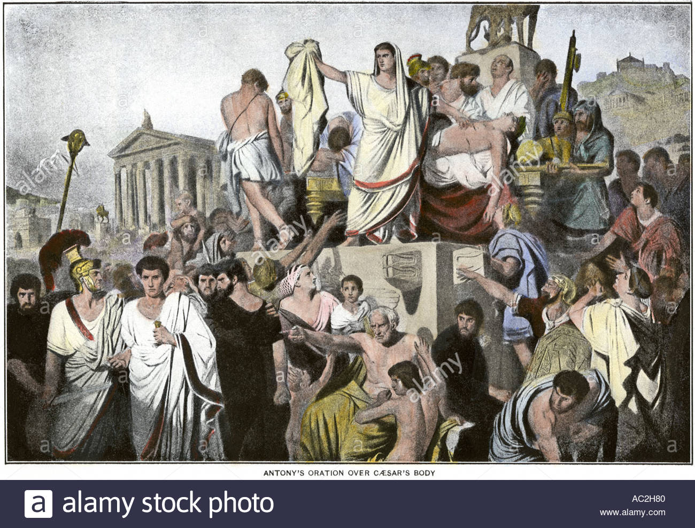
Liberators Chased Out
Antony gave away Caesars estate and enraged the masses against the liberators

Slide 15
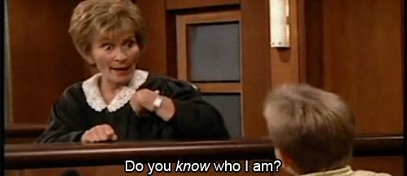
Octavian (Gaius Julius Caesar Octavianus)
Became GJC – not Octavian
Legions accepted him because of his new name and because Antony acted benevolently to the assassins… forgiveness for Caesar’s legislation

Slide 16
Turned his Vets against Antony
Antony forced to abandon any negotiations with Senate, and side with Octavian
Antony Forced many of the conspirators out Rome in exile
Proconsul in Gaul – stealing from Brutus, a conspirator

Slide 17
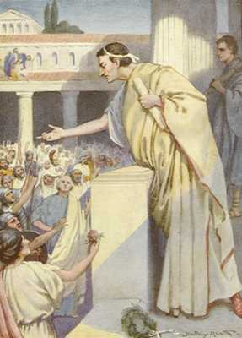
WHAT IS GOING ON
Cicero against Antony
The Philippics – Enemy of State
Cicero Pro- Octavian
Didn’t really like him, but…
Antony marches against Brutus
“The young man should be praised, honored, and exalted.”

Slide 18
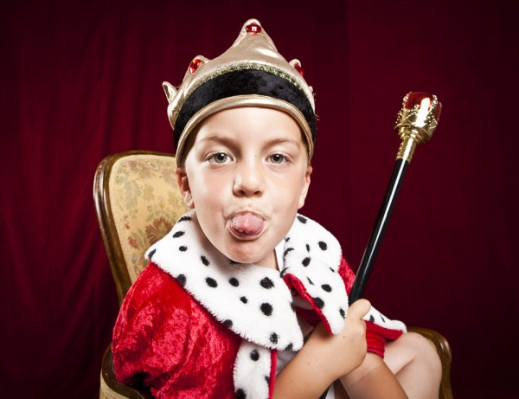
Antony vs. D. Brutus
Senate and Consuls (Hirtius and Pansa… who loved Caesar) vs. Antony
Octavian – all private power, but wasn’t even 20… received position as pro-praetor (Senate had to)
Went north, to fight AGAINST Antony, who was fighting AGAINST an assassin…?
WTF

Slide 19
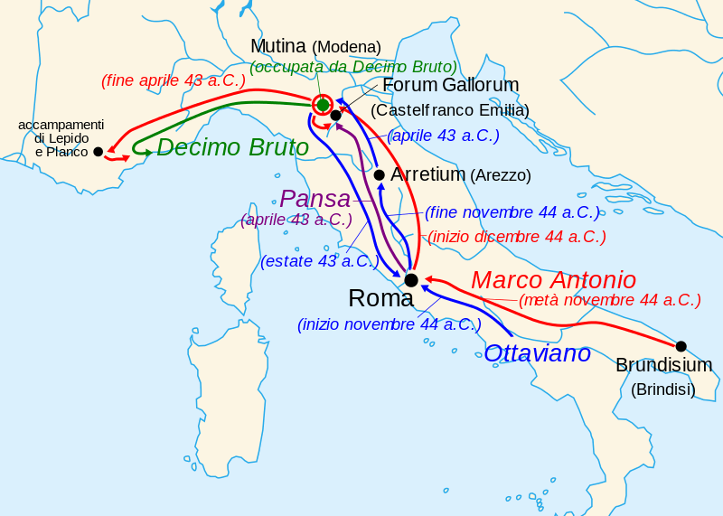

Slide 20
Battle at Forum Gallorum
Pansa marched north, Octavian and Hirtius, as well, but separately
Antony decided to attack the divided troops before they could meet
Antony crushed Pansa’s troops, including injuring Pansa
Attacked by Hirtius when returning
Octavian was… sick

Slide 21
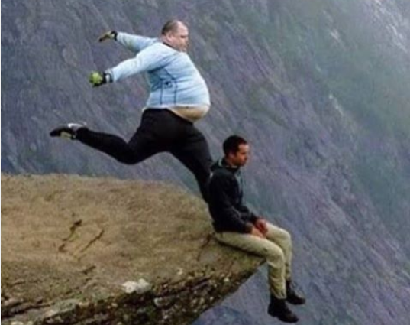
What happened to Hirtius and Pansa
Octavian bravely dragged Hirtius’ mortally wounded self out of the battle… OOORRRR….
Pansa died from wounds a few days later…poison?
Regardless… 8 legions

Slide 22
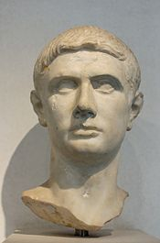
Octavian told Brutus, who he had just rescued, to cram it
Brutus chased Antony with his troops
Octavian refused to help him
Antony met up with 11 legions (and Lepidus)
Octavian had 8 legions
Brutus had soiled his pants… he died and his head was sent to Antony by Gallic Tribes

Slide 23
1st Consulship
Octavian asked to be made consul
The Senate said no

Slide 24
1st Consulship
Octavian asked to be made consul
The Senate said no
So he took an army to Rome

Slide 25
1st Consulship
Octavian asked to be made consul
The Senate said no
So he took an army to Rome
So the Senate said Okay!

Slide 26
Mutual Interests Brings enemies together
43 BC – Formation of the “Commission of three for Ordering the State or….?”

Slide 27
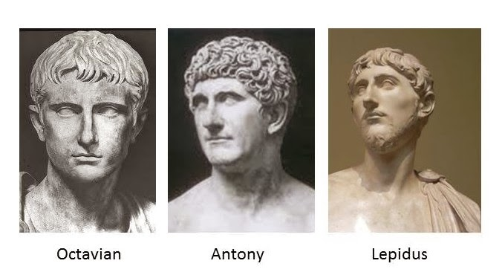
The Second Triumvirate
Antony and Octavian
And Lepidus I suppose
Goal number one – Kill Cassius and Brutus
Needed funding for armies

Slide 28
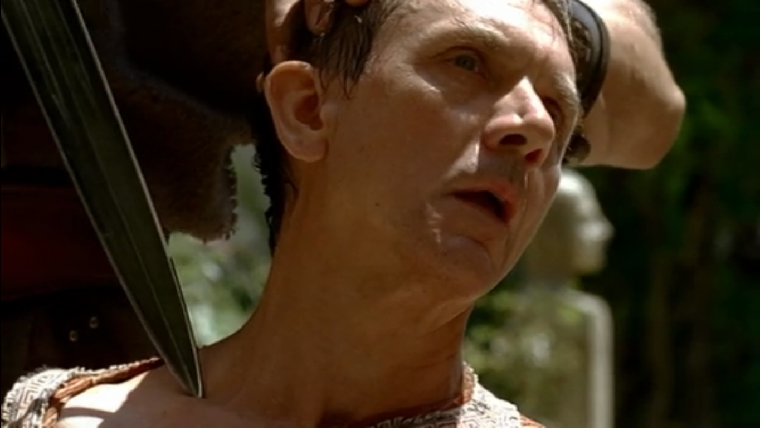
PROSCRIPTIONS!!!
Multiple benefits – People not given clementia…
Instead, the people hated were listed, their lives and property forfeited
Cicero = persona non gratis

Slide 29
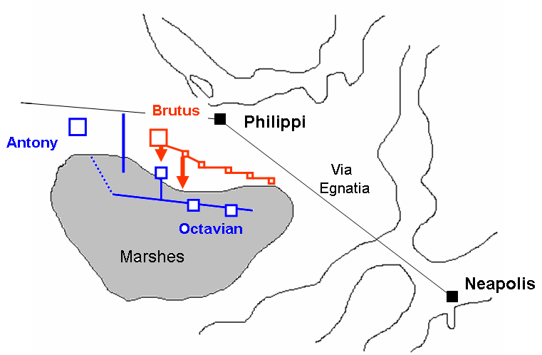
Battle of Philippi

Slide 30
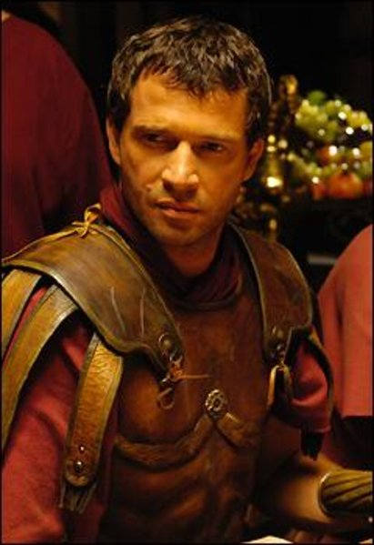
Rome Divided

Slide 31
Triumvirate Secured
To secure the triumvirate, Octavian married his sister, Octavia, to Marc Antony

Slide 32
Octavian in Rome
While in Rome, Octavian has a daughter (Julia – why not Octavia?) by his first wife, whom he divorces
Remarries a woman named Livia (who has a son named Tiberius**)

Slide 33
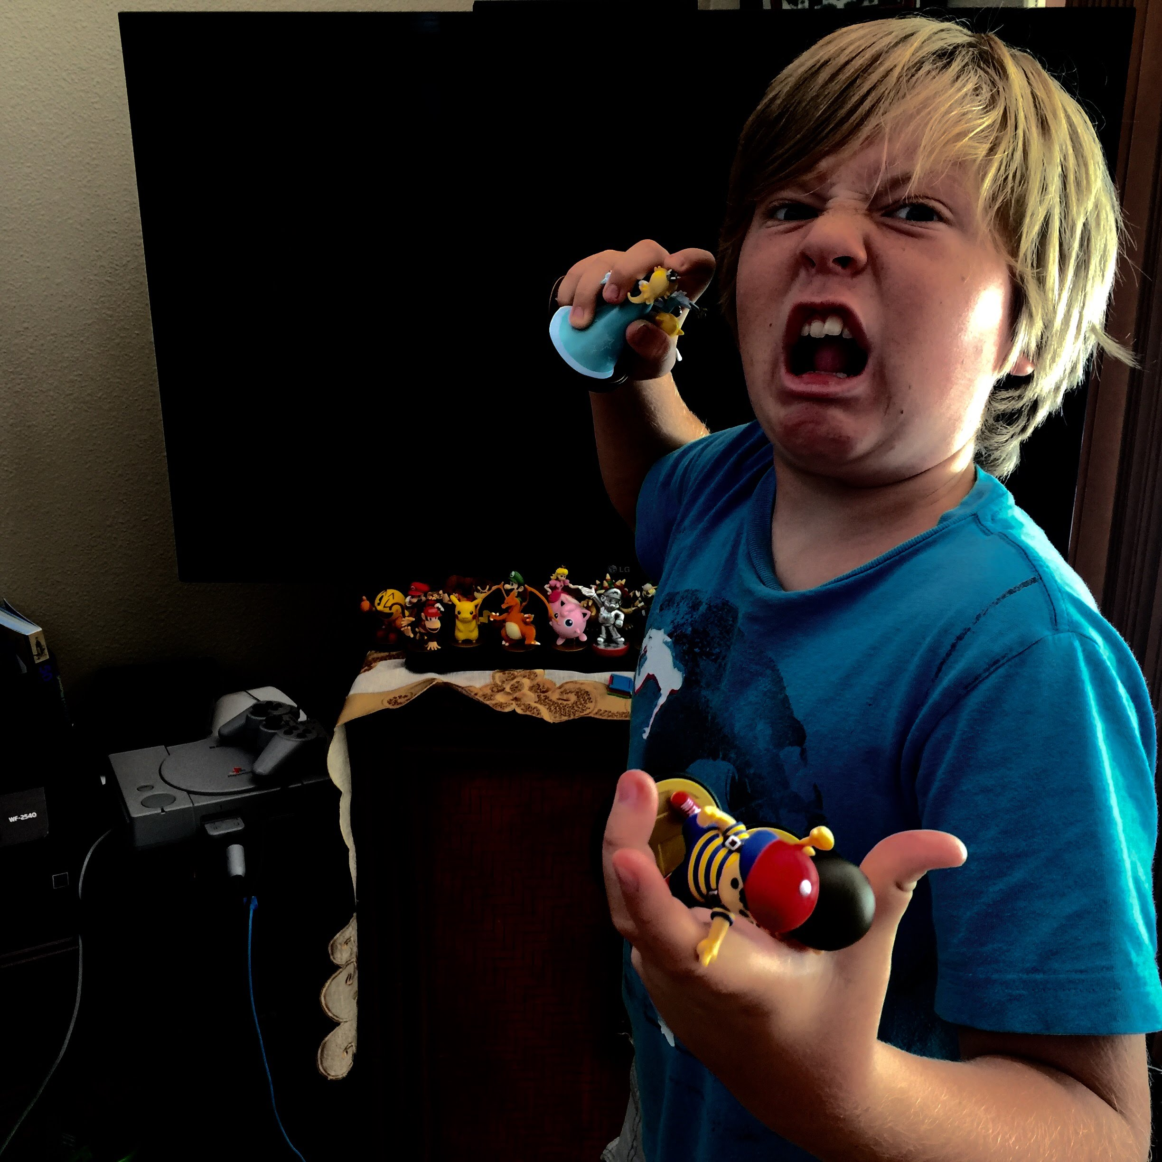
Sneaky Octavian
Octavian and Lepidus faced an enemy in Sextus Pompeius (son of Pompey)
They required more ships and asked Antony to make a donation of 120 ships
He agreed, in return for 20,000 of Octavian’s troops
He sent 2,000…

Slide 34
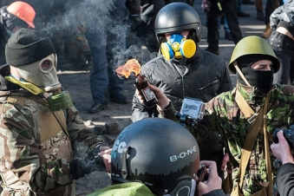
Goodbye Lepidus
After killing Pompeius, Lepidus made a bid for power in Sicily…
It didn’t work

Slide 35
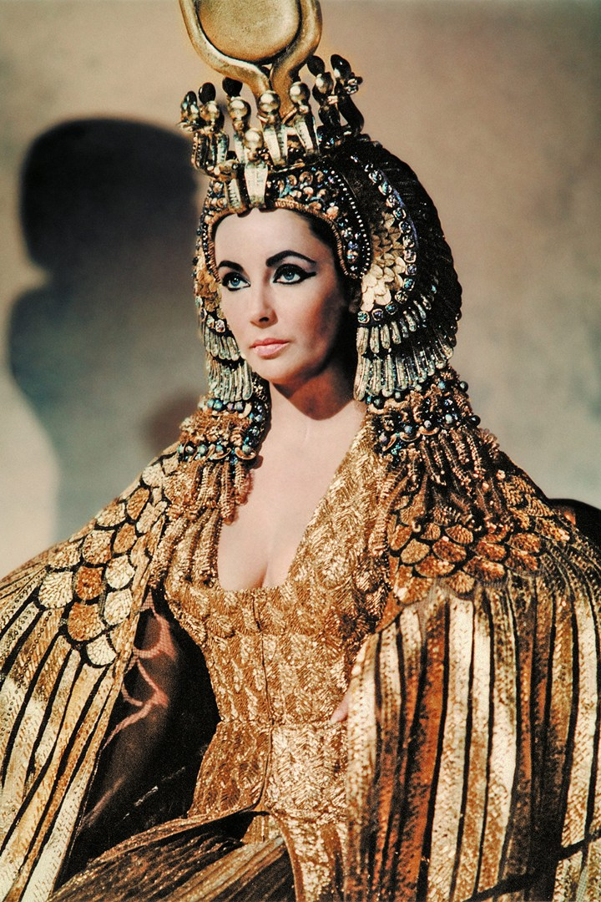
Dammit Cleopatra

Slide 36
Donations of Alexandria
Clad in royal garb, from a gold throne Antony threw some fierce shade
Caesarion is true heir
Children by Cleopatra given Roman lands

Slide 37
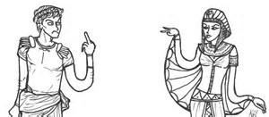
32 BC – Not Good
Marc Antony officially divorces Octavia
Octavian to the rescue!

Slide 38
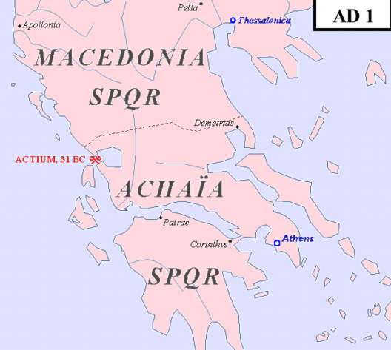
Battle of Actium – Sept 2, 31 BC
The climactic showdown between the Octavian and Antonian forces took place at Actium, in Greece

Slide 39
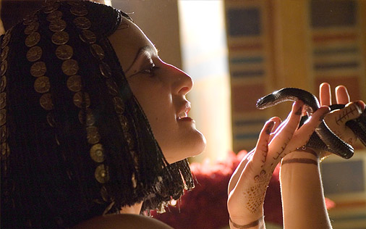
Aftermath of the Battle of Actium
After pursuing Antony and Cleopatra to Egypt where the two eventually killed themselves, Octavian was left in sole control of the Roman World

Slide 40
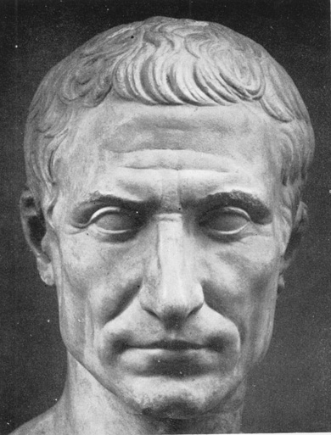
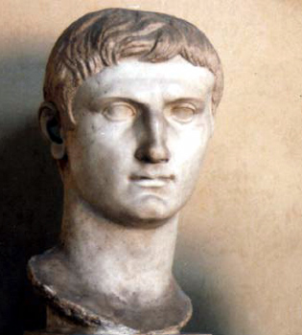

Slide 41
Comparing Octavian to Caesar
Similarities
Both loved by the people
Control MASSIVE army
Eliminated military threats
Differences
Caesar practiced clementia
Augustus truly eliminated ALL threat
Caesar = lots of remaining Republican Sentiment
31 BC – different memories for active political families

Slide 42
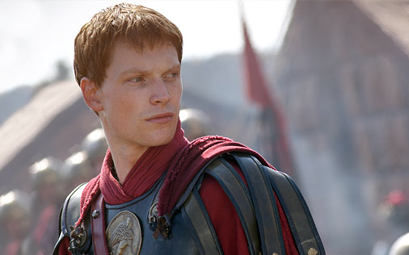
The Benefit of starting early
Octavian eliminated ALL threats by 30 BCE... at the age of 33
He could not give up power... Rome would descend into chaos
He could not name himself king... no one would accept that.

Slide 43
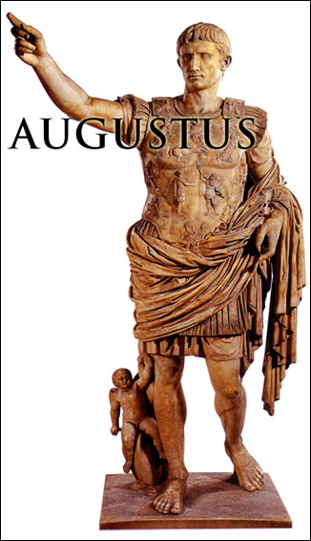
The First Settlement 27 BCE
Octavian “gave up” all of his power in a public show
This pleased the Senators, who BEGGED Octavian to retain control in certain provinces... the border provinces
He received the title: Augustus

Slide 44
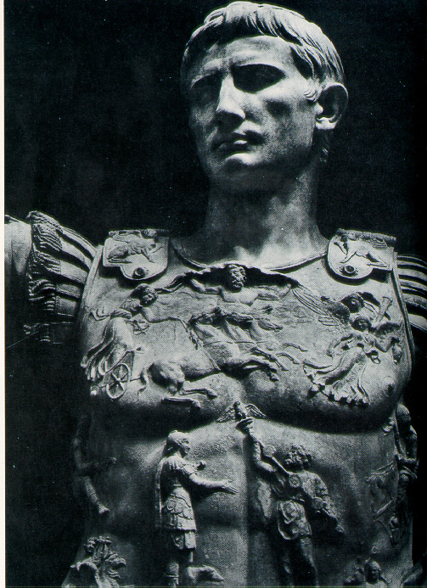
Auctoritas Augusti
Except for times of Crisis, Augustus rarely held political offices
He let the traditional workings of the Republic continue, with his authority being the guiding force

Slide 45
Augustus claimed that he found the city of Rome one of brick, and left it one of marble.

Slide 46
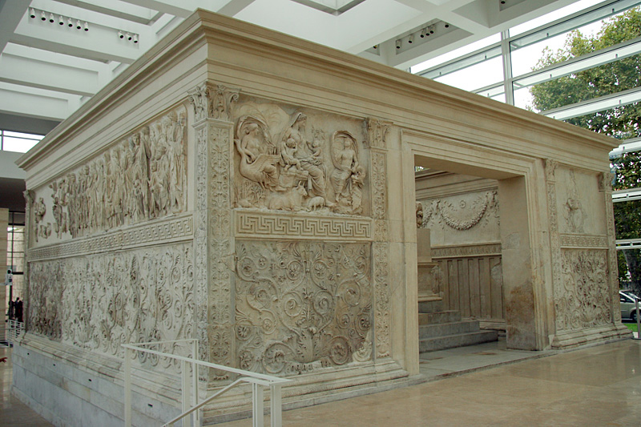
The Pax Romana
During the period of his reign, Rome experienced an unprecedented flourishing of arts, architecture, and trade

Slide 48
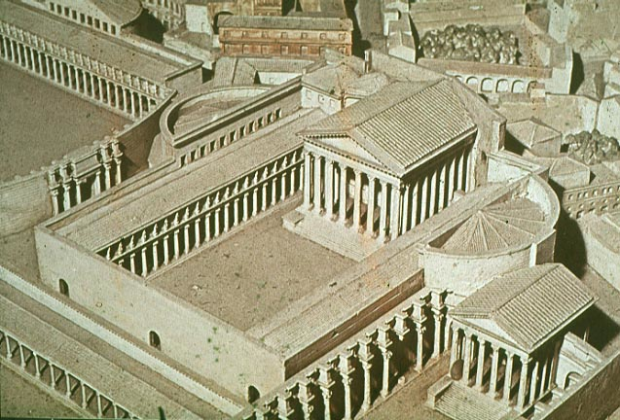
Augustan Forum

Slide 49
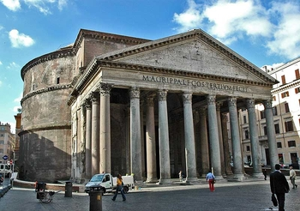
The Pantheon

Slide 50
Concerns Augusti
Throughout his reign, Augustus had two main concerns:
Establishing a system that would be stable through the transition of authority... a system where a successor could be designated
Establishing a system where everyone was taken care of... he established a veil of competition under a system where he was absolute ruler.

Slide 51
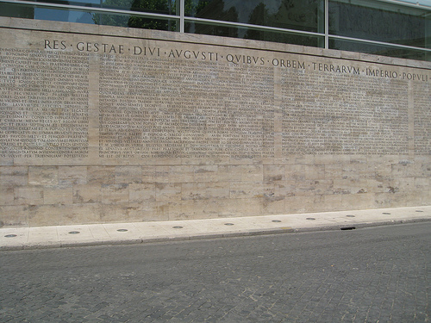
What Augustus Accomplished
In his Res Gestae, Augustus displayed proudly, though humbly his most important accomplishments.

