Slide 1
Roman Expansion in Italy
~400 Bc – ~270 BC
Notes:
This portion of the semester takes us through Rome’s first expansion through the Second Punic War, in which it becomes the powerhouse of the Mediterranean World. We will look at the wars Rome fought on the Italian Peninsula first.

Slide 2
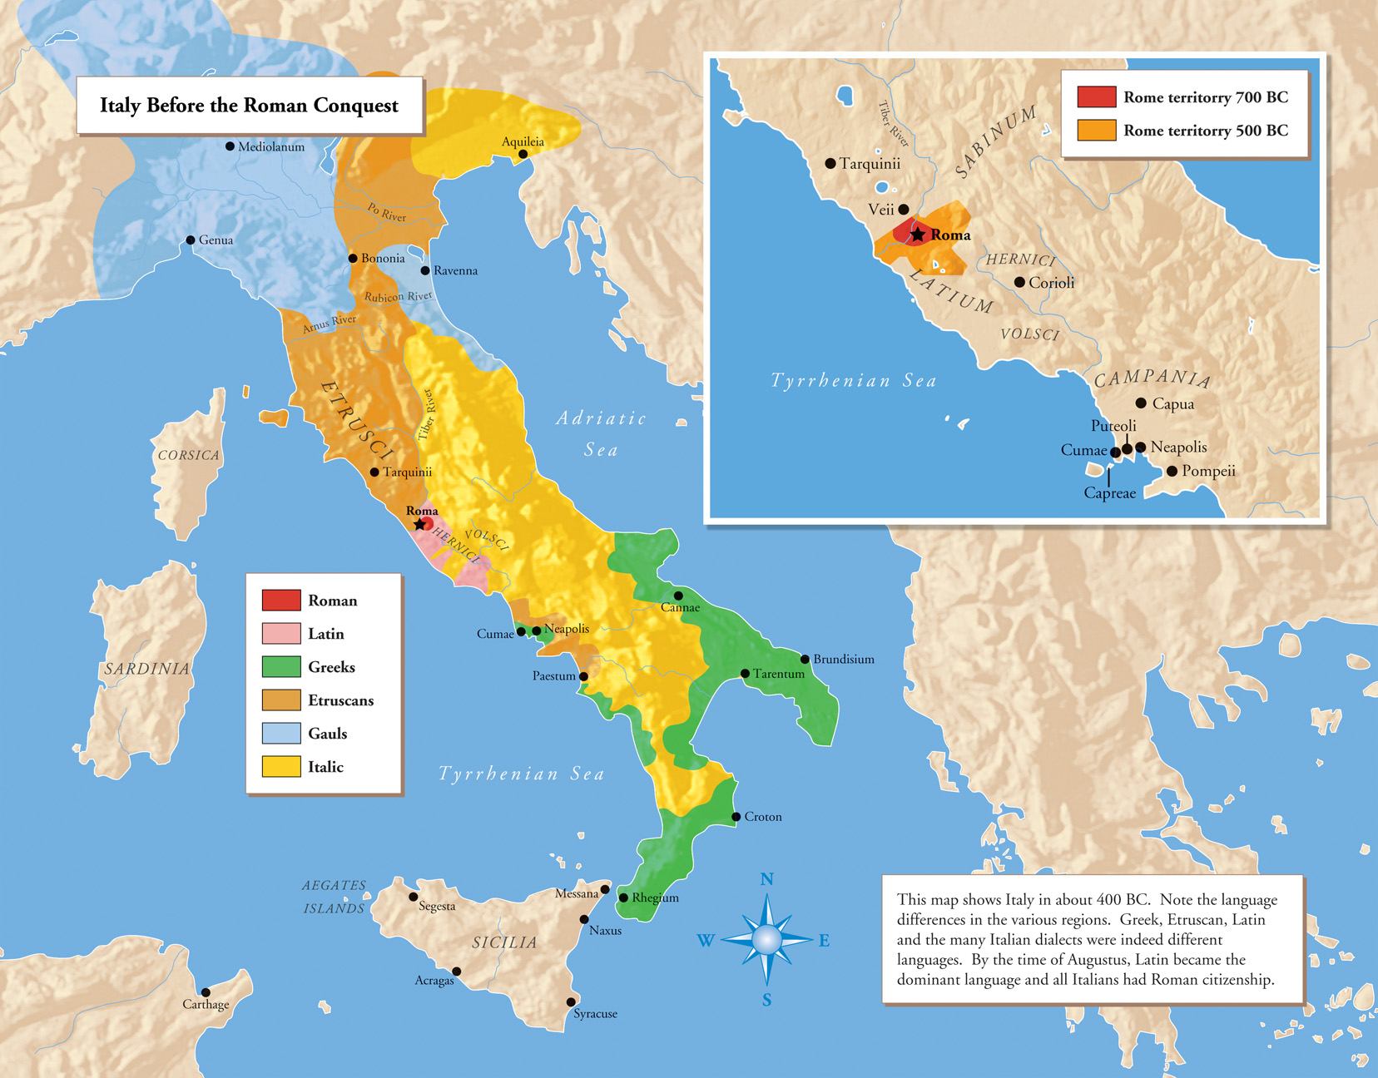
Roman Strategic Situation 400 BC
Rome’s Dangerously Excellent Position
Although Rome is situated in an excellent location for many reasons, it was also located in the middle of a number of hostile civilizations
The Romans, in their early history fought the Sabines and Etruscans, but were led to conflict with more and more peoples as The Romans became more powerful
Notes:
Rome was not necessarily destined to rule the Med. They happened to, though a series of wars, expand their domain, and by doing so, added to the size of their military. The more people the conquered, the larger their forces got. Located on the Tiber river, the Romans were situated amongst a number of tribes that were fighting with one another, and because they were in hostile territory, Rome got involved in the wars… Rome fought a number of “defensive” wars that added significantly to her size

Slide 3
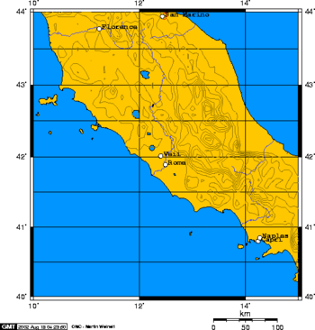
Battle of Veii
~396 BC
The Romans had long fought against one of their closest neighbors, Veii.
The Romans had fought the Veientes under Romulus, Tullus Hostilius, Servius Tullius , and had supported Tarquin in his attempt to regain power after the Republic was established
Notes:
By the time the battle of Veii was reaching its climax, the two cities had decided that it didn’t make sense for the other, hostile neighbor, to continue existing so close. Either Rome or Veii had to go.

Slide 4
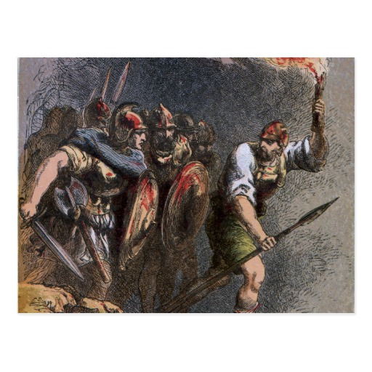
Enough is enough
TOO Dangerous, Too Close
The Romans decided to end their fear of Veii’s aggression by destroying the city
Campaign led by Dictator, Marcus Camillus
Notes:
The Romans fought a “ten year” war against the people of Veii. Realistically, this war was not 10 years long, but this idea was invented to mirror the Greek war against the Trojans… regardless, by the end, Rome decided that besieging Veii was the best way to end the war, however, this upset a number of soldiers who were not used to having to stay away from their families and homes for more than the traditional campaign season.

Slide 5
It never hurts to ask for help…
Pythian Apollo, guided and inspired by thy will I go forth to destroy the city of Veii, and a tenth part of its spoils I devote to thee. Thee too, Queen Juno, who now dwellest in Veii, I beseech, that thou wouldst follow us, after our victory, to the City which is ours and which will soon be thine, where a temple worthy of thy majesty will receive thee. He attacked from all sides. – Livy
Notes:
Above is a prayer offered by Camillus to Apollo… it demonstrates a) Roman prayer techniques, b) the values Romans placed on other peoples’ gods, and c) the end of it hints at the end of the war.

Slide 6
Under, over, all around
Camillus had his men dig a tunnel under the walls of Veii
He divided his troops and had them attack from all angles
The Attack on the walls distracted the Veientines from the men mining under their walls

Slide 7
Here they come…
"what had happened to make the Romans, after never stirring from their lines for so many days, now run recklessly up to the walls as though struck with sudden frenzy".
Notes:
This is the distraction that Camillus ended up using in order to lure the defenders towards the walls.

Slide 8
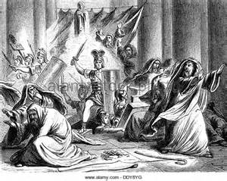
Dsog;isdfjglkjsfdg;cvlbijsdfg
As the Veientines rushed to defend their city walls, the Roman’s second army emerged from their tunnel inside the temple of Juno, fanned out, and quickly took the city
Rome slaughtered most of the adult male population, and seized the women and children
Notes:
While most of the men were defending the walls, Camillus’ tunnel emptied into the temple of Juno. Veii’s soldiers were predisposed, so the Roman army was able to take the city, open the gates, and destroythe town

Slide 9
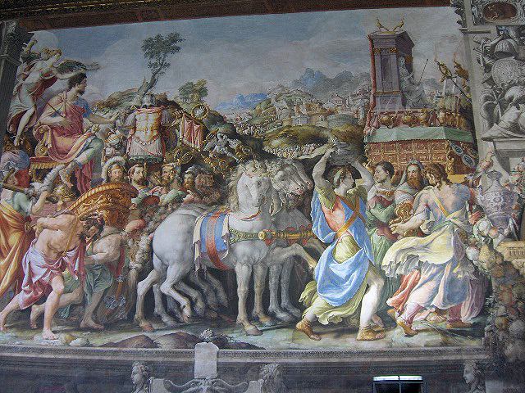
Camillus… you silly boy
Camillus’ celebration was too much…
He did not give to the gods as he had promised
He stood in the way of Plebs using the now unoccupied land

Slide 10
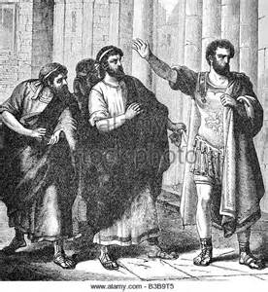
Camillus exiled
Camillus was accused of embezzelmentt and, for his crimes was exiled.
He did not return until 390 BC…

Slide 11
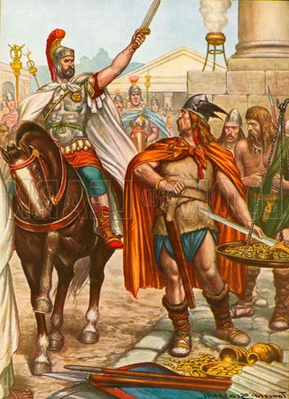

Slide 12
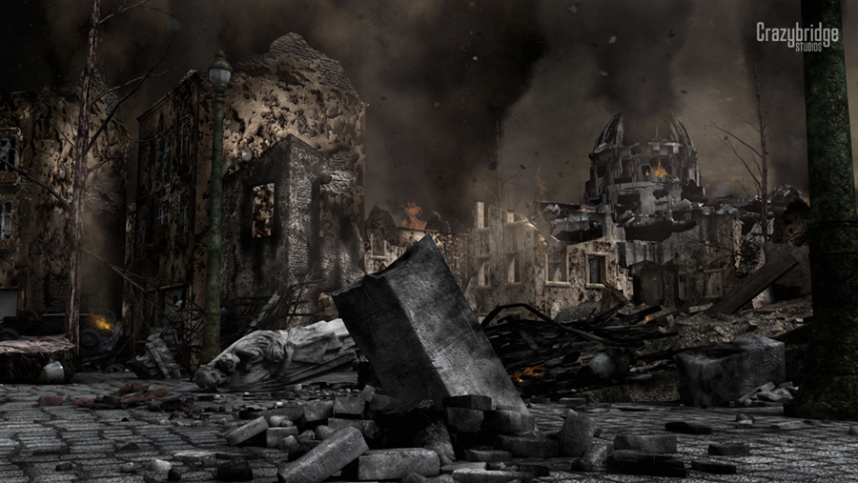
What to do after the sack of Rome
The Gauls had a profound effect on Rome, both physically and emotionally.
Following the sack, many Romans wanted to leave Rome to the ruins of Veii, which were unoccupied

Slide 13
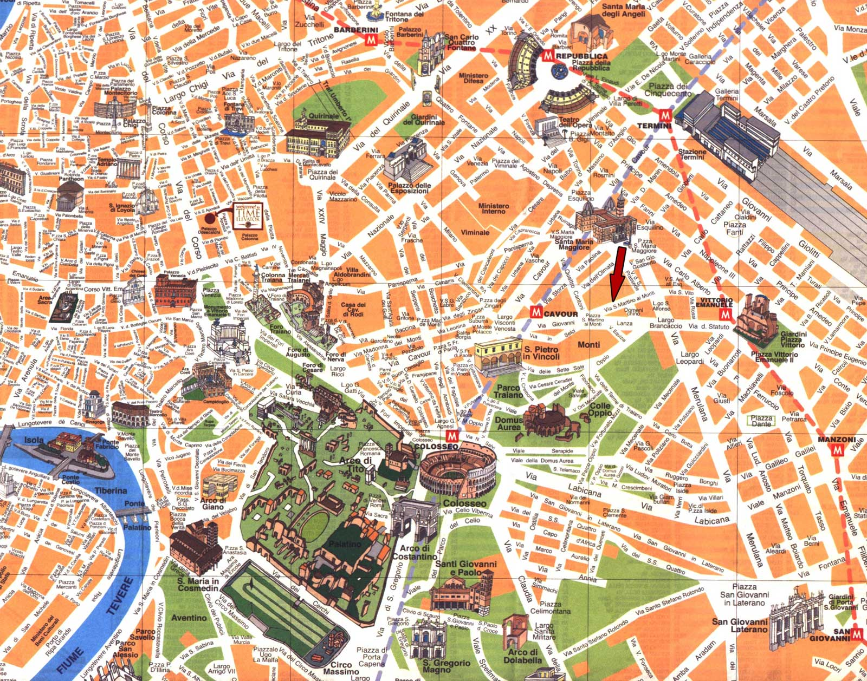
Rome Rebuilt
While the Romans tried to rebuild, they were attack from enemies all around. The rushed means by which they threw together their city demonstrates a lack of planning…

Slide 14
Manlius vs. Camillus
Not everyone was thrilled that Camillus was back. Although he had saved the city, many people were disturbed that Camillus was back and in such a position of power
Camillus Served as dictator 5 times in his life, always at the Romans’ request
A rival, Manlius, decided to compete using the plebs

Slide 15
A Man(lius) of the People
Helped indebted plebs
Manlius Capitolinus, the hero of the sack of Rome, used his own personal finances to buy debtors, including former soldiers out of prison
Some people didn’t like this…

Slide 16
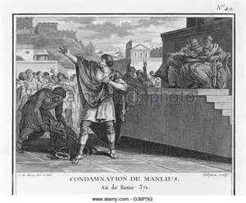
Hero and Savior? Or Wannabe King?

Slide 17
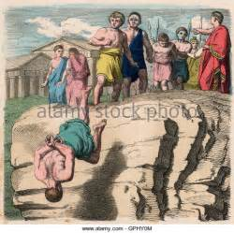
So He Was Hurled from a Cliff
The Tarpeian Rock, to be more specific

Slide 18
Plebs Wanted Authority
All of the land being conquered in Rome’s battles was being given to a select few Patricians, rather than the Plebs who were in need.

Slide 19
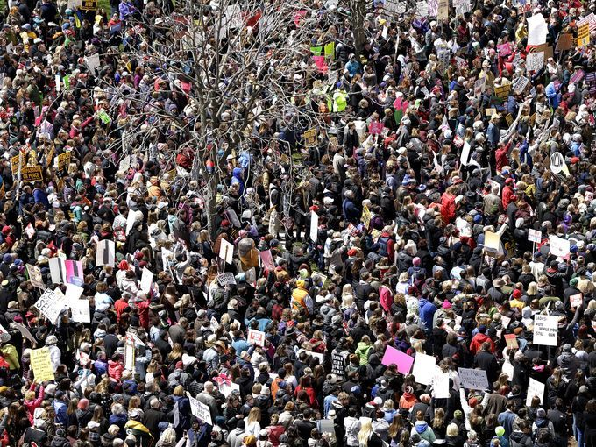
Licinius – Tribune with a plan
Utilizing Power of Veto – Nothing done
3 Demands
Of the two consuls, one COULD be Plebeian… eventually a must (367 BC)
Cap on the amount of land one can own
Cap on interest rates

Slide 20
For Tomorrow
Read – 74-76
Begin @ first full paragraph of 74. Read until “Samnite Wars”
Look for – Rome’s relationship with defeated/conquered communities

Slide 21
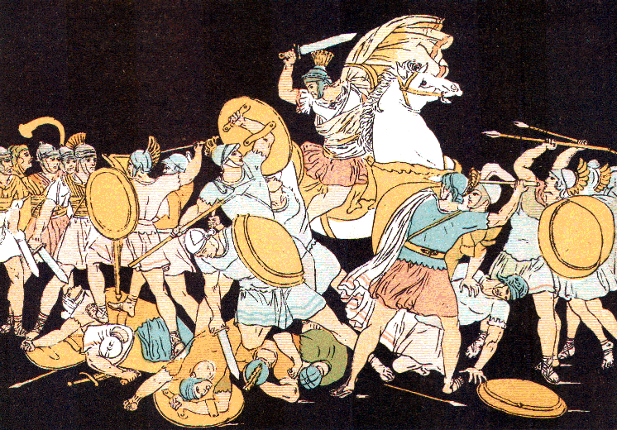
The First Samnite War
343-341 BC

Slide 22
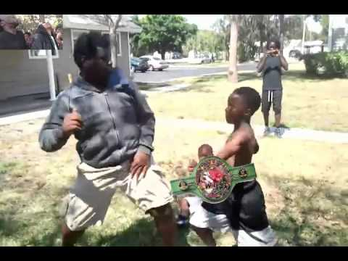
Big Kid on the playground
As Rome’s power increased, many peoples in Italy looked to the Romans as the settlers of disputes, or sought them as allies

Slide 23
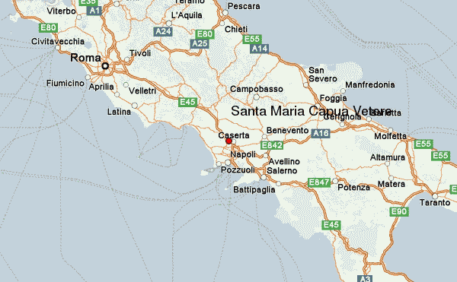
On such dispute breaks out
Rome had treaties with both the Samnites and the People of Capua, so when the Samnites began attacking Capua, they asked for Rome’s military assistance
But were denied

Slide 24
Rome did not want to take sides
The Romans were forced to tell Capua that, as per their agreement with the Samnites, they could not use military force to solve their affairs with other people…
That’s a thinker… Put on your Capua pants

Slide 25
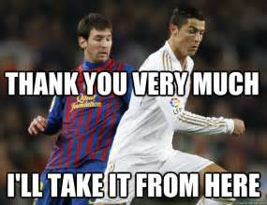
Capua gives itself to Rome
The Capuans give their city to the Romans…

Slide 26
Dear Samnites, please stop…
The Romans sent their emissaries to the Samnites to inform them of the change in circumstances

Slide 27
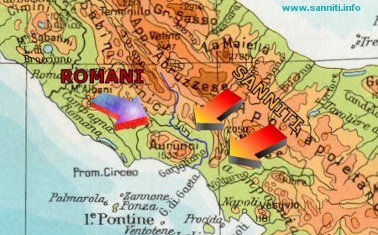
No…

Slide 28
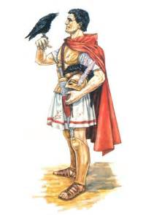
Marcus Valerus Corvus
Good Consul for the year 343
Hero from a war against the Gauls
Elected at the age of 23
Victorious, but difficult win in first battle vs. the Samnites

Slide 29
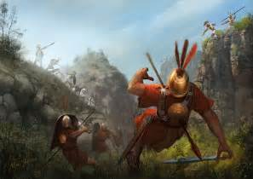
Decius Saves the Day
The other consul for 343, an idiot, led his troops into a trap
His troops began entering a narrow ravine when a military Tribune, Decius, noticed the Samnites on the higher ground

Slide 30
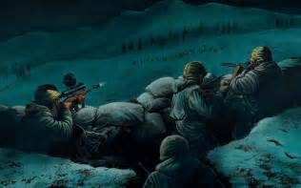
Decius saves the day (Part 2)
Decius noticed there was a hill from which he could destroy the ambushing Samnite force. He and a squad of men snuck up on the Samnites and saved the men in the Ravine.

Slide 31
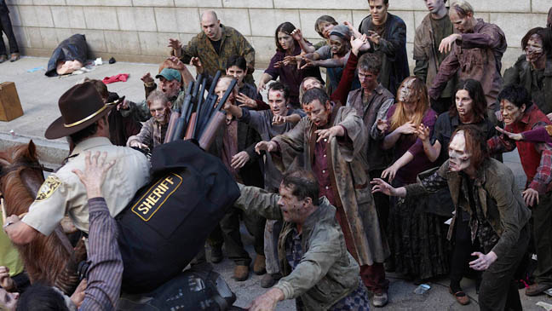
Decius Saves the day (Part 3)
Unfortunately, Decius and his men got trapped on the hill. They waited for the cover of dark and tried to sneak out
They were not very sneaky…

Slide 32
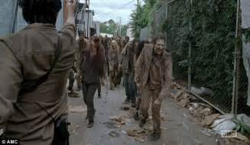
Decius Saves the Day (Part 4)
The Samnites woke up, but while they were stirring, Decius ordered his men to kill anything that moved…

Slide 33
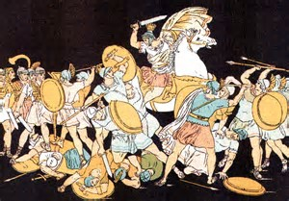
Step on their throats…
The next morning, when Decius reported back to the camp with all his men, he urged an immediate, incredibly successful attack against the confused Samnites

Slide 34
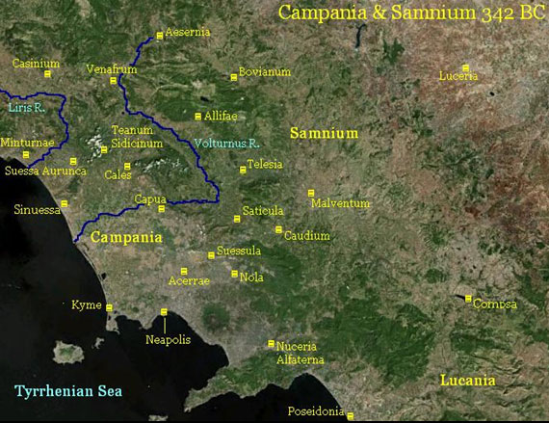
End of First Samnite War
Camping out in Suessula
Samnites underestimated the Roman Force – Small camp, rushed deployment
Divided forces easily conquered

Slide 35
Decius and Corvus Honored
Corvus and his co-consul were granted Triumphs
Decius awarded the highest military honor, the Grass Crown
Awarded by soldiers, to outstanding soldier

Slide 36
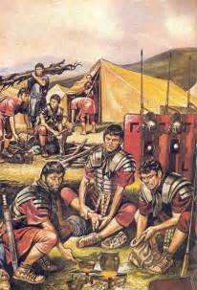
Rebellion for Capua’s Garrison
Mutiny discussed among the soldiers, who were bitter that Capua was living large, they were in army camps
Led by a kidnapped man…
Marcus Corvus (former Consul) named dictator… ended conflict peacefully

Slide 37
Quick break from the hostilities to focus internally
The Plebeians received, during this period, 2 very important political laws
1) One of the Consuls MUST be Plebeian
2) After holding the Consulship, one may not do so again for 10 years

Slide 38
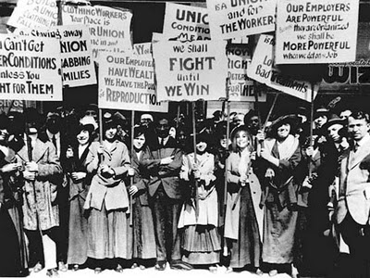
Latin War (340-338 BC)
The Latin communities who had helped out in this, and many other wars, decided that they wanted to demand equality from the Romans…
The Romans weren’t as responsive to these demands as say, the US to the suffrage movement…

Slide 39
They were much more responsive
The Latins saw that the Romans were “weak” in that they didn’t finish the war against the Samnites, but instead reached a peace
They decided to exploit this weakness

Slide 40
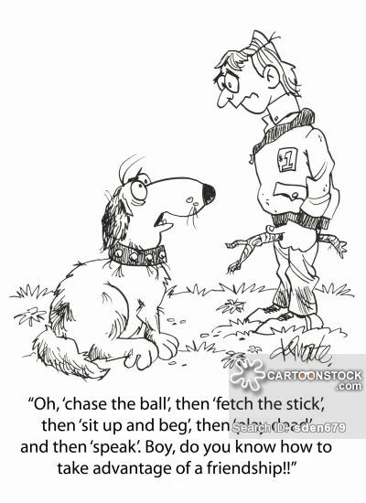
The Good and the Bad of Being Friends with the Romans
As the Romans expanded their power in Latium, they offered Latin communities deals
Protection for Forces
As the Romans became more and more powerful, and the Gauls an increasing threat, the Latin communities had no option but to give in

Slide 41
We demand our Rights!
The Latins sent emissaries, including a man named Annius, to demand that the Romans elect one of their Consuls and ½ of the Senate from the Latin Communities…
Lol…
He spoke ill of Jupiter Optimus Maximus during the meeting…

Slide 42
He was smited…

Slide 43
Rome Declares War
The Romans, under the leadership of their consuls Manlius and the 1st Samnite War hero, Decius, declare war against the Latin communities

Slide 44
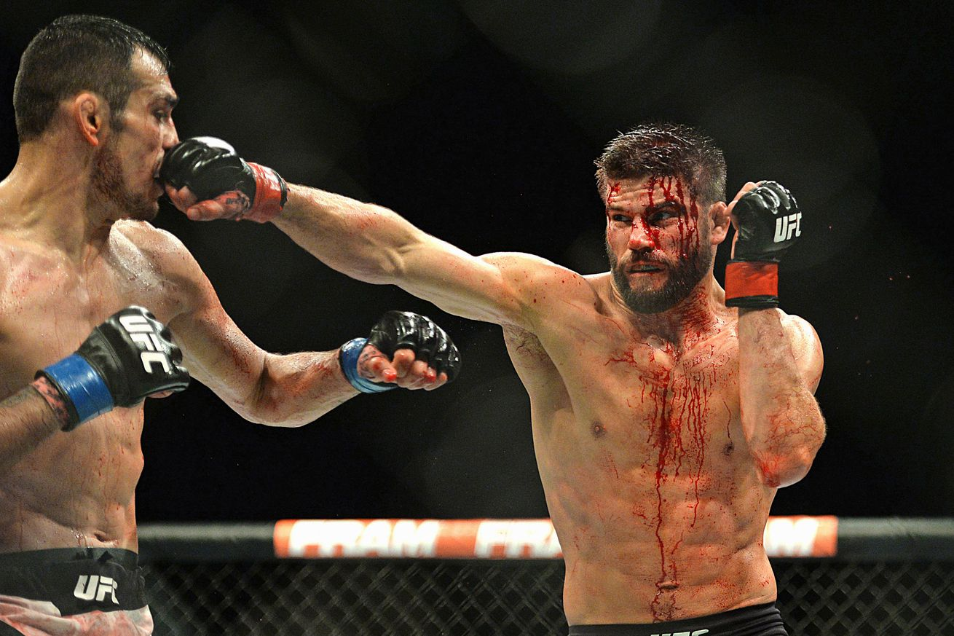
Rome vs Latin
The Romans and Latins were incredibly similar. Similar fighting tactics, similar language, similar gods, and even similar friends
It basically boiled down to who was going to fight harder

Slide 45
The Dreams…
The day before battle with the Latins, both consuls had the same dream.
They made an agreement that when it came time for battle, whoever seemed to be losing would sacrifice himself

Slide 46
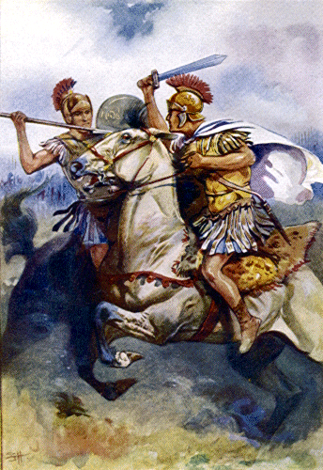
Titus Manlius… Rule Follower
Due to an omen they received, the Romans did not want to start the fighting
Romans ordered not to abandon their posts
Manlius’ son was goaded by one of the Latins…

Slide 47
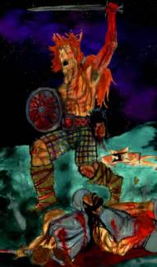
So he killed him
And came back to the camp with his spoils.

Slide 48
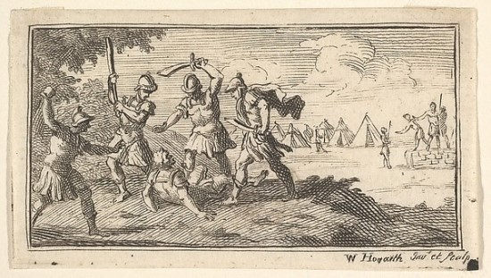
So his dad ordered him flogged and beheaded…
☹

Slide 49
This should remind you of something…

Slide 50
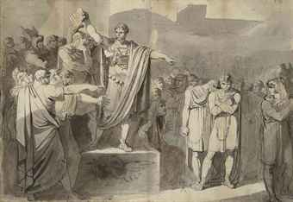

Slide 51
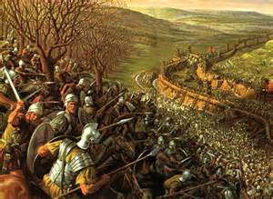
Divide and Conquer… and ally with your enemies
With the help of the Samnites, the Romans laid siege to each of the individual Latin cities.

Slide 52
By the end, Rome won.
Treated the cities differently
The cities who hardly resisted were granted citizenship
Quasi resistors kept their right to marry Romans and trade, but were denied suffrage
Significant resistors and leaders saw their lands stripped

Slide 53
Roman pragmatism
The Romans were happy to welcome more and more people into their communities as they expanded.
Policy of welcoming people who wanted friendship were accepted
Those who resisted were crushed
Led to an ethnically diverse empire
And some genocide…

Slide 54
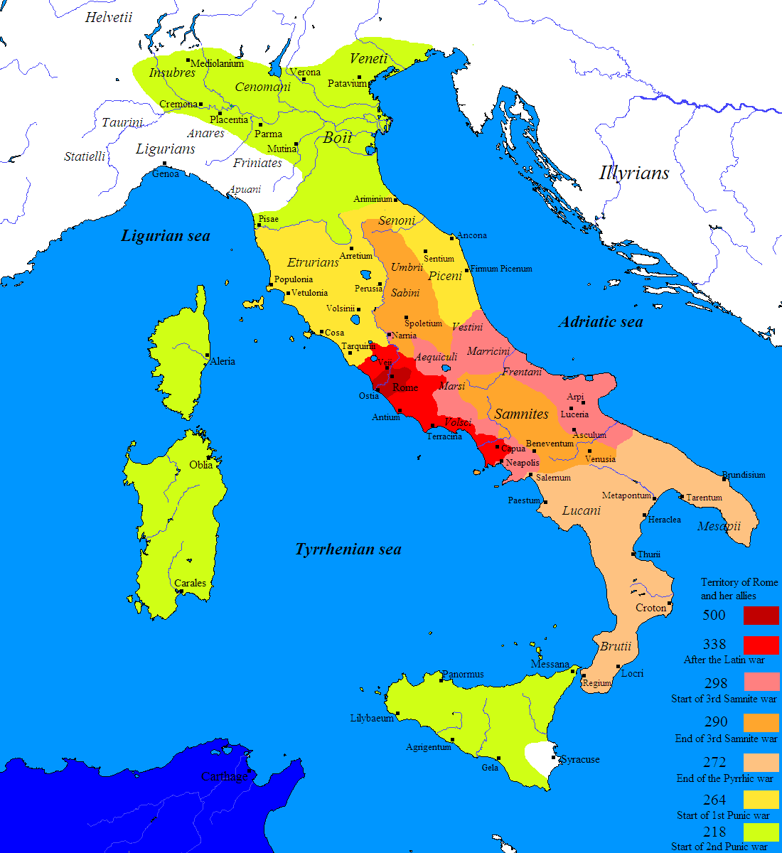
IT’s good to be the big dog
After defeating the Latin communities, the Roman saw the economic and military benefits of controlling more territory, so they set about expanding

Slide 55
The Second (Great) Samnite War (326-304 BC)

Slide 56
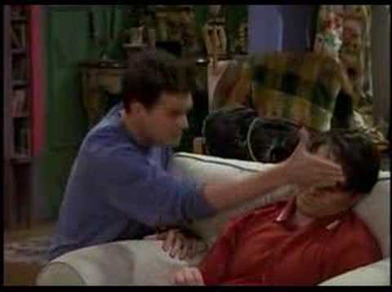
Rome didn’t want to “start” the war
So they just sent some colonists into Samnite territory… hoping either to gain land or provoke an attack

Slide 57
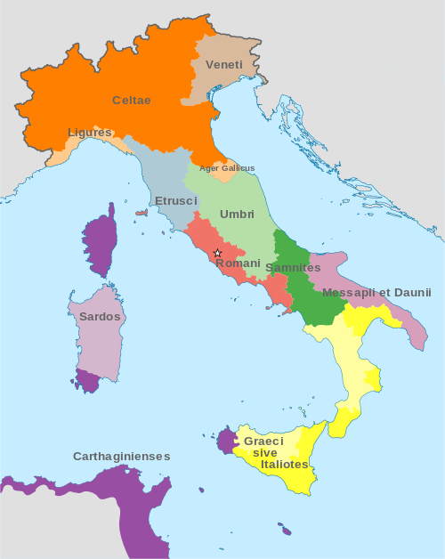
The Samnites had 99 Problems
Although the Roman colonies WERE one of them, the Samnites were already engaged in a war with the Greeks
Since the Samnites couldn’t resist, the Romans sent out more and more colonies
It finally became too much (Naples) -327 BC

Slide 58
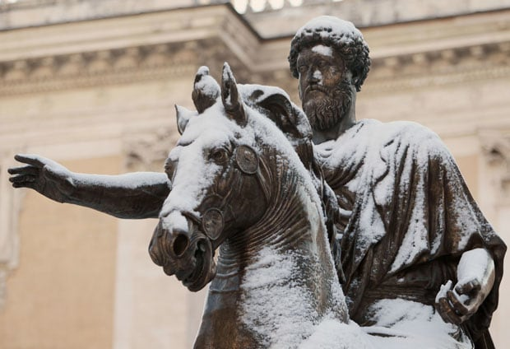
Rome’s Only True enemy, early on, was herself
325 – Dictator and Master of horse – received bad omens
Master of horse, couldn’t “hold his horses” for a better omen
Quintus Fabius Maximus

Slide 59
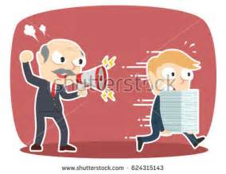
Fabius Crushed a Samnite Army
His dictator, however, was still livid
He had explicitly disobeyed his orders
The gods did not favor the battle… risked the relationship here
Fabius Arrested, despite his incredible victory
Fabius escaped and Ran to Rome, asking his dad for help

Slide 60
Hey there…. Mr. Grumpy Gills
The dictator, rather than executing Fabius, stripped him of his title and left him behind
He led his men into battle in which they were decisively defeated

Slide 61
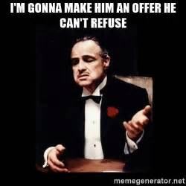
After Rome won a few victories ,
The Romans, who had the upper hand offered a peace treaty they knew the Samnites could never accept, so the war continued

Slide 62
The Battle of the Claudine Forks
The Romans were told by “captured” Samnite heardsmen where the Samnite army was
The Romans rushed to attack, but found themselves between literal rocks and a figurative hard place

Slide 63
Trapped

Slide 64
Samnite commander so successful he didn’t know what to do
Asked his dad for advide
Let them go
Kill them
Just don’t be an idiot…

Slide 65
He Elected for option 3
Embarrass the Romans…

Slide 66
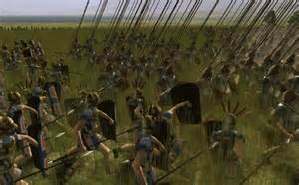
Well that was silly
The Romans did not accept the peace, eventually formed a new army, and soul crushed the Samnites, brining an end to the Second Samnite War (304)
The Peace Lasted Only 6 years

Slide 67
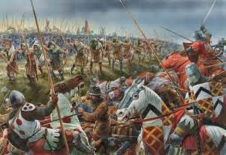
Third Samnite War
After just 6 years, the 3rd Samnite War broke out
The decisive battle was fought at Sentinum in 295
Consuls for the battle were
Quintus Fabius Maximus Rullianus and Publius Decius Mus

Slide 68
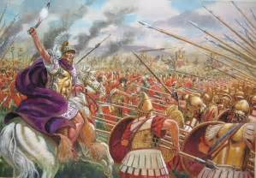
Roman Victory (again)
Although the battle looked as though it was turning away from them, Decius sacrificed himself, as his father had years before
His death inspired the troops enough to turn the tide against the coalition force

Slide 69
A Roman Italy
By the end of the 3rd Samnite War, the Romans controlled all of northern and central Italy… conflict in the south was inevitable.

Slide 70
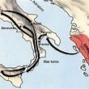
The Pyrrhic War
Pyrrhus, a descendent of Alexander the Great, was asked by the people of Tarentum, in Southern Italy, to arbitrate a disagreement between Tarentum and Rome…
This didn’t work out well…

Slide 71
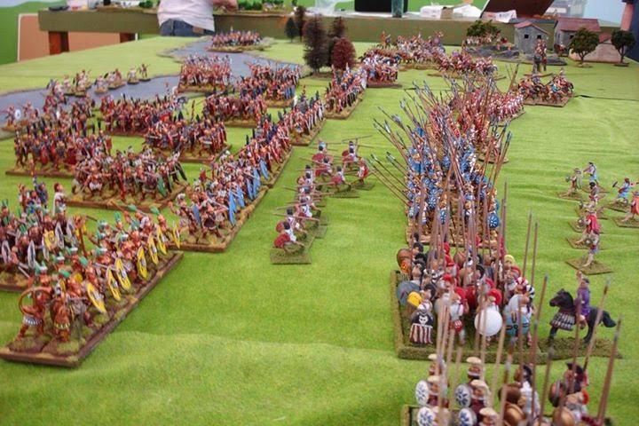
The Battle of Heraclea 280 BC
The first Pitched Battle was fought at Heraclea
Pyrrhus carried the day with the help of one of the most effective ancient battle units

Slide 72
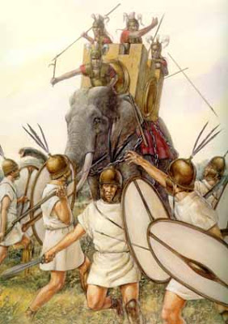
WAR ELEPHANTS!!!!

Slide 73
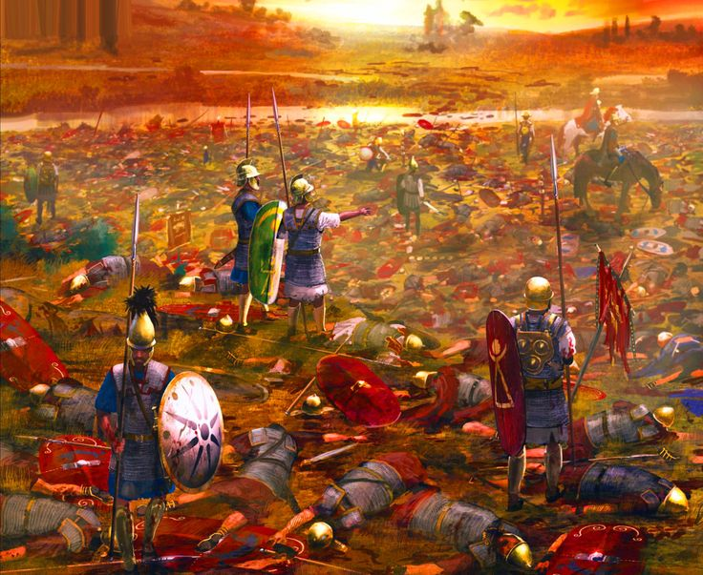
High Casualties
Casualty lists differ, ranging from 7,000 to 15,000 for the Romans and 4,000 to 13,000 for the Greeks.
This is when the system Rome had been establishing for decades was tested… and it worked wonders

Slide 74
The Allies stay allied
Pyrrhus had hoped to get Rome’s allies to abandon her, but they stayed true
Rome’s ability to replenish its armies proved to be the turning point in the war

Slide 75
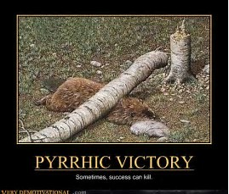
Battle of Asculum and the Pyrrhic Victory
Pyrrhus won his second battle against the Romans, this time in 279 BC at Asculum.
Although victories, Pyrrhus knew that his cause was dammed

Slide 76
Major Non-War Developments
Appius Claudius
Although he abused his power as Censor and filled the Senate with yes men, Appius Claudius is remembered for two major developments in Roman infrastructure

Slide 77
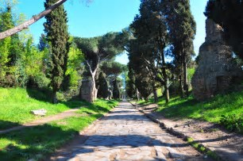
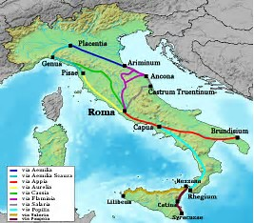
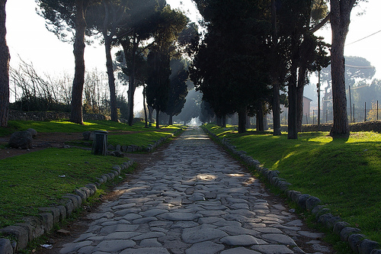
The Appian Way
A Roman road that stretched from Rome to Brindisi allowed for the Romans to move their troops much faster during the Third Samnite and Pyrrhic Wars

Slide 78
Aqua Appia
He also built Rome’s first Aqueduct, which flowed over 15 KM to Rome and supplied the city with a constant source of Fresh Water

Slide 79
Marcus Valerius (Corvus) Establishes an important precedent
Despite the Romans wanting to reelect his as Consul to fight in the third Samnite war, Marcus Valerius refused to stand for office to show respect for the 10 year moratorium on repeating the office of Consul

Slide 80
The Roman Maniple

