Slide 1
The Sack of Rome
~390 BC
The End of the Beginning

Slide 2
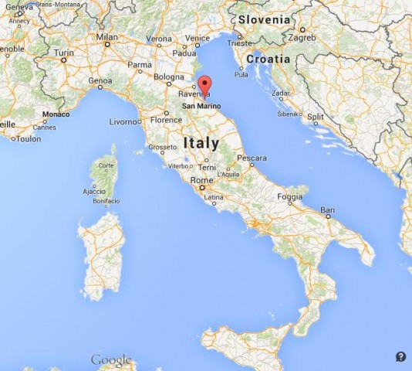
Helping a Friend in Need
Although there are various accounts for WHY, we know that a group of Gauls entered Rome and threatened an ally of Rome
The Romans dispatched 3 emissaries (The Fabii) to show their support for Rimini

Slide 3
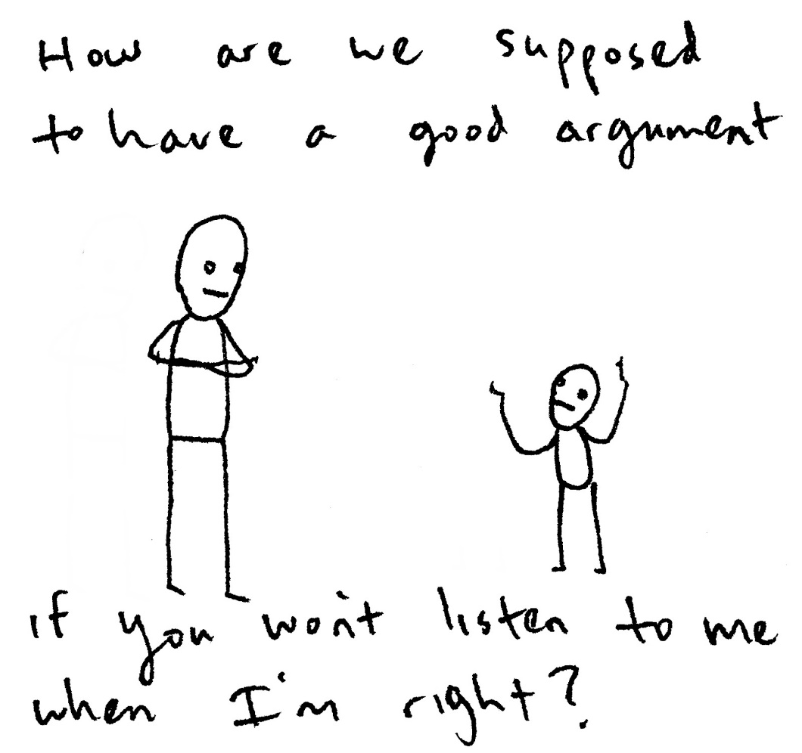
Not quite how they wanted it to go
The negotiations went wrong and a fight erupted
Violating diplomatic neutrality, the Roman diplomats took the side of the Rimini in the argument…

Slide 4
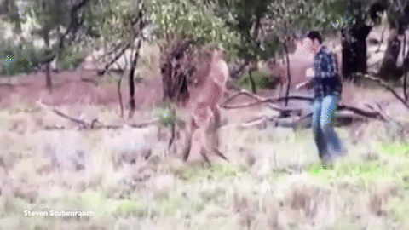
…
And killed a Gallic Chieftain

Slide 5
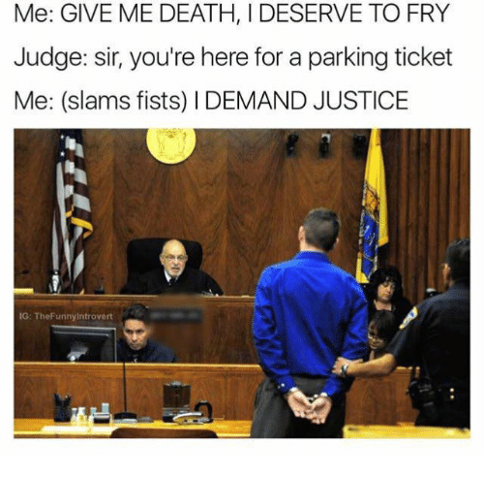
The Gauls Demand Justice
When the Gauls dispatched their own diplomats to Rome, demanding that the Fabii be turned over to face justice, the Senate decided to allow the Roman people to vote on what ought to be done with them

Slide 6
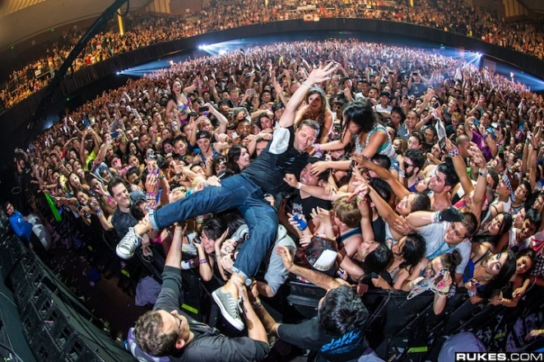
They Did
Instead of condemning the Fabii to death at the hands of the Gauls, they instead elected them as the leaders of Rome (basically to the consulship)

Slide 7
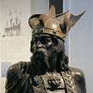
The Armies
Gaul’s Forces
Estimated between 12,000 and 70,000 –led by Brennus
Rome’s Forces
Estimated to be between 15,000 and 40,000
Numbers are probably exaggerated

Slide 8
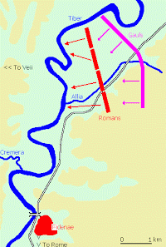
The Battle of Allia
The Gauls advanced on Rome far more rapidly than the Romans had anticipated, and they were largely unprepared for the battle
Rome was thunderstruck by the swiftness at which they moved, which is shown both by the haste in mustering the army, as if it were meeting a spur-of-the moment emergency and the difficulty in getting any further than the eleventh milestone.” ^{Livy}

Slide 9
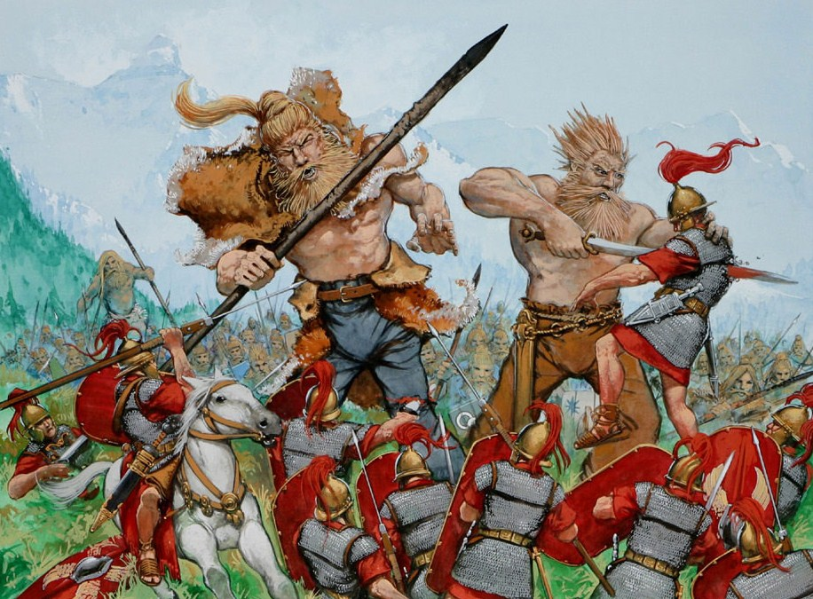
Panic
The Romans were crushed
The Left Flank ran away to Veii
There’s a big problem there…
The Right Flank ran to Rome

Slide 10
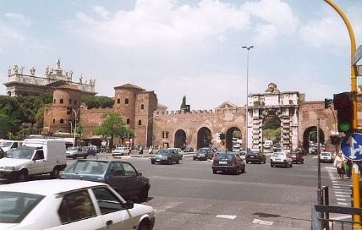
On to Rome
The Gauls were amazed by the ease of their victory
They set off for Rome before sunset and as they approached, were amazed to find the city gates open
But they didn’t go in

Slide 11
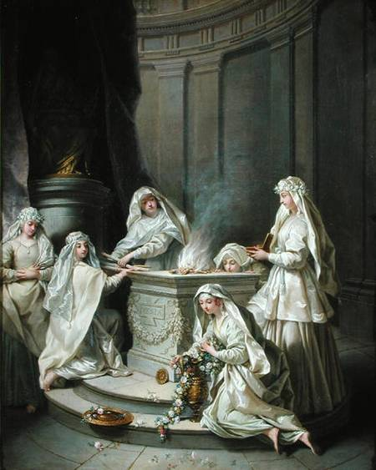
Retreat to the Capitoline
The Remaining soldiers as well as the younger members of the senate retreated to the Capitline Hill
The Vestal Virgins and Flamen of Quirinus left to take shelter on a hill just outside the city
They were forced to abandon many sacred artifacts
The Elderly and poor were abandoned

Slide 12
The Gauls Looted… and played with beards…
The houses of the plebeians were barricaded, the halls of the patricians stood open, but they felt greater hesitation about entering the open houses than those which were closed. They gazed with feelings of real veneration upon the men who were seated in the porticoes of their mansions, not only because of the superhuman magnificence of their apparel and their whole bearing and demeanour, but also because of the majestic expression of their countenances, wearing the very aspect of gods. So they stood, gazing at them as if they were statues, till, as it is asserted, one of the patricians, M. Papirius, roused the passion of a Gaul, who began to stroke his beard - which in those days was universally worn long - by smiting him on the head with his ivory staff. He was the first to be killed, the others were butchered in their chairs. After this slaughter of the magnates, no living being was thenceforth spared; the houses were rifled, and then set on fire.

Slide 13
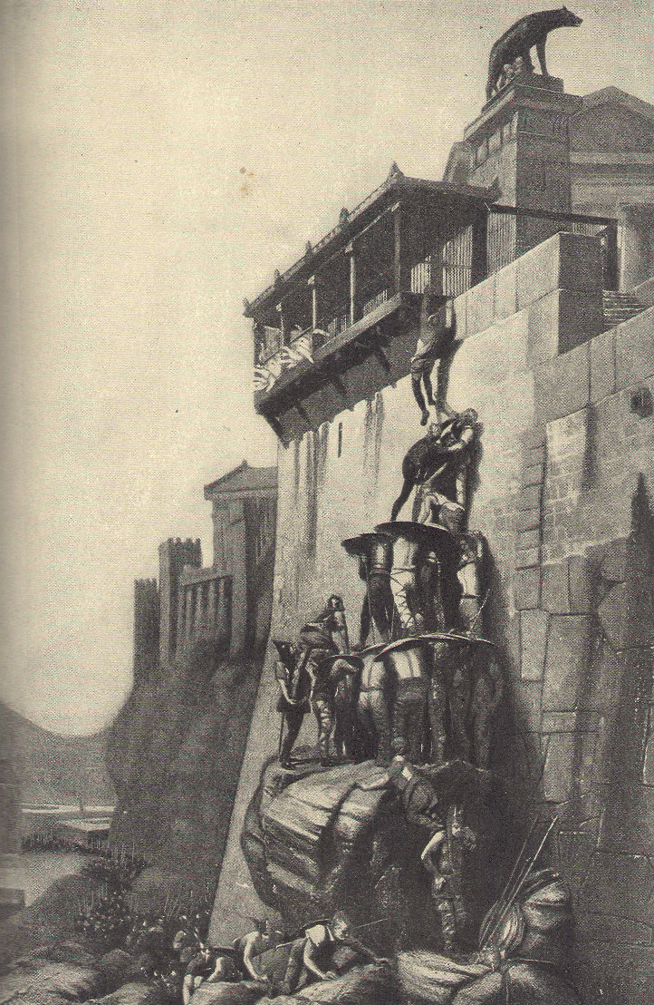
Didn’t want to Destroy
The Gauls tried to lure those on the Capitoline Down, but they refused to surrender
They Repelled Gallic advances up the hill
Needed a commander to come save them… footprints
They finally found a way up the hill, but the Romans were saved by their gods

Slide 14
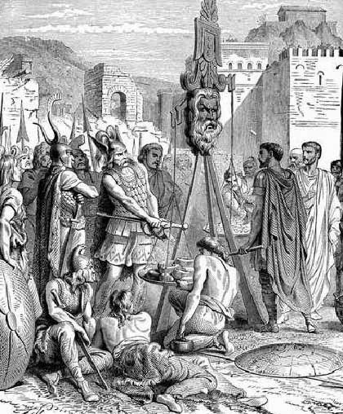
The Armies Grow Wary
The Siege Began to Work
The Ransom
Both armies were growing tired and hungry, the Gauls were sick, so both sides agreed to a Ransom of 1000 pounds of gold
“Woe to the Vanquished”

Slide 15
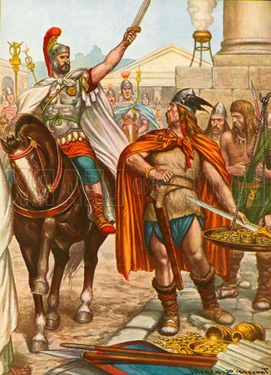
Help Arrives
A Roman Consul, Camillus, arrived, and vetoed the deal
He subsequently soul crushed the Gallic Army

