Slide 1
Numa Pompilius

Slide 2
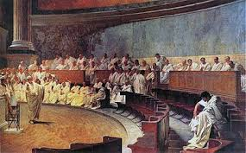
Chapter 17- AJ
After Romulus reign The senators were fighting over the kingship, The people wanted a king that they new and trusted.
The senators decided they were all going to switch responsibilities every 5 days.
For one year Rome was an oligarchy and the people were fed up and wanted a monarchy.
The senate wanted to please their plebs (people) so they granted them the power to choose whatever leader they wanted, with the senate's approval.
The plebs (people) were so pleased that they let the senate choose their leader.

Slide 3
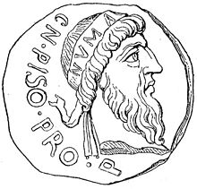
Roam hit up Numa
Grew up in a Sabine City
Roman interex asked Numa to be their king
They didn’t have any other options and Numa was super smart

Slide 4
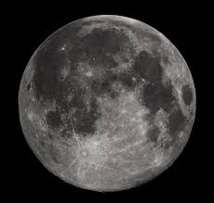
Temple of Janus and Religion
Numa was against war and created religion so that he could pacify his barbaric and uncivilized people
At the base of Aventine (a hill in rome) Numa built the temple of Janus, The doors opened when there was war and the doors closed during peacetime
He pretended to have nocturnal meetings with Egeria, a God and his wife, to appoint priests and establish rites
He divided the year into twelve months (a lunar calendar) and created days off for his people

Slide 5
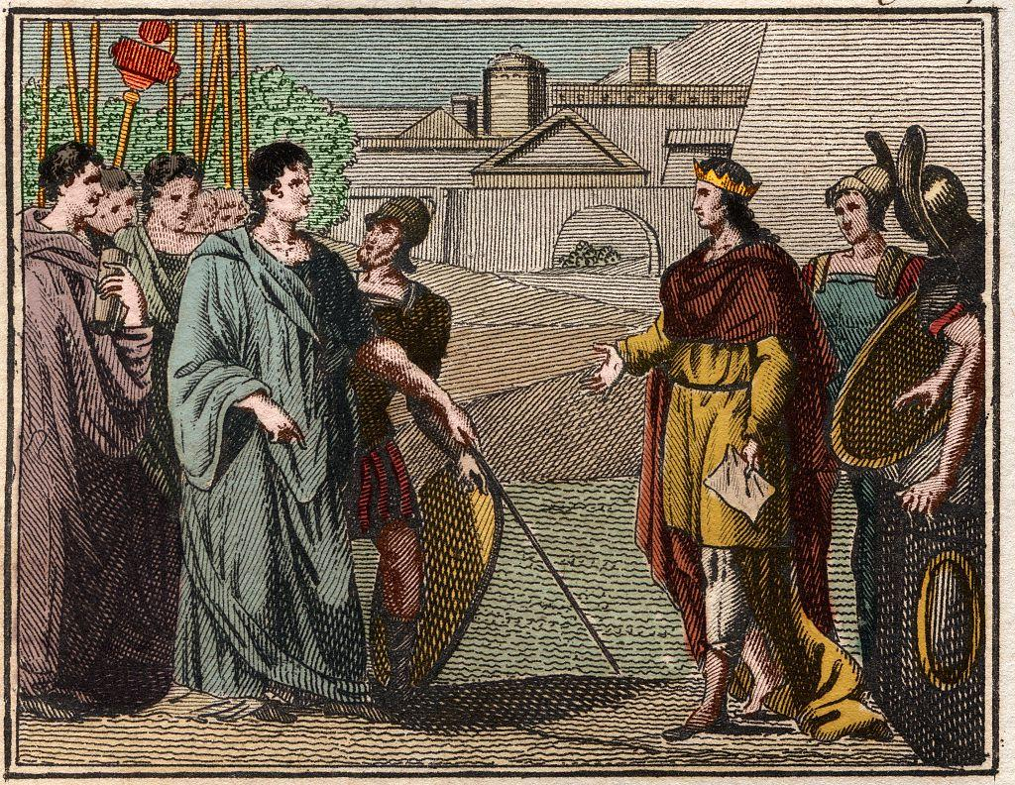
Chapter 20 - Numa and religion
Under King Numa Important developments in religion took place.
King Numa appointed many different Flamen ( priests)
Flamen were appointed to gods of Mars, and Jupiter
Numa took initiative to “ build up” the church and roman religion.
In addition to appointing flamen he appointed the Pontifex Maximus (pope)

Slide 6
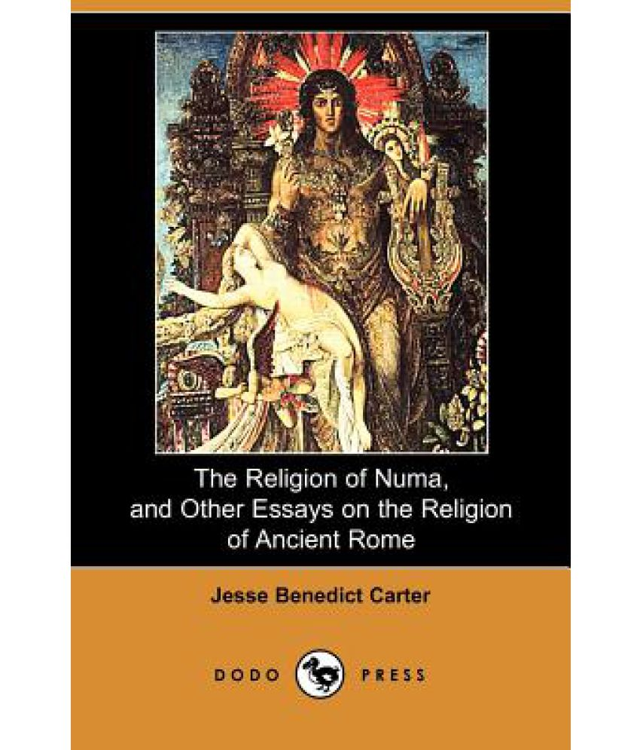
Victor-21: the reuniting
Romulus was a terrible ruler, he left the citizens in chaos.
However when Numa was in power he controlled his citizens through religion.
With religion he was able to calm his citizens.
Even the neighbors hated them at one point.
God's watching citizens, better be good.
Numa Pompilius

Slide 7
http://www.perseus.tufts.edu/hopper/text?doc=Perseus%3Atext%3A1999.02.0151%3Abook%3D1%3Achapter%3D21

