Slide 1
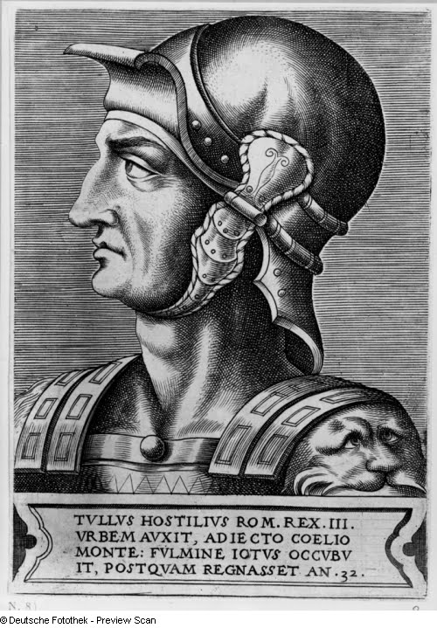
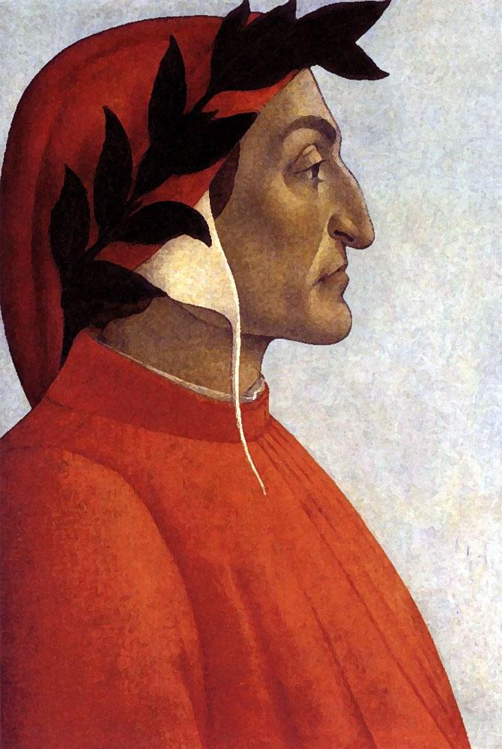
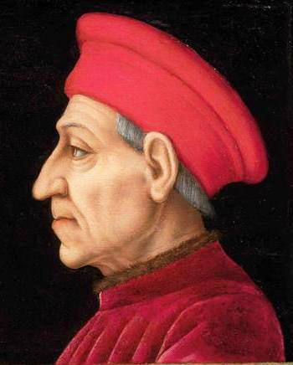
Tullus Hostilius
673–642 BC
Notes:
Draven

Slide 2
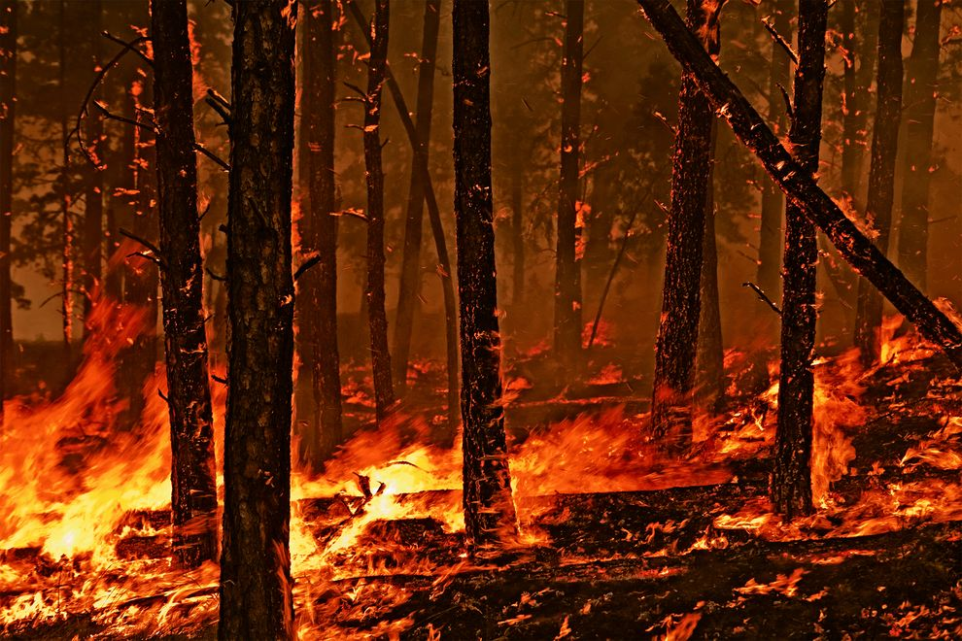
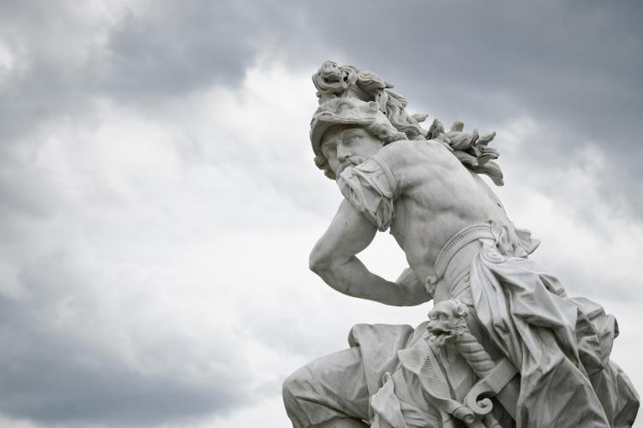
Who Was He?
Warlike and Bloodthirsty
Didn’t heed the Gods
Notes:
Draven

Slide 3
Albans
Tell your king ‘that the king of Rome calls the gods to witness that whichever nation is the first to dismiss with ignominy the envoys who came to seek redress, upon that nation they will visit all the sufferings of this war.’
Notes:
Brett

Slide 4
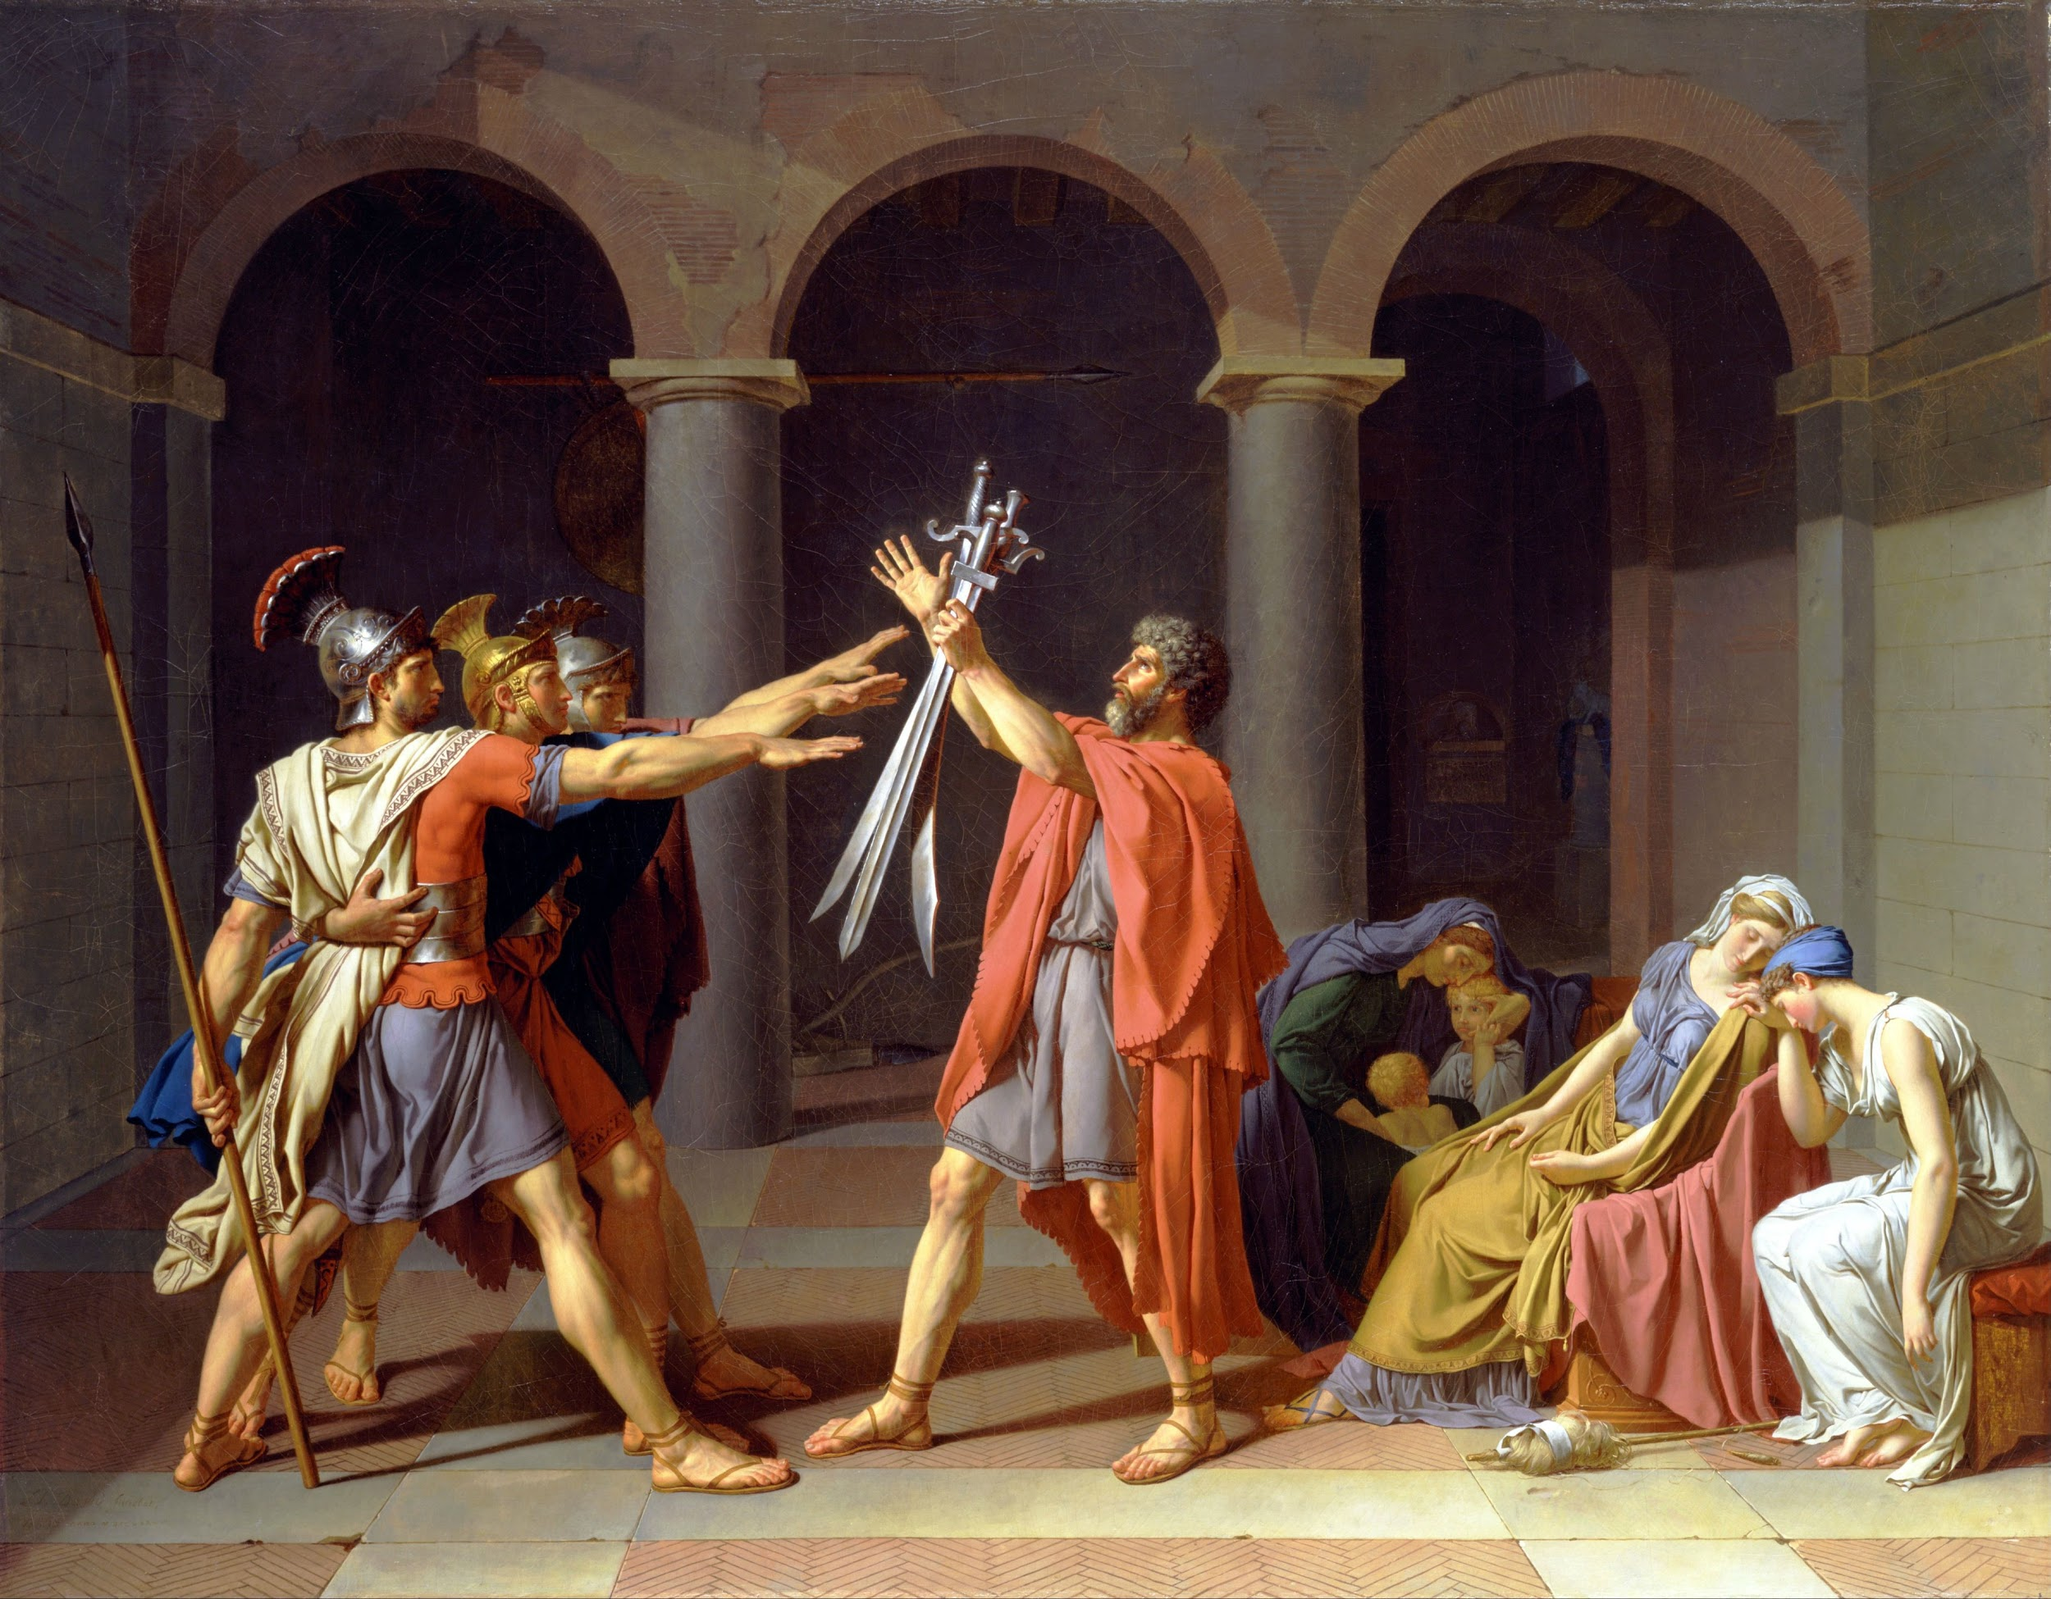
Horatii v Curiatii
Notes:
Tyler

Slide 5
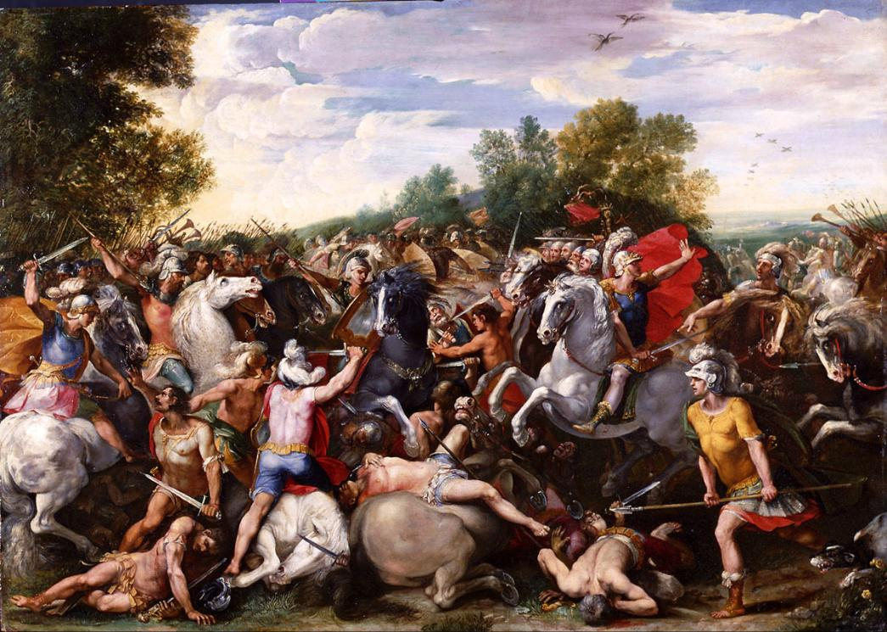
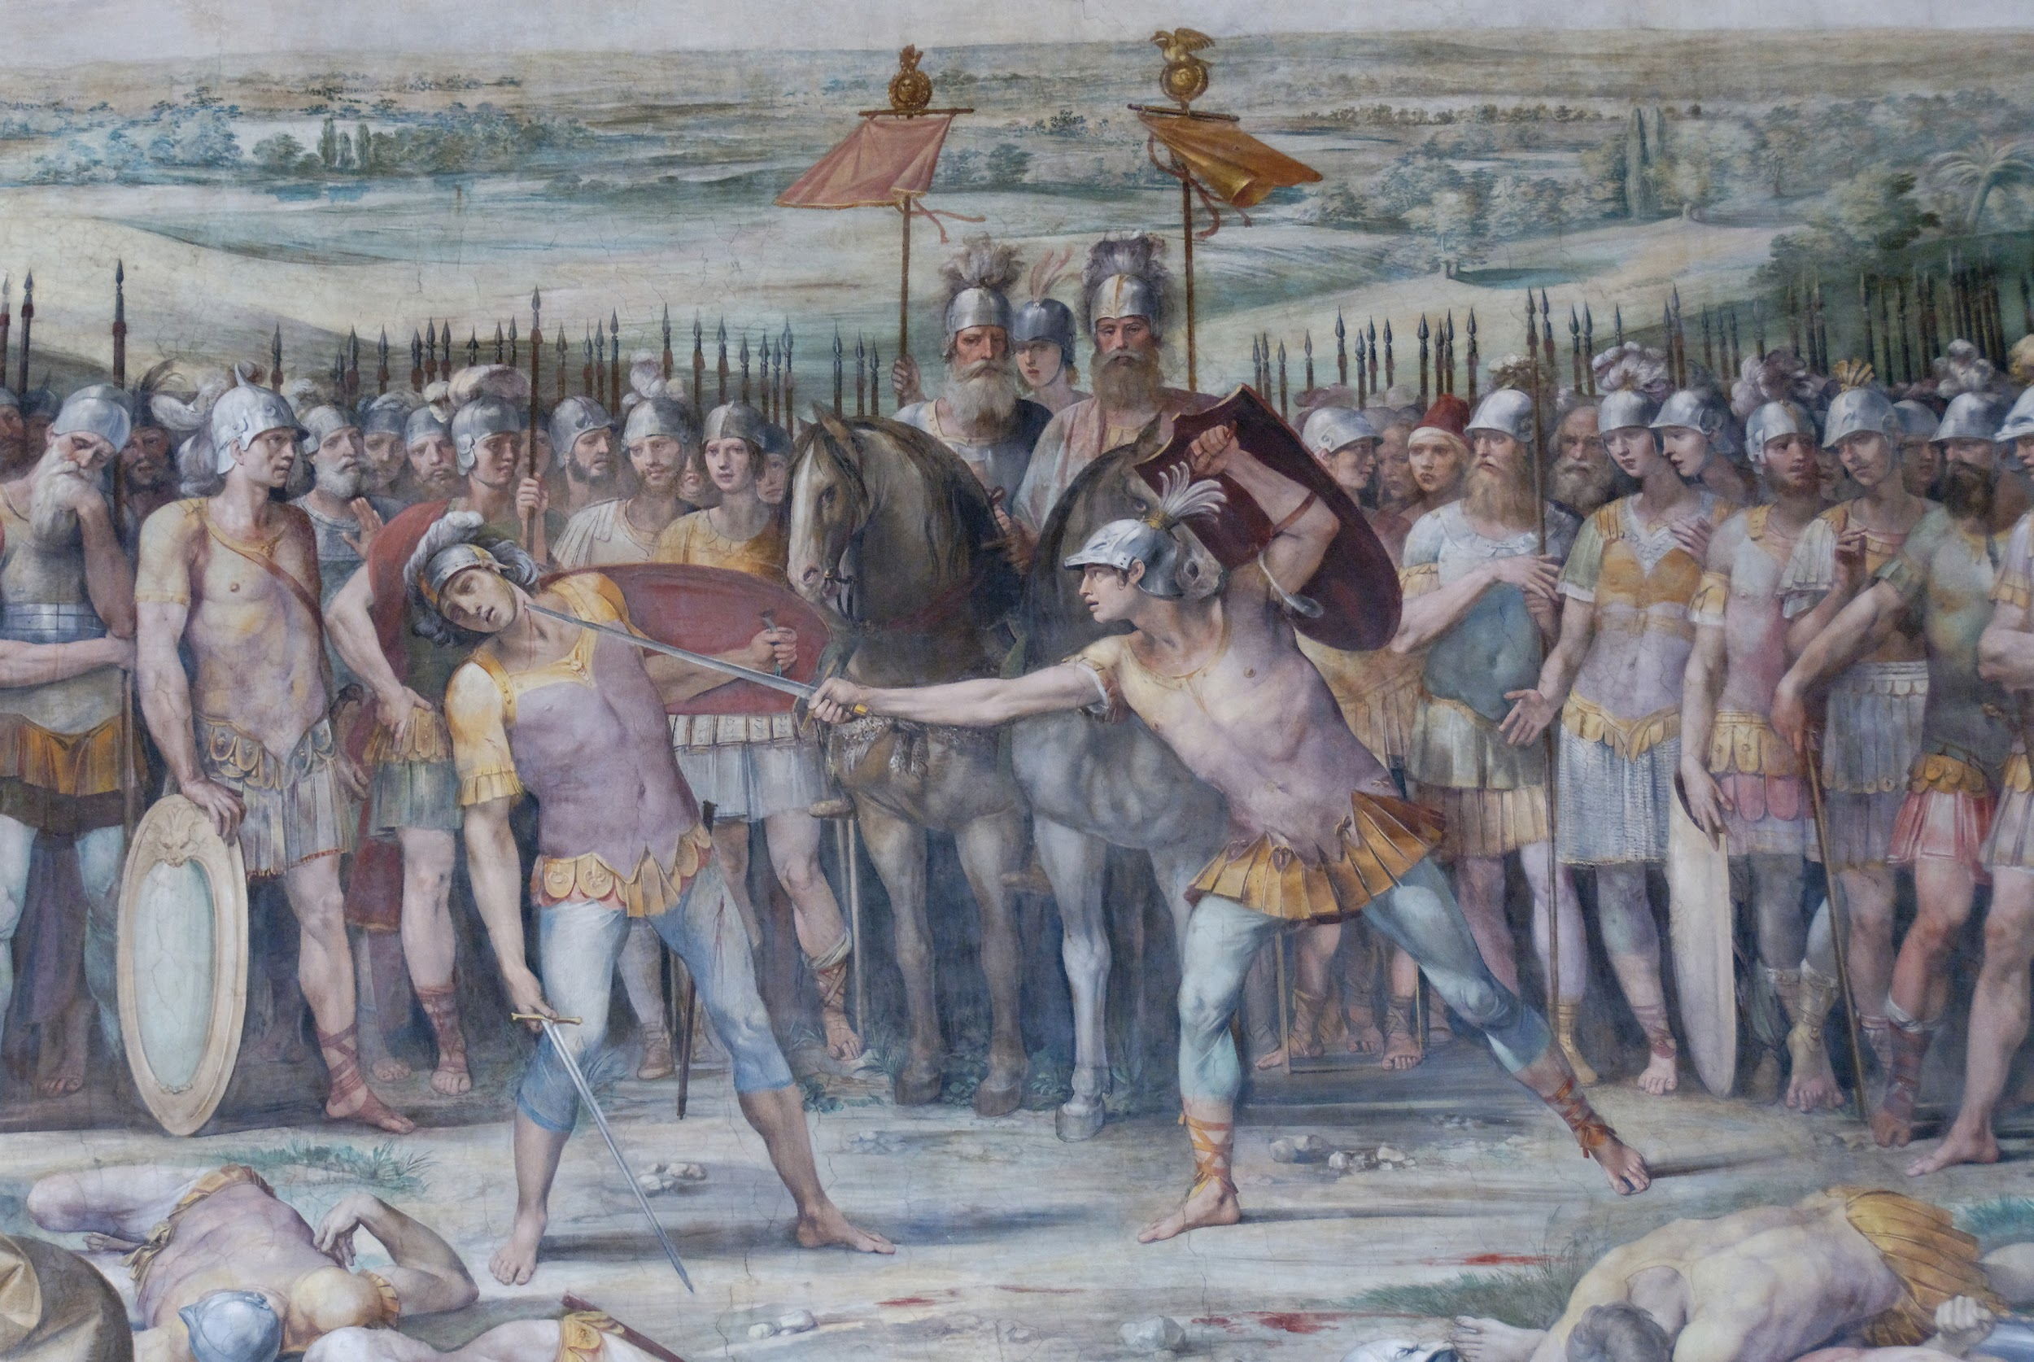
Alban Betrayal
Fidenates and Veientines
Albans retreated, Romans still won.
Mettius Fufetius killed
Alba Longa destroyed, citizens brought to Rome
Notes:
Tyler

Slide 6
War with the Sabine
Circa 1430
Notes:
Liam
<3

Slide 7
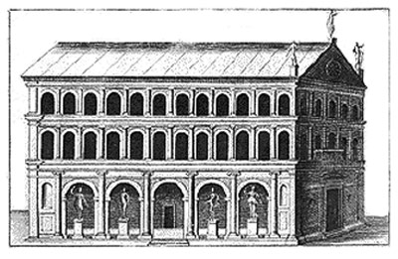
Curia Hostilia
Notes:
Liam
<3

Slide 8
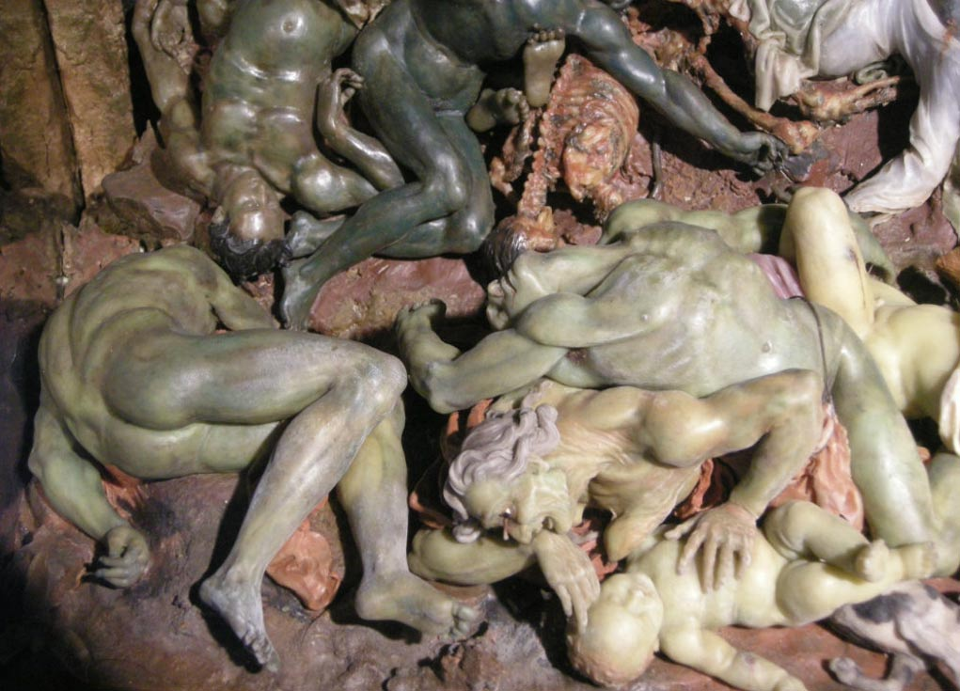
Plague
Notes:
Ryan

Slide 9
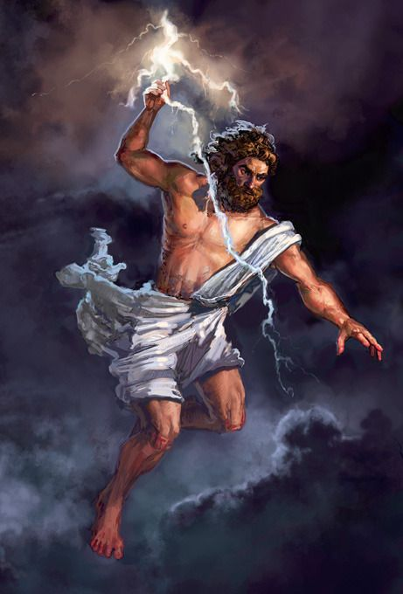
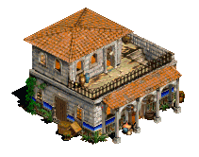
Death?
Notes:
Ryan

