Slide 1
Tarquinius Superbus

Slide 2
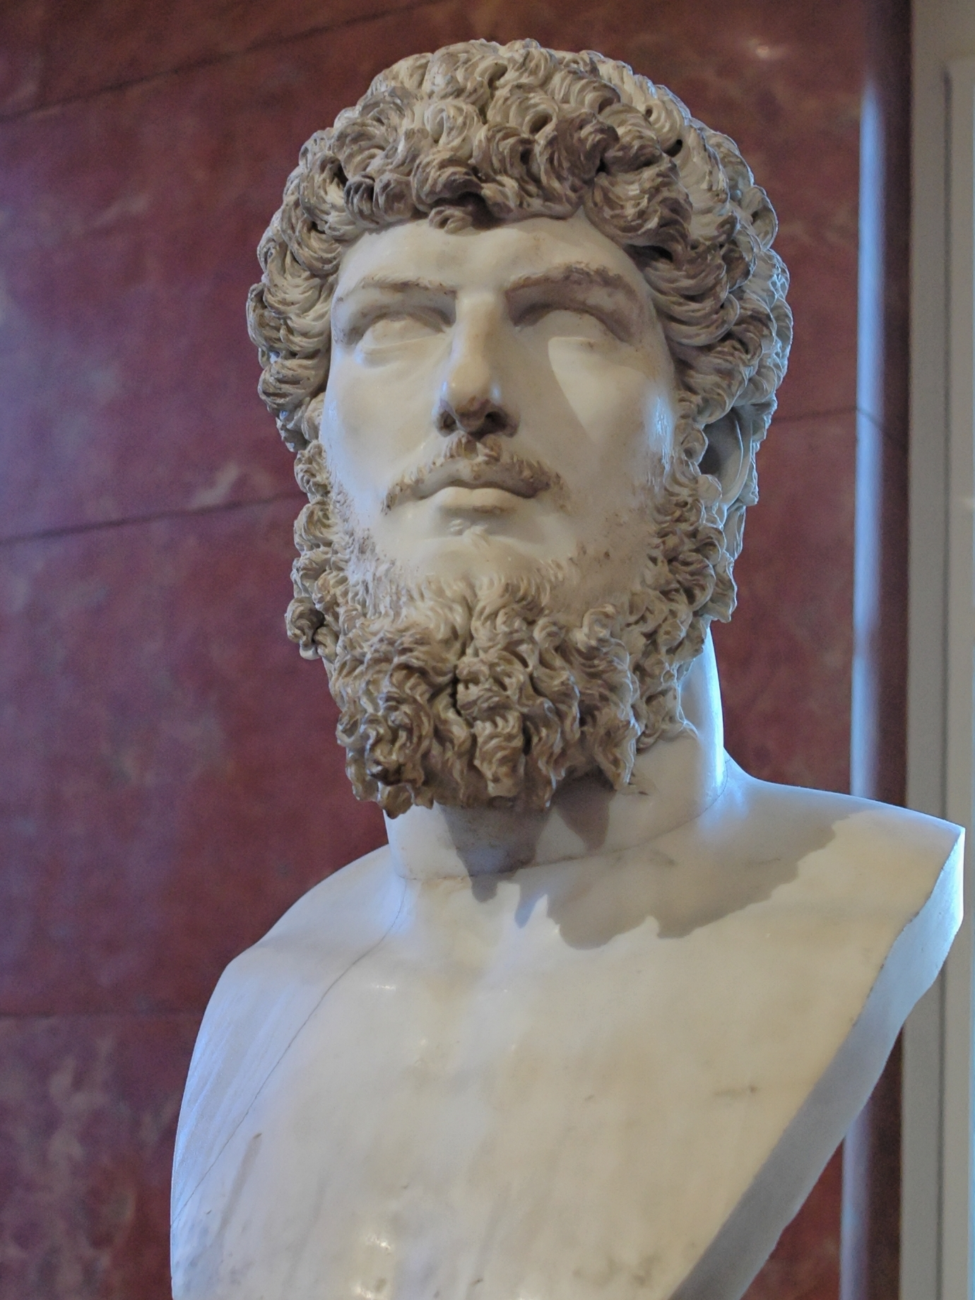
Background:
Tarquinius Superbus was the son or grandson of the fifth king, Tarquinius Priscus.
He reigned from 535-509 BCE
Tarquinius Superbus came to power after the king Servius Tullius.

Slide 3
How he came into power:
-His wife Tullia convinced him to overthrow the reigning king, Servius Tullius
-Tarquinius sent assassins murder Servius as well as all the senators that supported him. He was then declared king.

Slide 4
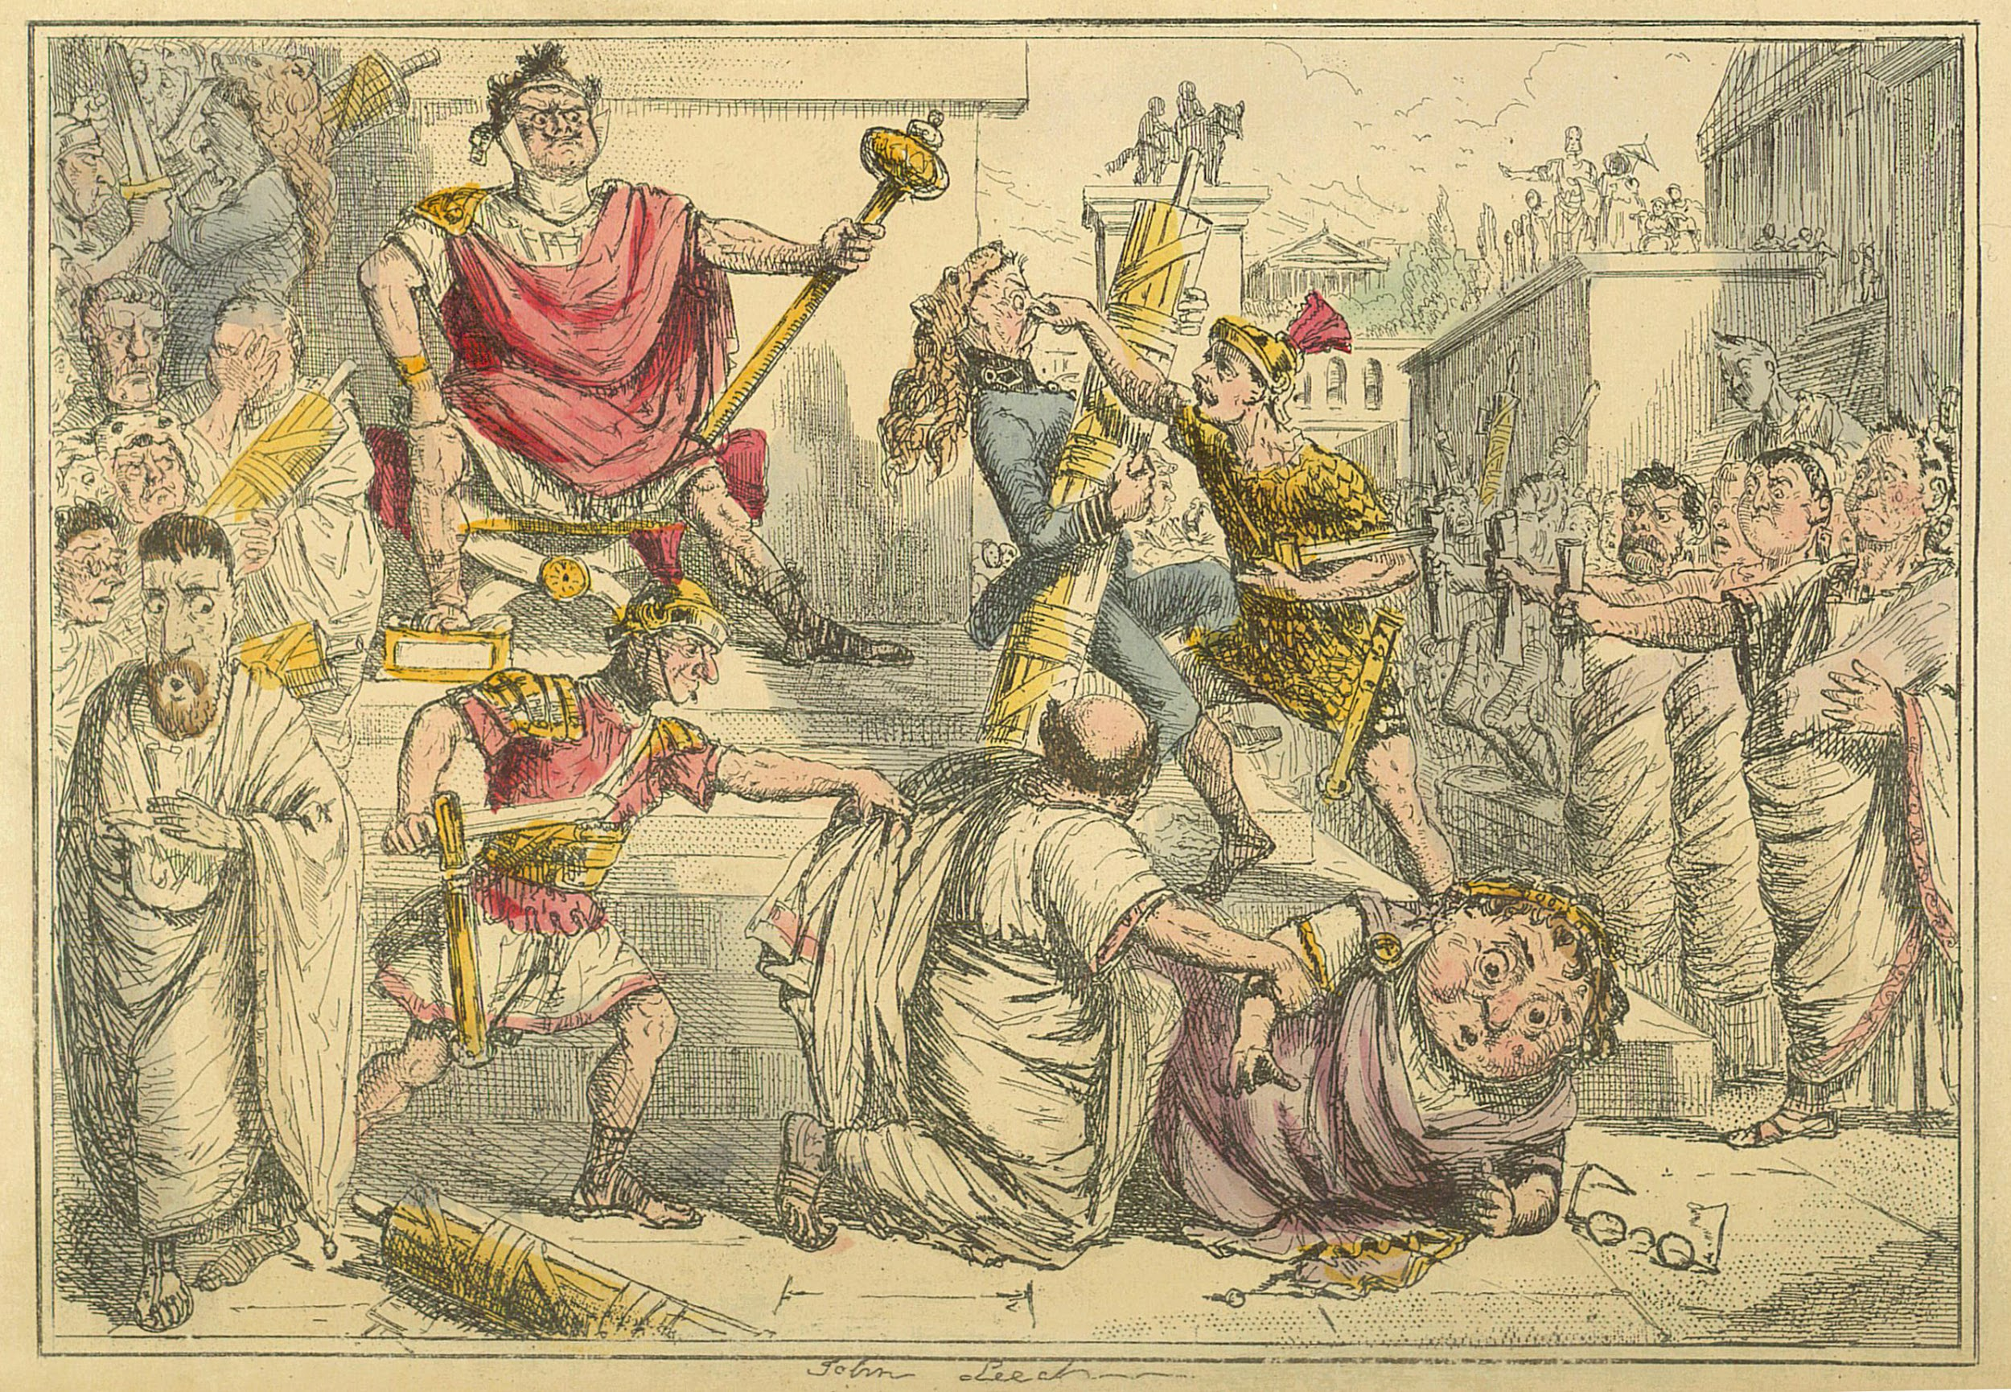

Slide 5
Reign:
Superbus began his reign by refusing to bury dead Servius, and by putting to death many senators.
He did not replace these dead senators and therefore weakened the power and size of the Senate.
Superbus did not consult the Senate when making decisions.

Slide 6
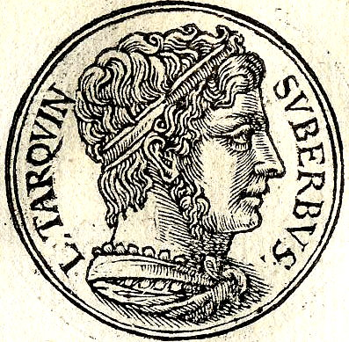

Slide 7
Reign (cont.):
Early in his reign Superbus called a meeting to discuss relations between Rome and Latin towns.
At the meeting, Turnus Herdonius, spoke out about Superbus’s arrogance and warned people not to trust him.
Superbus then convinced fellow Latin leaders that Turnus was trying to assassinate him and had Turnus killed.

Slide 8
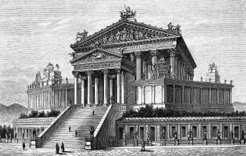
Reign (cont.):
Superbus was the first king to start war against the Volscians (a war which would last 200 years after his reign)
After taking a wealthy town, he celebrated by making the Temple of Jupiter Optimus Maximus.

Slide 9
Reign (cont.):
Superbus agreed upon peace with the Aquei, and renewed a treaty of peace between Rome and the Etruscans.
He won victory over the Sabines and established Roman colonies in Signia and Cerceii.

Slide 10
Overthrow/Exile:
-Tarquinius embarked on a conquest against the Rotuli, which resulted in a siege
-Sextus Tarquinius raped Lucretia and she later committed suicide
-Brutus convinced the roman comitia to revoke Tarquinius’s imperium and exile him.
-Tarquinius arranged an army with his allies and fought against the Roman army to maintain power, he loses and is exiled

Slide 11
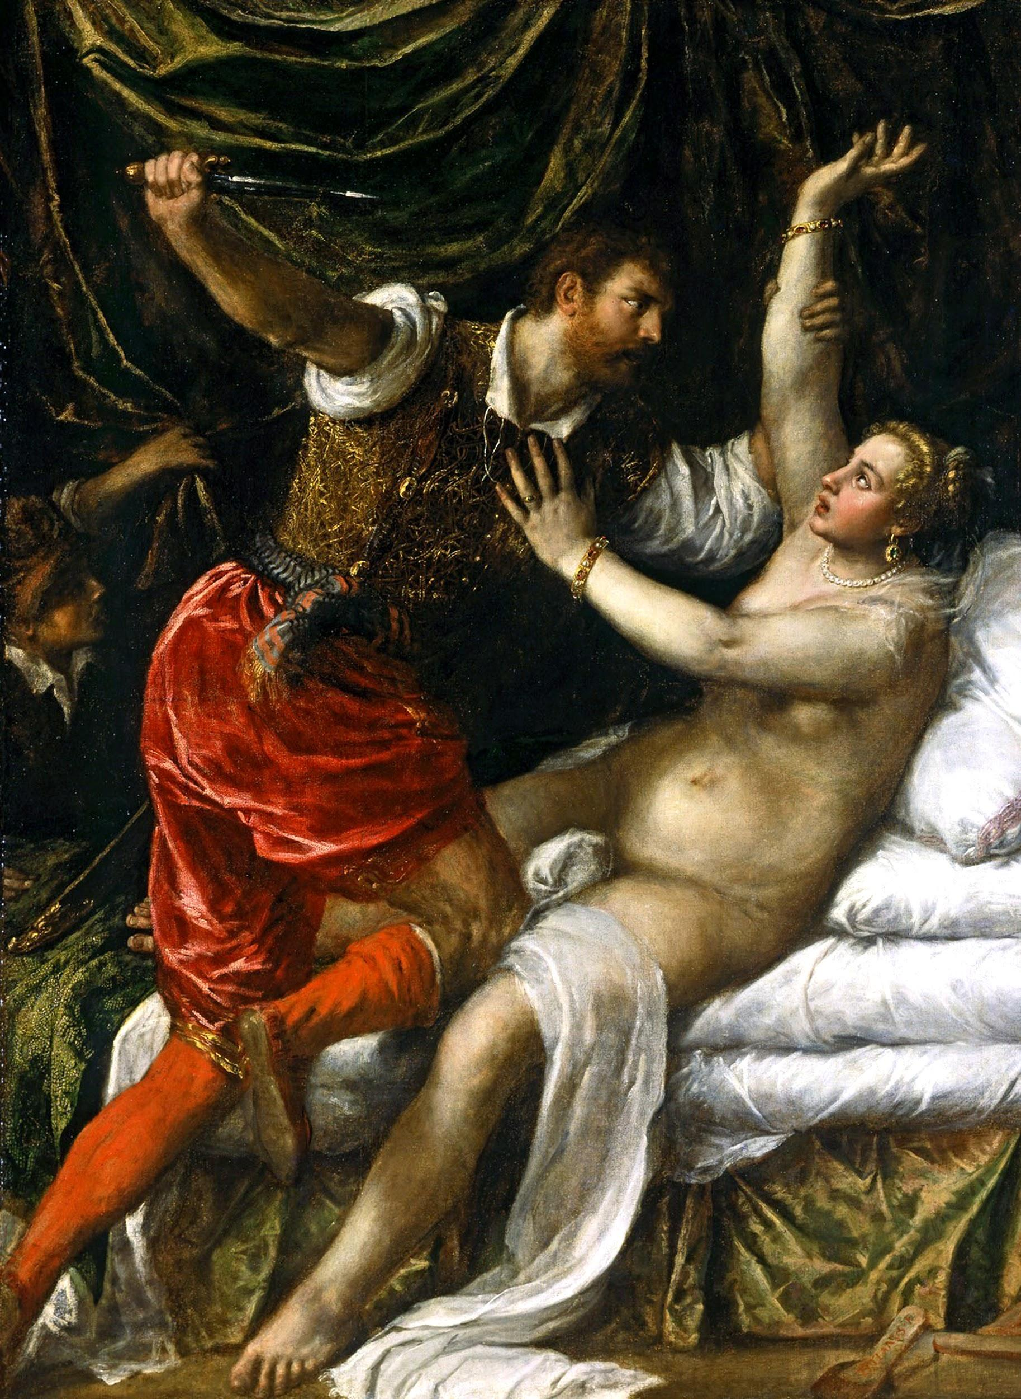

Slide 12
Overthrow/Exile (cont.):
-Tarquinius attempted to return from exile with a latin army
-He lost, and his only remaining son died
-Tarquinius finally went to Cumae before his death in 495 BC
-Tarquinius’s overthrow led to the start of the Roman Republic.

Slide 13
