Slide 1
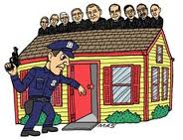
The Exclusionary rule

Slide 2
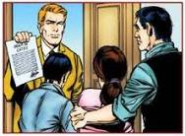
Exclusionary rule
This rule stems from the Fourth Amendment, which protects citizens from unreasonable searches and seizures.
This rule is meant to discourage the police from breaking the rules in conducting searches.

Slide 3
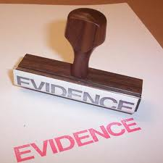
The exclusionary rule
The exclusionary rule prevents evidence obtained illegally from being used at a trial.
Although evidence may be excluded, a trial can still be held, using other evidence.

Slide 4
Cases where the rule does not apply
The exclusionary rule does not apply to:
Grand jury proceedings
Civil proceedings
Impeach proceedings

Slide 5
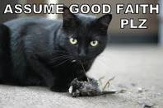
Exceptions to the rule
Good faith—the police acted in an honest belief that the search was legal.
Harmless error—using the evidence did not make any significant difference in the trial.

Slide 6
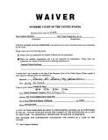
Exceptions to the rule
Waiver—the defendant waived the right to privacy. Sometime this occurs when the defendant previously entered a plea bargain.
Inevitable discovery—the evidence would have been found in the normal course of events.

Slide 7
Exceptions to the rule
Plain view—the evidence can be seen from a place there the police have a legal right to be.
Emergency—the police do not need a search warrant in an emergency situation.

Slide 8
Exceptions to the rule
Hot pursuit—the police are chasing the criminal immediately after the crime.
Vehicles—the police may search a vehicle after a reasonable stop.

Slide 9
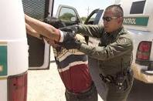
Exceptions to the rule
Border searches are allowed due to national security.
The “plain feel” exception allows police to search for evidence that is illegal during a legal “pat down” search.

