Slide 1
The First Punic War
264-241 BCE

Slide 2
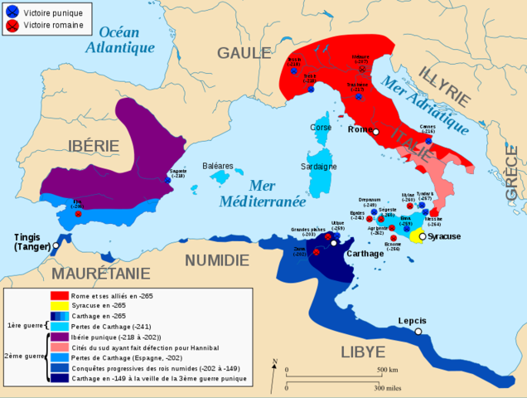

Slide 3
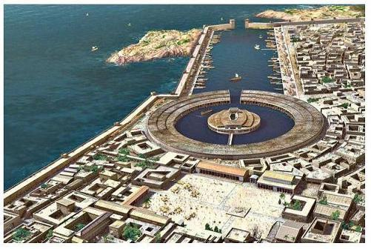
Carthage was, at the time, a much stronger nation than Rome
Their previous treaties reflect that Rome was clearly subordinate to Carthage

Slide 4
Messana (Messina)
Messana was a mess. A mercenary army was trying to establish itself.
They decided to ask Carthage for help
Then they decided they didn’t like Carthage
So they asked Rome for help
So Rome, eager to expand onto Sicily, helped

Slide 5
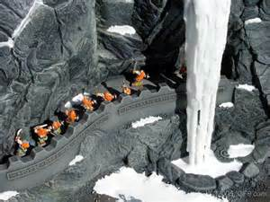
Expeditionary Force
Rome dispatched a small contingent of troops which was easily able to surprise and displace the Carthaginian garrison at Messana
The Carthaginians weren’t happy their general did not put up a fight

Slide 6
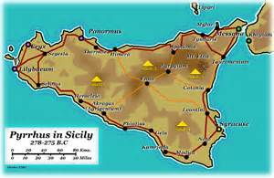
Carthage allied itself with Hiero of Syracuse
Carthage quickly responded to the Roman incursion, allied itself with Syracuse, and attacked Messana

Slide 7
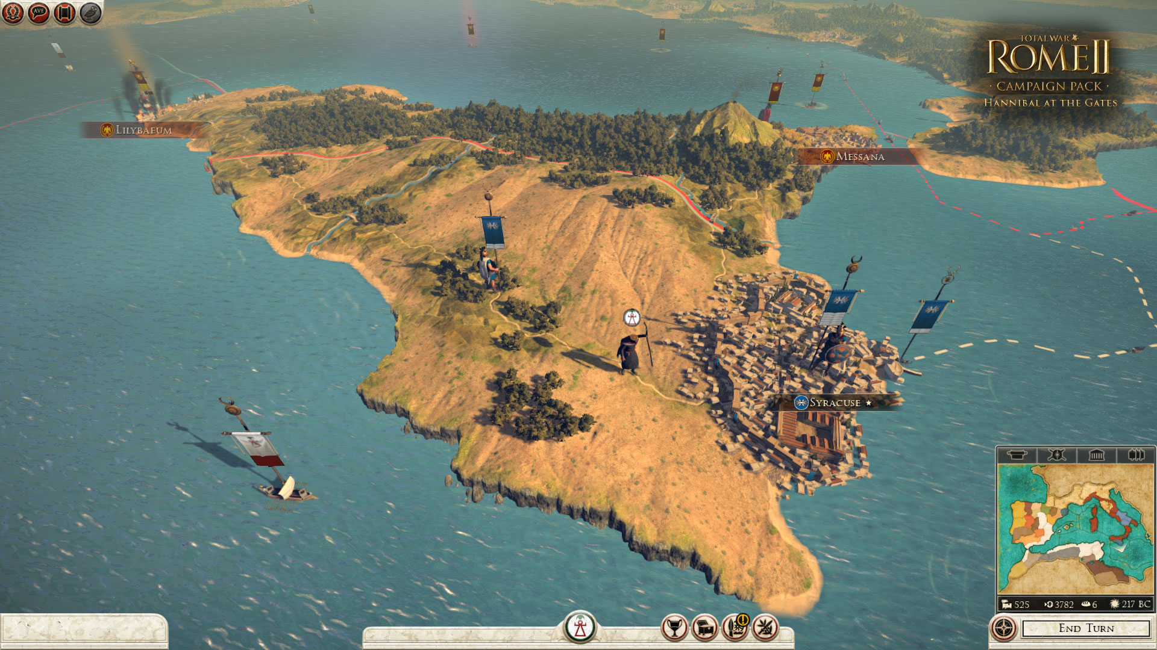
Rome Secures a New Ally
Rome was able to quickly address an attacking Syracuse/Carthage combined force,
The subsequently besieged Syracuse and were able to convince Hiero to join with the Romans

Slide 8
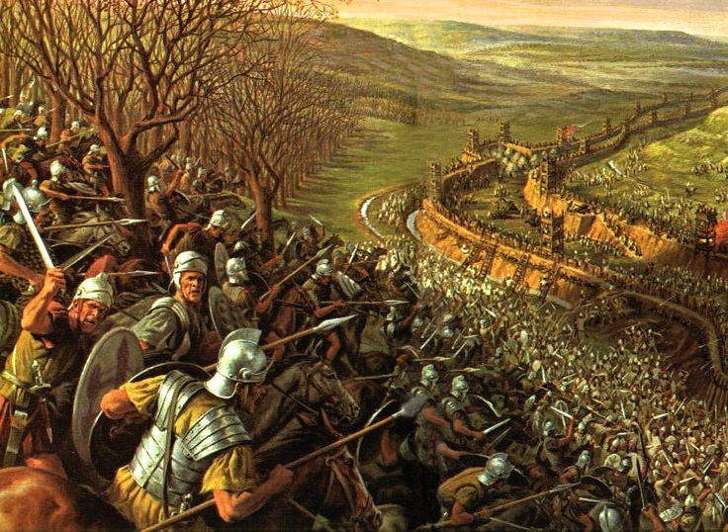
Siege At Agrigentum
The Romans besieged the city of Agrigentum. After months, they were drawn into a pitched battle
Carthage sent reinforcements who met Rome in a pitched battle
The Romans soundly defeated them and celebrated

Slide 9
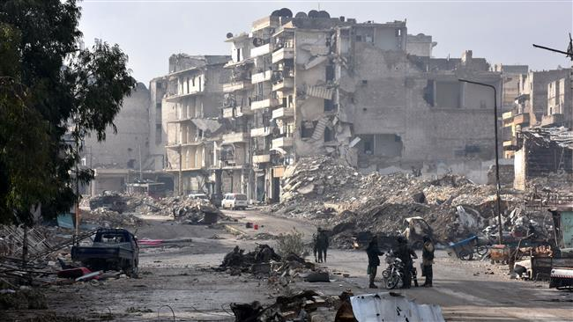
That’ll show them
As the Romans celebrated their victory, the besieged Carthaginians escaped Agrigentum
The Romans weren’t thrilled, so they entered Agrigentum and killed everyone…. Wait…

Slide 10
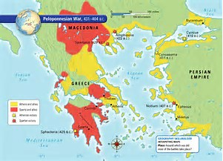
~ Stalemate
Carthaginian Sea Power and Roman Land Power just didn’t work well in a war with one another
Rome couldn’t take Carthaginian strongholds that they kept supplied by their navies

Slide 11
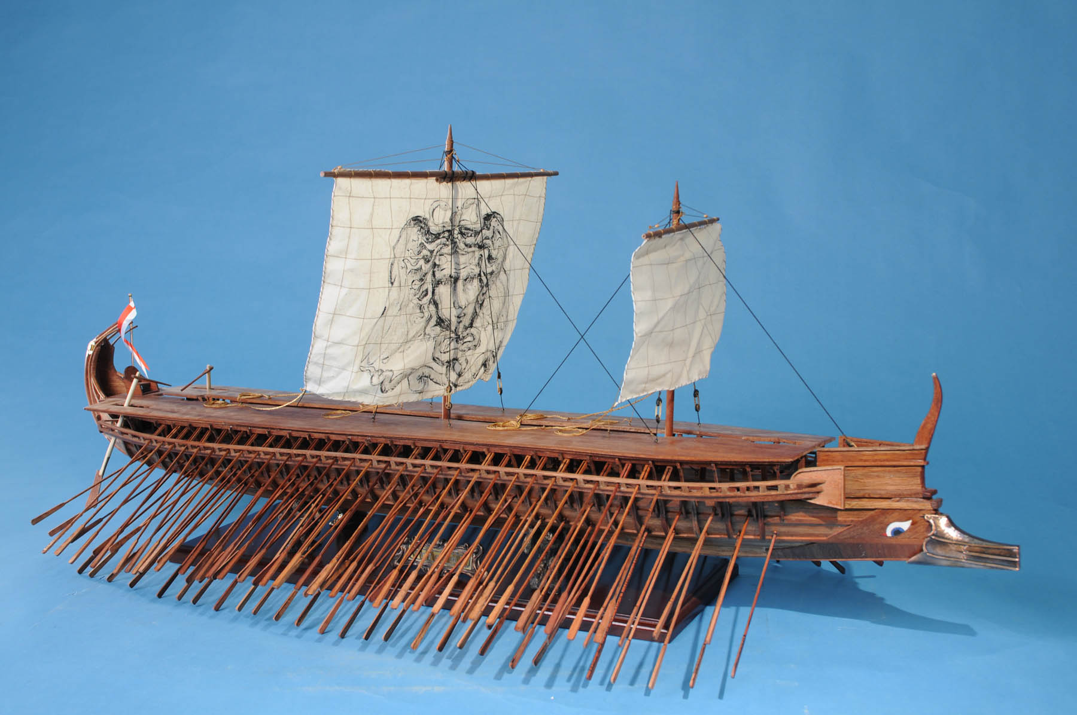
Wrecked Carthaginian Ship
The Romans discovered a Carthaginian ship that had run aground
They reverse engineered it and made a fleet (120 Ships and over 100,000 sailors

Slide 12
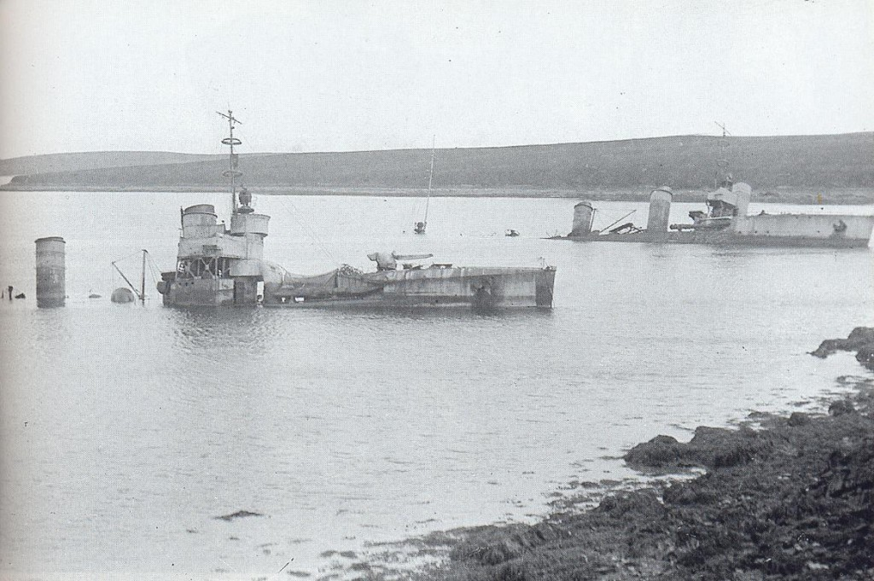
But they sucked at Naval Battles
Cornelius Scipio (remember this last name)
Led all of his ships into a tiny little harbor. He was bottled up and defeated.
Renamed – Scipio Asina

Slide 13
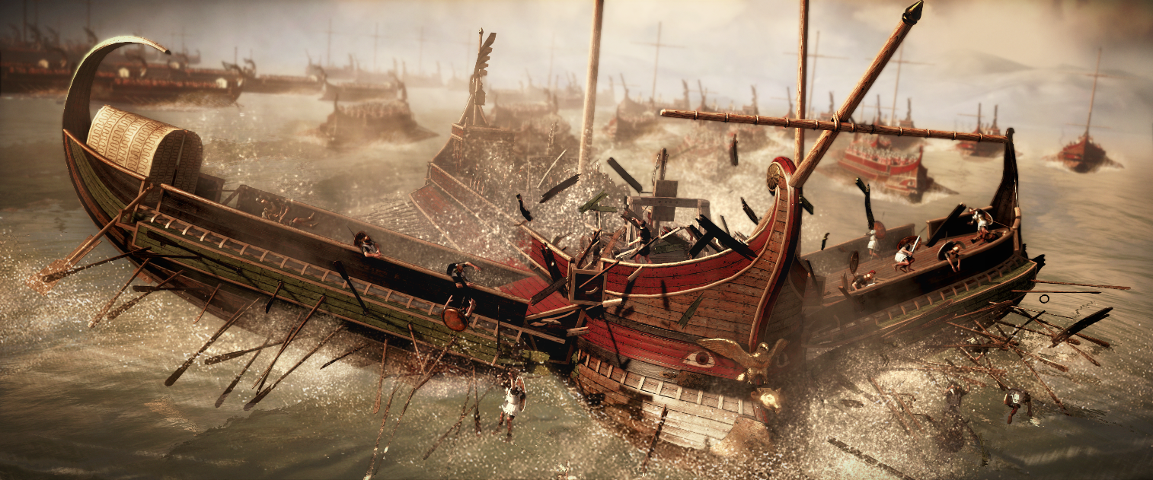
Do what you’re good at.
While the Romans were NOT good at fighting naval battles, initially, they were very good at fighting hand to hand.
So… they changed the naval battles to better suit their abilities
THE CORVUS

Slide 14
The Corvus (The Raven)

Slide 15
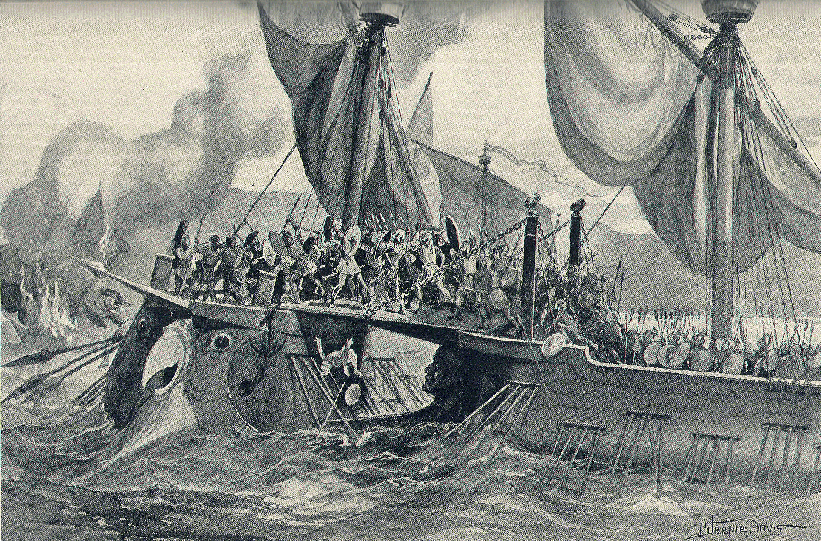

Slide 16
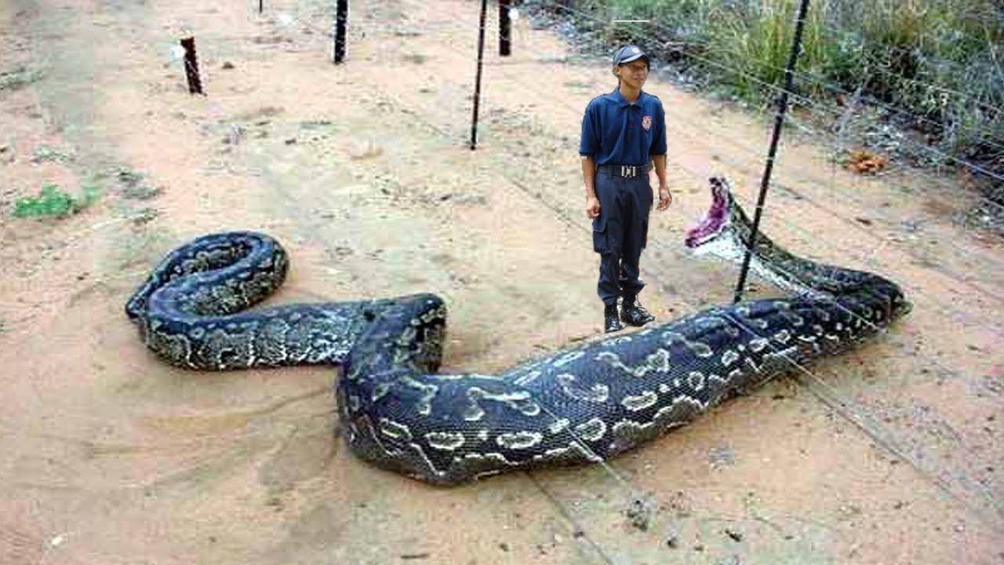
Stalemate
Although the corvus was initially very successful, the Carthaginians figured it out, and the war went back to a stalemate, with no side gaining the upper hand
Rome decided to take the fight to Africa

Slide 17
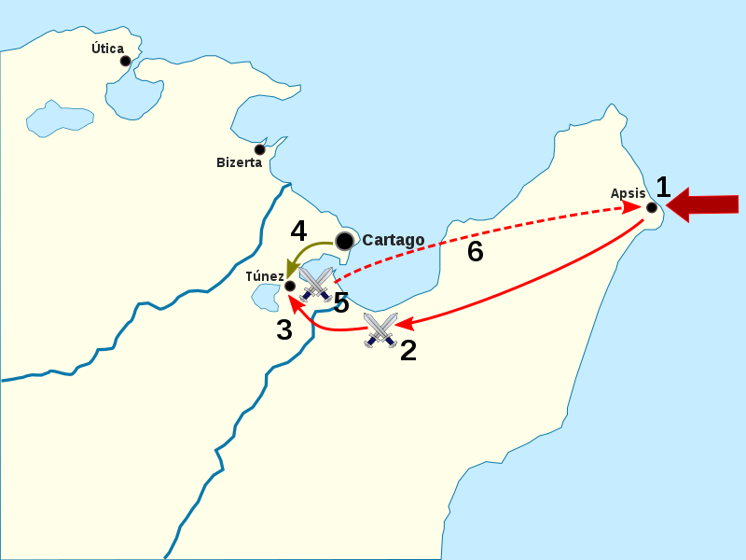
Rome wanted to move slowly to Carthage
They wanted to land southeast of Carthage and, as they made their way up towards the capitol, convince other cities to forsake Carthage
The negotiated peace was so damning to Carthage that they had to reject it
Rome wanted to place Carthage under the sovereignty of Rome

Slide 18
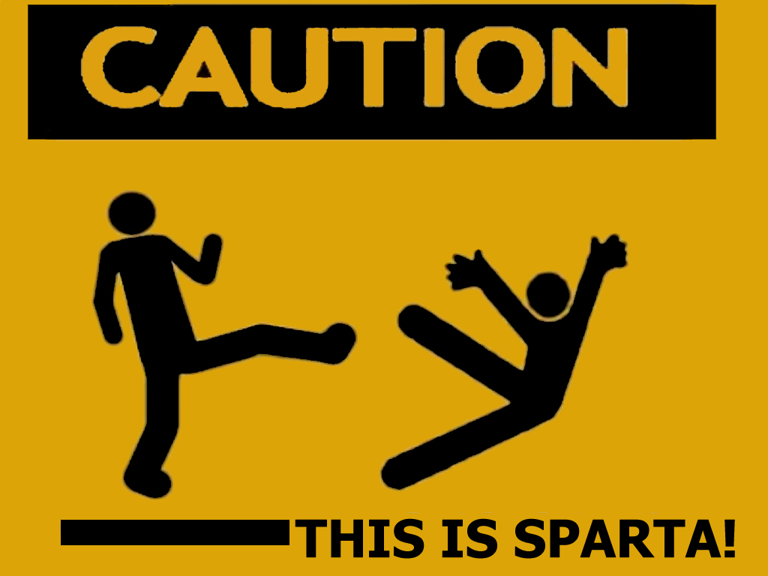
Carthage continues to Fight… WITH SPARTA
Greek Mercenaries arrived in Africa.
The Spartan general quickly figured out where Carthage had been going wrong
The Romans rushed into battle, and were soul crushed
Elephants in the Center, Cavalry to the side = not awesome for the Romans

Slide 19
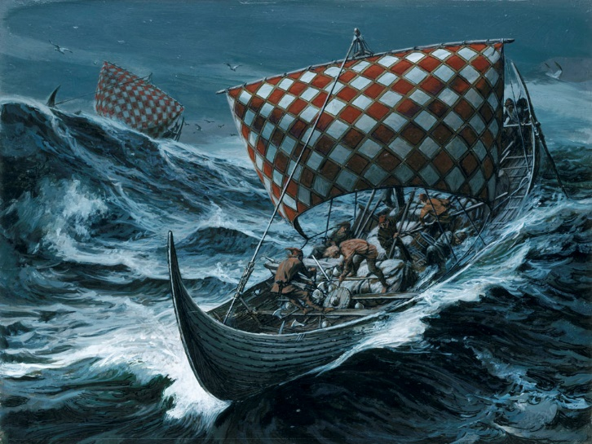
Rome withdrew
A beleaguered Roman Army was picked up, but a huge storm hit the fleet that had picked up the army, and 100,000 men drowned
☹

Slide 20
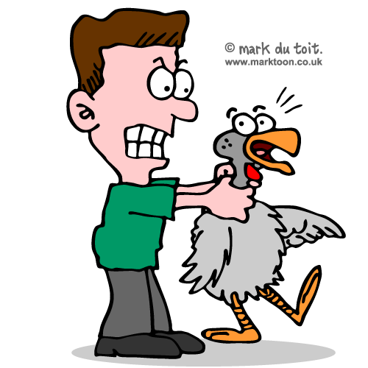
STALEMATE!!!!
Gotta listen to the birds…
Battle of Drepana didn’t go well…

Slide 21
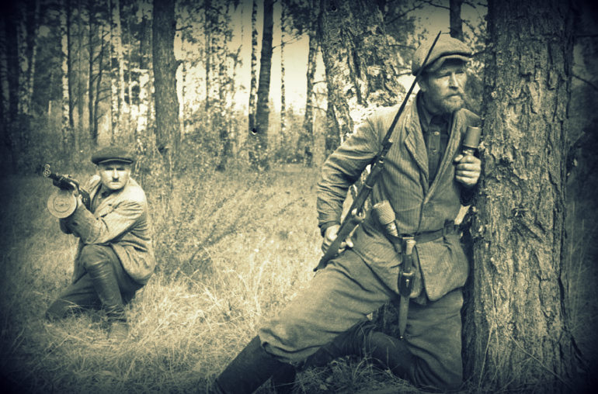
This is getting really stupid…
Carthage and Rome (kind of) fought over Rome for almost a decade
The Carthaginians (under the leadership of Hamilcar) led a Guerilla War
But to no real accomplishment

Slide 22
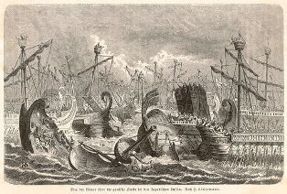
The Battle of the Aegates Islands
The Romans finally, in 241, defeated the Carthaginians in a decisive naval battle
Carthage became unable to supply its troops on Sicily
Had to sue for peace

Slide 23
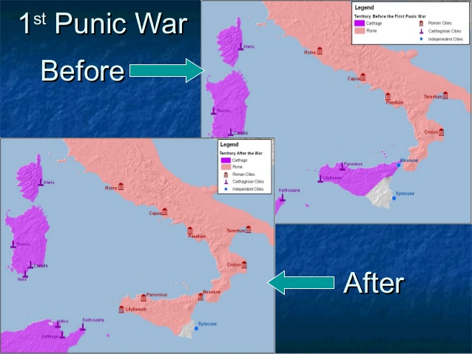
Settlement
Carthage Off Sicily
All Roman prisoners returned
Pay a massive war indemnity

