Slide 1
The Second Punic War
218-201 BCE

Slide 2
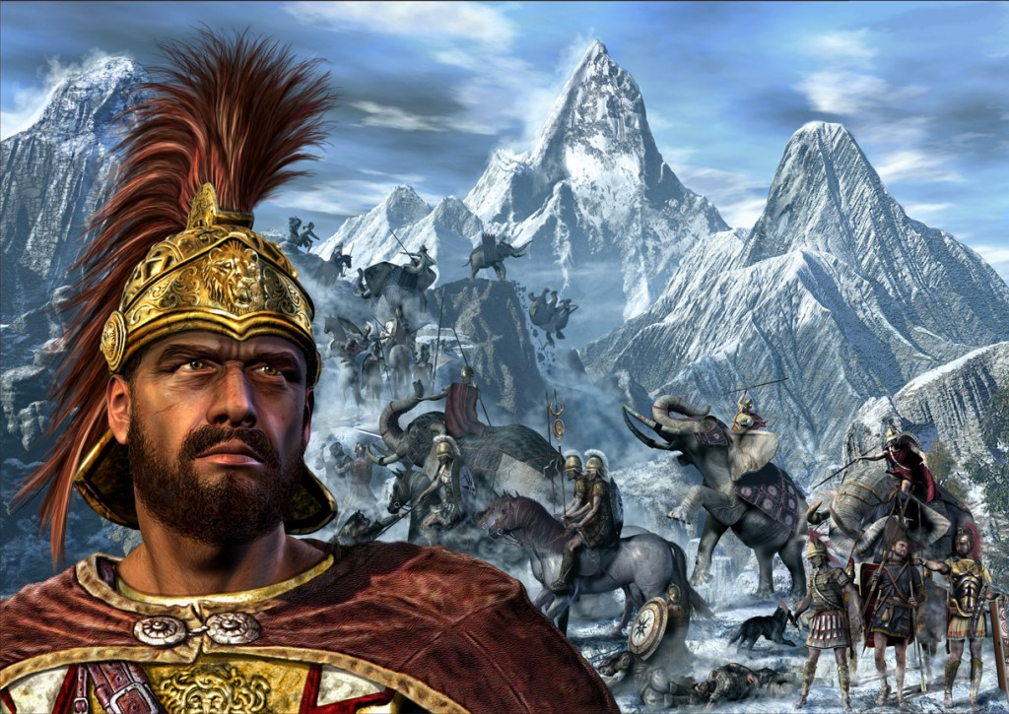
Hannibal Crosses the Alps
Notes:
2

Slide 3
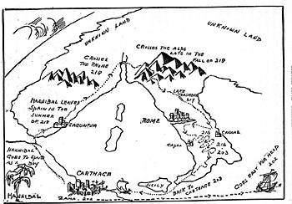
Notes:
3

Slide 4
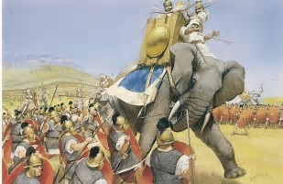
Initial Confrontation
Scipio left a force in Spain and returned to Italy to lead the fight against Carthage
He was defeated in a skirmish in Northern Italy where he may have lost his life were it not for the heroic efforts of his son… Scipio

Slide 5
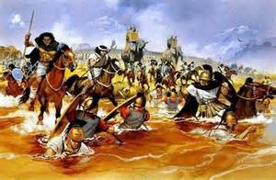
Don’t do it…
The defeated Scipio urged his co-consul not to meet Hannibal in a pitched battle, but his consul was eager to gain glory…

Slide 6
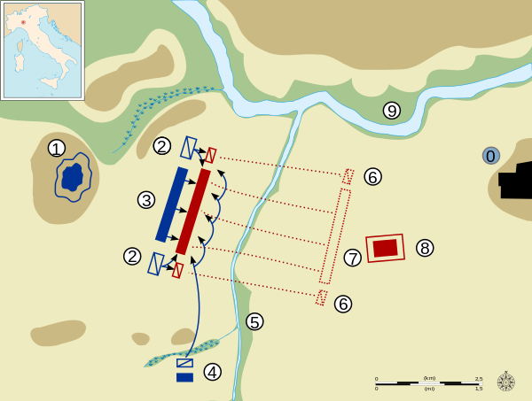
Battle of Trebbia – Dec. 218 BCE
He did not find the glory he wanted

Slide 7
Size of Army and Losses
Carthage
Rome
40,000(including 37 Elephants)
11,000 of this Cavalry
4000-5000
42,000 (4000 Cavalry)
Casualties – 26-32,000

Slide 8
Post Trebbia
Rome knew it was doomed, luckily for them, winter set in
And Hannibal didn’t want to besiege Rome, so he camped out for the winter

Slide 9
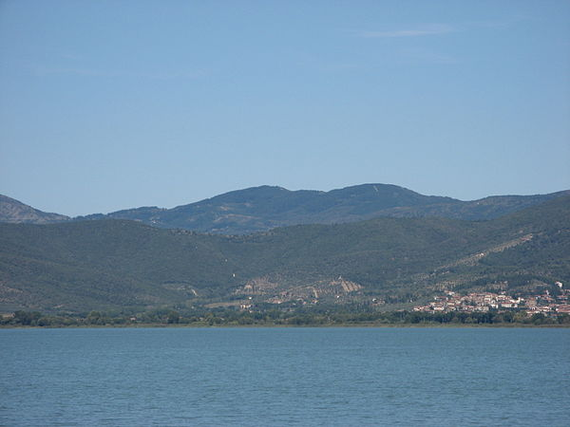
Fear not… we have more men, and another fearless leader!
Gaius Flaminius decided that he was going to be the one to put to an end the Hannibalic Scourge
With it’s vast armies, Rome stationed troops along all the roads in Italy, so Hannibal marched through a swamp, until he found the place for his next battle… Lake Trasimene

Slide 10
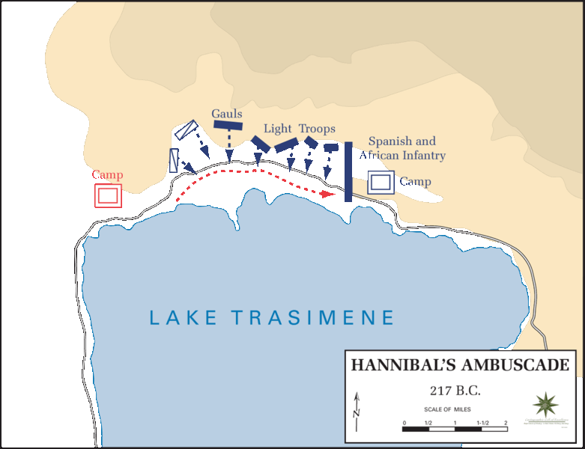
Battle of Lake Trasimene: 217 BCE
Notes:
10

Slide 11
Losses at Trasimene
Carthage
Rome
1500-2500 Killed
15,000 Killed

Slide 12
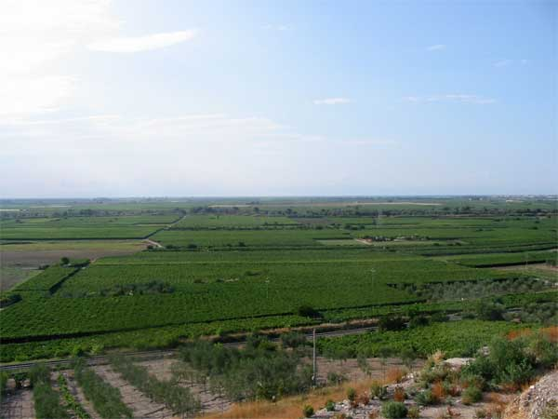
Fear not… we have more men, and another fearless leader!
Gaius Terentius Varro decided that he was going to be the one to put to an end the Hannibalic Scourge
Rome decided that it was going to end Hannibal, once and for all, at Cannae

Slide 13
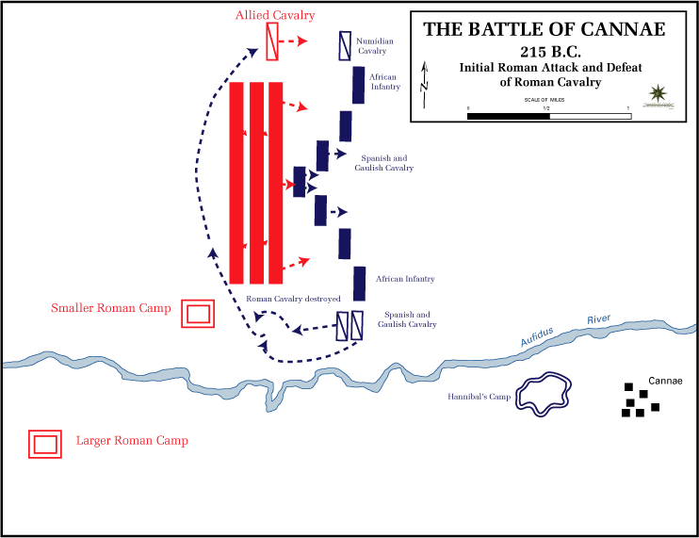
Battle of Cannae was not great also (216)

Slide 14
Death Tolls - Cannae
Carthaginian
Roman
Battle of Cannae -- 8000
Battle of Cannae 50-75,000

Slide 15
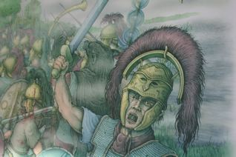
The Romans’ Lack of Success
The Carthaginian army invaded Italy and terrorized the land for almost 2 decades.
From 218-203, Hannibal and his army of almost 30,000 men ravaged the Italian countryside
The Romans lost battle after battle. They were unable to match the generalship of Hannibal
Notes:
15

Slide 16
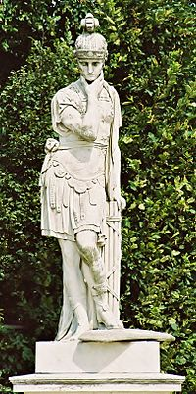
How Rome Won
At one point, the Romans had a dictator, Fabius Maximus, who refused to fight the Carthaginians… he thought this was the only way to defeat them
He received the nickname, Cunctator – “The Delayer
Notes:
16

Slide 17
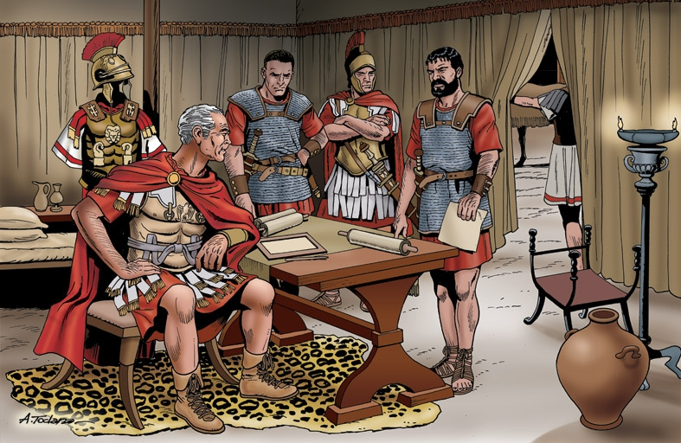
Not popular, but effective
Although pretty much everyone was grumpy about Fabius not seeking out battle, he certainly didn’t lose an army
Because both he and Hannibal were unwilling to fight a battle where their respective armies didn’t have an advantage, no battle was fought during Fabius’ dictatorship

Slide 18
Hannibal ravaged the countryside
Hannibal pillaged the countryside, but made sure to spare any land owned by Fabius

Slide 19
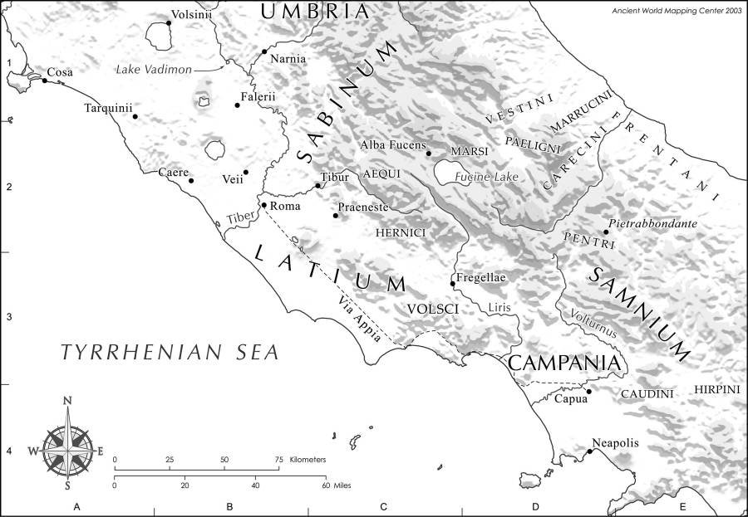
Fabius ALMOST caught Hannibal
He trapped him in valley with only three escape routes.
One night, he saw lit torches, as Hannibal and his army tried to escape the valley…

Slide 20
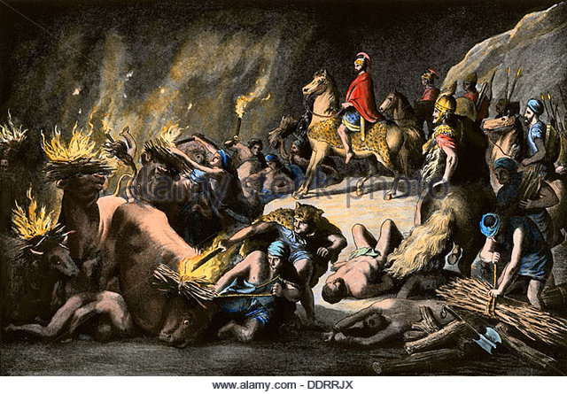
But his genius didn’t fail him
Hannibal tied torches to a bunch of Oxen.
As Fabius and his legions descended upon the oxen, Hannibal and his men slipped through another of the exits
End (for now) of the dictatorship

Slide 21
Political Effects of the Second Punic War
Democratization down
Too Slow
Mob rule → Horrendous defeats
Senate seized more control
Opportunity to Advance
Dead Patricians → Need to fill vacancy
Rise of meritocracy

Slide 22
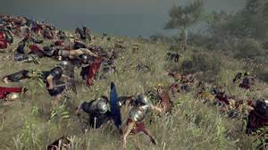
Still lots of man power, but not as much
Surrender was never an option
Lowered and raised the eligible ages
Bought 8,000 slaves and enrolled them in an army

Slide 23
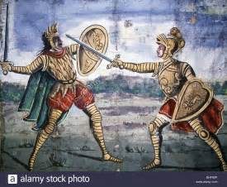
Fighting Everywhere
Rome was engaged in Spain against Hannibal’s brother, Hasdrubal (no, not that one)
King Hieron of Syracuse died and his punk of a son, age 15, allied himself with Hannibal (until he was assassinated)
Carthaginian’s able to, at least temporarily hold Sicily

Slide 24
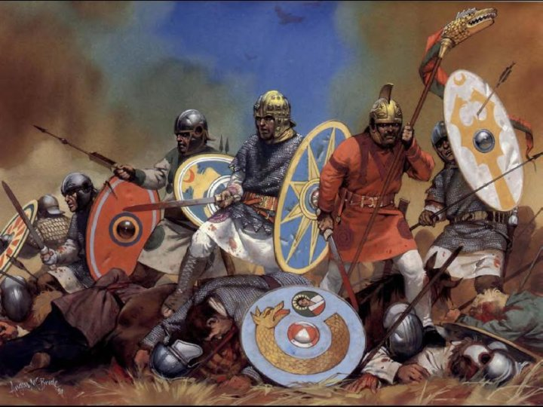
Spain was… interesting
Although Scipio recaptured Saguntum, there was no real success
Hasdrubal and his generals were not on the same page
Stalemate in Spain until…

Slide 25
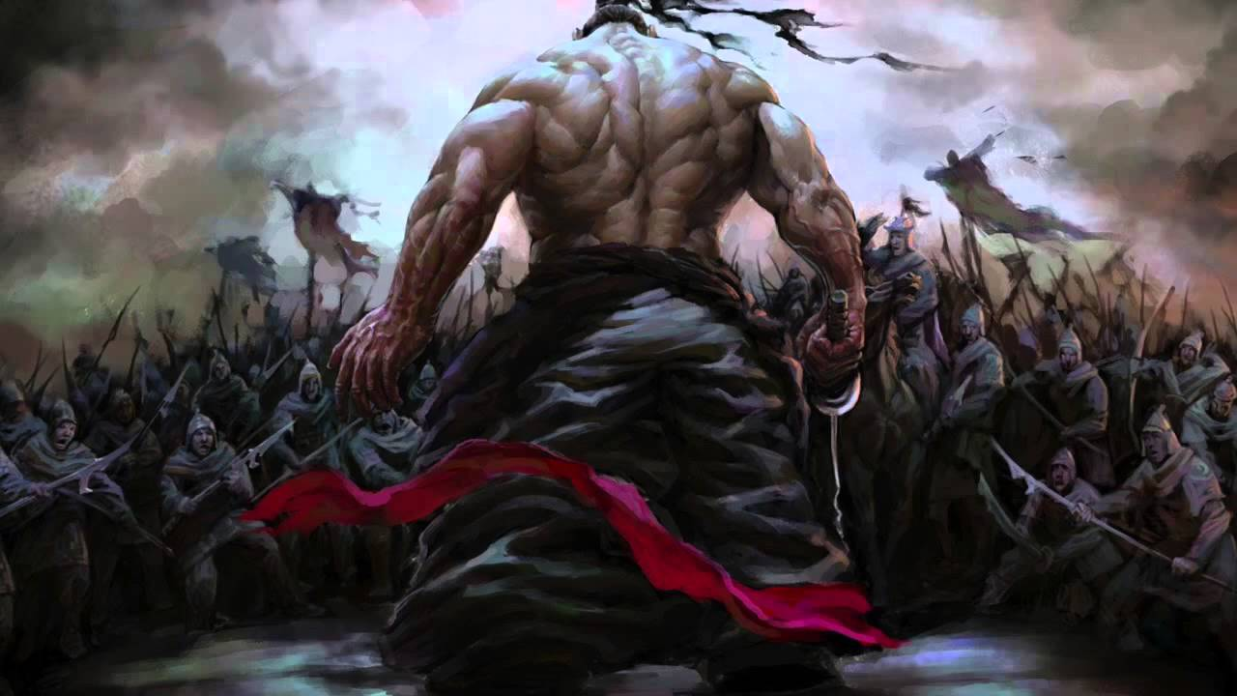
Scipiones decided to fight the multiple armies
They divided their troops and both armies had a hard time
One went against a Carthaginian army that was receiving reinforcements (Publius Died)
One saw their Celtibarian allies bribed away from them. They left at the start of the battle… (Gnaeus died, albeit epically)

Slide 26
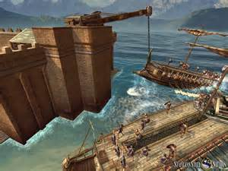
Rome Retakes Syracuse
Although it was defended by one of the most brilliant minds ever, Archimedes, the Romans besieged and eventually retook Syracuse

Slide 27
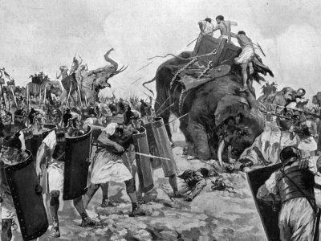
How Rome Won
Because of its alliance system, Rome had an almost endless supply of men
Eventually, they created a second army which invaded Africa
Hannibal had to chase it, and was finally defeated in the battle of Zama in 202 BCE
ZAMA!!!!
Notes:
27

