Slide 1
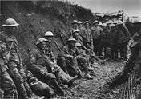
The War to End All Wars....
Notes:
1

Slide 2
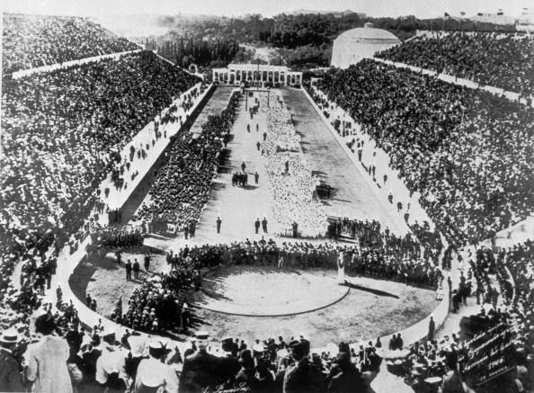
Europe in 1914
Except for wars of Unification, Europe had largely been at peace for almost a century
Olympic Games – 1896
Universal Conference on Peace – 1899
Notes:
2

Slide 3
Differing Views
“The future belongs to peace”
French Economist Frederic Passy
“I shall not live to see the Great war, but you will see it, and it will start in the East”
Otto von Bismark
Notes:
3

Slide 4
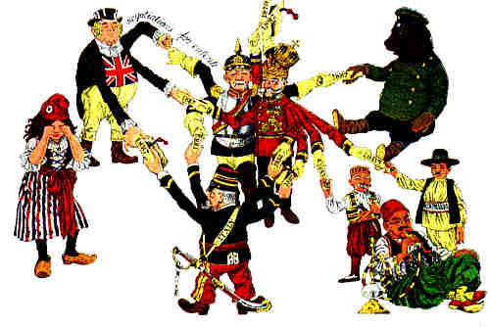
Reasons for the Great War 1- Alliance Systems
The European Powers distrusted one another
Allied with one another
Promote peace through massive threats
Notes:
4

Slide 5
Reasons for the Great War 1- Alliance Systems
The Triple Alliance
Bismarck knew France would want revenge for Franco-Prussian War
Germany, Italy, Austria-Hungary
Don't ask about Italy...
Notes:
5

Slide 6
Reasons for the Great War 1- Alliance Systems
The Triple Entente
Entente – a non-binding agreement to follow common policies
France-Russia (1893) -alliance
France-Britain (1904) - entente
Notes:
6

Slide 7
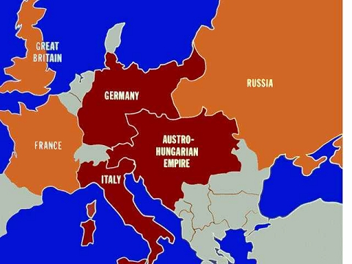
Reasons for the Great War 1- Alliance Systems
Notes:
7

Slide 8
Rivalries and Nationalism
England feared Germany... it had industrialize very quickly
Germany feared Russia. If it was able to industrialize, Russia had a massive pool of workers
Notes:
8

Slide 9
Rivalries and Nationalism
Austria-Hungary and the Ottomon Empire, two old empires, struggled to survive in the age of nationalism
Notes:
9

Slide 10
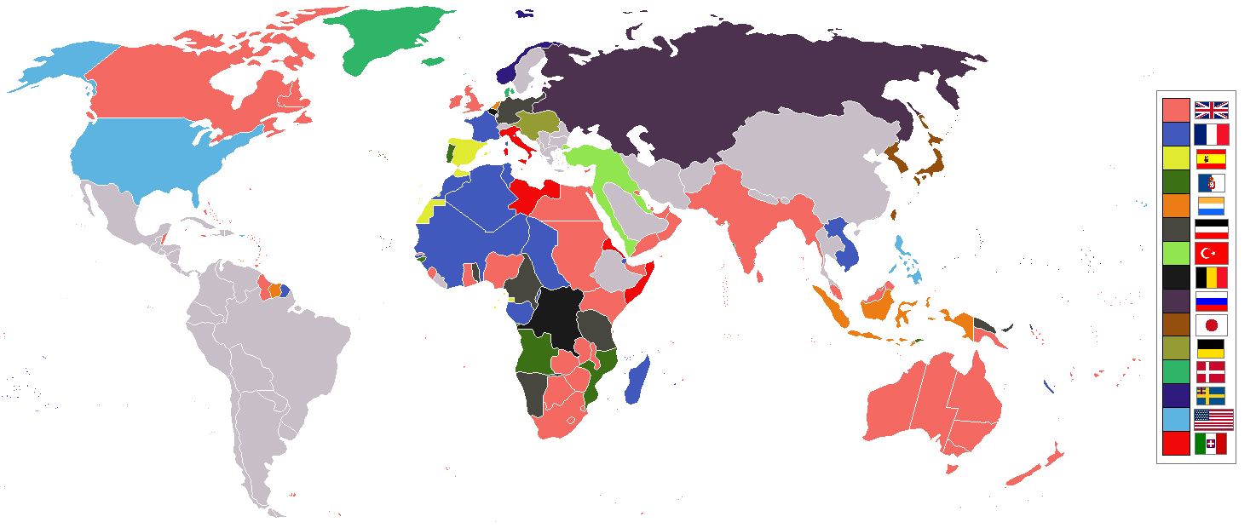
Empires
Notes:
10

Slide 11
Competition overseas
France and Germany competed with one another for control of Morocco – 1905 and 1911, the two Moroccon Crises
Notes:
11

Slide 12
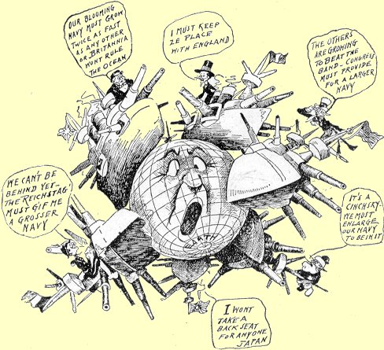
Arms Race
Notes:
12

Slide 13
Building Militaries
Britain had a massive navy
Germany increased the size of it's empire... so
Britain's response?
Notes:
13

Slide 14
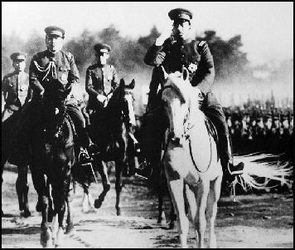
Militarism
Notes:
14

Slide 15
Militarism
Militarism, the glorification of the military, excited young men about the prospects of war and courageous cavalry charges
Notes:
15

Slide 16
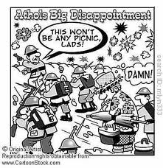
Militarism
Notes:
16

Slide 17
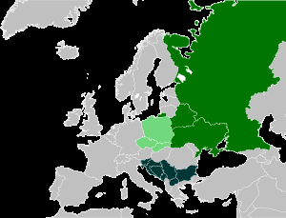
Nationalism Continues
Alsace and Lorraine
France bitter it lost this region in the Franco-Prussian War (1871)
Pan-Slavism
Russia's idea that all Slavic people should be United
Sebia
Notes:
17

Slide 18
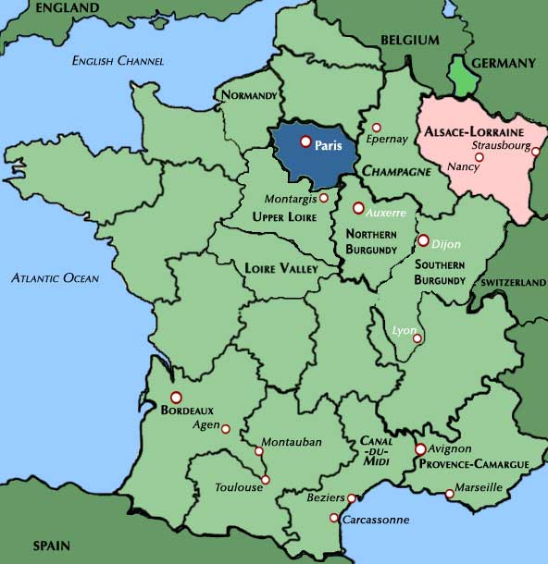
Alsace Lorraine
Notes:
18

Slide 19
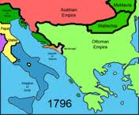
The Powder Keg of Europe
The Balkan States, in east Europe, attacked both Austria-Hungary and the Ottoman Empire, seizing Slavic land from the two empires
Notes:
19

Slide 20
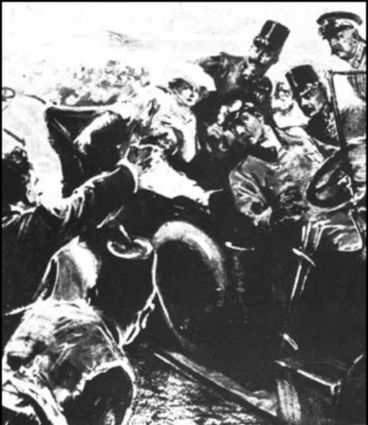
Archduke Francis Ferdinand The Austria-Hungary Heir Assassinated
The Archduke of Austria-Hungary was on a visit to Sarajevo, Bosnia
A Serbian nationalist group, the Black Hand, assassinated the Archduke and his wife – June 28, 1914
1389- Serbia conquered (Ottoman)
1912 – Serbia gained freedom
Notes:
20

Slide 21
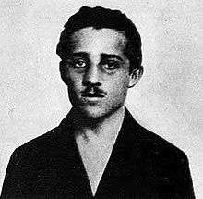
Gavrilo Princip
Notes:
21

Slide 22
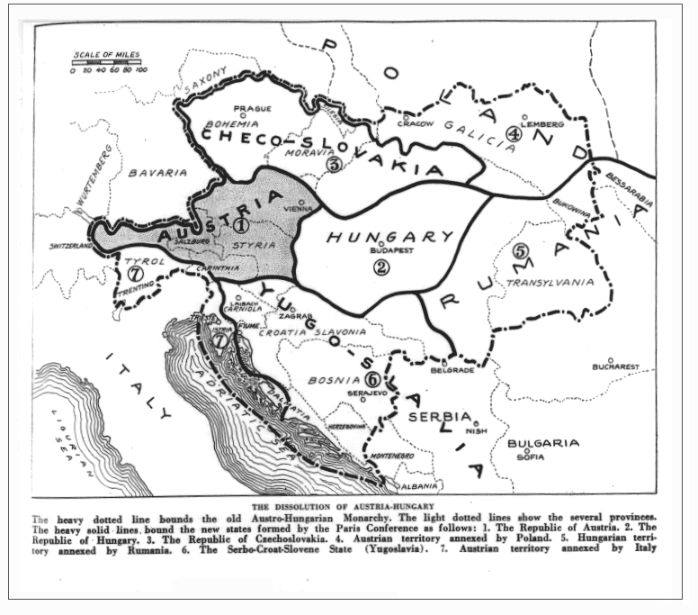
The Blank Check
Germany promised “unconditional support” to Austria to punish Serbia
The Ultimatum
A final set of demands
Notes:
22

Slide 23
War Starts
Austria declared war on Serbia. This could have been a quick “summer war” but alliance systems kicked in

Slide 24
Russia, allied with Serbia, mobilized troops

Slide 25
GERMANY, ALLIED WITH AUSTRIA, DECLARED WAR ON RUSSIA

Slide 26
FRANCE PROMISED RUSSIA THEY WOULD SUPPORT RUSSIA -THEY WANTED ALSACE LORREIN GERMANY DECLARED WAR ON FRANCE

Slide 27
Italy and Britain initially remained neutral
Neutral: a policy of supporting neither side of a conflict

Slide 28
Nationalism Continues
Germany – 11 Million
France - 8.5 Million
England – 9 Million
Russia – 12 Million
Notes:
28

Slide 29
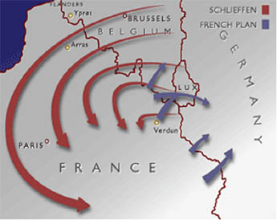
The Schlieffen Plan

Slide 30
The Schlieffen Plan
Germany wanted to avoid a two front war… they were at war with Russia and France
The plan was to eliminate France quickly while Russia was busy mobilizing

Slide 31
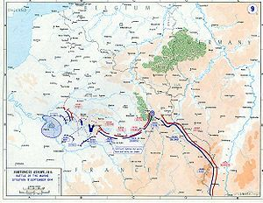
Stalemate Develops – Trench Warfare
Russia mobilized too quickly, and Germany could not take Paris
The Armies dug in to the lines they would be in... for the next 4 years

Slide 32
“To say where the trenches began and where they ended is difficult... There were vas stretches of mud, of fields once cultivated, but now scarred with pits, trenches, rusty barbed wires. The roads were rivers of clay. They were lined with dugouts, cellars, and caves.”

